Slide 2
Changes
Is change necessary?
What changes have you been through in your life already?
What would happen if nothing ever changed?

Slide 3
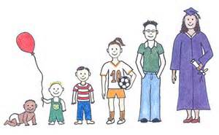
RSE What does this stand for?
Here are our key questions
How do we change as we grow older?
Why do we change as we grow older?
How can we manage these changes?
How can we support each other as we move on?
Notes:
Relationship Sex Education

Slide 4
Question Box
Why?
You may feel unable to ask a question in front of the class
You can ask a question anonymously
You can provide the name of the person you would like to talk to (including school nurse)
You can say whether you would like a whole class/individual response
We do not want you to search for answers to any of the questions on the internet - misinformation and age-inappropriate information

Slide 5
Asking questions…
Throughout this unit we will be using correct scientific language - try to use this language when you are asking questions

Slide 6
Question Box
Question stems displayed next to the Question Box:
I would like to know more about….
I am still confused about how…….
Is it true that ………
Why do girls…………
Why do boys………..
Why do some people………..
When will I…………

Slide 7
Discussions and agreements during RSE
Getting the giggles
Our aim to provide a supportive environment where we can all help each other learn.
Jigsaw Charter - confidentially
Not sharing your learning with younger siblings
Carry on the conversations at home

Slide 8
The set up...
One PSHE lesson a week
Information on the learning intention will be shared each Monday with your parents via a newsletter so that you can talk about your learning at home
Two lessons will be taught in single sex groups (girls with girls and boys with boys)
The rest of the lessons will be taught as a class with your class teacher
Question Boxes will be available this week

