Slide 1
Phonics workshop
Dominique Chandler and Raj Ladva
6th February 2018

Slide 2
Aims of the session
To gain an understanding of the development of reading skills including comprehension and phonics.
To understand how we teach phonics at BPS

Slide 8
Phonics
Why?
National Curriculum – ‘Phonics remains at the heart of early reading’
This means word recognition, blending, segmenting and other skills as their reading skills becoming more proficient.
At BPS we follow the ‘Letters and Sounds’ program, which teaches a range of reading, writing and segmenting skills.

Slide 9
Terminology
Phoneme
Grapheme
Sounds
Letters
Vowels
Phoneme Buttons
Consonants
Split digraph
Digraph
Trigraph

Slide 10
Phonics
Phase 1 - Sound discrimination
Phase 2/3 – Blending and segmenting
Phase 4 – Adjacent sounds
Phase 5/6 – Alternative spellings

Slide 11
Phase 1 - Sound discrimination
Environmental sounds
Write down the sounds that you can hear in this listening exercise.
Body percussion
Can you copy this beat?

Slide 12
Phase 1 - Sound discrimination
Rhyme and alliteration
Hickory dickory dock, the mouse ran up the ___________
The ball bounces, bangs and bumps.
Oral blending and segmenting

Slide 13
Phase 1 - Sound discrimination
Suggested activities to develop sound discrimination at home
Nursery rhymes
Musical instruments
“Guess the sound/song”
Sound patterns/sequences

Slide 14
Phase 2/3 – Sound recognition and blending
Phoneme recognition
Phoneme blending and segmenting
c
a
t
dog

Slide 15
Phase 4 – Adjacent sounds
rip
trip
rag
crag
lap
flap
lot
lost

Slide 16
Phase 5 Alternative spellings and pronunciations
Despite there being 26 letters in the English language there are 44 unique sounds, also known as PHONEMES
Can you guess how many different ways there are of spelling these phonemes?
More than 100

Slide 17
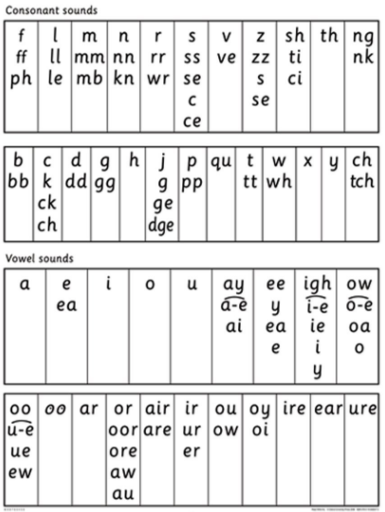

Slide 18
Children will broaden their knowledge of graphemes and phonemes.
They will learn alternative spellings and pronunciations of graphemes , including split digraphs.
(the same grapheme can represent more than one phoneme)
Fin/find cat/cent got/giant cow/blow
Tie/field eat/bread hat/what yes/by/very
chin/school/chef out/shoulder/could/you

Slide 19
Fin/find cat/cent got/giant cow/blow
Tie/field eat/bread hat/what yes/by/very
chin/school/chef out/shoulder/could/you

Slide 20
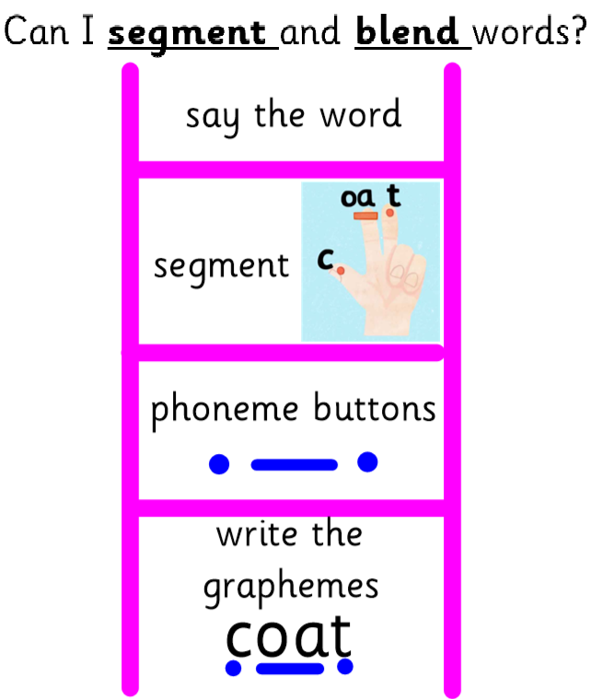
So lets have a go…
First we need to use our fingers to count our phonemes
bucket

Slide 21
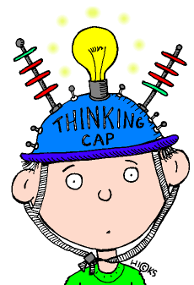
So now it is your turn!
p
l
ay
er

Slide 22
plare
plaiur
plar
plaiir
Plaer
playir
playur
plaer
plare
plaier

Slide 23
So now it is your turn with a nonsense word!
Why do you think this would be important?
Ti
o
ng
ph
ee

Slide 24
Phase 6
Children learn and practise writing common words
eg keep, last, even, before
Children are taught common spelling patterns and learn how to spell longer words
Children will learn how to use suffixes and prefixes
Eg add ing to a verb
To know when to drop the e eg hope
hoping
To know when to double the letter eg hop
hopping

Slide 25
Children are taught past tense and irregular past tense verbs
This will include the spelling rules for adding the suffix ed
To know when to drop the e eg hope hoped
To know when to double the letter eg hop hopped
Children are taught how to use a dictionary/thesaurus
Children are taught homophones eg the difference between their, there and they’re

Slide 26
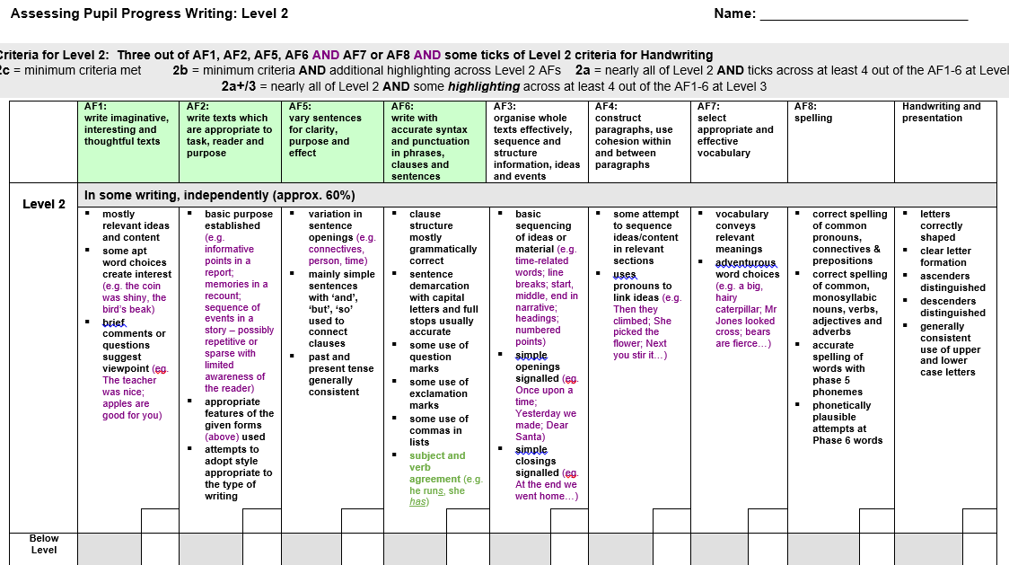
Phase6

Slide 27
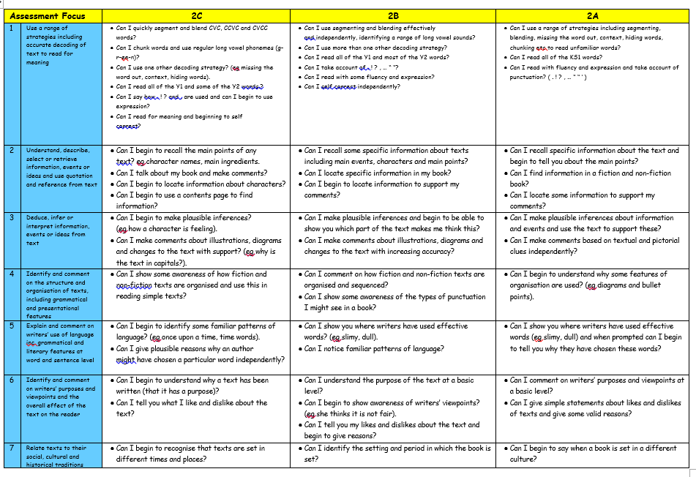

Slide 28
Common questions
Why hasn’t my child moved up their reading level yet? They find the books too easy.
Why doesn’t my child know how to spell?
Why doesn’t my child’s teacher correct their spelling?

