Slide 1
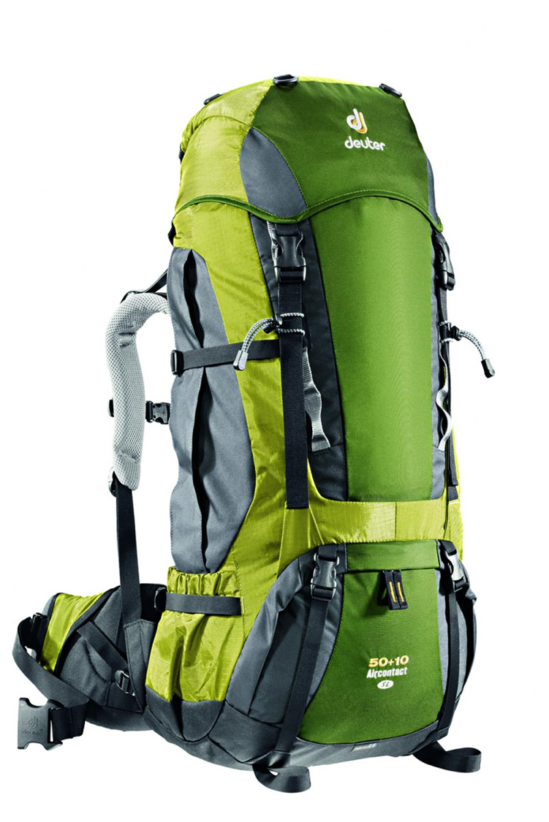
Equipment and how to pack:
Success Criteria:
I can:
- Explain exactly what kit is needed for trekking.
- Pack kit correctly in a rucksack so that it easily accessible, comfortable and stable.
- Adjust the rucksack harness and straps so it is the correct length and fitted correctly.

Slide 2
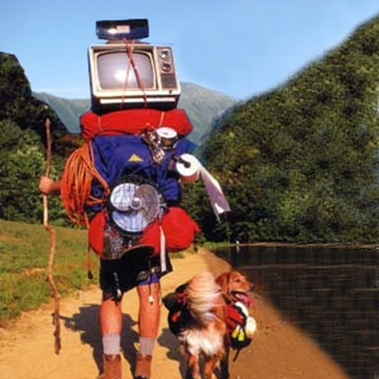
Don’t let this be you!

Slide 3
In pairs, brainstorm the types of things you think you are going to need to bring on the expedition.
Rank these items from heavy to lightest.

Slide 4
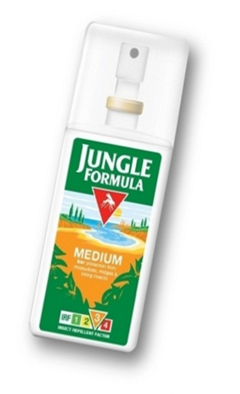
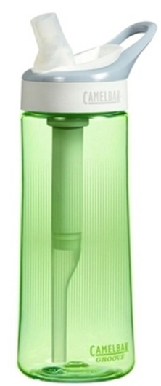
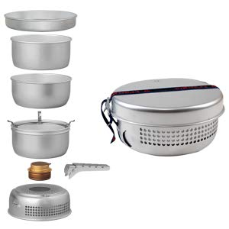
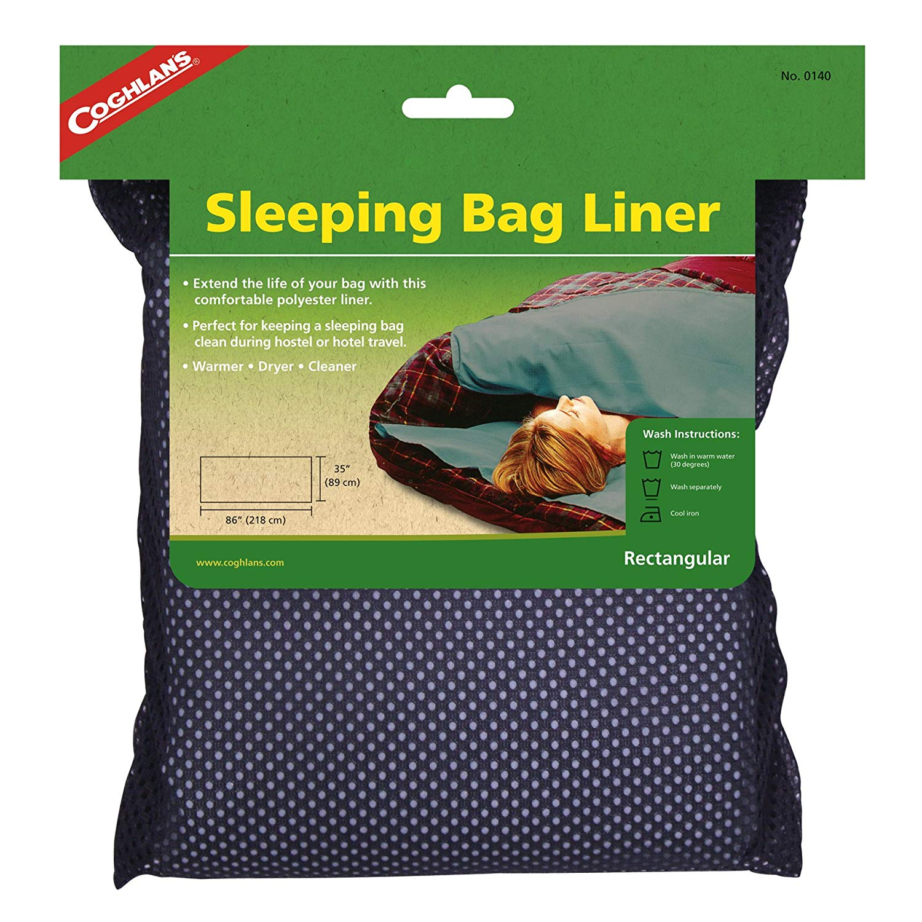
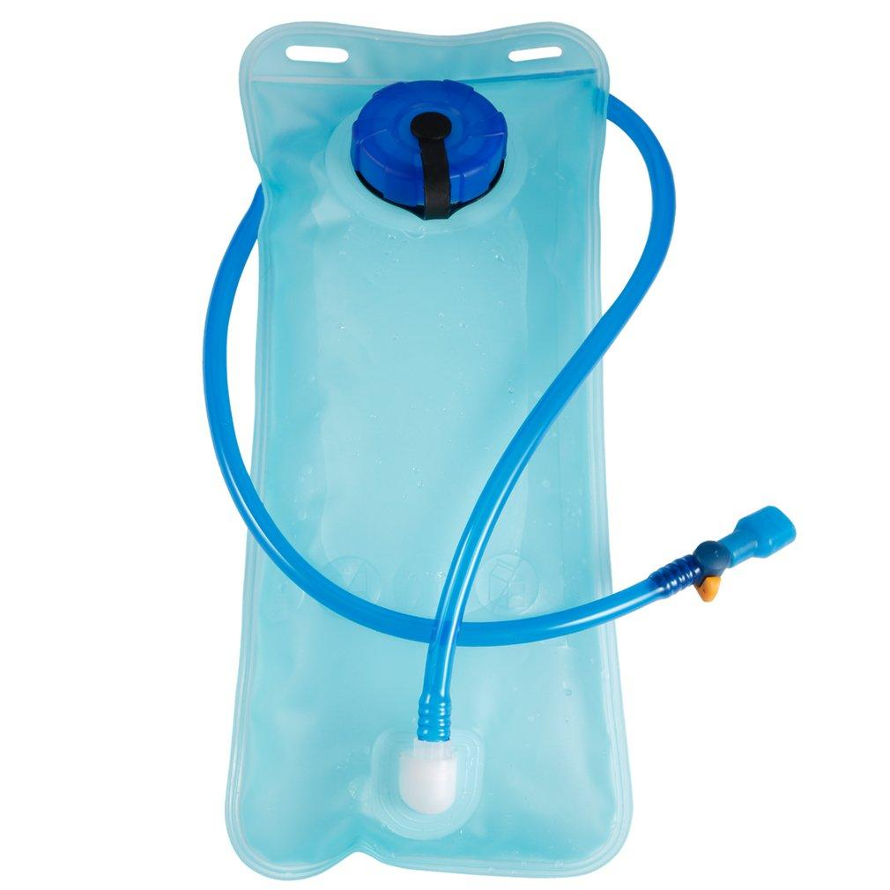
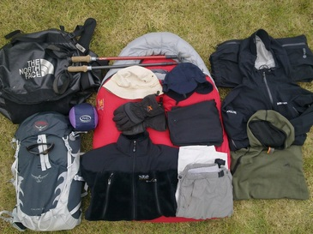
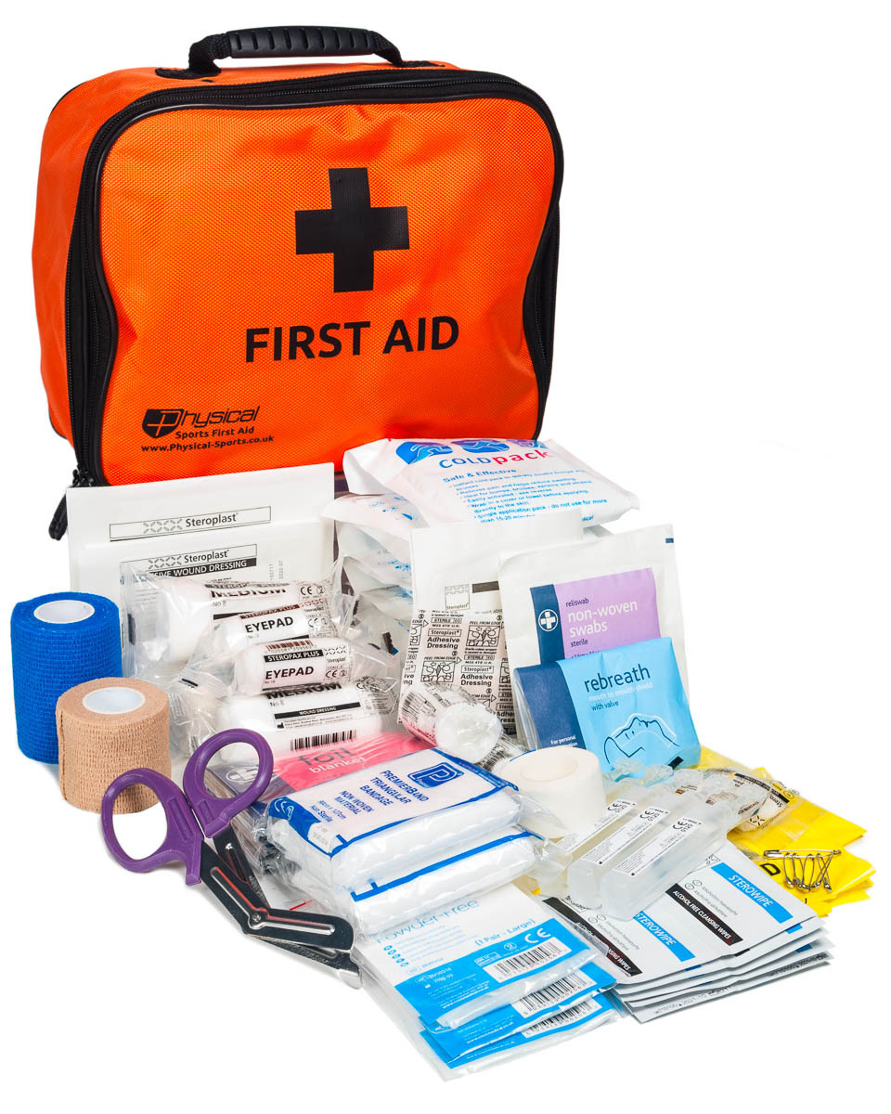
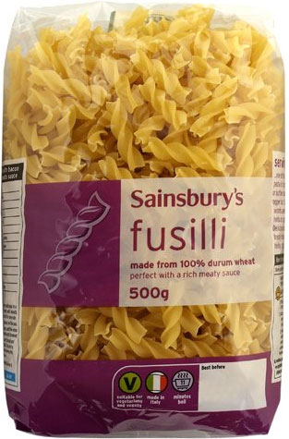
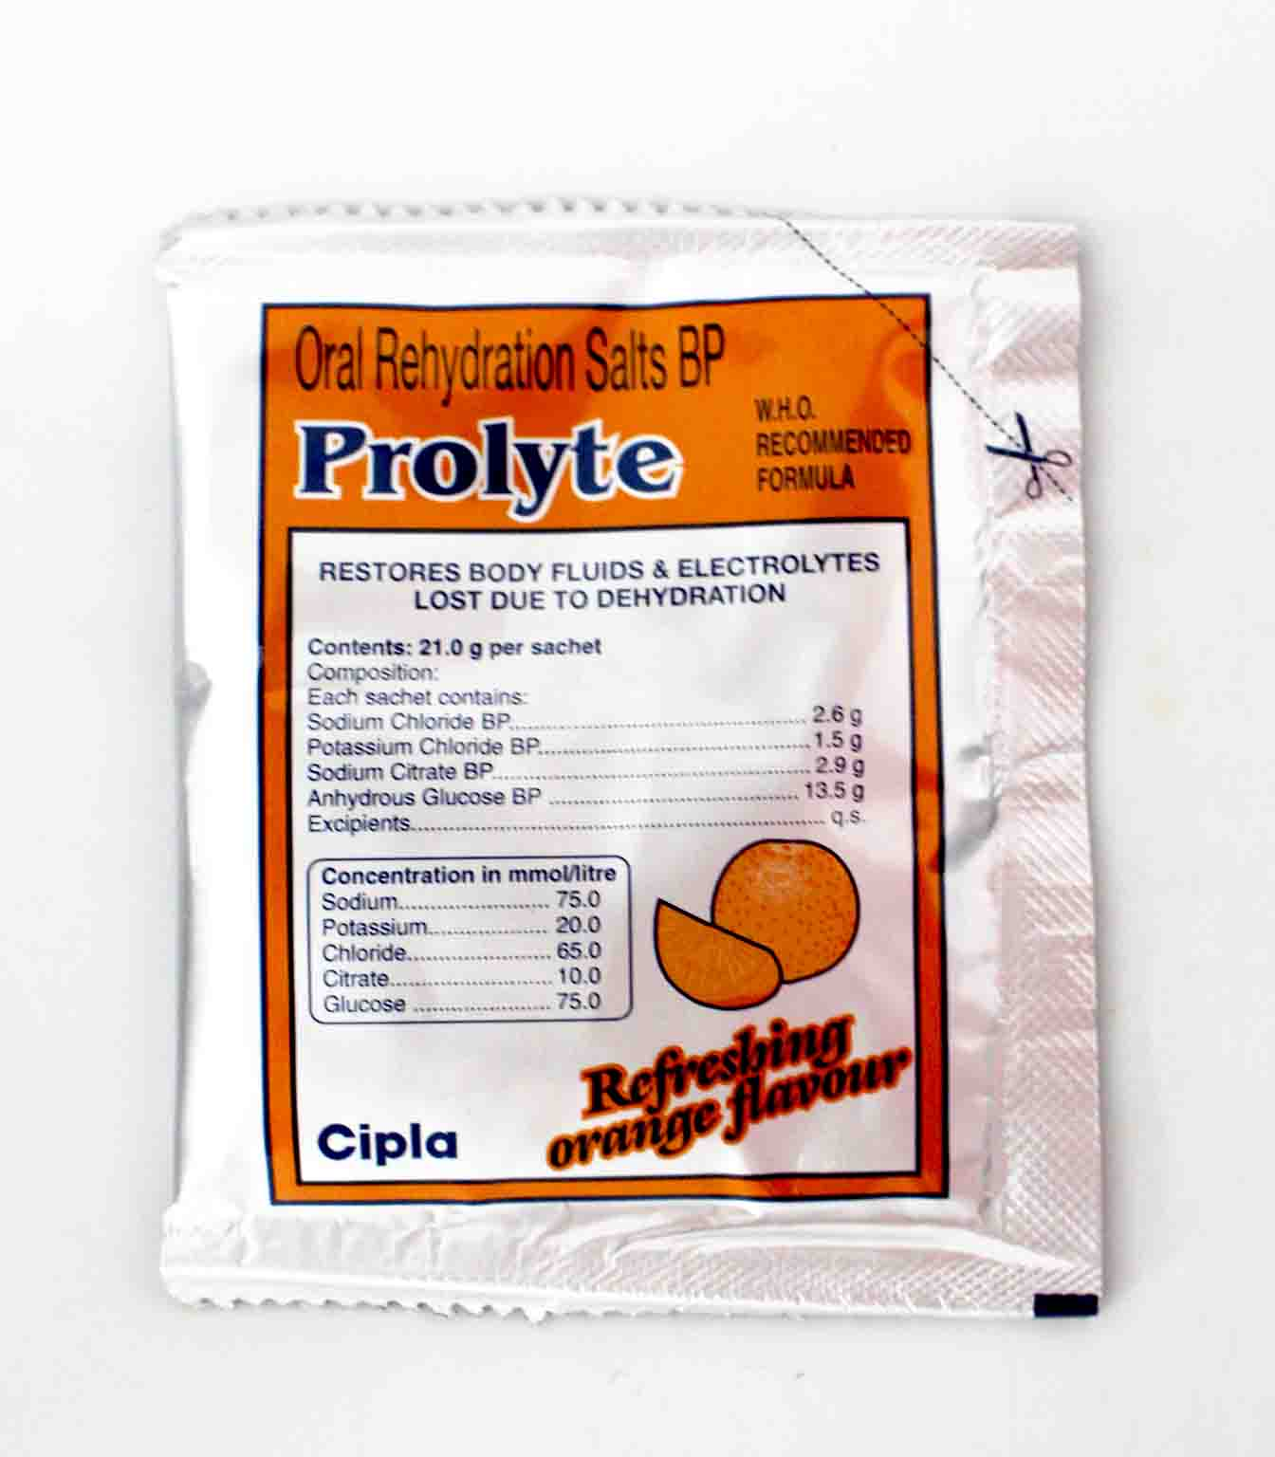
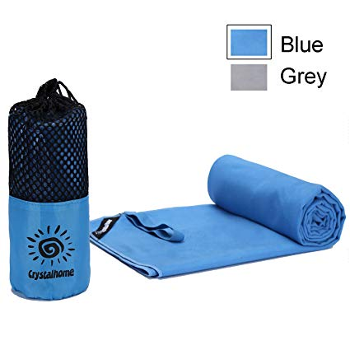
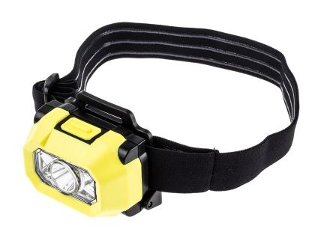
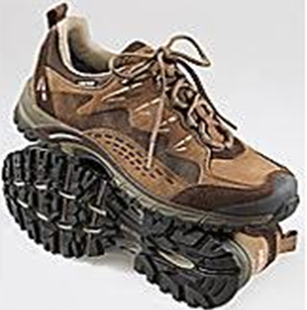
Rank these items from heavy to lightest.

Slide 5
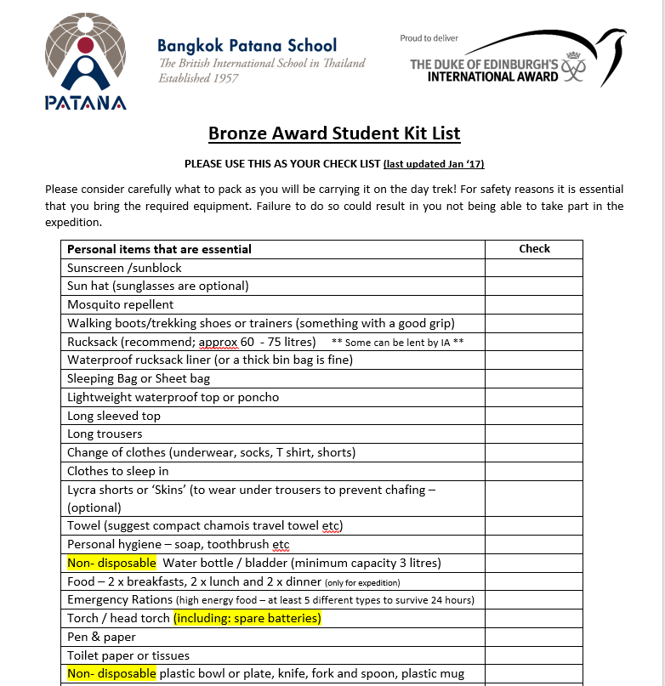
Lets have a look over the kit list and see if there is anything we missed:

Slide 6
How much should I pack?
As little as possible and what you NEED
Maximum of between 20% and 30% of individual's body weight
i.e. A 50kg student should pack no more than 15kg
At least 4kg of this will be water!
How much do you weigh?
Calculate the approximate weight you should carry.

Slide 7
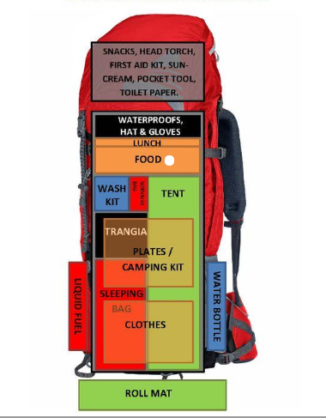

Slide 8
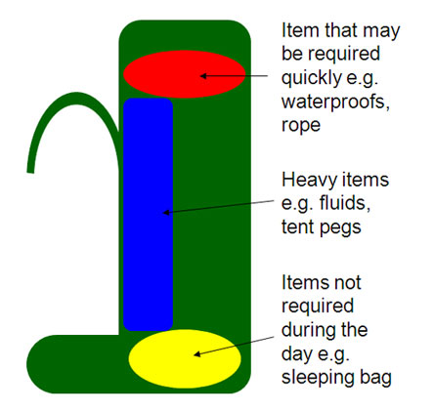
Your back
How to pack a rucksack?

Slide 9
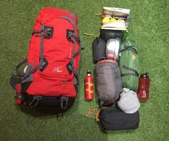
Pack for accessibility and comfort.
Where should you place the following in the rucksack?
Change clothes
Water proof jacket
Trangia
Small water bottle
Sun block
Personal hygiene
Large water bottles
Lunch
Heavy items
On the bottom
At the top
Close to back
At the top
At the top
On the bottom
Close to your back / At the sides
At the top
Close to your back

Slide 10
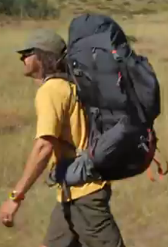
How to wear and adjust your backpack correctly
have the most weight on the hips
and some on the shoulders.
The pack should be comfortable, stable and be sat close to back.
How to wear a rucksack
Watch from 1min 20 until 5 min 32
https://youtu.be/Sl1yJakKp-4?t=83

Slide 11
Common mistakes...
Back length is:
Too long
-leaves a gap behind the shoulder
Too short
-puts weight on the shoulders
-the waist belt too high
Straps are not done up tightly
Test your pack by...
Get someone else to grab the waist belt firmly and shake it, you should move with it, and not stay rigid.
If someone pulls the shoulder straps apart they should move but give some resistance.

Slide 12
Other things …Top tips...
1. Waterproof things thoroughly in individual dry bags or zip-lock bags
2. Keep things in groups
3. Repack your food into minimal, waterproof packaging (but beware of ants!)
4. Use bags not boxes
5. Several small packages are better than one big one. Divide your things using bags within your big bag.
Have a system when packing
Do not empty your rucksack all over camp
Do not dangle things from the outside of your pack

Slide 13
Thinking back to the online DofE ECA, what will you plan to cook with your group and who will carry what?
Some ingredient ideas
Spend some time coming up with tasty meals you could make for breakfast lunch and dinner.
What additional sauces, spices could you bring to the Bronze expedition to make your meals more enjoyable?
What healthy snacks could you bring to eat whilst you are trekking?
White and whole wheat bread
Jam, Cheese, Banana, Tuna, Cooked Bacon, Onion, Tomato, Cucumber
Apple/Orange
Chocolate wafer
Sweet corn
Bell pepper
Tomato
Parsley
Carrot
Pumpkin
Rice
Macaroni
A selection of jucies

Slide 14
What steps could you take to ensure that your packing and expedition as a whole are as sustainable and environmentally friendly as possible?

