Slide 1
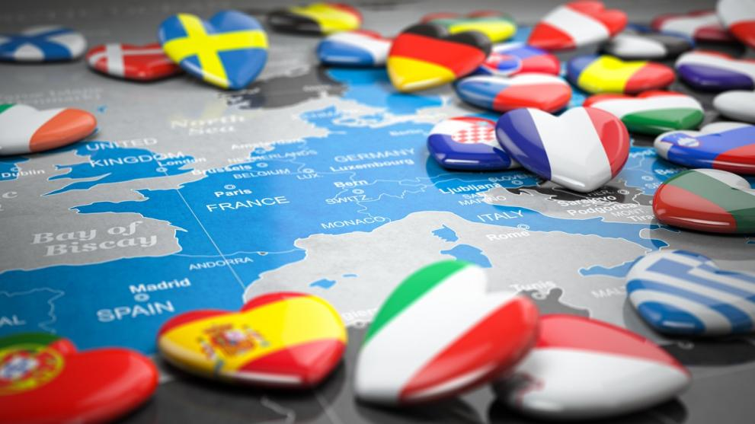
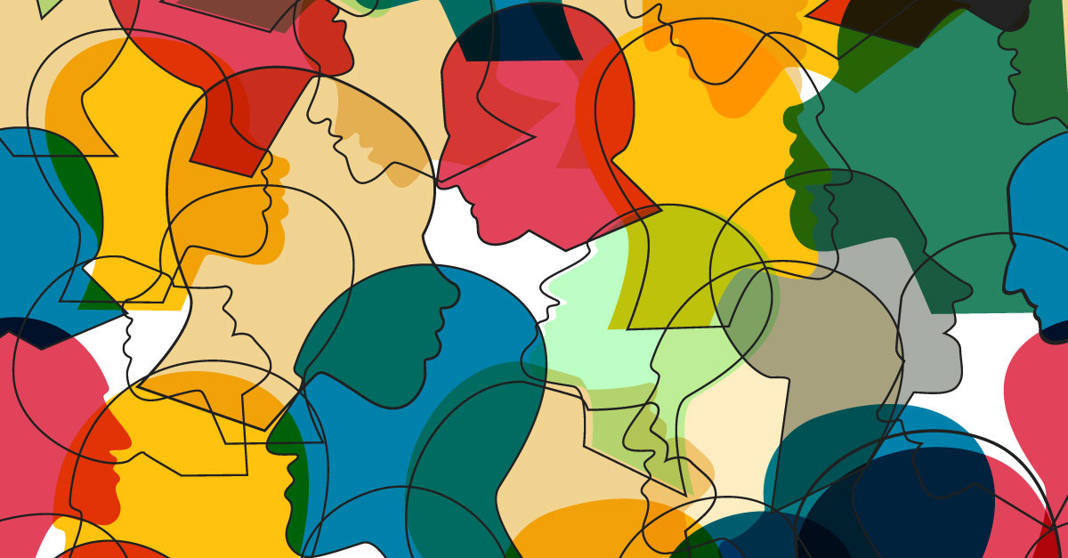
How do we value culture?
The big question….

Slide 2
What does intercultralism mean to you?

Slide 3
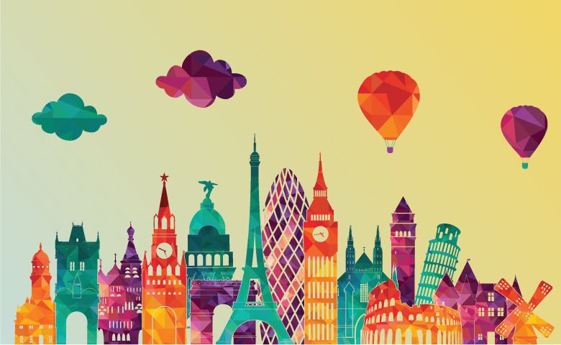
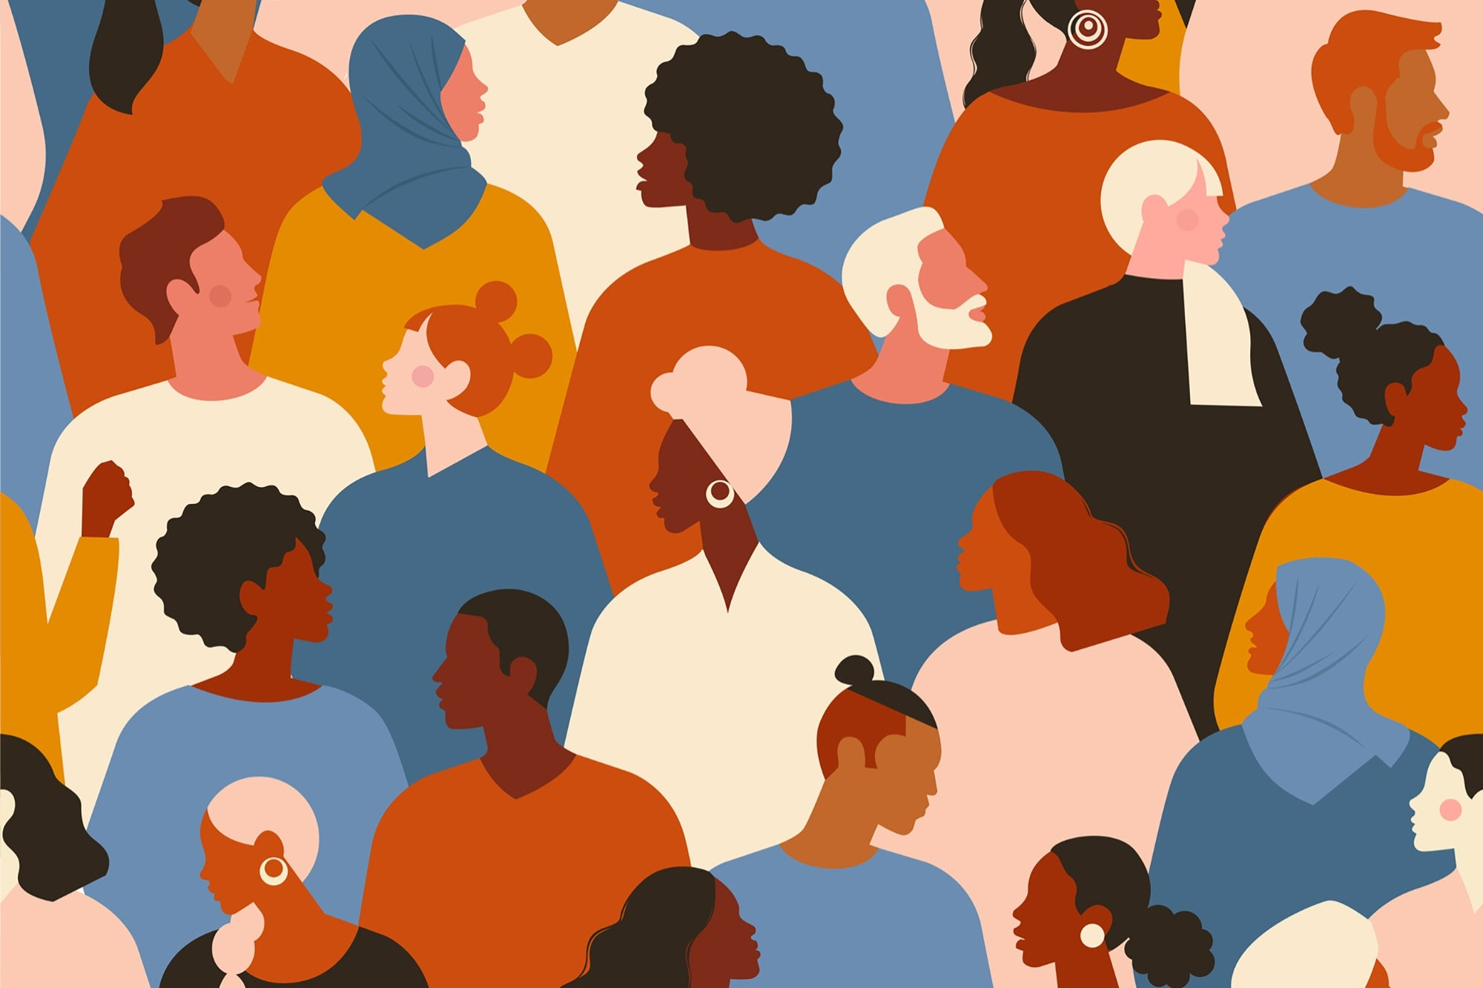
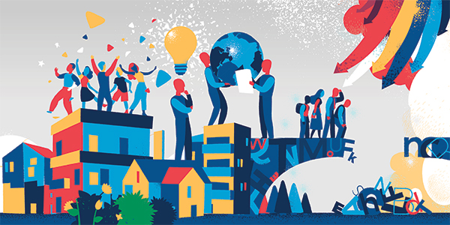
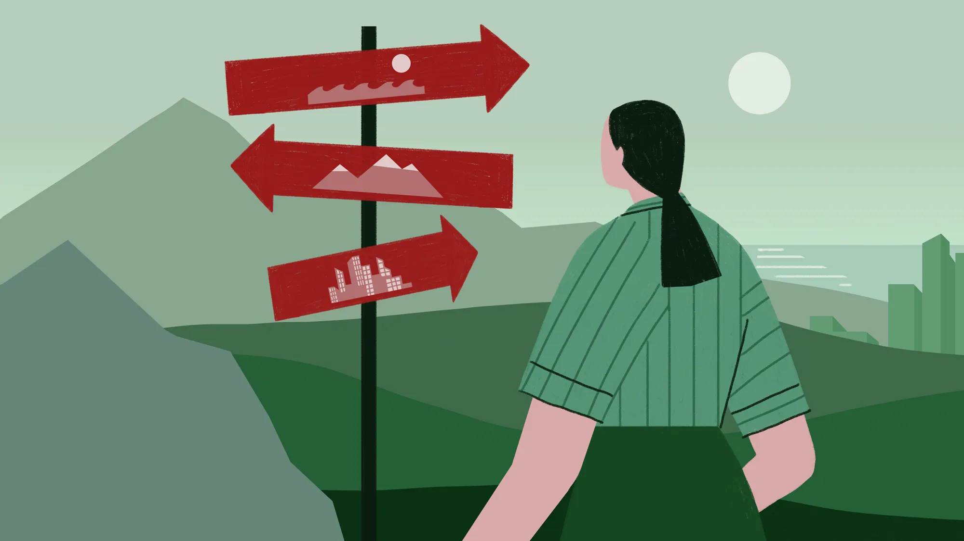
INTERCULTURALISM
History and Culture
Identity and Personal Narrative
Diversity and Kindness
Community and Respect

Slide 4
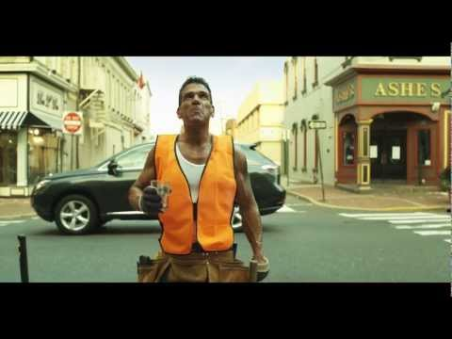
What do you think is the key message from this video?
https://www.youtube.com/watch?app=desktop&v=nwAYpLVyeFU

Slide 5
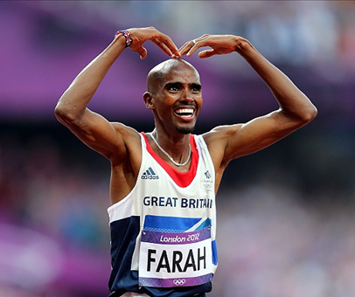
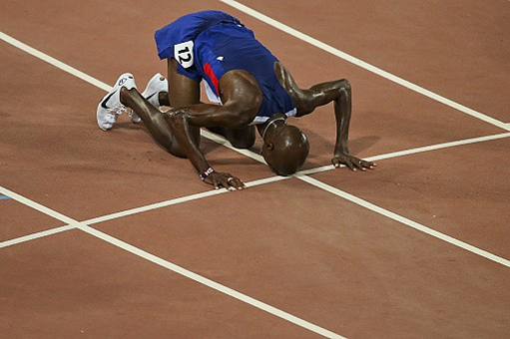
Let’s think about the link between culture and identity ….
Who is this?
How would you describe their identity?

Slide 6
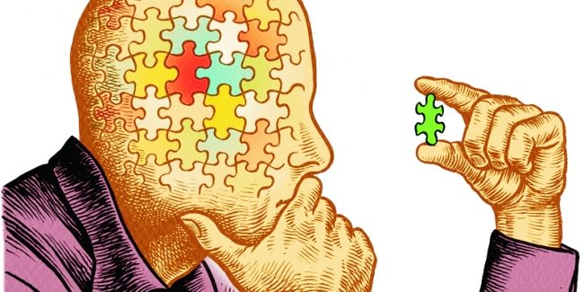
What is your identity?
How would somebody describe you in only one sentence?

Slide 7
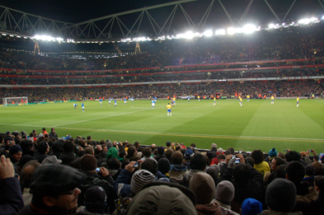
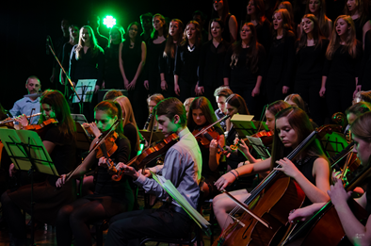
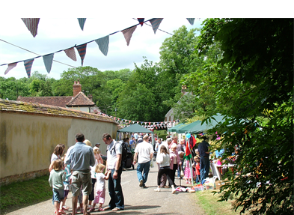
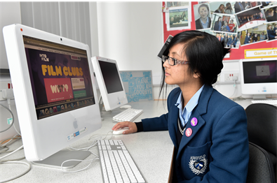
What do these images have in common?

Slide 8
Watch this clip from
The Book of Life (2014)
and think about:
1.Which country do you think this scene is from?
2.What are they celebrating?

Slide 9
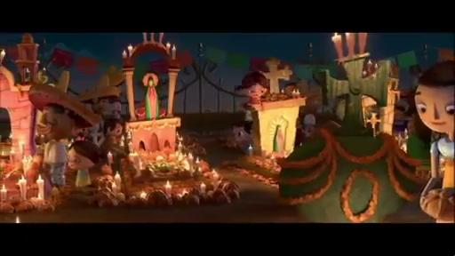
‘Celebration’ without sound
https://youtu.be/mCSljmwNs_U

Slide 10
‘Celebration’ with sound
https://youtu.be/mCSljmwNs_U

Slide 11
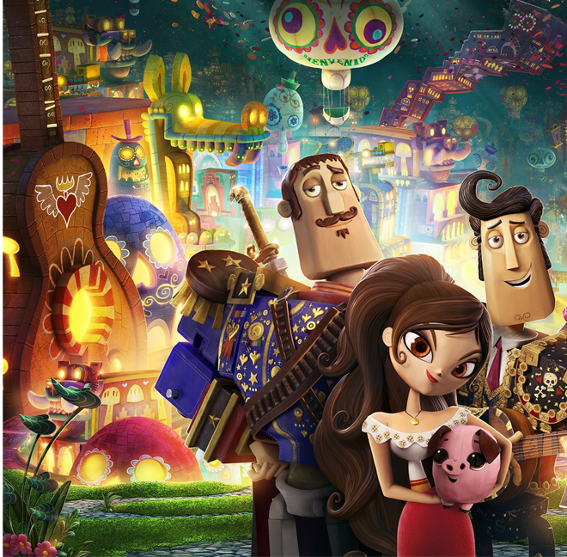
As you watch this clip from The Book of Life (2014) think about:
1.Does it remind you of another cultural celebration? In what way?
2.How is Manolo feeling? How does his family respond?
3.Why do you think Day of the Dead is celebrated in this way?

Slide 12
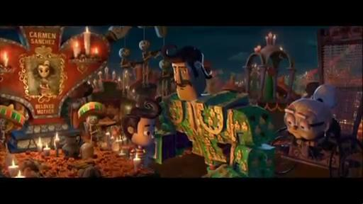
‘Manolo’
https://youtu.be/DX_3DW1iOw4

Slide 13
Reflection:
How can our cultural differences make our community stronger?

