Slide 1
PSHE

Slide 2
LI: Can I identify what kindness is?
What is kindness?
Last time we looked at what being kind online means. We all know that kindness is important, but what does it mean to be kind?
You can draw pictures or write the meaning down on a post it or a piece of paper.

Slide 3
LI: Can I identify what kindness is?
What does it mean to be friendly? Can you think of a time when someone was friendly to you?
What does it mean to be generous? Can we be generous without giving away money? (For example, being generous with your time)
What does it mean to be considerate? How it is different to being friendly or generous?

Slide 4
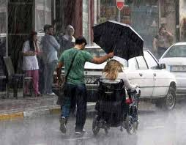
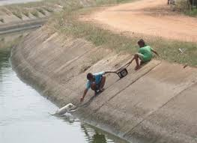
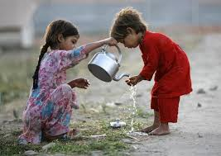
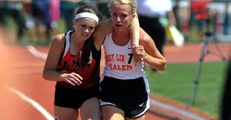
LI: Can I identify what kindness is?
KINDNESS: the quality of being friendly, generous and considerate.

Slide 5
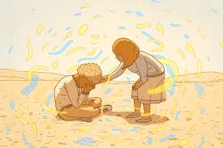
LI: Can I identify what kindness is?
Watch the video of children talking about kindness.
Now can you tell someone at your house about a time when someone was kind to you.
How did it make you feel?
Did it make you want to be more kind to other people?

Slide 6
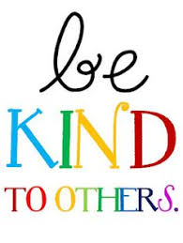
LI: Can I identify what kindness is?
Here are some examples of what we can do to be kind and it’s free! 😀💛Have you done this to anyone today?
-Saying thank you to people who help you.
-Asking someone if they’d like to play.
-Smiling at people, and just looking out for each other.
Online
-Calling people to make sure they are ok.
-Sending a funny picture.
-Playing a game.
-Sending a message to check if people are ok.

Slide 7
LI: Can I identify what kindness is?
Your task for today is to make kind notes for people in your family. Give one to a family member in the morning to help their day start well. Or you could hide them around the house for them to discover, (For example in a drawer or a shoe, be creative.) They’ll get a lovely surprise when they find one! Make sure they are decorated and colourful. 💖

