Slide 2
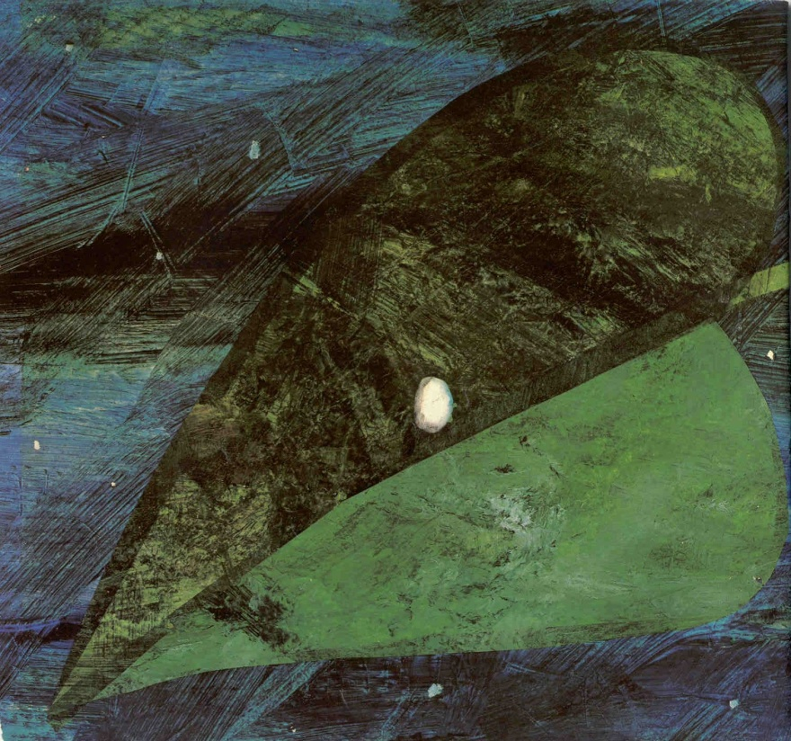
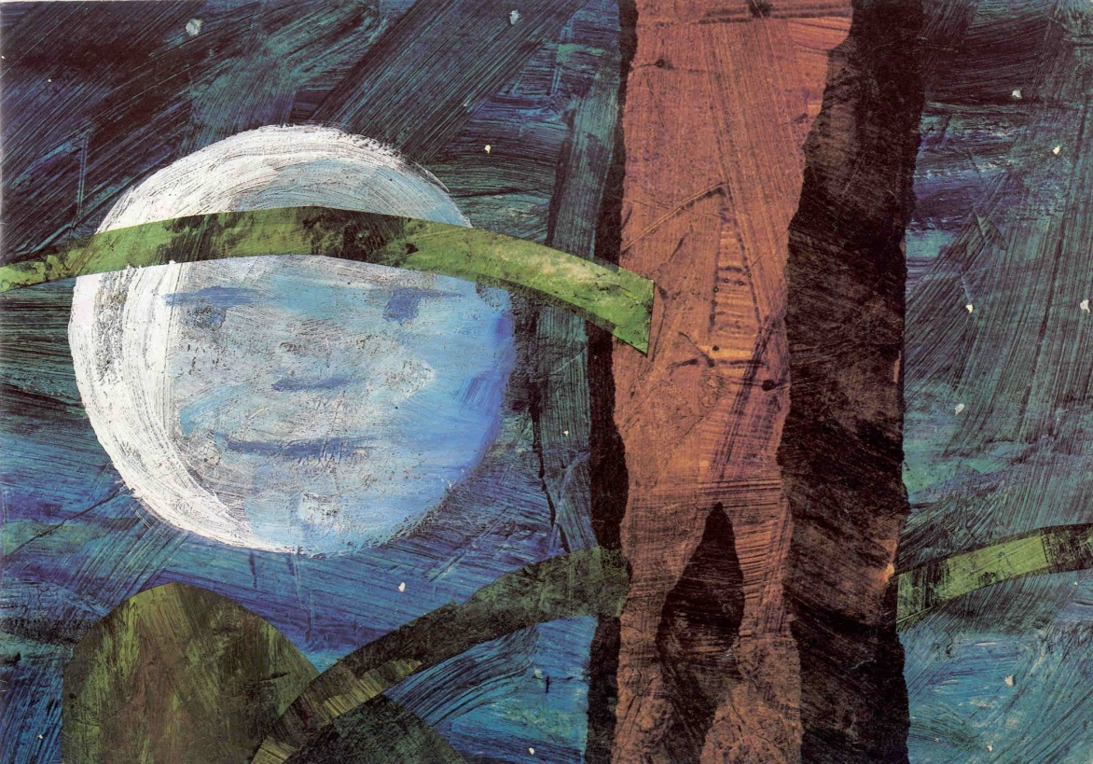
In the light of the moon
A little egg lay on a leaf

Slide 3
One Sunday morning a warm sun came up and-pop!-out of the egg
came a tiny and very hungry caterpillar

Slide 4
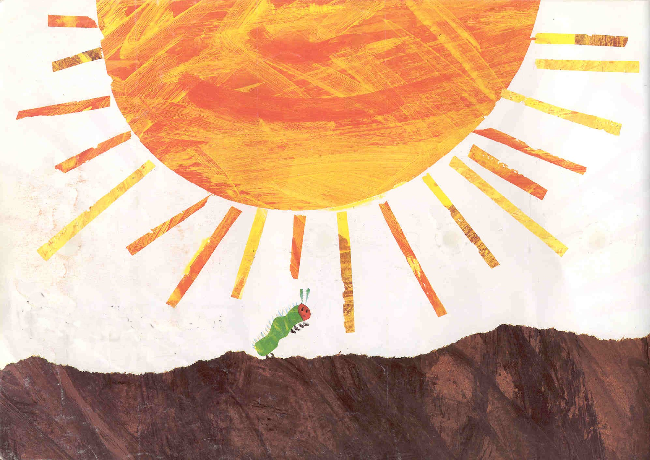
He started to look for some food.

Slide 5
On Monday
he ate through
one apple,
but he was still
hungry.

Slide 6
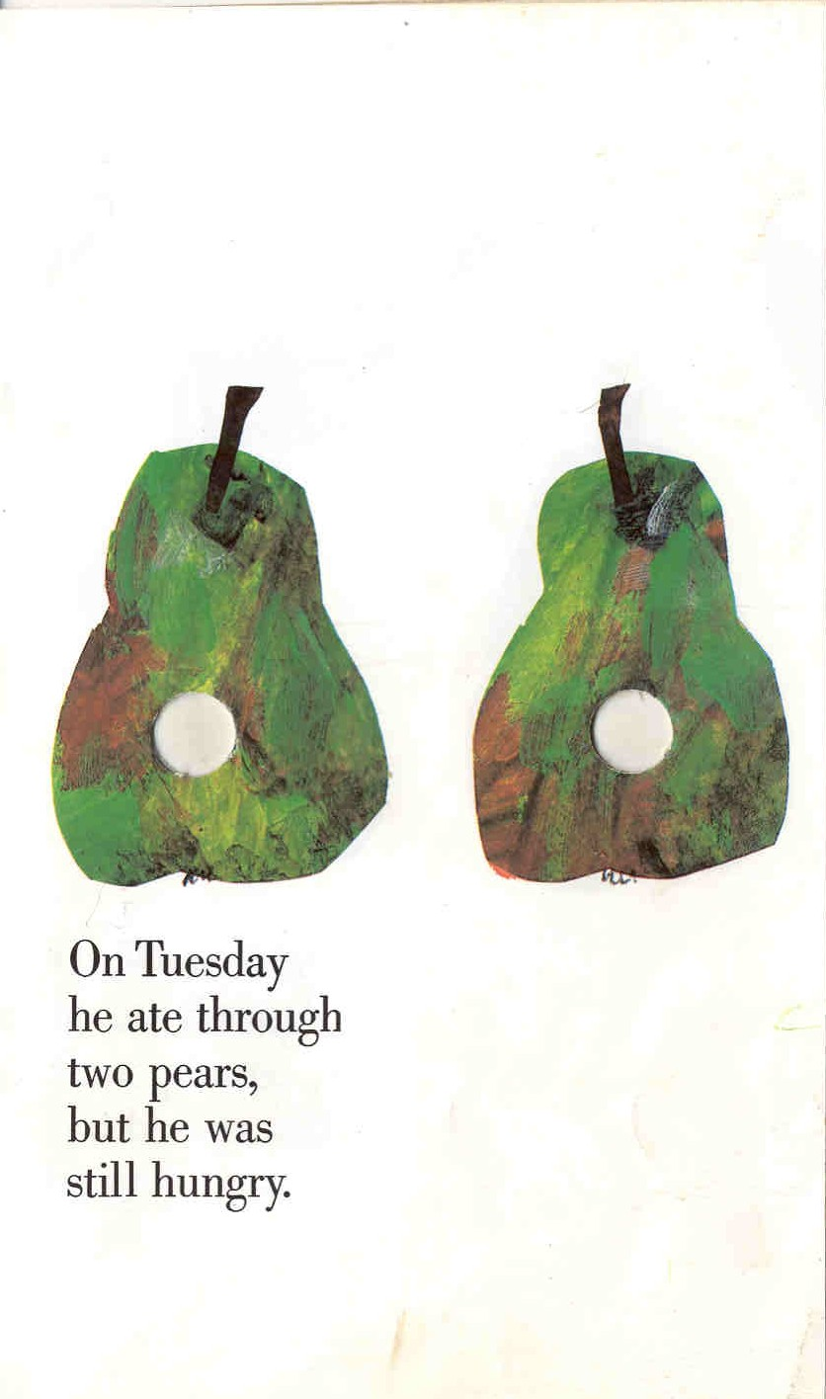
On Tuesday
he ate through
two pears,
but he was still
hungry.

Slide 7
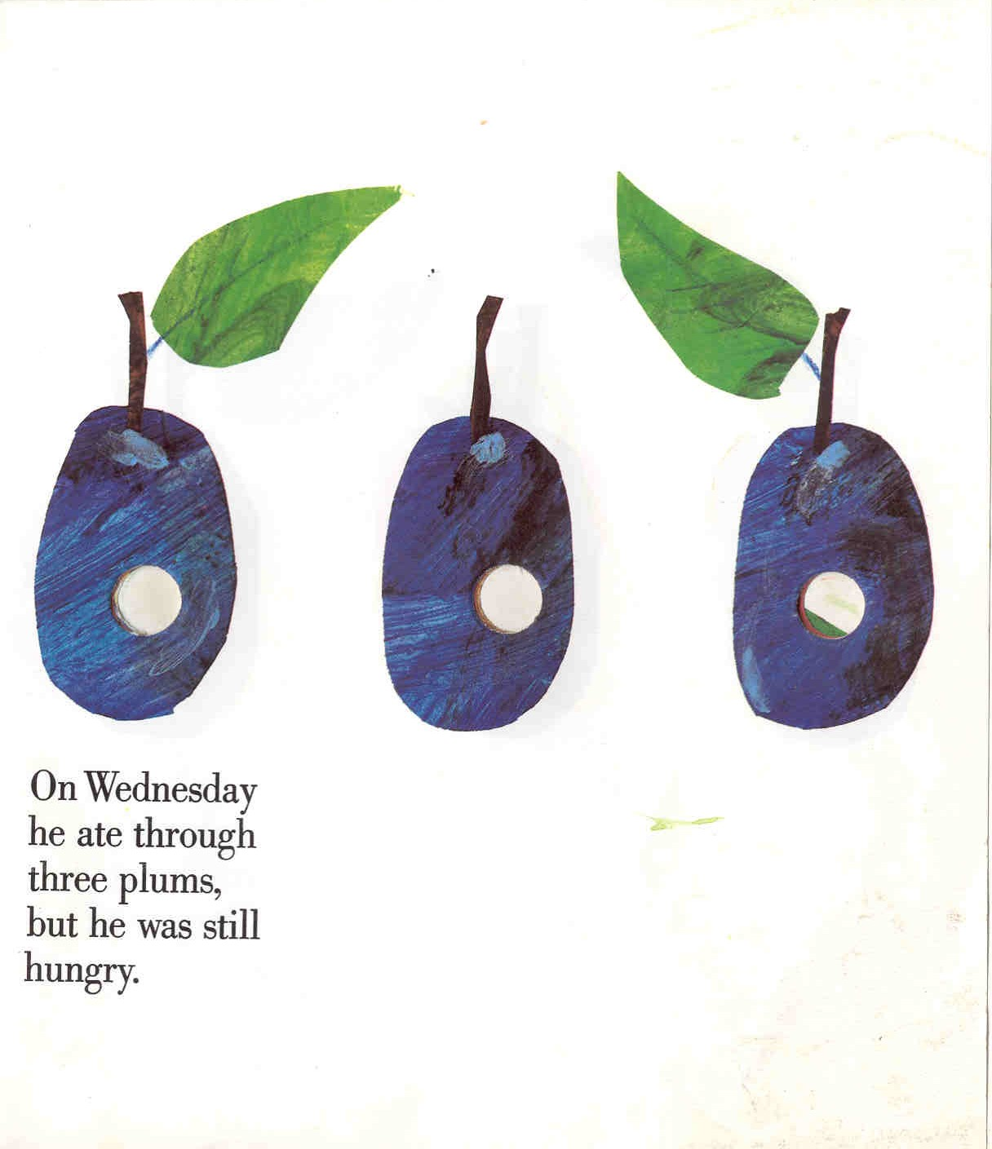
On Wednesday
he ate through
three plums,
but he was still
hungry.

Slide 8
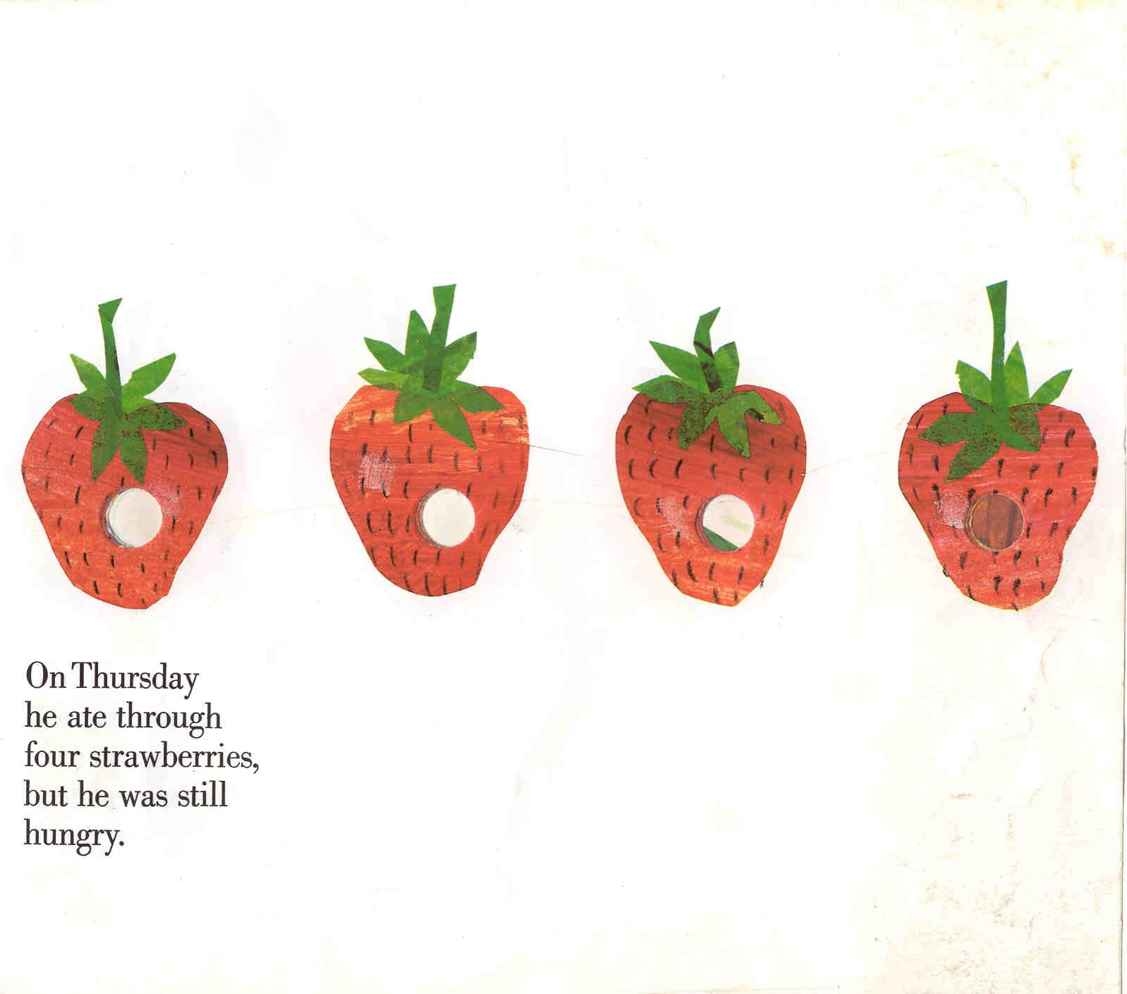
On Thursday
he ate through
four strawberries,
but he was still
hungry.

Slide 9
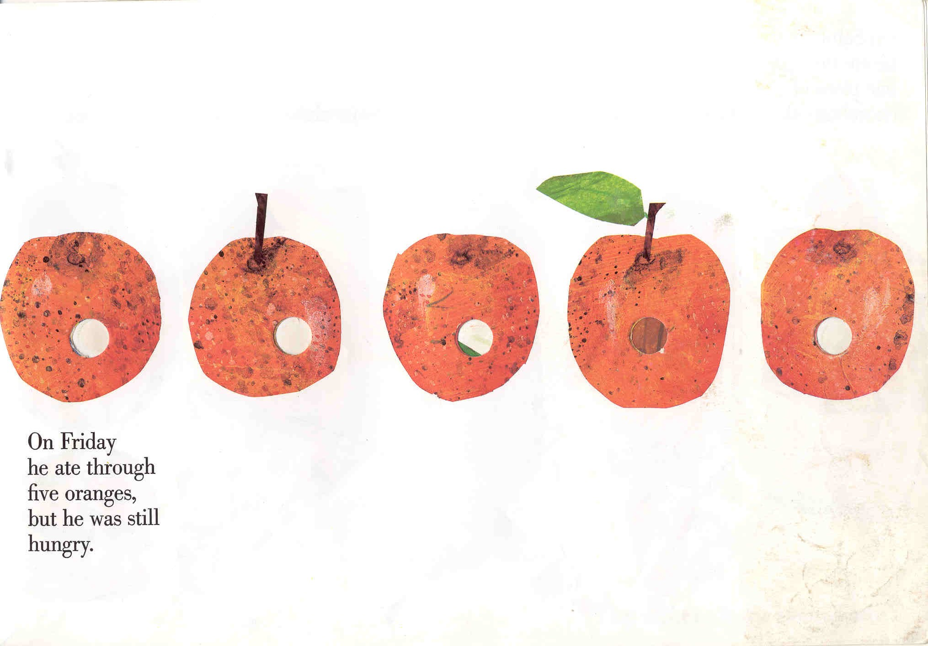
On Friday
he ate through
five oranges,
but he was still
hungry.

Slide 10
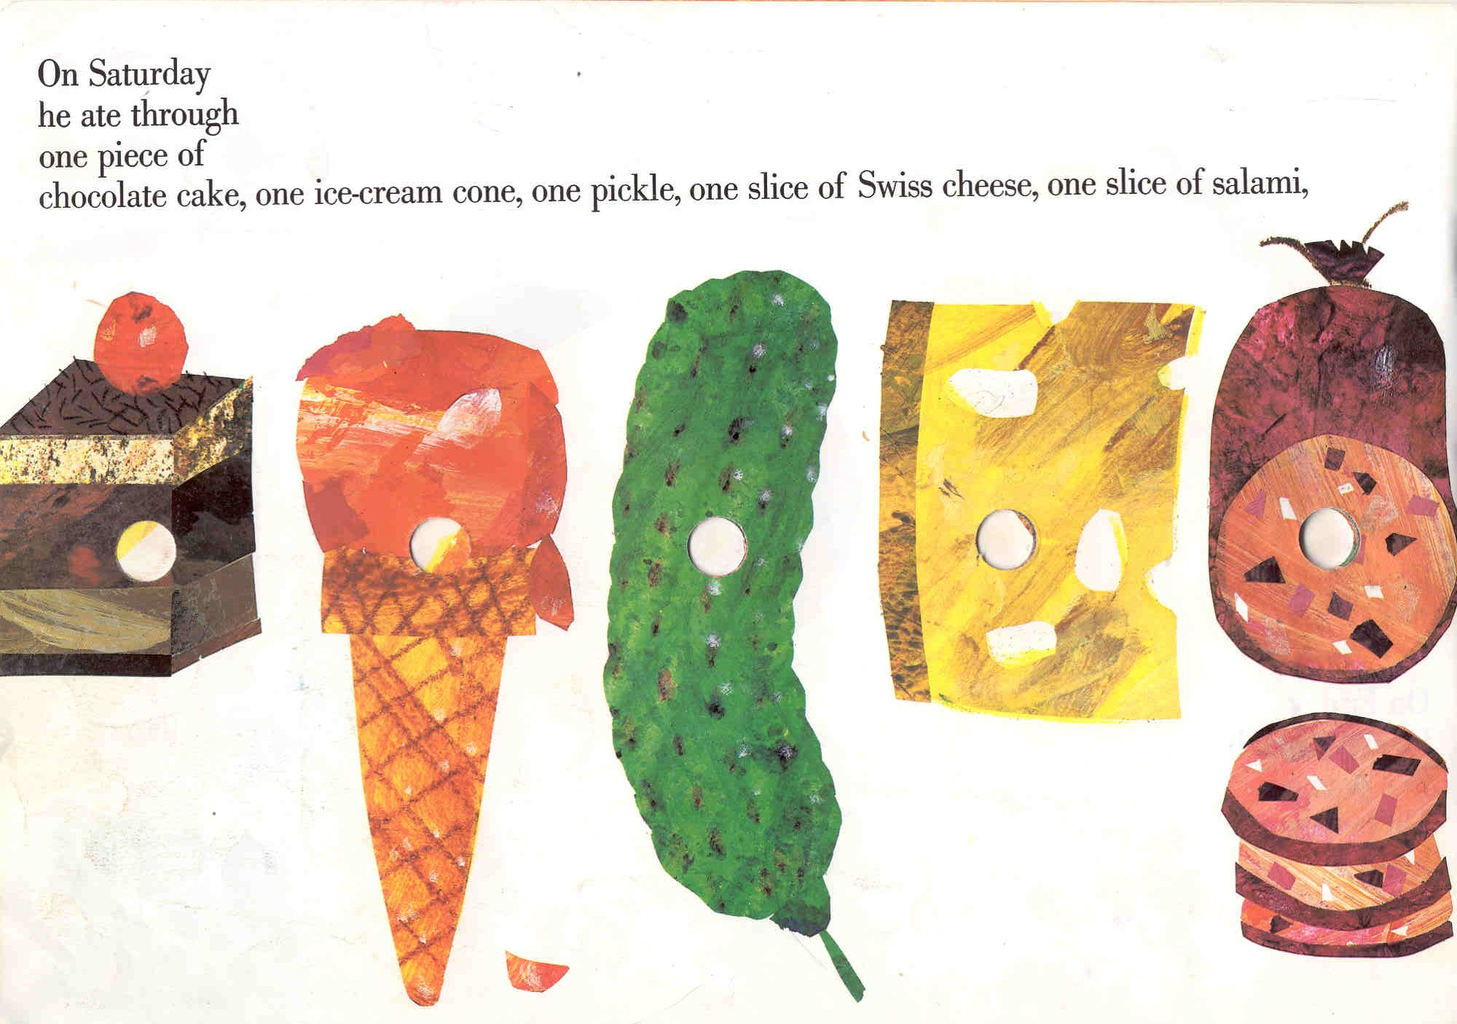
On Saturday he ate through one piece of
chocolate cake, one ice-cream cone, one pickle,
one slice of Swiss cheese, one slice of salami,

Slide 11
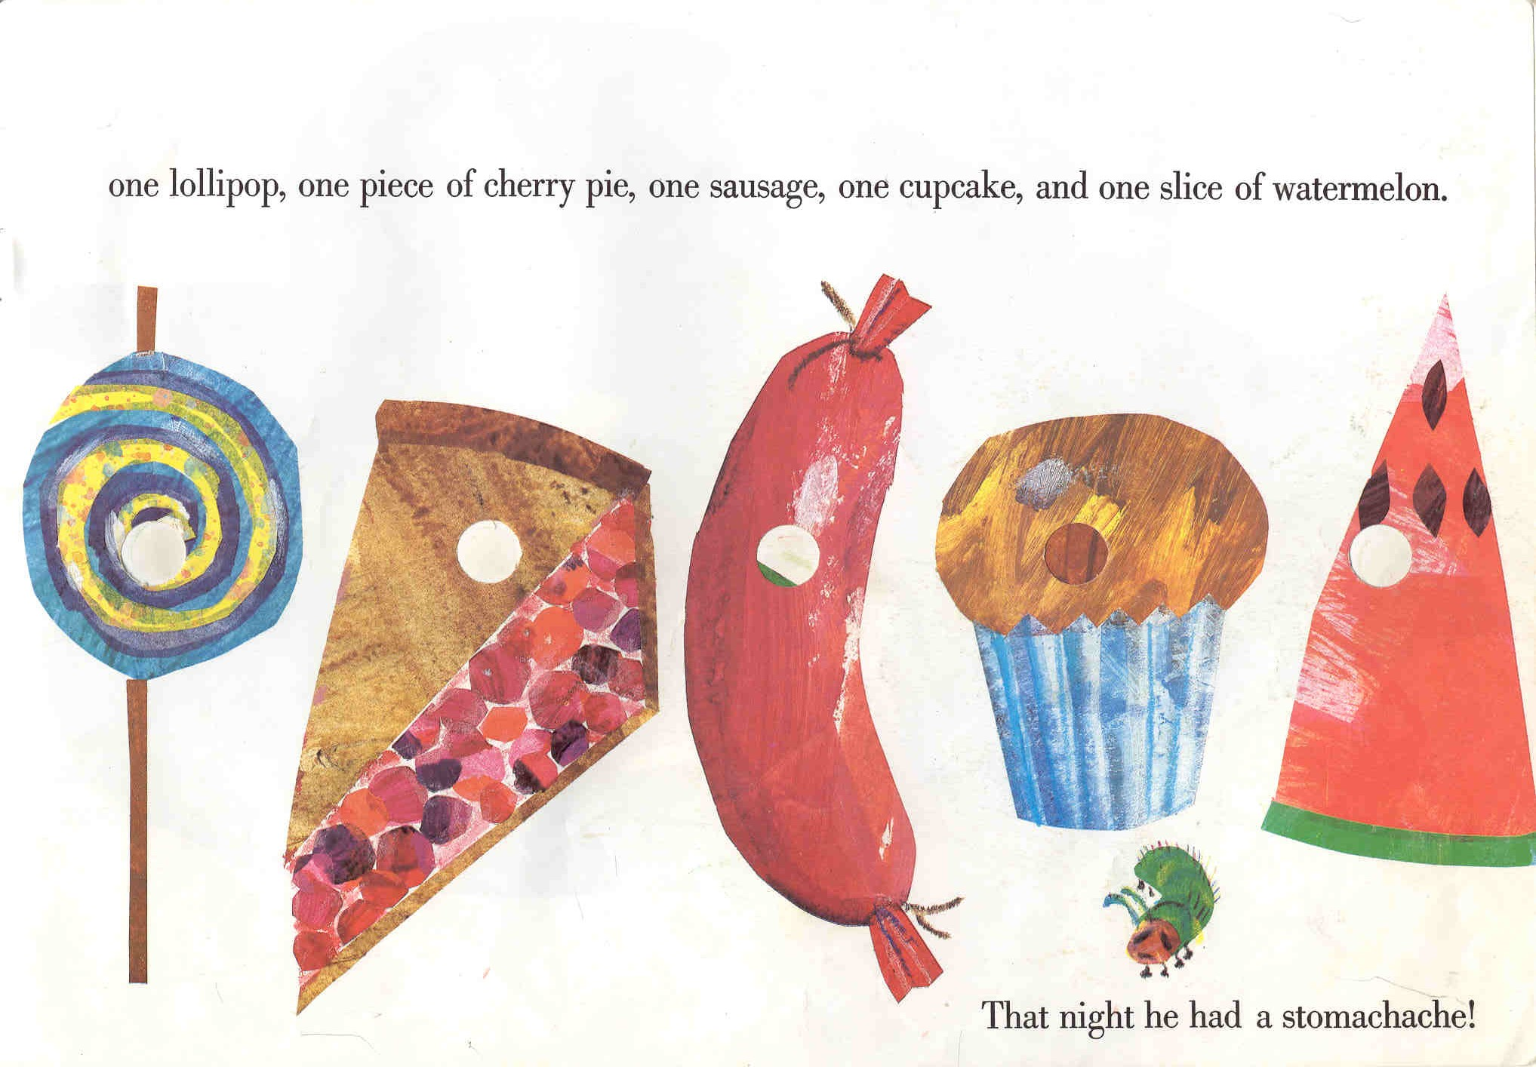
One lollipop, one piece of cherry pie, one sausage,
one cupcake, and one slice of watermelon.
That night he had a bad stomach-ache!

Slide 12
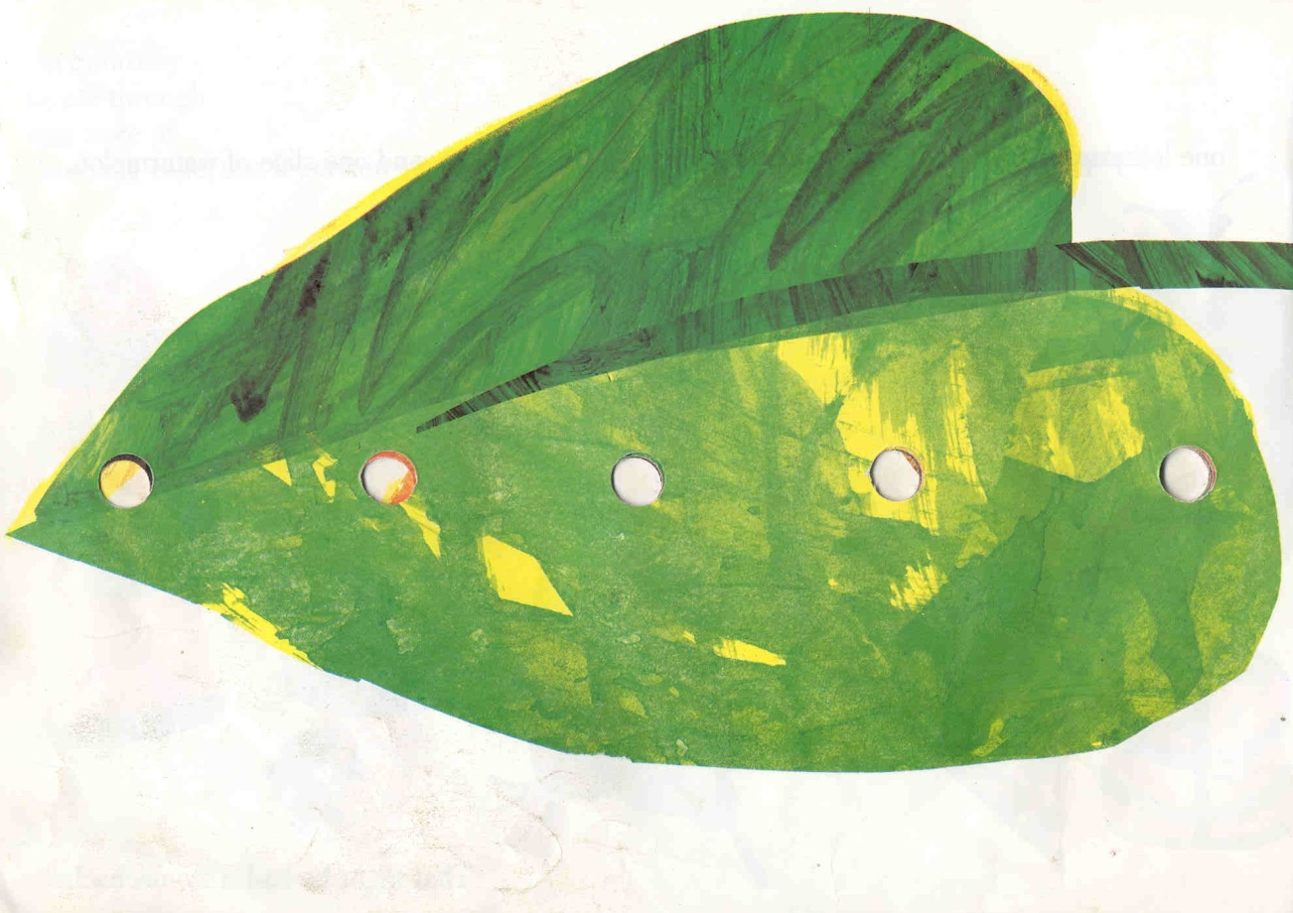
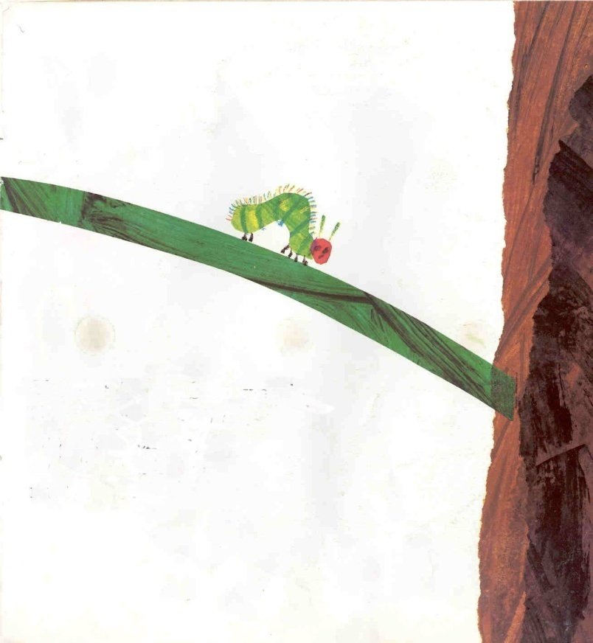
The next day was Sunday again.
The caterpillar ate through
one nice green leaf,
and after that he felt
much better

Slide 13
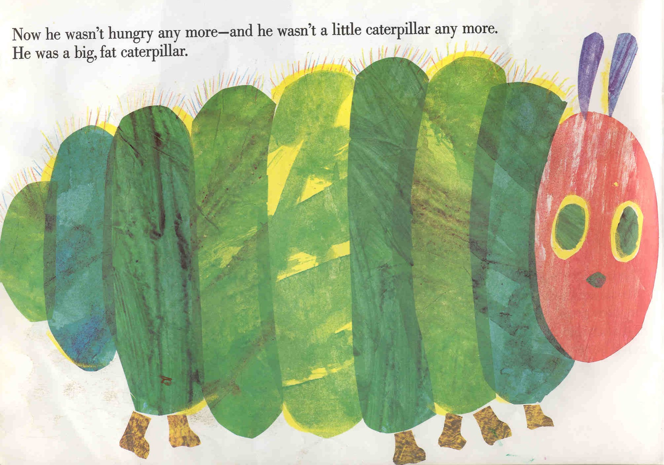
Now he wasn’t hungry any more
and he wasn’t a little caterpillar any more
He was a big, fat caterpillar

Slide 14
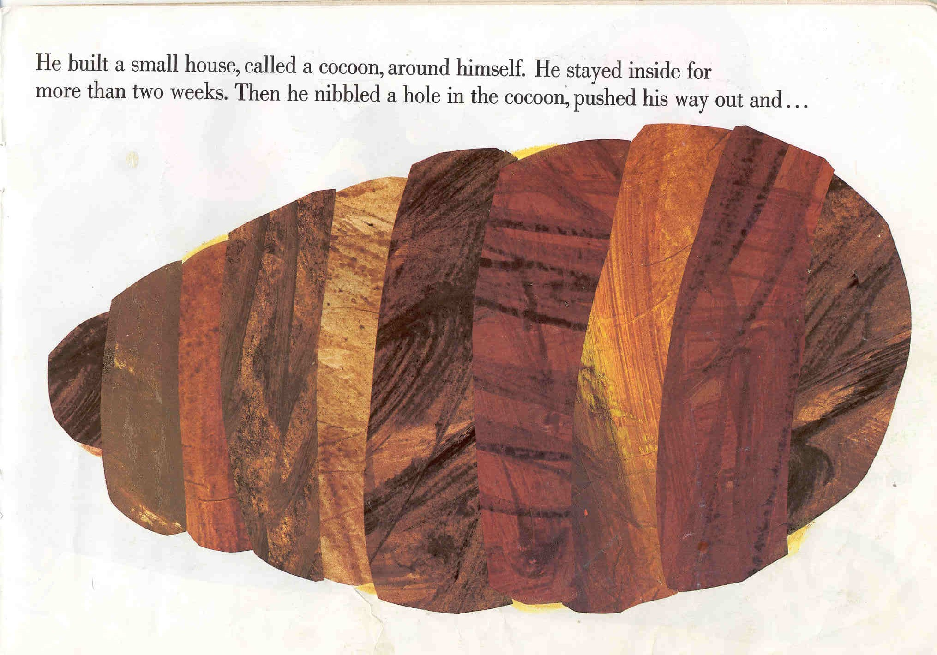
He built a small house, called a cocoon, around himself. He stayed inside for more than two weeks. Then he nibbled a hole in the cocoon, pushed his way out and...

Slide 15
He was a beautiful butterfly!

