Slide 1
A J
A Journey with a Purpose

Slide 3
“Generative topics are issues, themes, concepts, ideas and so on that provide enough depth, significance, connections, and variety of perspective to support students’ development of powerful understanding.”
Blythe et al (1998)
The Teaching for Understanding Guide

Slide 4
“Generative topics are… of interest to professionals in the field...”
Blythe et al (1998)
The Teaching for Understanding Guide

Slide 5
Park ranger
Naturalist
Biologist
Explorer
Trekking guide
Teacher
Outdoor Educator
Emergency responder
Conservationist
TV survival show presenter
Habitat monitor
Challenge course manager
Wilderness therapist
Artist
Environmental campaigner
etc.
etc.

Slide 6
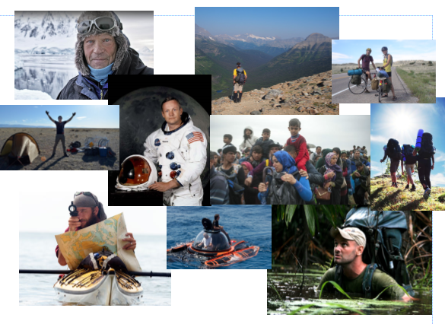
Why do people take Adventurous Journeys?

Slide 7
Your challenge:
to design an investigation around one of these ideas
to carry out your investigation over two days
to find out something you do not already know
to present your findings in an appropriate and engaging way

Slide 8
P = purpose
A = audience
F = format

