Slide 1
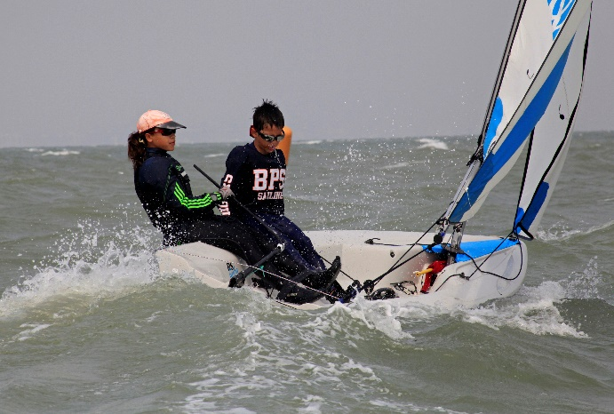
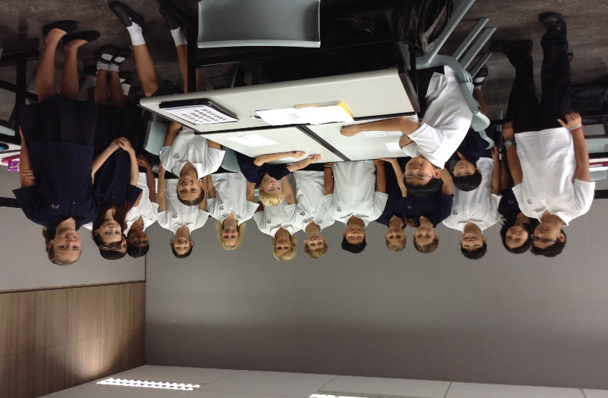
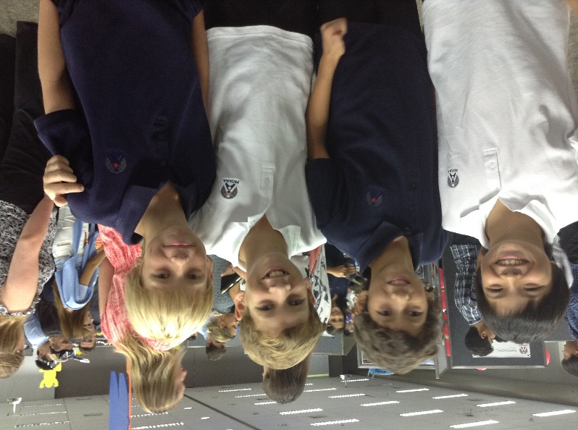
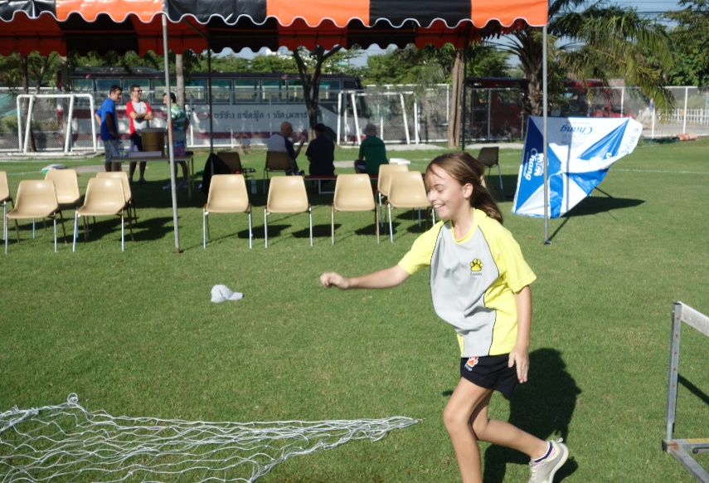
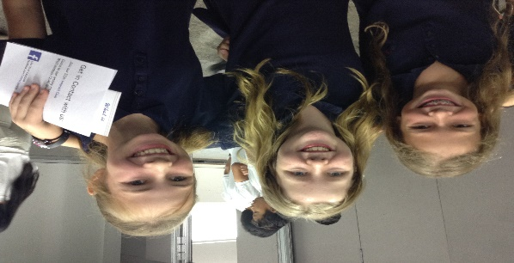
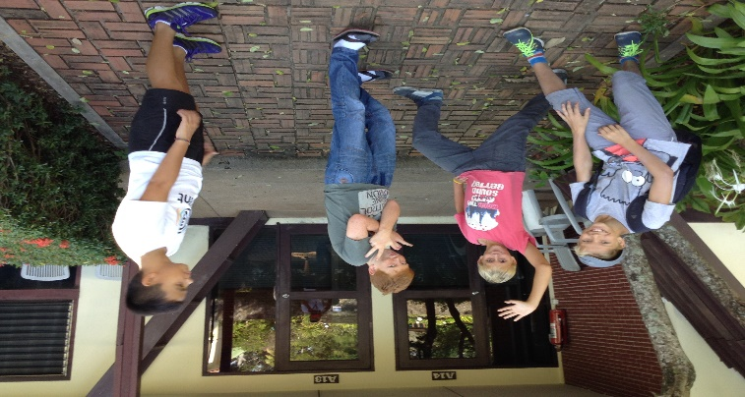
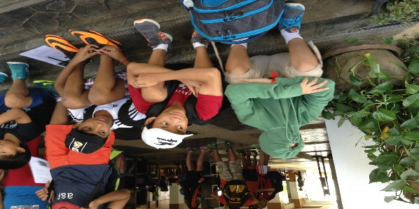
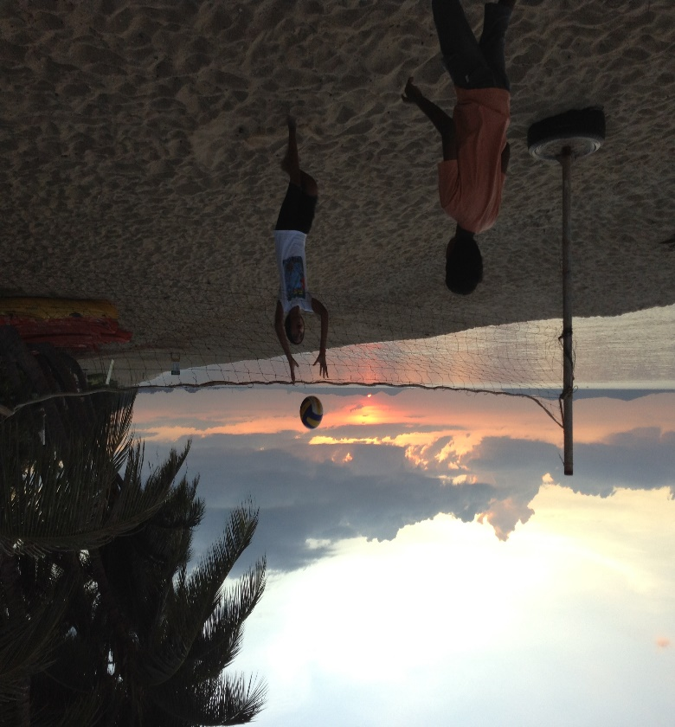
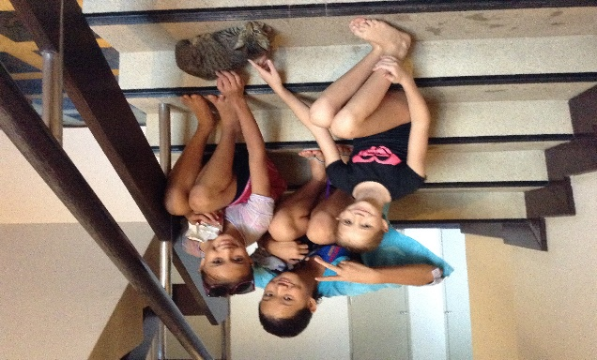
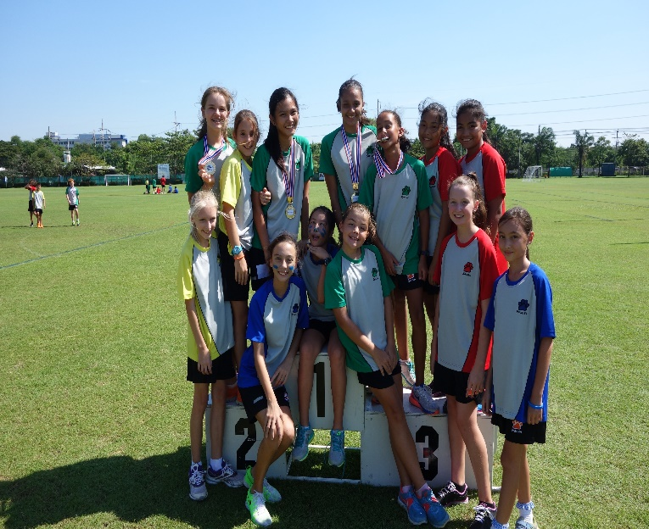
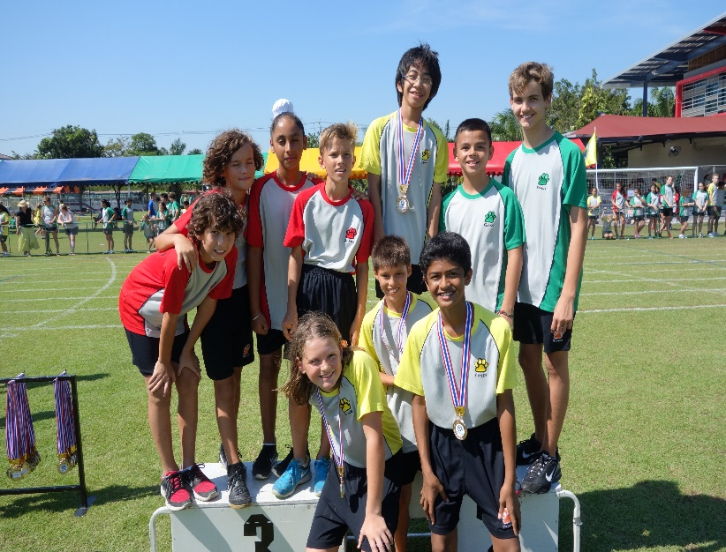
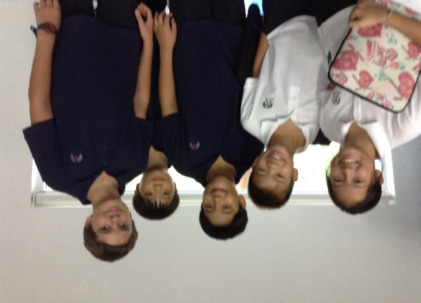
Welcome to Term 2!

Slide 2
Agenda
Key dates and events
Y6 to Y7 transition
Learning to Learn
A message from the PTG
Year 7 Tutorial

Slide 3
What is happening?
Term 2
January
Sat 17 Jan: Mercy Centre Visit
Fri 23rd Jan: House Sport (softball)
February
Monday 2nd February (all week): U-Smile Photographs (individual & tutor group)
Wednesday 11th February: Patana Classic Concert (6pm)
12 – 27 Feb – 8 Y6 Taster Days (shadowing Y7 students)
Friday 13th February: Non Uniform Day
Fri 20th Feb – House Quiz
Saturday 21st February: Fun Day
Fri 27th Feb KS3 Assembly
March
Monday 2nd - Friday 6th March: Half-Term Break
Tuesday 10th March: House Swimming Gala
Thursday 19th March: Patana Jazz and Blues Concert (7-10pm)
Friday 20th March: Key Stage 3 Dance
April
Thursday 2nd April: Patana Unplugged
Friday 3rd April: Term 2 reports issued/Last day of Term 2.
Term 3
May
Friday 15 May – Y7 Coffee Morning
June
Wed 3 – Tues 9 June – KS3 Exams
Mon 22 – Thurs 25 June – Patana Student Convention (PSC)
Fri 26 June – Last day

Slide 4
Year 6 to 7 Transition
Year 6 to 7 Transition

Slide 5
Learning to Learn

Slide 6
PTG
Y7 Representatives - Line Echivard and Anne Morganthaler Vandlik
The PTG are on Facebook. All information on events and other social happenings in Bangkok are forwarded to parents via Facebook.
Check the school calendar for PTG events.
The next big event will be Fun Day which will take place on February 21st. We hope to see many parents and students attending.
Anyone who would like to be involved in the organisation is welcome. Please contact: ptg@patana.ac.th

Slide 7
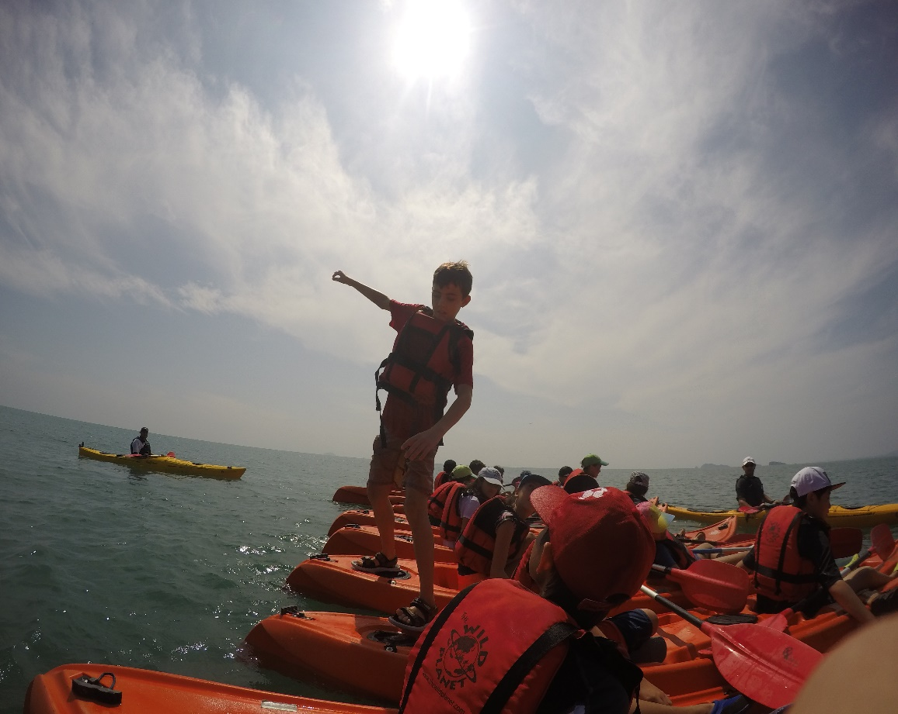
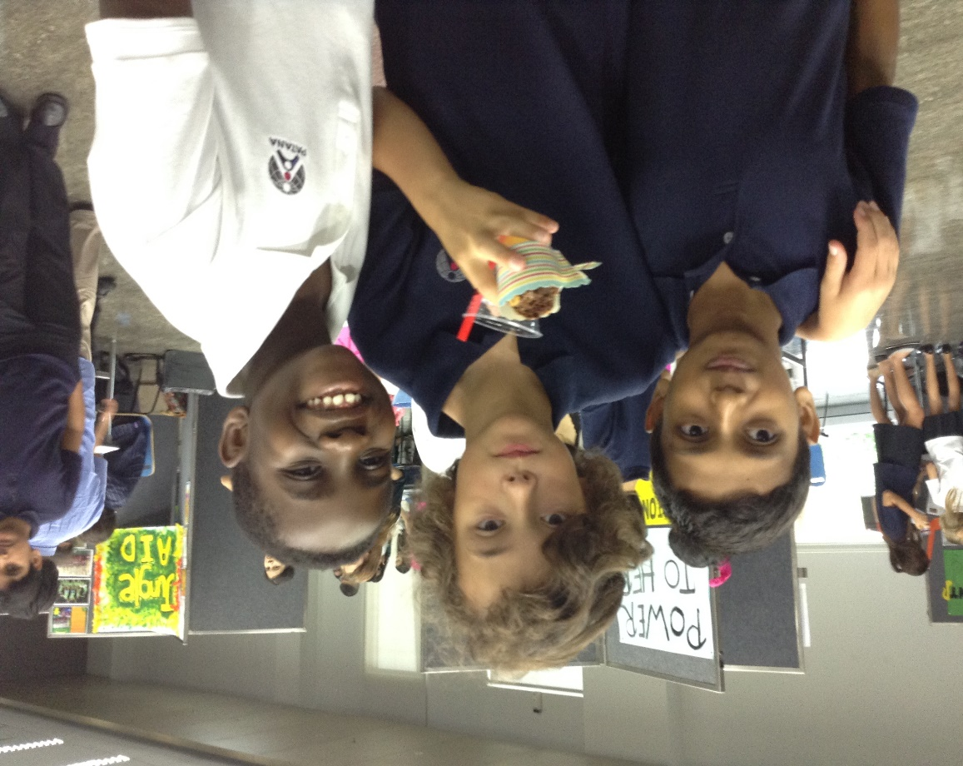
Tutorial Themes
Term 1 - Overcoming Challenges
Term 2 – Making Connections
Term 3 – Our Values

Slide 8
Making Connections
Australia Scotland Israel USA
Malaysia Singapore Taiwan Pakistan
New Zealand Thailand Hong Kong China
Indonesia Myanmar England
Argentina Cambodia Vietnam Laos
Sri Lanka India Canada Ireland Wales France Spain Finland Denmark Iceland Holland South Africa Nepal Germany Korea Estonia Japan

Slide 9
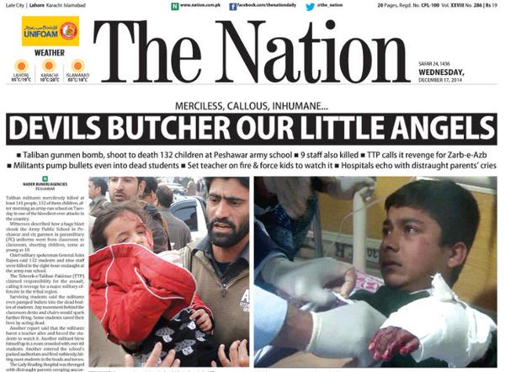
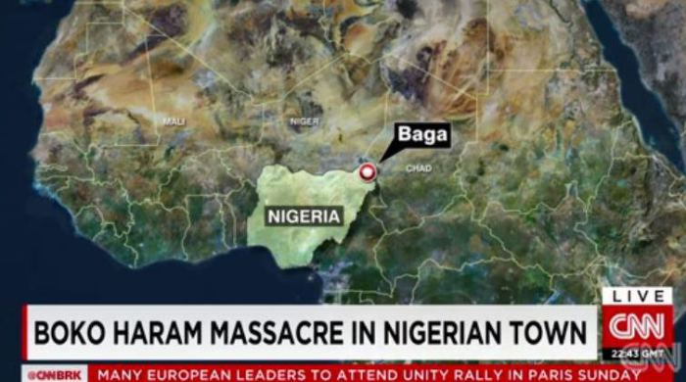
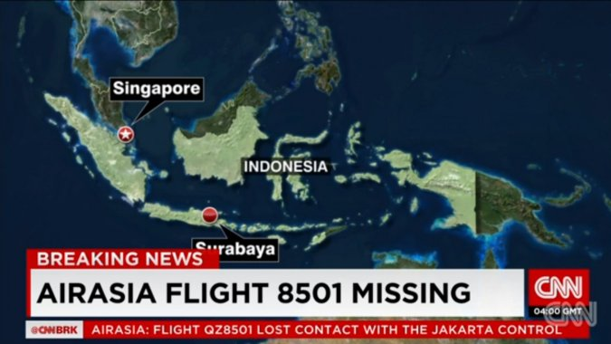

Slide 10
Ubuntu - a quality that includes the essential human virtues; compassion and humanity. The belief in a universal bond of sharing that connects all humanity.
People are people through other people.
Xhosa proverb.

Slide 11
Originally
We came from our own country in a red room which fell through the fields, our mother singing our father's name to the turn of the wheels. My brothers cried, one of them bawling Home, Home, as the miles rushed back to the city, the street, the house, the vacant rooms where we didn't live any more. I stared at the eyes of a blind toy, holding its paw.
All childhood is an emigration. Some are slow, leaving you standing, resigned, up an avenue where no one you know stays. Others are sudden. Your accent wrong. Corners, which seem familiar, leading to unimagined, pebble-dashed estates, big boys eating worms and shouting words you don't understand. My parents' anxiety stirred like a loose tooth in my head. I want our own country, I said.
But then you forget, or don't recall, or change, and, seeing your brother swallow a slug, feel only a skelf of shame. I remember my tongue shedding its skin like a snake, my voice in the classroom sounding just like the rest. Do I only think I lost a river, culture, speech, sense of first space and the right place? Now, Where do you come from? strangers ask.. Originally? And I hesitate.
by Carol Ann Duffy

Slide 12
Making Connections - Who are you?
Now, Where do you come from? strangers ask.. Originally? And I hesitate.

Slide 13
Making Connections – In tutor bases
Discussion – Who are you?
Task – Create a family tree.
Homework – During this week, talk to three people you have never spoken to before within the year group (not your tutor group!)and learn a fun fact about that person to share within your tutor group in two weeks.
Reminder – Ubuntu: The belief in a universal bond of sharing that connects all humanity.

Slide 14
Making Connections (from the specific to the general)
Who are you?
Your role and responsibilities in the world

Slide 15
Y7 Tutorial (PSHE – Personal, Social, Health Education)
Tasks:
Discussion – what would you expect to be covered in each Term?
Split the paper into quarters. List the points from your discussion in 3 of the quarters.
Discussion – what is missing?
List the points from this discussion.
Go for a wander.
Term 1 - Overcoming Challenges
Term 2 - Making Connections
Term 3 - Our Values (+ Exam preparation)
Student
Parents
Teachers

Slide 16
Making Connections Y7 Parents’ Homework/Home Learning Task
During the remainder of this coffee morning, talk to three people you have never spoken to before within the year group and learn a fun fact about that person to share at the Term 3 coffee morning…

