Slide 1
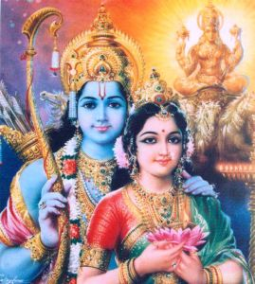
Rama and Sita
The first Diwali

Slide 2
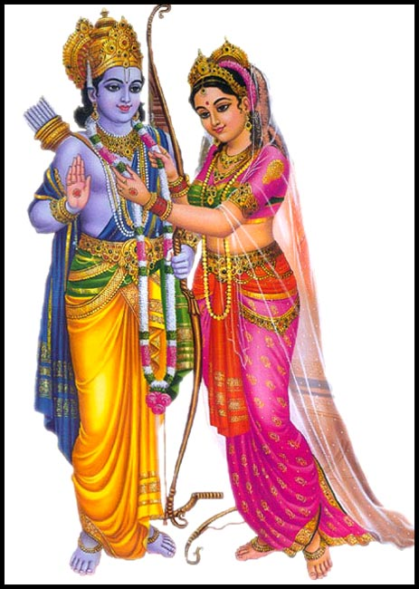
A long time ago in India lived Prince Rama and his beautiful wife Sita.

Slide 3
When the wicked demon-king Ravana saw Sita he fell in love with her and he decided to steal her away.
Ravana had 10 heads so it was easy for him to spy on Rama and Sita and see where they went.

Slide 4
One day, when she was alone in the forest, Ravana snatched Sita and took her away to his kingdom.

Slide 5
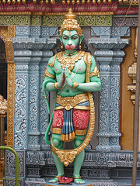
Rama searched everywhere for Sita. Then the monkey- king, Hanuman said he had found Sita and would help Rama to get her back.

Slide 6
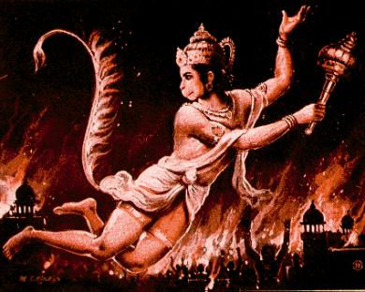
Hanuman played tricks on Ravana and made him so angry that he set light to Hanuman’s tail! But Hanuman had magic powers and jumped over the rooftops, spreading fire all over Ravana’s kingdom and burning it all down!

Slide 7
Rama fought a battle with the demon-king Ravana, and he killed him with a big spear.

Slide 8
Sita was so happy that Rama and Hanuman had come to rescue her!

Slide 9
The people lit diva lamps so that Rama and Sita would see them and could find their way home.
Everyone was so happy and came out of their houses to cheer. The people made Rama their King.

Slide 10
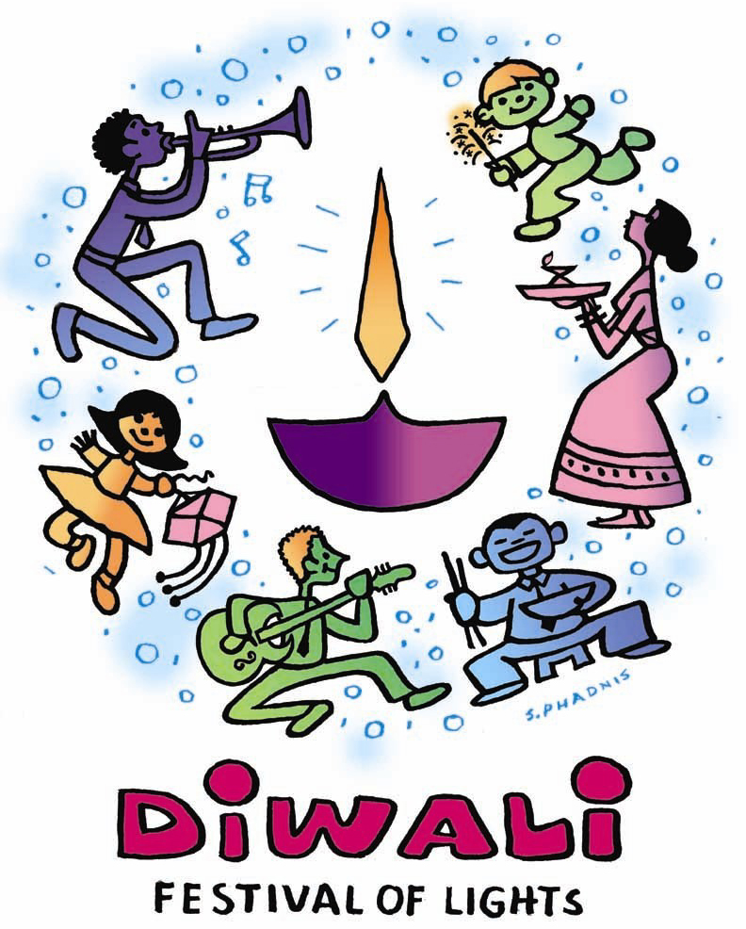
That was the first Diwali, and every year from that time, people have celebrated Diwali by lighting diva lamps.

