Slide 1
Poster Adverts to Persuade

Slide 2
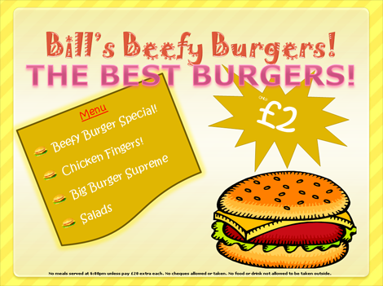
Checklist of key features of effective adverts
• snappy slogans (alliteration) e.g. ‘Mustard Munch – the snack that kicks back’ • exaggeration e.g. ‘the holiday of a lifetime’ • intriguing questions e.g. ‘How would you feel if you never needed to tidy your room again?’ • appealing adjectives e.g. ‘velvety chocolate’ • wordplay e.g. ‘Use Tubb’s Margarine – it’s a spreading habit’. • tempting descriptions of benefits e.g. ‘After just ten minutes in a Mello bubble bath, you’ll feel soothed, relaxed and refreshed.’
slogans
exaggeration
questions
adjectives
wordplay
benefits

Slide 3
More Examples
Snappy slogans - "For those too lazy to cook!" "One sip and your in heaven!" "Makes you feel on top of the world!" " Keeps you up up and away!" Exaggeration - "The quickest 3 course meal in the world " "The coolest / healthiest drink in town" Questions - "Are you bored of...?" " Are you worried about your kids health?" Appealing/strong adjectives - exotic, powerful, smooth, gob-smacking, fresh, fruity, refreshing Wordplay - " Don’t get drowned in a cook book, just drink DinnerWater " Tempting descriptions of the benefits - Its part of your 5 a day. Energy boost. Keeps you awake and healthy. Its good for you. Powerful verbs - Destroys thirst. Punches bacteria in the face. Demolishes tiredness. Kills your thirst for several hours.
slogans
exaggeration
questions
adjectives
wordplay
benefits

Slide 4
Words that Sell!
wanted
last chance announcing
magic
challenge
it's here
introducing
improvement
compare
just arrived
sensational
amazing
bargain
free
remarkable
offer
hurry new
revolutionary
quick
suddenly
startling
easy
the truth about
now
miracle

Slide 5
Amusing Adverts to Persuade
Posters

Slide 6
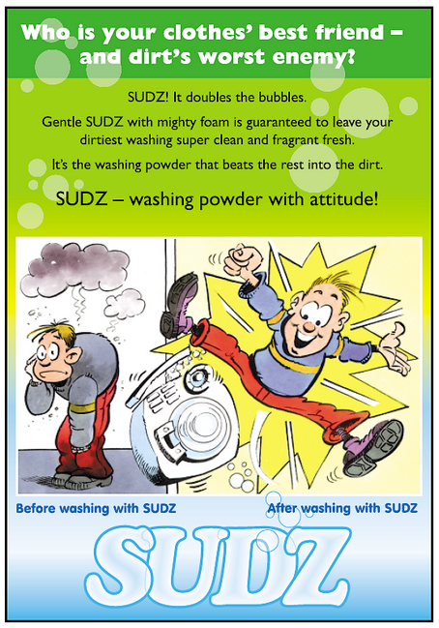

Slide 10
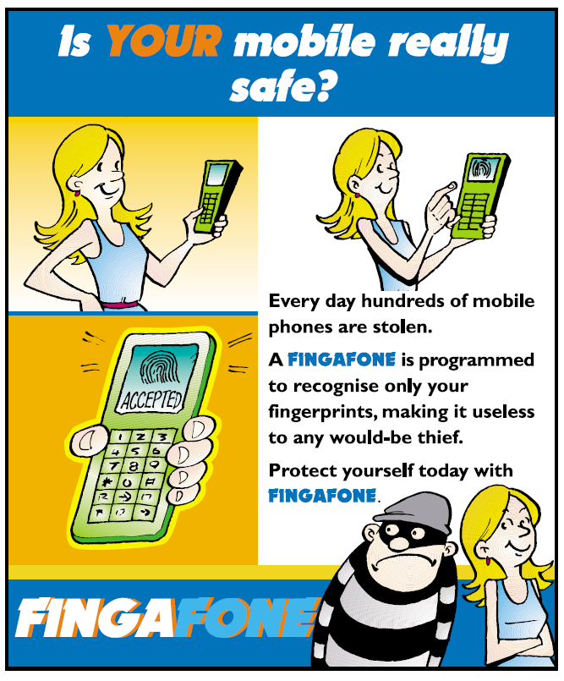

Slide 13
