Slide 1
THIS TERM:
FILM & FILMMAKING
Celebration, Creativity, Culture, Fun and Positivity​

Slide 2
INTRO TO PRODUCTION
week
To work in a production team to shoot a simple scene using industry procedures

Slide 3
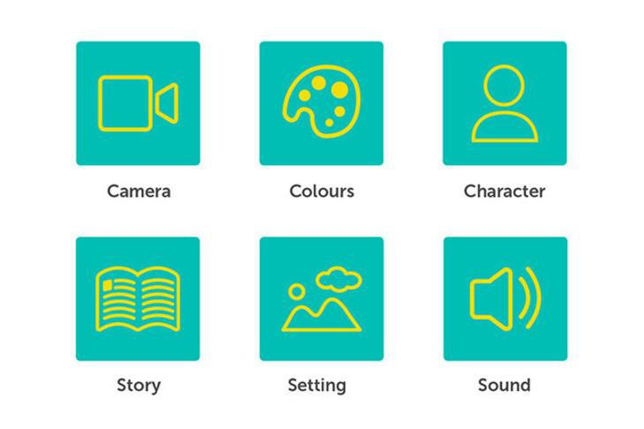
Recap: The 3Cs and the 3Ss of ﬁlm

Slide 4
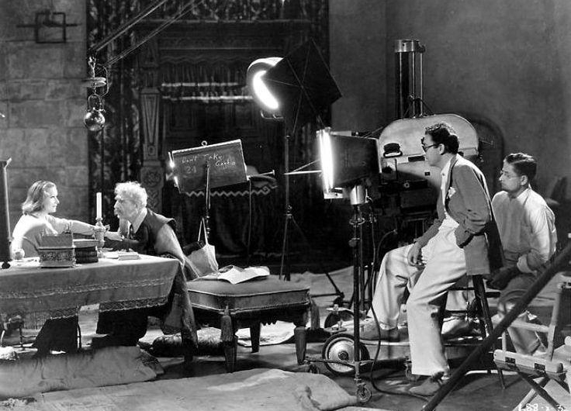
Production
The Shoot
Today you will be learning to:
Work collaboratively in a production team
Observe ﬁlm set protocol
Shoot a simple scene using the ‘Master shot technique’

Slide 5
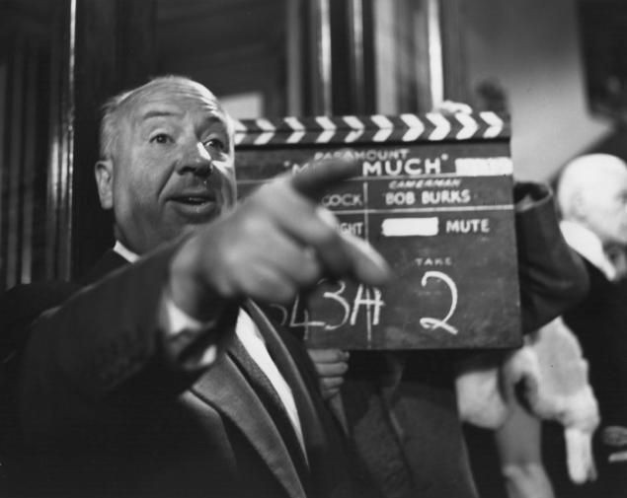
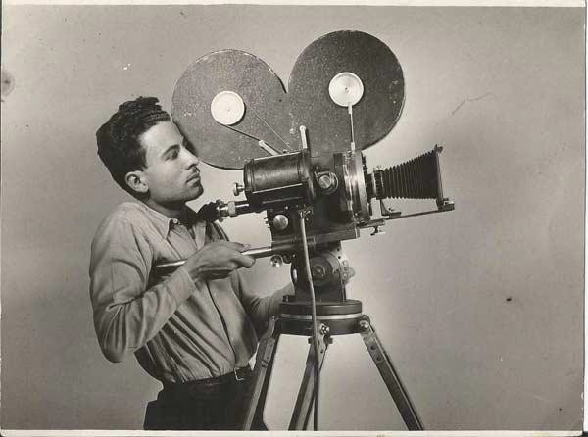
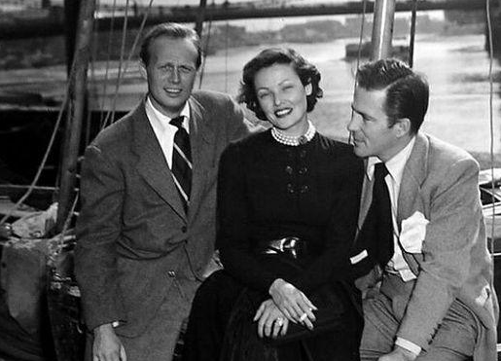
THE ROLES
Filmmaking is the ultimate team sport
- Michael Keaton
Director: Make the decisions, run the shoot, encourage the team. Make suggestions to the actors
Camera operator: Set up the shots with the director, watch carefully for continuity
Actors: learn your lines and hone your performance. Try to repeat your takes in the same way, listen to the director!

Slide 6
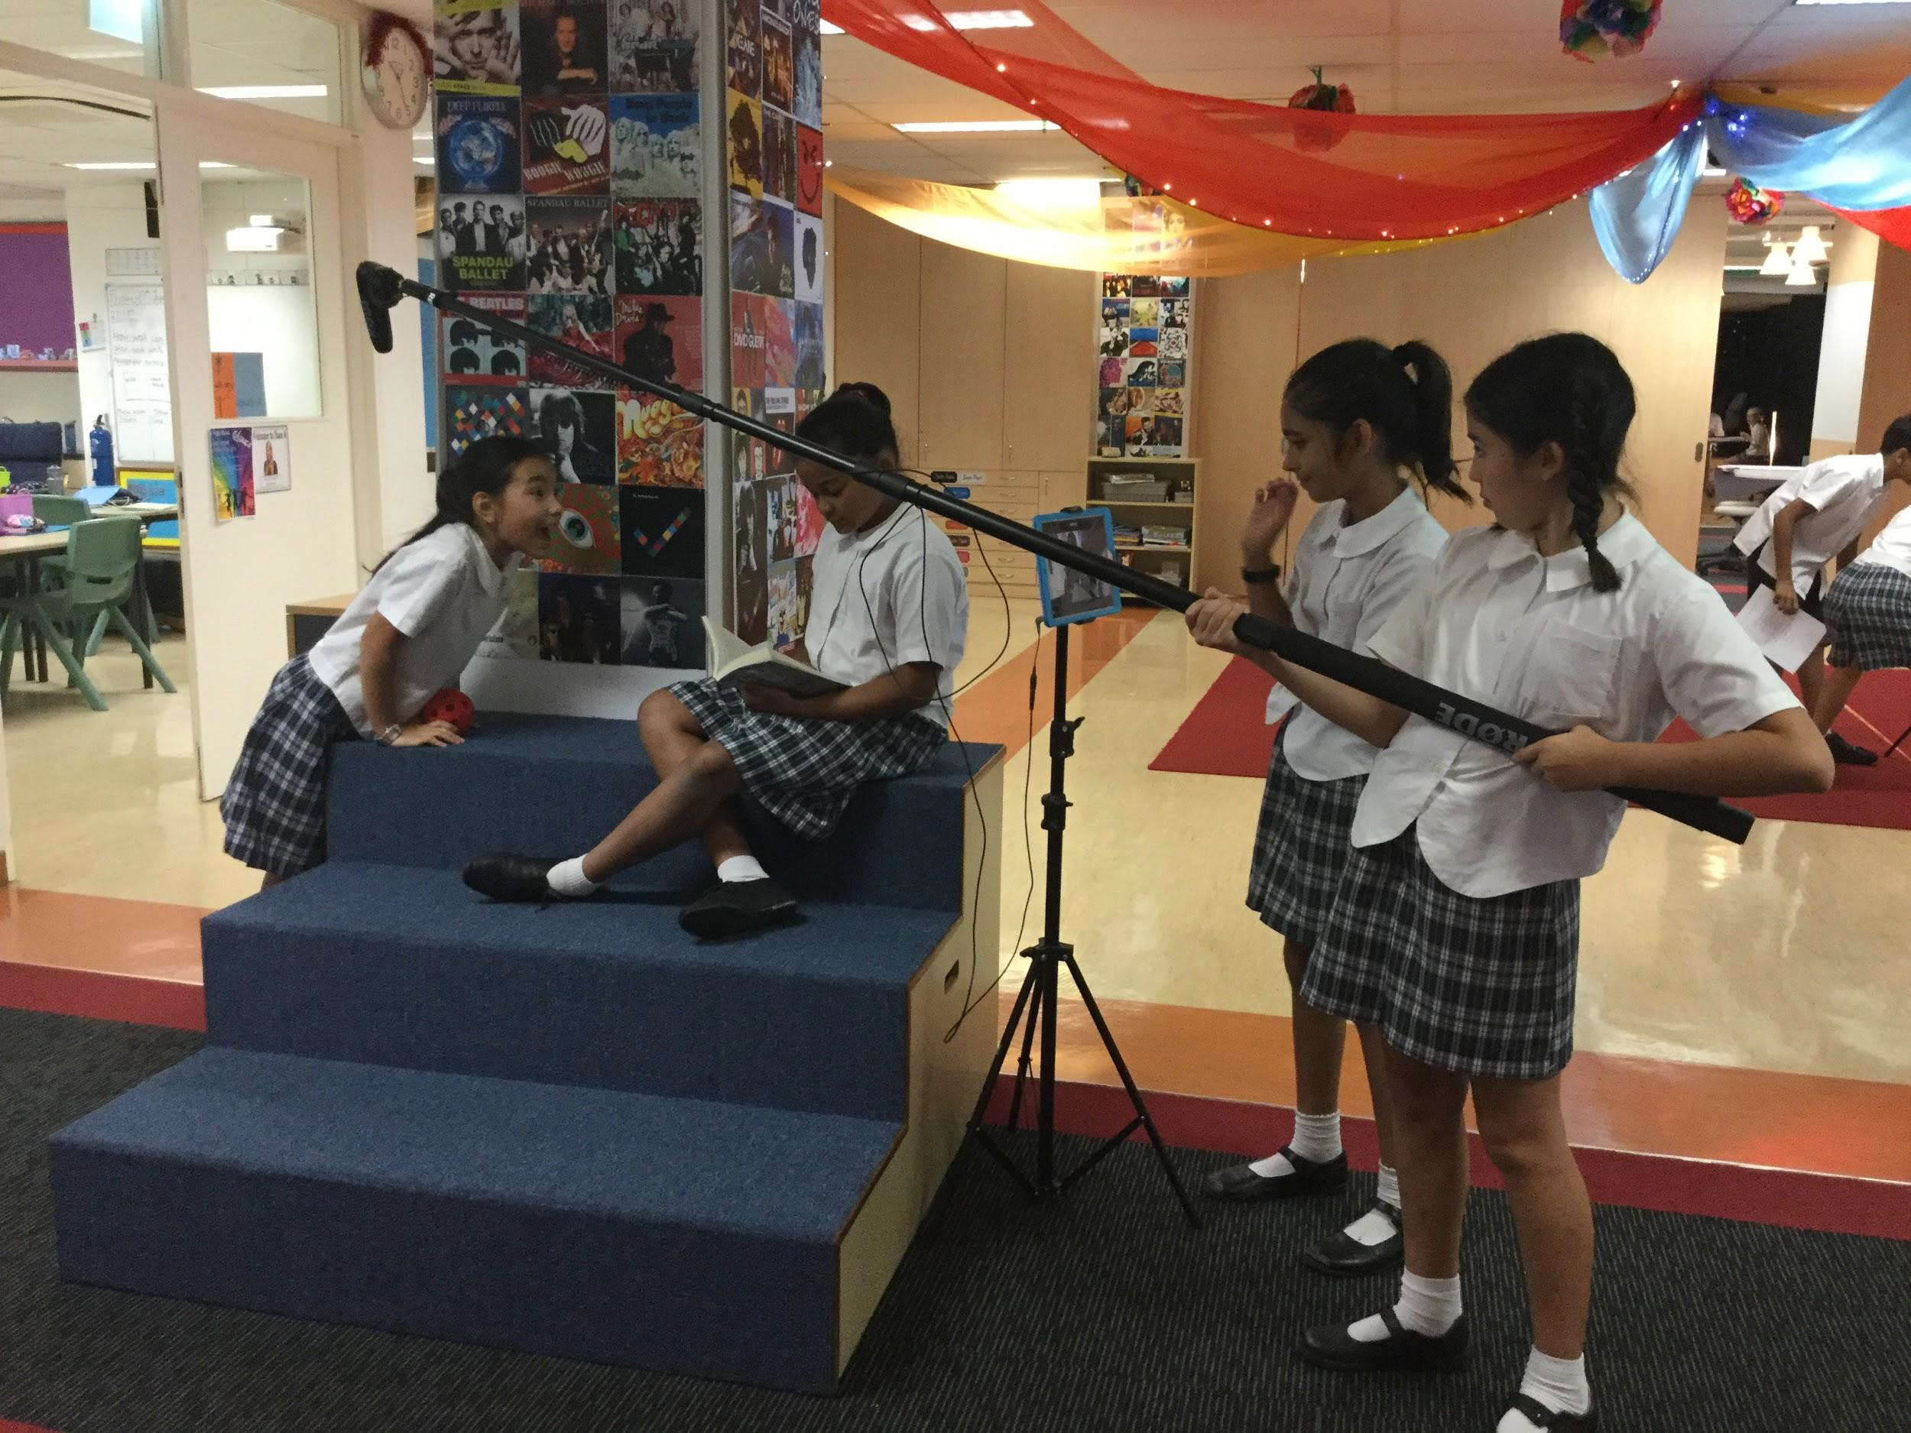
IDENTITY
ROLES ON A FILM SET

Slide 7
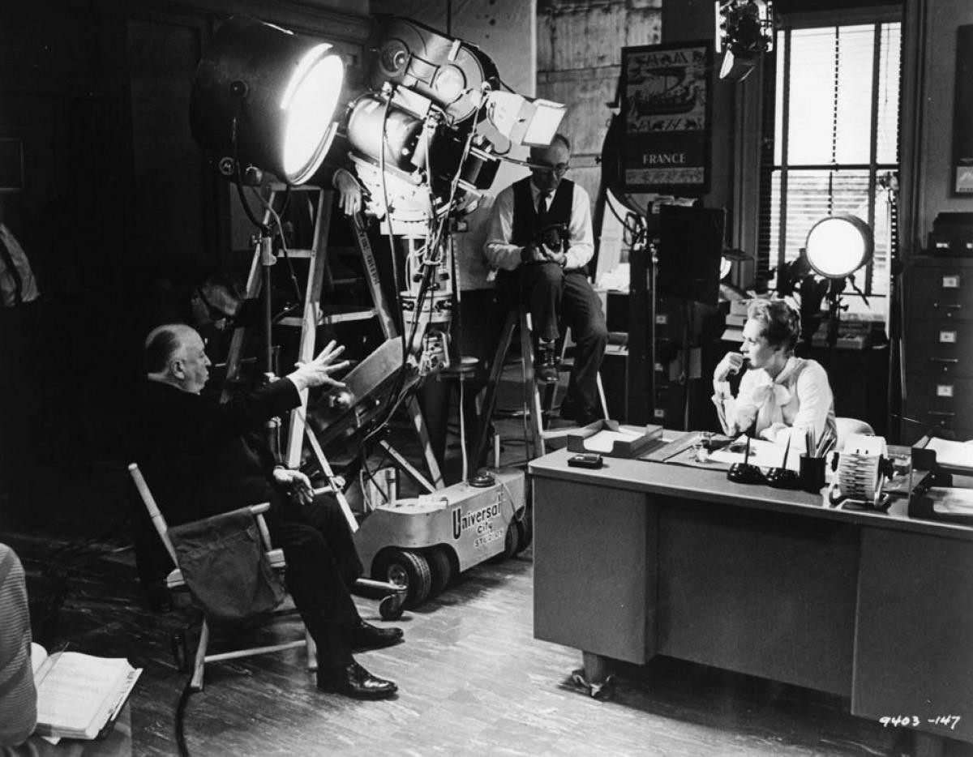
CALLING THE SHOTS
FILM PRODUCTION PROTOCOL
After blocking and rehearsal, camera operator sets up the shot.
Director calls out “Everyone ready - Quiet on set” When everyone’s quiet, Director: “Roll camera”.
The Camera Operator starts the camera “Camera rolling”
Now the Director waits ﬁve seconds before calling “And Action”
The actors run the scene
The Director waits ﬁve seconds at the end of the scene before saying “Cut”. ONLY THE DIRECTOR SAYS CUT!
Camera operator stops ﬁlming.

Slide 8
Director, Andrew Adamson
Director, Evie Year 6

Slide 9
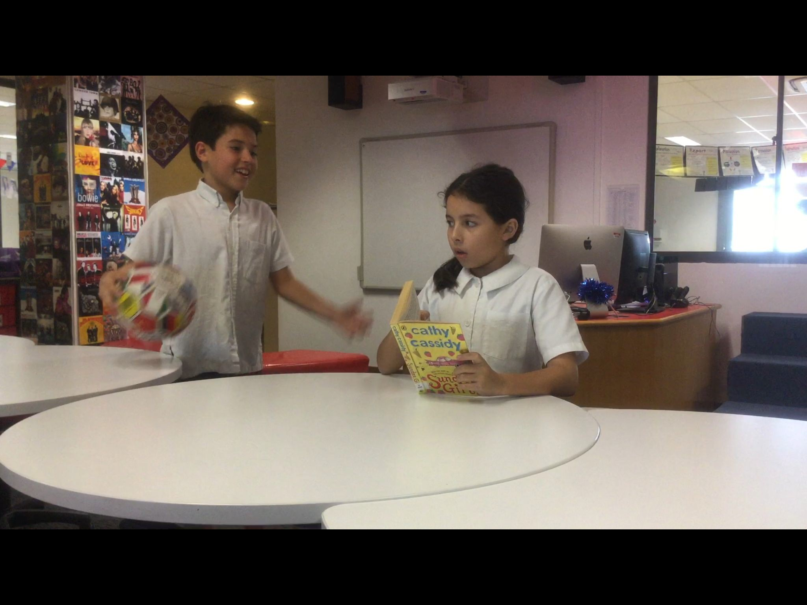
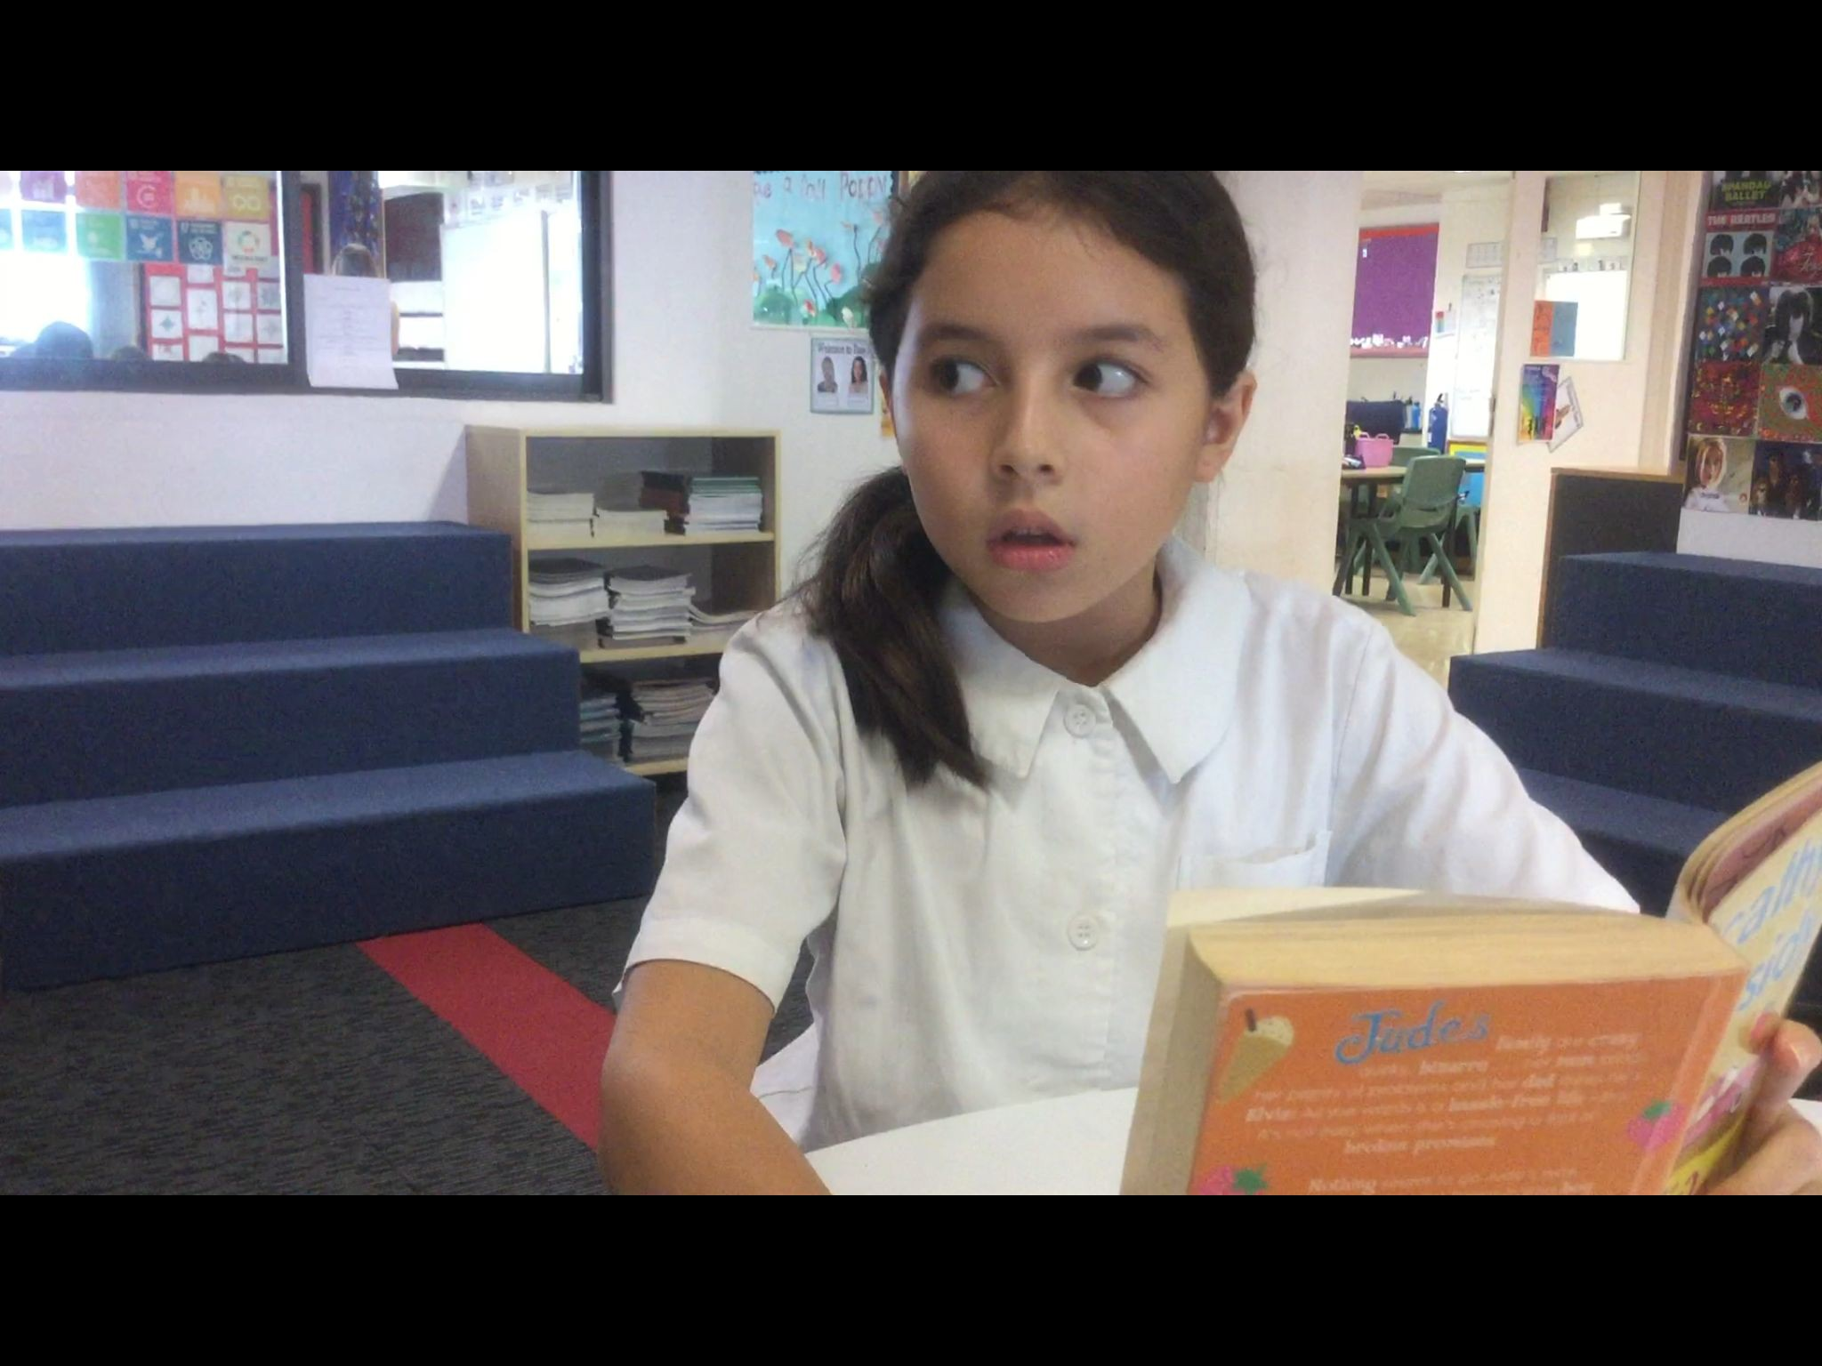
THE MASTER SHOT APPROACH
SHOOT THE SCENE FROM DIFFERENT ANGLES USING ONE CAMERA AND MULTIPLE TAKES
Shot 1: Mastershot
Wide shot capturing whole scene beginning to end
Shot 2: MS Over the shoulder
Shot 3: MS Over the shoulder (reverse)

Slide 10
