Slide 1
The Entrepreneur

Slide 2
Entrepreneurship
What does this word mean to you?
The act of setting out on your own and starting a business instead of working for someone else in their business.
Characteristics of an entrepreneur:
interested
skilful
able to (financially) invest
a risk-taker

Slide 3
The Mind of an Entrepreneur
What is the mind of an entrepreneur like?
Entrepreneurs are independent thinkers who believe they have the ability to succeed.
How do they start a business?
Identify the target audience.
Identify the specific problem that audience is experiencing.
Design a product that will help.
Explain how the product will help to solve the problem.

Slide 4
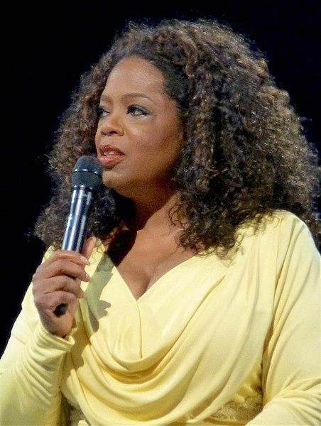
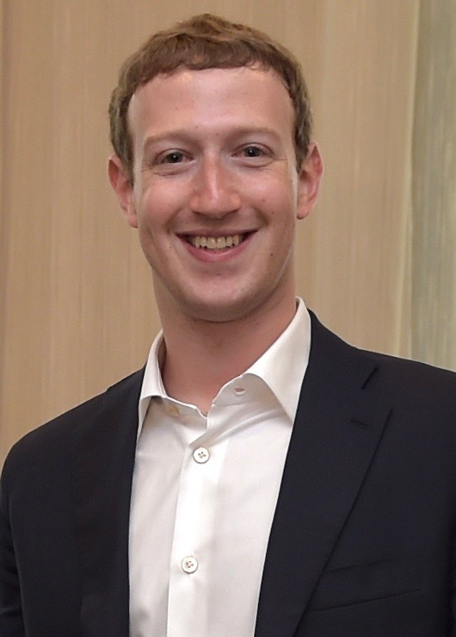
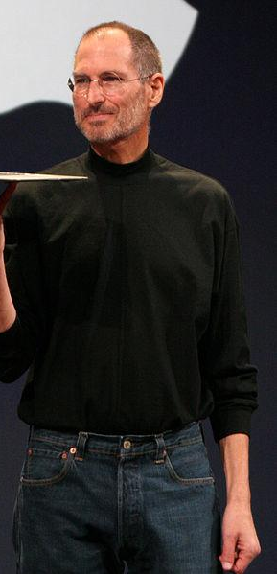
Famous Entrepreneurs
Who are these people?
Oprah Winfrey
Mark Zuckerberg
Steve Jobs
Images courtesy of aphrodite-in-nyc, Presidência do México, Matthew Yohe, via Wikimedia Commons

Slide 5
Young Entrepreneurs
Do you know these people?
Catherine Cook
myYearBook.com
in 2011 worth $100,000,000
Jamal Edwards
SB.TV
in 2012 worth £6,000,000
Images courtesy of Thos Ballantyne, U.S. Embassy London, via Wikimedia Commons

Slide 6
Intrepreneurs
An intrepreneur uses their skill, passion and innovation to manage or create something useful for someone else’s business.
Thinking in a critical way and having the same driving force to provide solutions are very valuable to employers (and your school!).
Could you be an intrepreneur at school?
What could you do at school that would be acting like an intrepeneur?
school prefect
after-school helper
organise a club or revision group

Slide 7
Business Challenge
Design a financial educational tool (e.g. app, video, board game etc.) to help young people.
Why is your product important?
What your product needs to solve?
People don’t save enough!
On average people save 5%.
People aged less than 35 save -2%.
The savings rate required to maintain living standards post-retirement is 15%.
“Giving young people a tool to help them feel in control of their money”

Slide 8
Business Challenge
Split into groups of 4-6 people.
Your task is to present a business idea pitch at the end of the session.
As entrepreneurs, you will have to think carefully about the next questions to be sure you are making the best product and doing the right thing.
Who is your target audience?
What are the specific problems that your target audience are experiencing?
What is your proposed solution?
How will your product solve the problem?

Slide 9
Summary
Entrepreneurs come from all walks of life – you all have the opportunity.
You can be an intrepreneur in the workplace or at school.
Set your goals.
Do your research.
Build your knowledge.
Build your network and give back.

