Slide 1
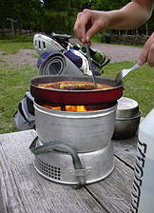
Cooking on a Trangia:
Success Criteria:
I can:
-Identify the different parts of a trangia.
-Put together a trangia safely.
-Cook on a trangia safely.

Slide 2
Trangia
1 Litre Saucepan
1 Litre Saucepan
Strap
18cm Frying Pan
Pan Handle (spondonical)
Upper Windshield
Lower Windshield
Spirit burner
G

Slide 3
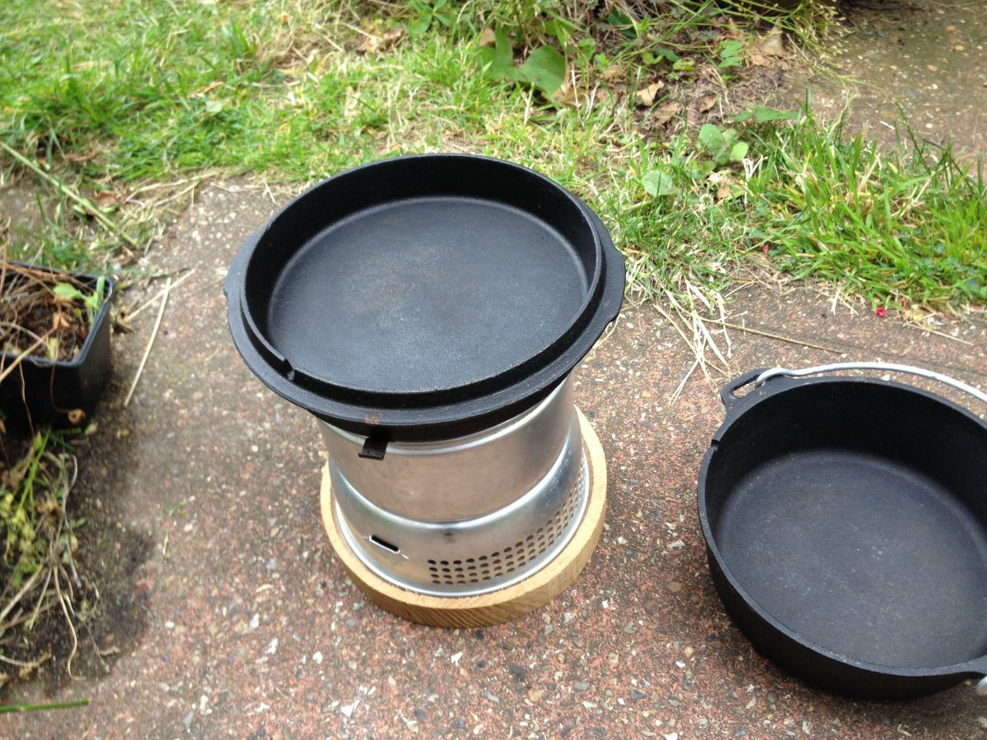
Safe Cooking
Location
A firm level surface at ground level where the stove will not be: knocked over
least two metres away from flammable items/tents.
Consider the weather conditions and wind direction.
Make it clear to other people when your stoves are lit/hot and
Have everything needed together before starting lighting your stove.
Have somewhere safe nearby to put hot pans.
G

Slide 4
Have water or a wet tea towel nearby, ready to use as a fire blanket.
Always be careful to check if there is a flame or not, especially in bright sunlight.
Never leave a lit stove unattended or unwatched.
Only ever quarter fill the burner
Only light when ready to cook
Never step over a trangia (lit or not)
NEVER refill a lit or hot burner, ALWAYS wait until the burner has cooled down sufficiently enough to be able to hold the burner in your hand before refuelling.
NEVER use inside a tent, be certain the stove is a safe distance away from any tent fabrics etc.
NEVER leave an empty pan on a lit stove they can burn
Always use the simmering ring (in the closed position) to extinguish the flame, NEVER use the screw top lid as the rubber seal will be damaged.
Finally, no ball games, or pets running around whilst you're cooking (for obvious reasons).
Safe Cooking
G

Slide 5
Top Tips
Only use the water you NEED,
don’t over fill your pot. Only half fill your pot.
Use Coconut oil to cook with. it has a higher flash point so isn’t going to burn
Keep frying things moving. So they don’t stick.
If anything sticks, put water on it and gently heat the water.
Wash immediately
Use only the fuel you need. You don’t have a endless supply
Keep an eye on your food, it can go from cooked to burnt very quickly
Keep it simple
Clean your trangia VERY WELL!!!!
G

