Slide 1
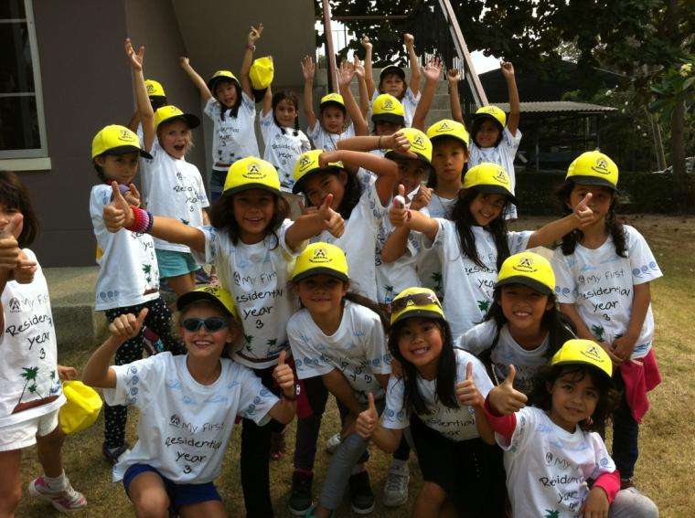
Year 3 Residential 2017
Children Briefing

Slide 2
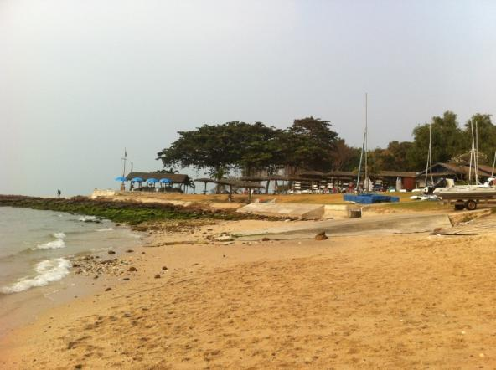
Staffing
Trip 1 | Trip 2 | Trip 3 | Trip 4
Emma Woodhouse Jade Ashby | Kirsten Himpelmann Emma Gardner | Bart Cowling Clare Hooper | Elizabeth Nolan Colin Brown
2 nurses will attend all trips
The mini bus driver will also stay in case of any emergencies.

Slide 3
Residential Visit Dates
WEEK ONE
Classes 3E and 3A will depart on Monday 30th January 2017, returning on Wednesday 1st February 2017.
Classes 3H and 3G will depart on Wednesday 1st February 2017, returning on Friday 3rd February 2017.
WEEK TWO
Classes 3C and 3K will depart on Monday 6th February 2017, returning on Wednesday 8th February 2017.
Classes 3N and 3B will depart on Wednesday 8th February 2017, returning on Friday 10th February 2017.

Slide 4
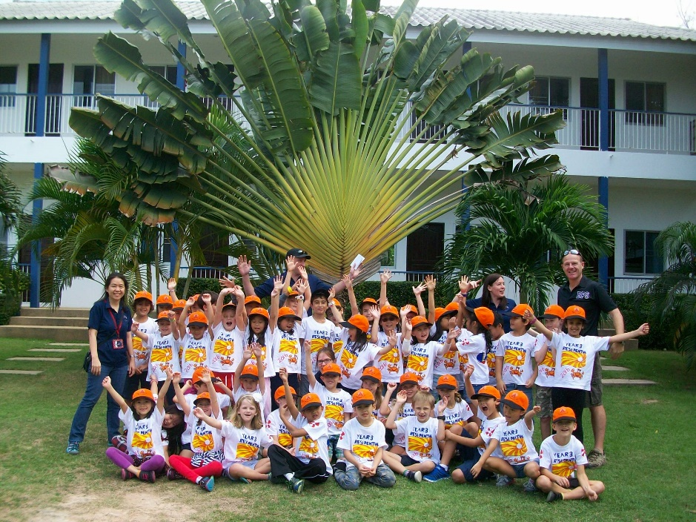
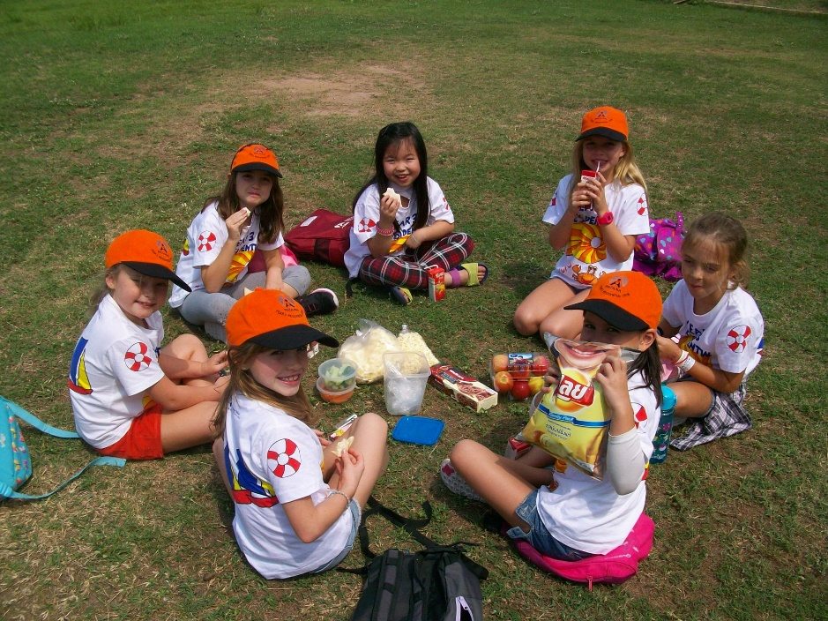
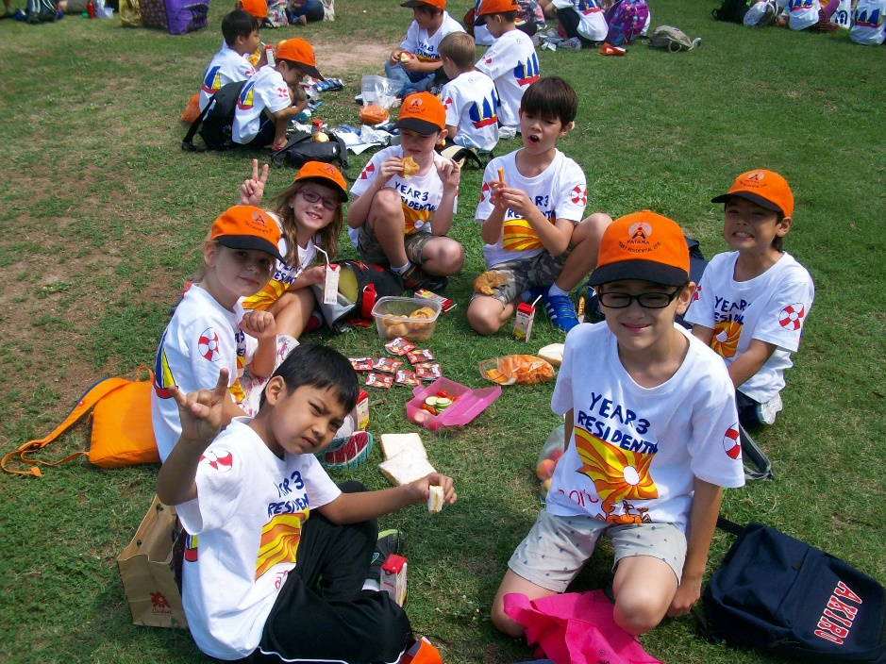
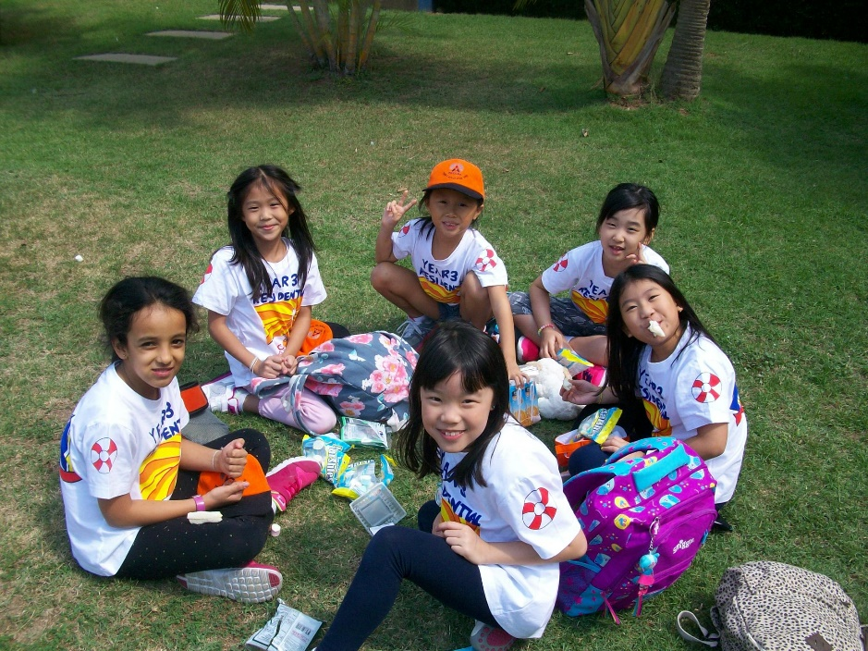

Slide 5
Year 3 Residential Visit Learning Programme 2016
 | DAY 1 |  | DAY 2 |  | DAY 3
 |  | 7.00 | Aerobics on the lawn Breakfast in the clubhouse | 7.00 | Aerobics on the lawn Breakfast in the clubhouse
8.45 | Leave Bangkok Patana School | 8.30 | Room Inspection | 8.00 | Pack Room Inspection Leave message for next group
10.45 | Arrive at Royal Varuna Yacht Club Snack Rooms Orientation of the site Fire Drill | 9.00 | Quest Boat Basics Beach Scene Creation First Aid Skills Team Games (Ice cream treat) | 10.00 | Depart The Royal Varuna Yacht Club
12.00 | Picnic on the Beach | 12.00 | Lunch | 12.00 | Arrive at Bangkok Patana School
13:00 | Treasure Hunt | 13.00 | Swim/Games on the lawn
14:00 | Swim/Games on the lawn | 14:00 | Creative Afternoon Kite Making Painting the Landscape
15:30 | Sandcastle building
17:00 | Shower and change for dinner | 17.00 | Shower and change for dinner
18:00 | Dinner | 18:00 | BBQ at the beach
19:00 | Games Evening | 19:00 | Campfire Entertainment
20:00 | Story and bedtime | 20:00 | Story and bedtime

Slide 6
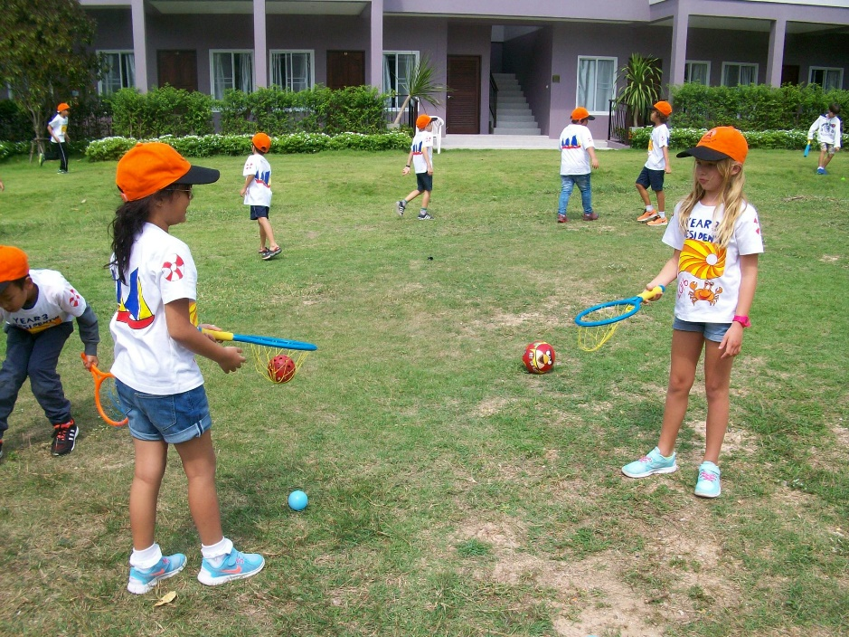
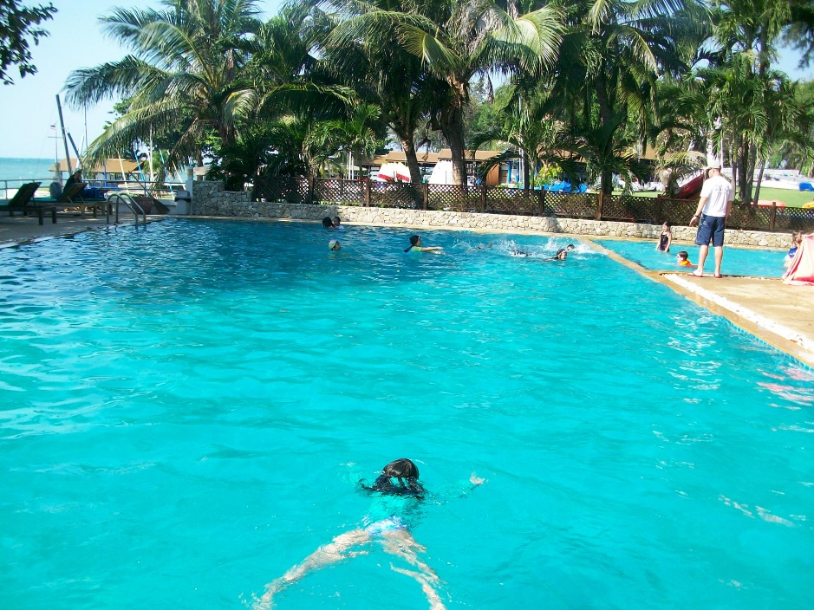
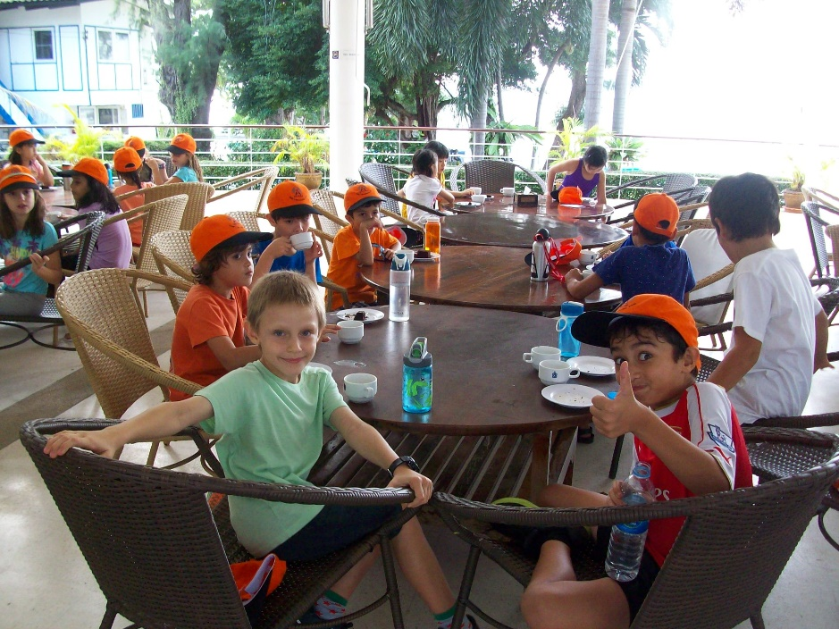
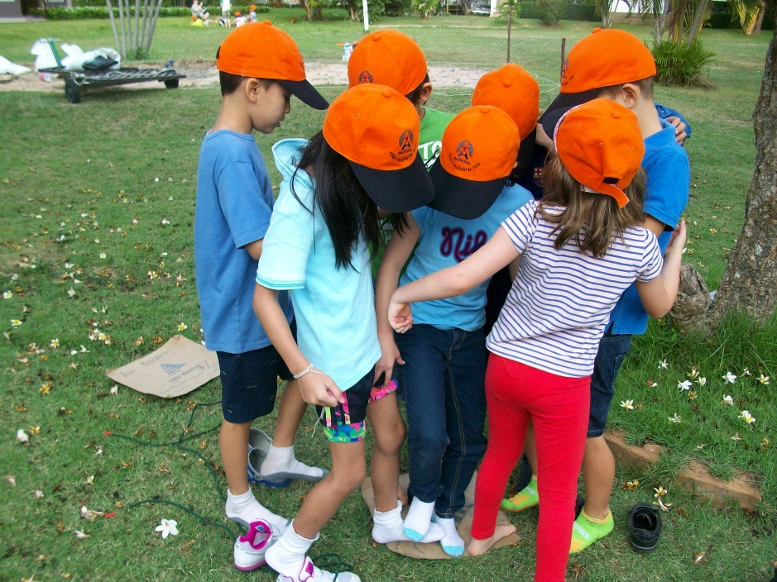

Slide 7
Health and Safety
Fire Alarm – A teacher will blow the whistle 3 times. You will then assemble in class lines, for the teacher to check you are here.
There will be pool safety-Please remember the rules you are told.
Teachers will decide if you can paddle in the sea – up to your knees!
Rooms at night will locked by the teacher and keys given to the teacher.
Be careful with the shower! Hot and slippery!

Slide 8
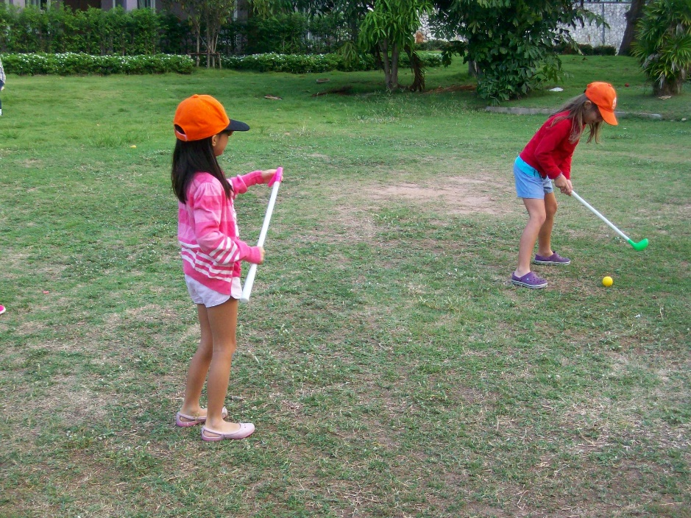
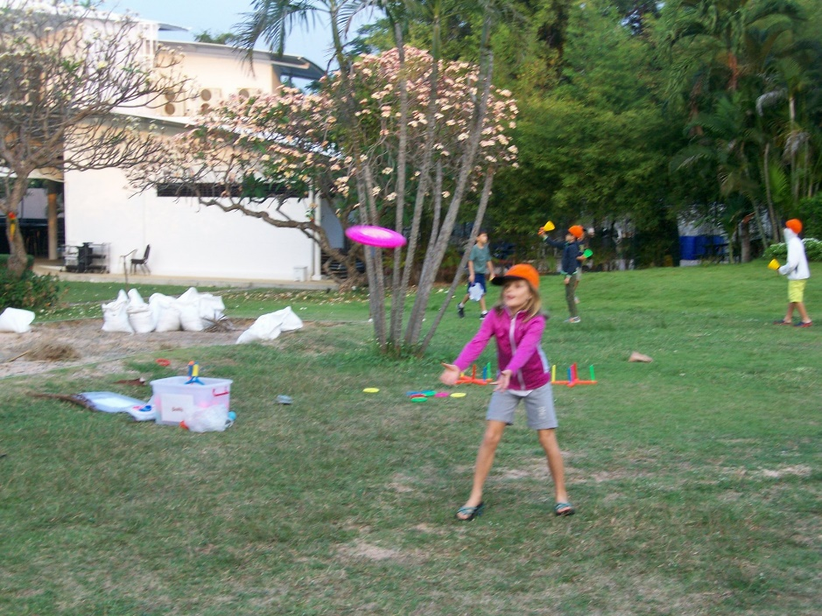
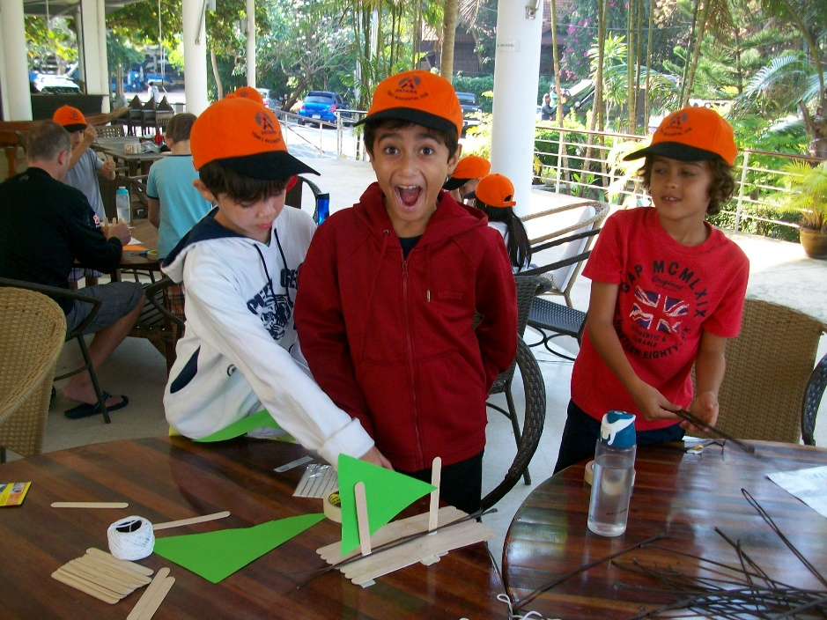
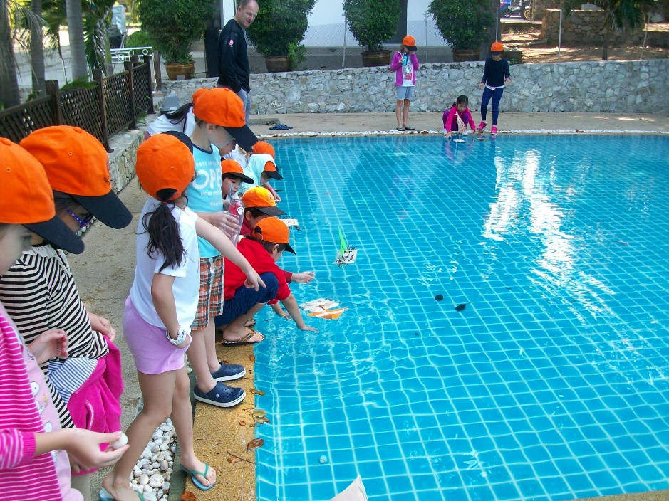

Slide 9
Rules to Remember
No Trash Packs
No eating on the bus. If you do feel sick, tell someone, so we can give you a sick bag.
Camera – cheap or disposable
NO electronics

Slide 10
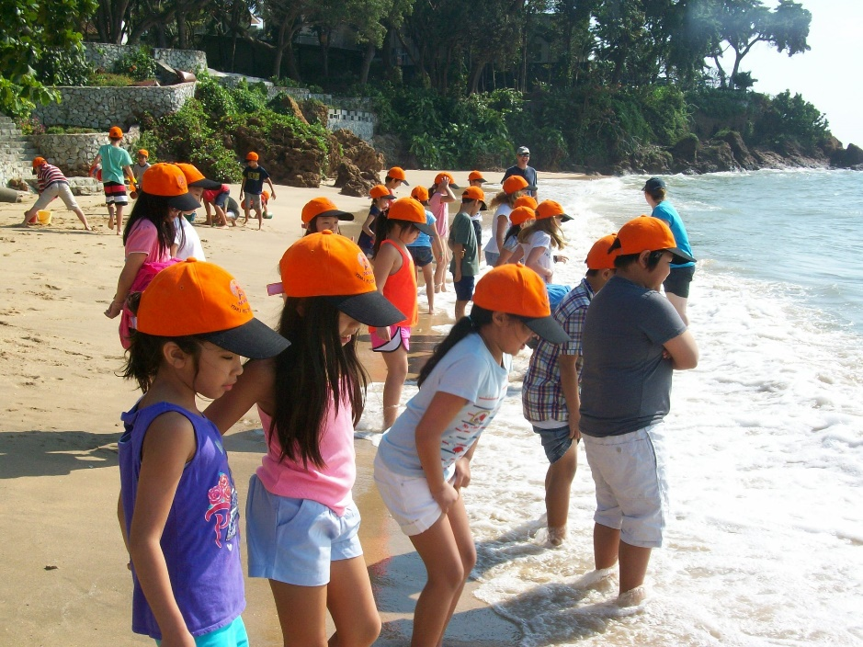
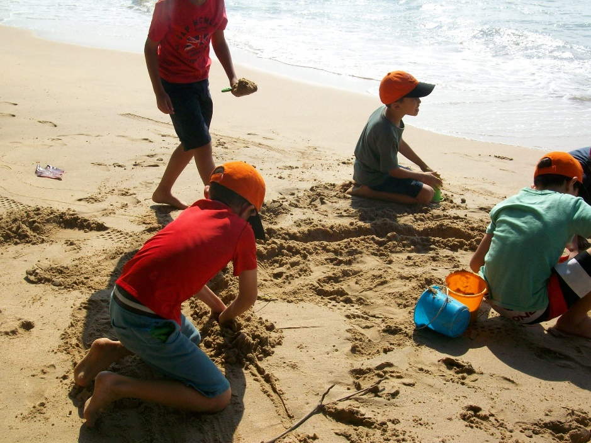
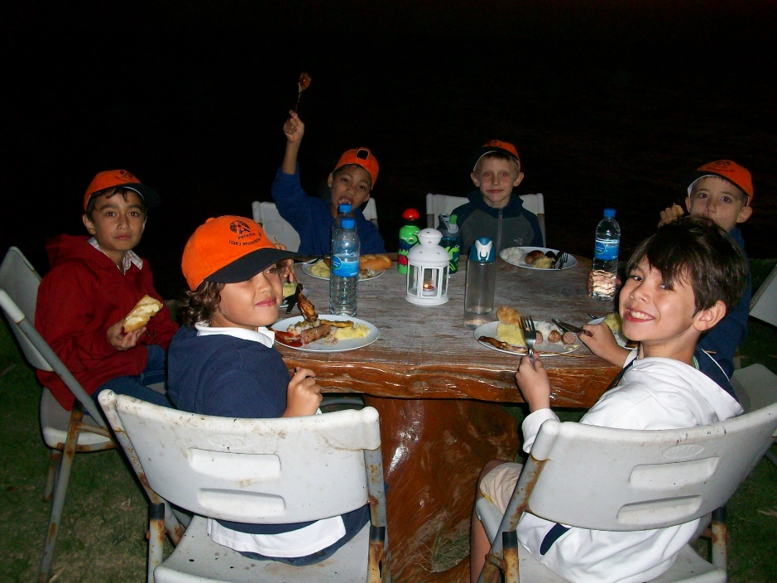
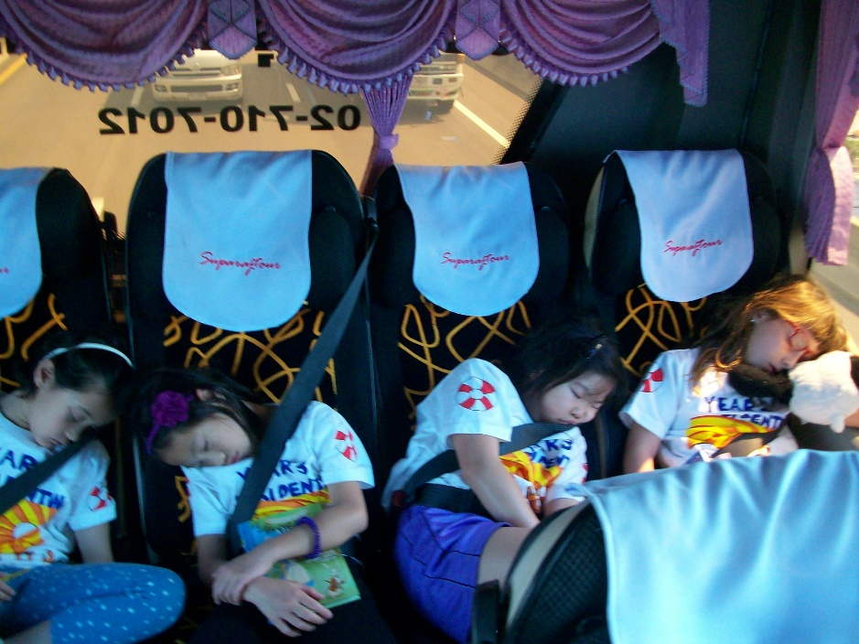

Slide 11
Rooms
Respect privacy of others within shared rooms
Shower individually – no sharing!
Sleep in your own beds
Do not open the door unless dressed
Find out who it is before opening the door
Get changed promptly
Teacher will knock 3 times and they MUST ask who it is. Once they know its someone familiar, open door.

Slide 12
Taking photos
Guidance for students
Only use a camera if the teacher is nearby.
Do not post a picture or video online without permission.
Do not take any photographs in the room in case people get silly.
Do not take a picture if it could cause upset or embarrassment.
Funny face pictures are OK if your friends agree.
Do not show a picture or video to anyone if it will cause upset.
Do not use somebody’s camera without asking permission.
Do not take a picture of someone if they don’t want you to.
Don’t take pictures of people you do not know without asking permission.

