Slide 1
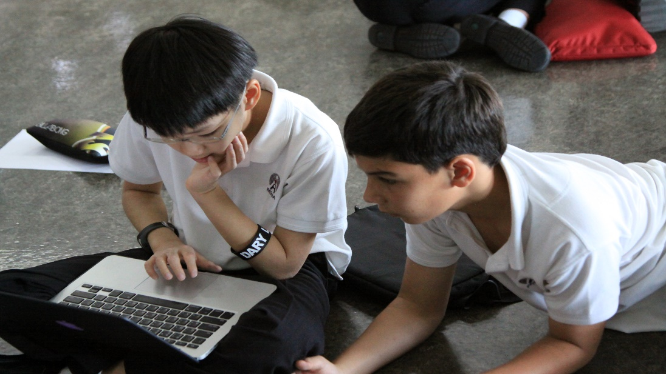
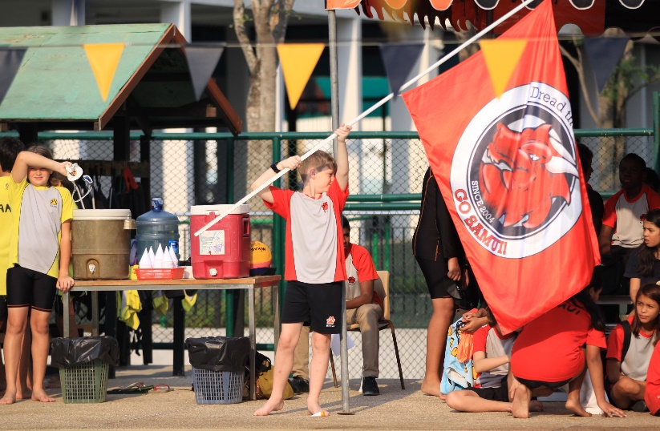
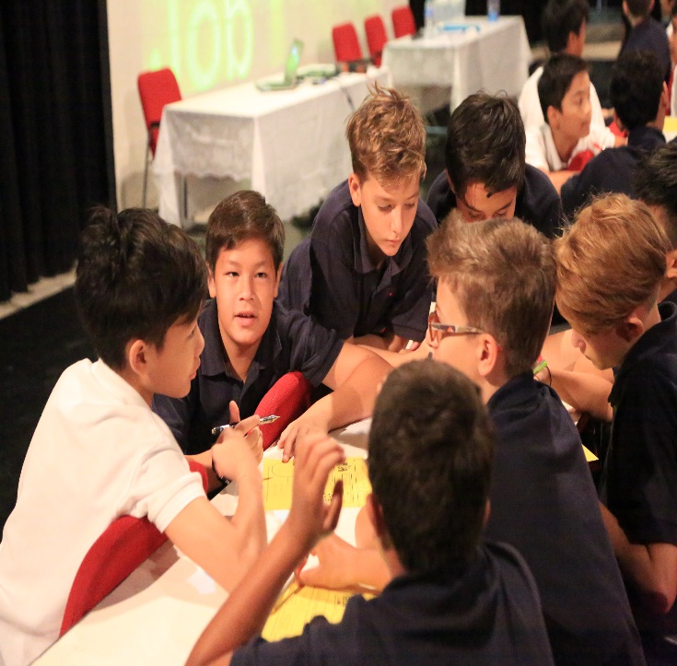
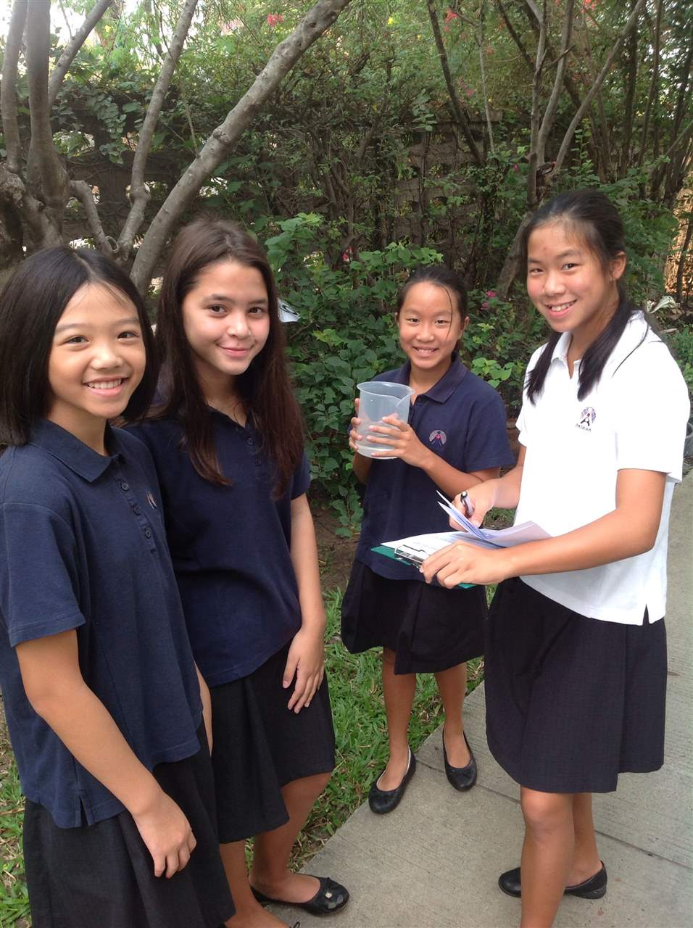
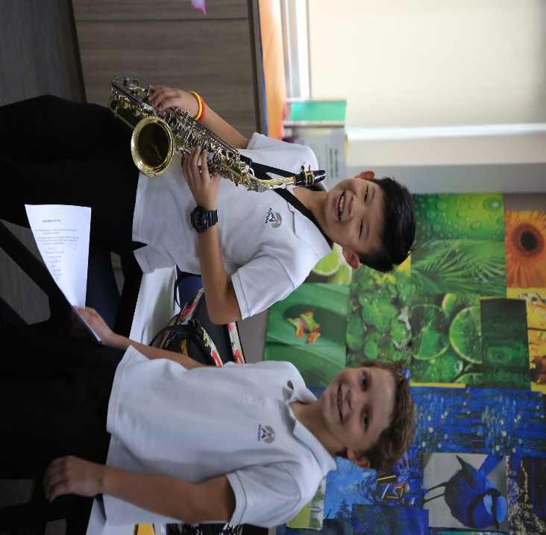
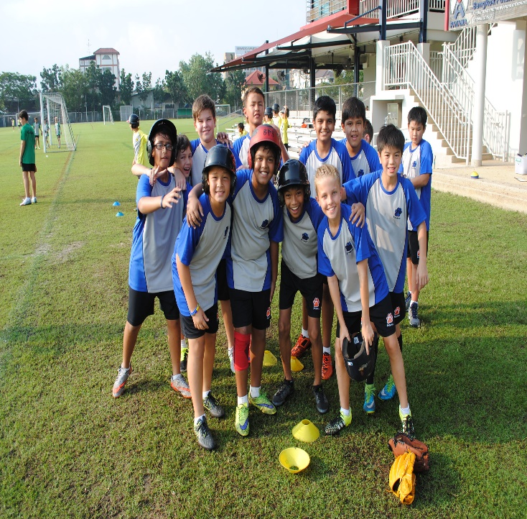
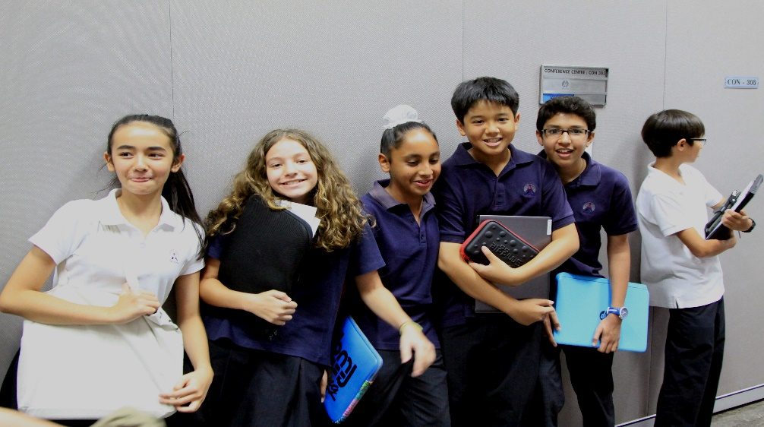
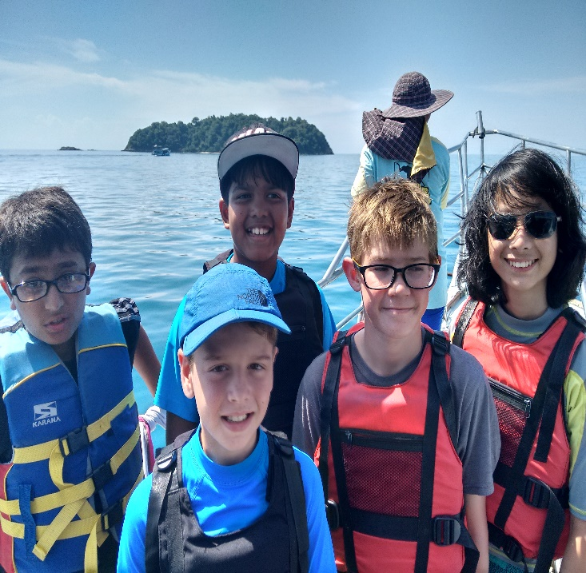
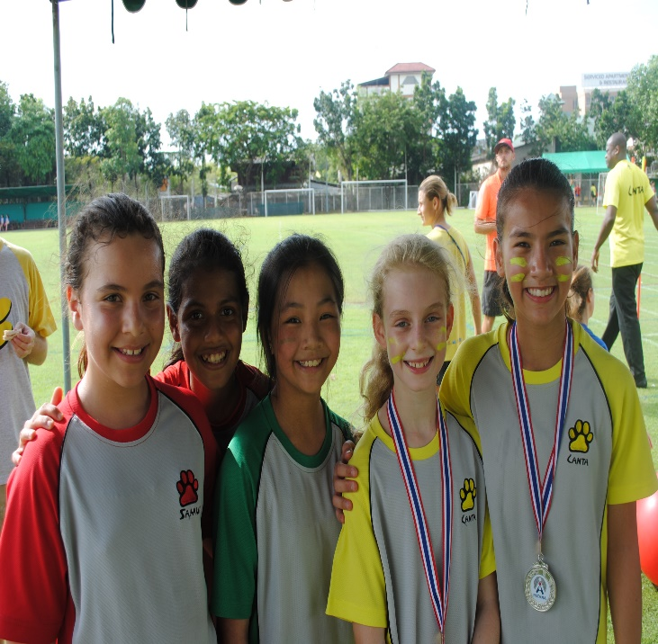
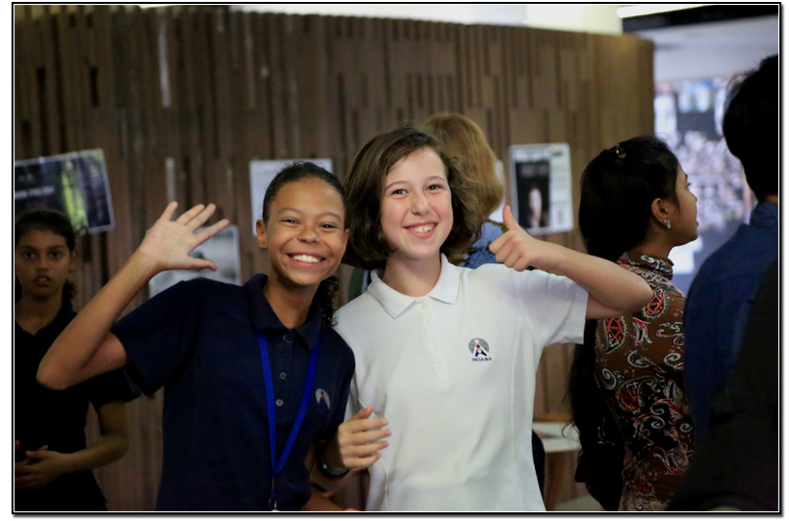
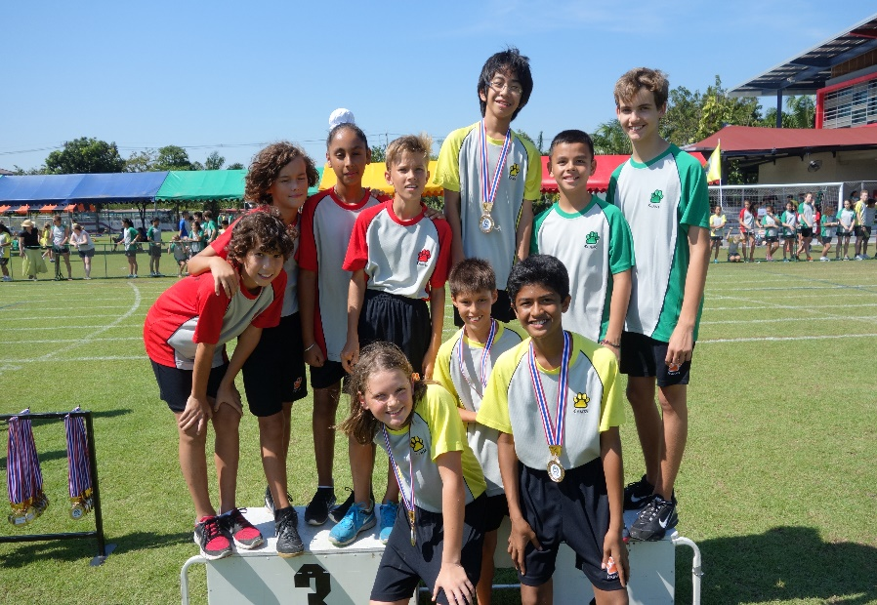
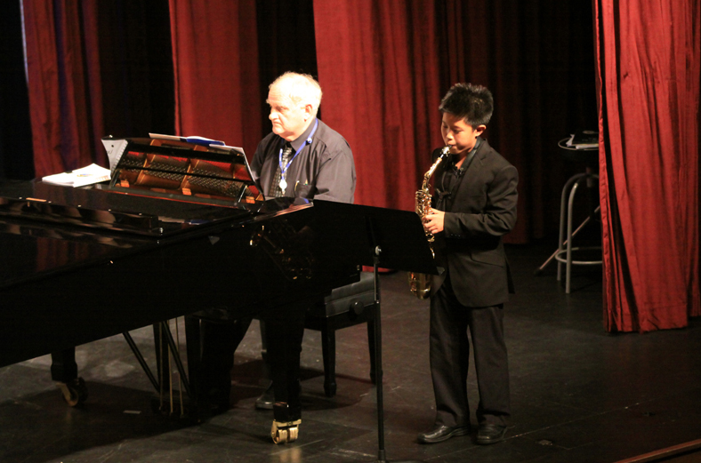
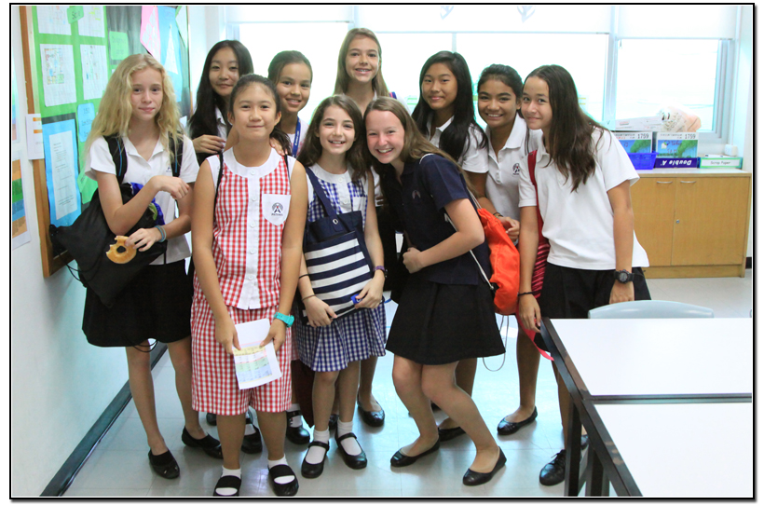
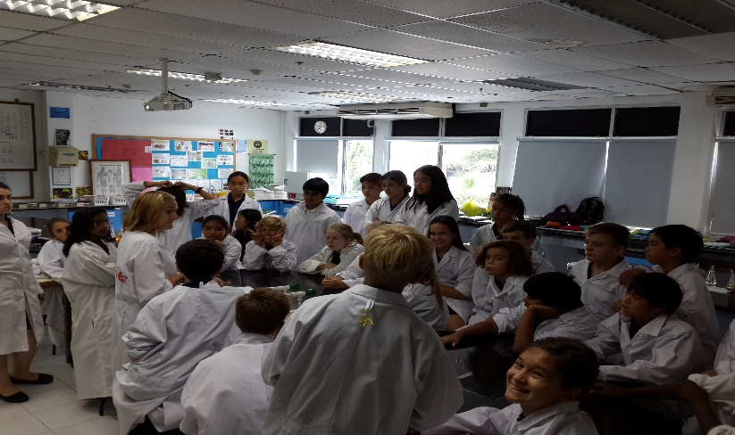
Welcome to Term 3!
Welcome to
Term 3

Slide 2
Year 7 – Grad 22 What went well (www)? Even better if…(ebi)?

Slide 3
Agenda
Key dates and events
Assessment – Mr Tony Berghuis
Child Safeguarding – Miss Lena Perriam
Tutorial
Head of Year 8 for 2016/17
Coffee and chat

Slide 4
KS3 Dates
28th April - Y7 Parent Student Conference
2nd May - Inset (No school for students)
5th May - Coronation Day (Public Holiday)
11th May - PTG AGM
12th May - Y7 Coffee Morning
20th May - Visakha Bucha Day (Public Holiday)
3rd June - Parents' AGM
7th June - Patana United (KS3 Music Event)
14th June - Dance Extravaganza
16th June - Final STAR reflections
24th June - Campus Assembly and House Music and Drama Competition
24th June - Term 3 reports issued and final day of Term 3

Slide 5
Assessments
Our mission is to ensure that students of different nationalities grow to their full potential as independent learners in a caring British international community.
Our vision is to know that every student leaving Bangkok Patana School has been given the opportunities and the support to fulfil their potential in all aspects of their school life.

Slide 6
November 26th
CEM testing
MidYIS Data
Student Attainment
Student Progress
Student Tracking
Reports
Levels
Sub-levels
KS3 curriculum
Science and Maths in KS3
Setting

Slide 7
November 26th
What do KS3 Levels mean?
What do sub-Levels mean?
Where should my child be?
How much progress should my child make?
What if my child is not “achieving”?
What if my child is “over-achieving”?
What is “CEM”?
What is “MidYIS”?
What is a Target Grade?
Is all work by students Levelled?
How are assessments used (to support student learning)?
When are assessments given to students?
How are students tracked?
Why is there sometimes a big difference in report grades between some subjects?
Do end of year report grades affect the following year’s classes (sets)?
What do KS3 Levels tell me about how my child will do in KS4?

Slide 9
Term 3 Assessments
Annual EXAMS for English, Maths, Science in Year 9 only.
Experience with formal exams
Summative assessment
Covers whole year’s content
In part, helps to inform pathways in KS4 Maths and Science

Slide 10
Assessments
Intention:
focus of Term 3 continues to be on supporting students’ progress and learning.

Slide 11
Assessments
Term 3 in the past:
Teaching and learning as throughout T1 and T2
Tests in the Conference Centre
Term 3 this year:
Teaching and learning as throughout T1 and T2
Tests in classrooms

Slide 12
Assessments
Key Assessments are scheduled at key points throughout each term – including Term 3.
(Key Assessments Calendar available online via Firefly.)
Throughout each term, there are a number of other, “smaller” tests and assessments with specific focuses.
Throughout each term, all assessments are used as part of the accumulated data which is used to monitor student progress.

Slide 13
Assessments
FOCUS: student progress/learning:
The full range of assessments used by teachers tend to be formative and they help teachers (and students) understand what needs to be planned for in subsequent lessons.
As always, the imperative is always to use assessments to provide timely, detailed feedback to students to support their ongoing learning as they strive to achieve their Target grades – and perhaps exceed them.

Slide 14
Assessments
FOCUS: student progress/learning:
The primary function of all assessments is to help teachers and students understand where each student “is at” in terms of whatever is being assessed.
This data is then used – mostly by the teacher – to determine what needs to happen next for each student in terms of supporting their learning and progress.

Slide 15
Term 3…
FOCUS: student progress/learning:
Students need to be aware of their report grades: TARGET GRADES and their current Attainment Grades.
They need to understand what they could/should be doing to continue to make progress – and then they need to be supported in doing so.

Slide 16
Assessments
2 sub-Levels per year equates to “good progress”
This means TWO whole Levels of progress from the beginning of Y7 to the end of Y9
Progress is typically consistent through Y8 and Y9, with slightly more progress made in Y7
End of Year 8 Target Grade
End of Year 9 Target Grade
End of Year 7 Target Grade

Slide 17
Assessments
Where should my child be?
End of Y9
End of Y8
End of Y7

Slide 18
Assessments
Term 3:
Continue to enjoy their learning…
Continue to develop their full range of skills – academic, social, emotional…
Continue to aspire to “more”…
Our mission is to ensure that students of different nationalities grow to their full potential as independent learners in a caring British international community.
Our vision is to know that every student leaving Bangkok Patana School has been given the opportunities and the support to fulfil their potential in all aspects of their school life.

Slide 19
Safeguarding
Since the visit from Tim Gerrish OBE
Formed a child protection focus group
Working on updating the child protection policy
Improving the recording and reporting of any safeguarding issues
Developing the training of all staff
Continually developing the communication with students, staff and parents e.g. emails when students are not marked present in the morning
Adding to the tutorial program in secondary and the PHSE in primary
Raising awareness in the entire Patana community

Slide 20
Tutorial Themes
Term 1 – Overcoming Challenges
Term 2 – Making Connections
Term 3 – Our Values/Careers - Healthy Happy Futures

Slide 21
Ubuntu - a quality that includes the essential human virtues; compassion and humanity. The belief in a universal bond of sharing that connects all humanity.
People are people through other people.
-Xhosa proverb.

Slide 22
Careers’ Happy Healthy Futures
Created by Claire Dale (KS3 Careers’ Counsellor and Head of Year 9)
Four lessons
Lesson 1 – Introduction
Lesson 2 – Discussion on survey feedback and Careers’ board game
Lessons 3 and 4 – Creating a 3 minute video for their peers that provides advice on a happy, healthy future.

Slide 23
Internet and Social Media Safety
http://community.patana.ac.th/digital-ecosystems/digital-citizenship/digital-citizenship-blog-1
www.commonsensemedia.org

Slide 24
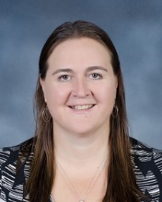
Head of Year 8 for 2016-2017
Miss Yvonne Brown

Slide 25
Coffee, Cake and Chat
Y6 to Y7 Transition – Advice to parents
What information was particularly useful to you at the
beginning of this year? What additional information
would you have liked to have known?
Please write your suggestions/ideas/contributions
on the coloured paper.
Thank you!

