Slide 1
Welcome to the last
D of E AJ training ECA!
Relive the drama of SRY https://www.relive.cc/view/2103482216

Slide 3
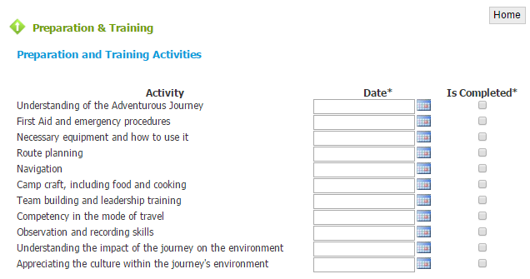
Completing your Adventurous Journey information
Preparation and Training – click on complete
Fill in the dates for the training

Slide 4
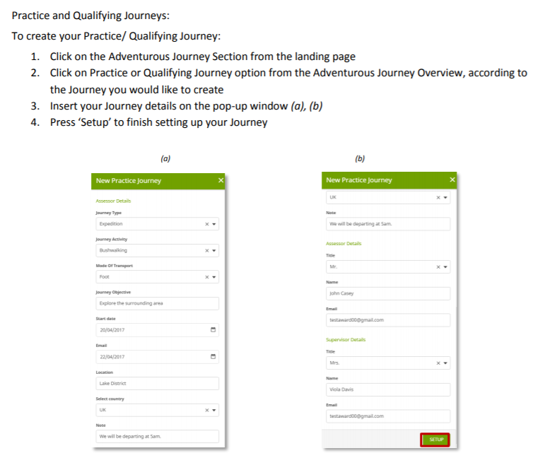

Slide 5
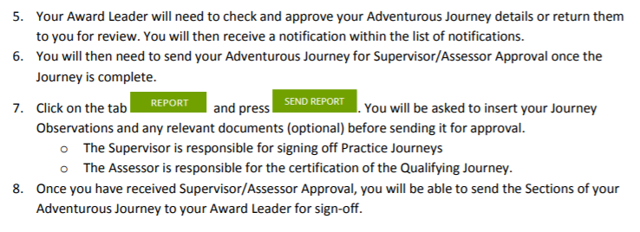

Slide 6
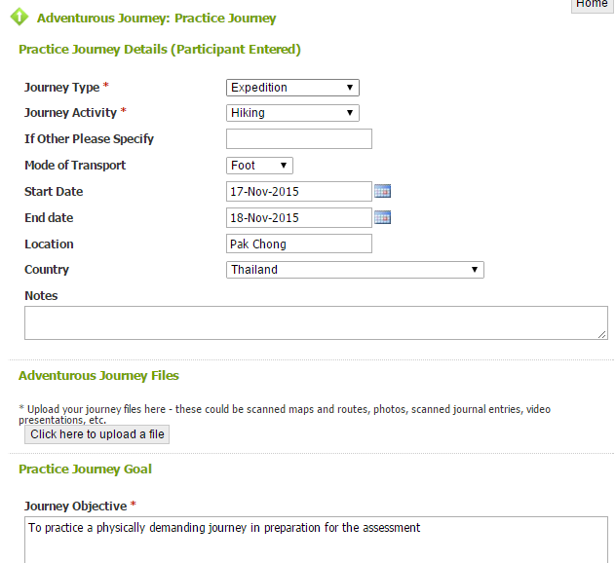

Slide 7
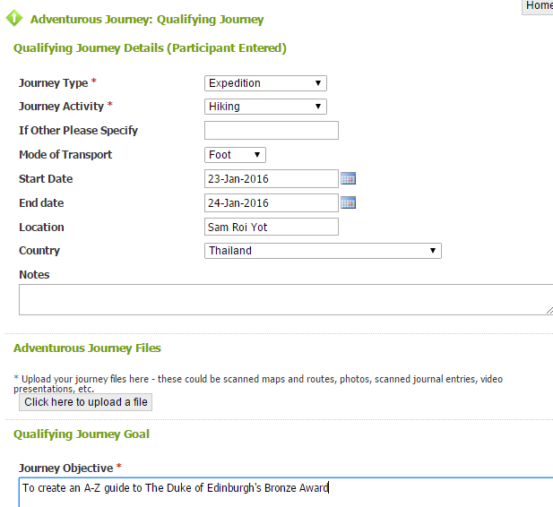

Slide 8
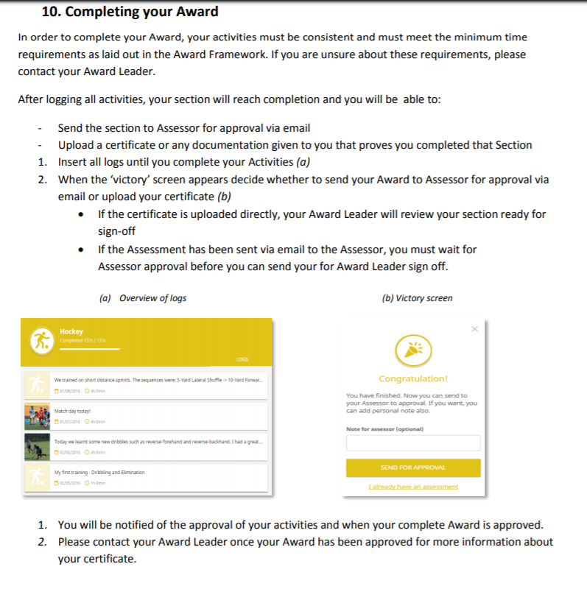

Slide 9
What if I miss the 5th April deadline? Can I still complete my Bronze Award?
Yes but..
You can not sign up for Silver until you have completed Bronze so you might miss out on what you would like to do for Silver.
You will not receive your certificate at the Awards Evening, Wednesday 12th of June.

Slide 10
And finally…..
You have all been emailed a google survey to let us know what you would like to do for your Silver Adventurous Journey.
Please chat with the people around you about those options and then fill in the google survey accordingly.
Your answers are not binding and serve only to give us an idea of which trips have the numbers to run and which do not.
A link to the google survey can be found here https://goo.gl/forms/VO8c07p9GTDer1v72

