Slide 1
Lesson One
Watch out! Helping to make good viewing choices
BBFC Education KS1
Notes:
Teacher notes: Before you teach this lesson ensure you have read the accompanying teacher guidance notes for guidance on establishing ground rules, the limits of confidentiality, communication and handling questions effectively.
Slides are designed to be used to support the teaching of the lesson - full teaching content is included in the lesson plan.

Slide 2
Learning objective and outcomes
We are learning that there are age-ratings that can help us make choices about what to watch
We will be able to:
Identify that some rules are made to keep us safe
Recognise some of the BBFC’s age-rating symbols
Identify why we should use these, and what to do if we need help
Notes:
Teacher notes: Learning objectives and outcomes:
Introduce the learning objectives and learning outcomes, reinforce or agree ground rules, introduce key words.

Slide 3
Draw and write
Draw a picture of a child of around your age who is watching a film or a programme.
Draw or write around the outside:
Where are they, and what are they watching on?
One thing that helps them to know if the film is right for their age.
One thing they could do if what they see makes them feel worried or upset
Notes:
Teacher notes: Baseline assessment:
Ask pupils to add anything else that they know about making good viewing choices, or add any questions they would like to ask.
Collect the responses in and keep to hand as these will be returned to at the end of the next lesson. Use pupils’ responses in this activity to guide your teaching and to address misconceptions or gaps in understanding.

Slide 4
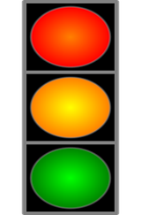
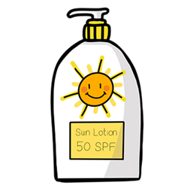
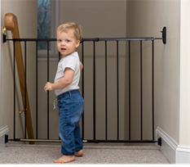
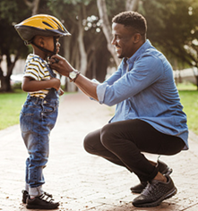
Exploring everyday safety rules
Notes:
Teacher notes: Exploring everyday safety rules
Resource 1: Safety rules shows some everyday images which identify rules that may be familiar to children. Explain that some of these rules are put in place by our families, whilst some are put in place by other people. Talk through some of the images and ask:
Why do we have these rules?
Suggested answer: To keep us safe
Pupils complete the activity - see lesson plan for content.

Slide 5
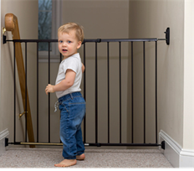
Exploring everyday safety rules
Family rules | Other people’s rules
Notes:
Teacher notes: suggested answers to Exploring everyday safety rules activity.

Slide 6
Recognising the BBFC age-rating symbols
Notes:
Teacher notes: Recognising the BBFC age-ratings symbols:
Remind pupils that someone might watch a film with other people, but that they might also watch something on their own. Because of this, it is good to know what rules help them choose a film or programme for themselves or others. The people at the British Board of Film Classification (BBFC) give children and families guidance on how to make safe choices for which films, programmes and shows they watch.
The BBFC made age-rating symbols which can help someone to decide what is good for their age. Films and shows that are suitable for children of primary school age can be called ‘child-friendly’ or ‘family friendly’.
See lesson plan for further content.

Slide 7
Age-ratings Superhero!
Notes:
Teacher notes: Age-ratings Superhero!
Resource 2: Age-Rating Symbols: Pupils choose either the U or the PG symbol to transform into a Superhero (example on next slide)

Slide 8
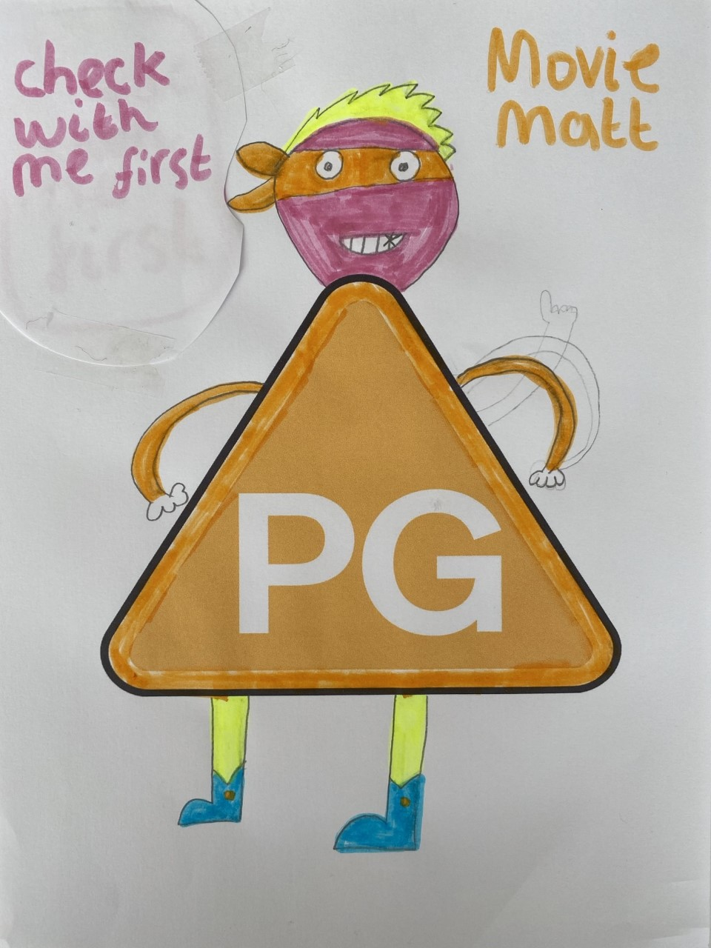
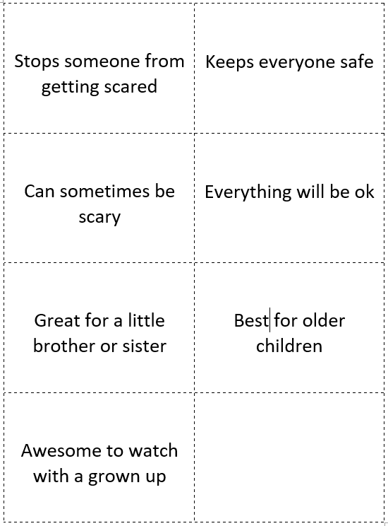
Age-rating Superhero!
Choose a name
Draw a face
Add some hair
Create a costume
Sort out which phrases match the U symbol
Sort out which phrases match the PG symbol
Notes:
Teacher notes: Age-ratings Superhero!
Resource 3: Superhero phrases.
Pupils should sort the phrases into those that refer to U, and those that refer to PG, then write or stick phrases to the appropriate character symbol to demonstrate the distinction between the age-ratings. Those pupils who require a challenge can add their own phrases to their Age-Rating Superhero.
For teacher use: Superhero Phrases answers: U = Can stop someone from getting scared / Keeps everyone safe / It all works out in the end / Good for a little brother or sister; PG = Can sometimes be scary / Better for older children / Good to watch with a grown up.

Slide 9
Draw and write
Use a different colour pencil to add to your draw and write
Draw or write around the outside:
What can help someone to make sure that what they watch is child friendly?
What could someone do if they need help to make safe viewing choices?
Notes:
Teacher notes: Endpoint assessment:
Return to the baseline assessment activity responses. Pupils should use a different colour pencil to add their responses to the above questions.
Discuss any misconceptions or further questions that pupils may have on the topic. The assessment sheets will be revisited at the end of lesson 2, so keep to hand for use in the next lesson.

Slide 10
Think about...
How you will help yourself to make good viewing choices
Notes:
Teacher notes: Reflecting on today’s learning:
Invite pupils to think about how they will help themselves to make good viewing choices with what they have learned in this lesson.

Slide 11
Remember...
If you need help, talk to an adult at home or at school
Notes:
Teacher notes: Signposting support:
Remind pupils that if they need any help and advice they should talk to a parent or trusted adult at home, or a trusted adult in school, such as a class teacher, or a member of the support staff. The BBFC website can also be helpful and should be looked at with the help of an adult. https://www.bbfc.co.uk/ or https://www.cbbfc.co.uk/
For further information they could look at the BBFC’s website www.bbfc.co.uk

Slide 12
Extension activity
Look out for the BBFC U and PG age-rating symbols at home, at school and when you are out and about.
What films did you see them on?
Draw a picture of a character from the film
Remember to draw the age-rating symbol as well.
Notes:
Teacher notes: Extension activity:
Ask the pupils to look out for the BBFC’s U and PG age rating symbols at school, home or out and about. Is it a U or a PG symbol? What is the name of the film? Pupils can draw a character from the film and include the age rating symbol. These drawings can be brought in to school and added to the classroom display. Ask pupils to look for age ratings for other things like toys, games or activities? Why do they think these things have age ratings?

