Slide 1
By the end of todays session …..
I can:
Explain what is required for the logs and assessors reports section of the ORB.
Create a SMART target to work towards based on the IA criteria.
Log on and use the ORB

Slide 2
Each group has been given a different activity (service, physical or skill)
In your groups, brainstorm as many ideas as you can think of for your given activity. Remember to think about the following:
Can I do it for one hour a week for three months (or six if its your major)?
Will I enjoy it enough so I don’t give up?
Is it challenging enough?
What would be my SMART goal?
Can I get someone to assess/supervise this activity?
Have I picked a skill by accident?

Slide 3
Top Tip: The more you write for your goal and logs, the less I look at your goal and log

Slide 4
Is it SMART or is it intellecturally challgened?
1.I want to play football
2.I want to play football every week
3.I want to play football during the Tuesday ECA and score a goal every game
4.During ECA blocks 2 and 3 I want to improve my shot accuracy in football. I will do this by working on drills to improve shooting technique. To measure how success I am I want to have an average of 2 shots on target each game

Slide 5
Choose one of the activities from your brainstorm. As a group come up with an appropriate SMART target for that activity. Think carefully about the criteria we have discussed.

Slide 6
Logging your hours: What do we require?
One log per hour per week for each activity.
It should be uploaded each week as you go along (preferably straight after the activity). Not all in one go at the end of the 12 weeks!
Each log should be at least a paragraph (4/5 lines preferably).
Each log should give specific detail about what you did in that hour.
You should reference your target – how do you feel that you are progress towards your smart target?
Top Tip: The more you write for your goal and logs, the less we look at your goal and log

Slide 7
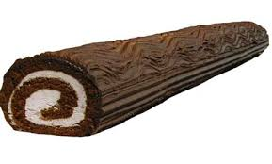
Is this a good log?
Have look at the examples you have been given. In your groups discuss what is good about them and what needs improving.

Slide 8
Work out the finish date of your major section of your Bronze Award. Take into account:
School holidays
School trips
ECA dates
Family commitments
And so on…..
Sentence starter: If I begin my major insert date I will finish on the insert date

Slide 9
Assessors reports:
- For each activity you choose you are required to have an assessor.
- An assessor can be a teacher, instructor or expert in the activity you have chosen.
- An assessor should not be a member of your family, family friend (some exceptions apply) or a direct employee of your family.
- It is essential that you make your assessor aware that you will be using their activity as part of your Award and ask them if they are happy to write a short report for you at the end of your 3/6 months.
- Speak to your assessor about your SMART target at the start of your activity – do they think it is suitable/achievable?
- On completion of your 13 weeks of each activity your assessor is requested to write a short report about your achievements and verify the information you have written in your logs.

Slide 10
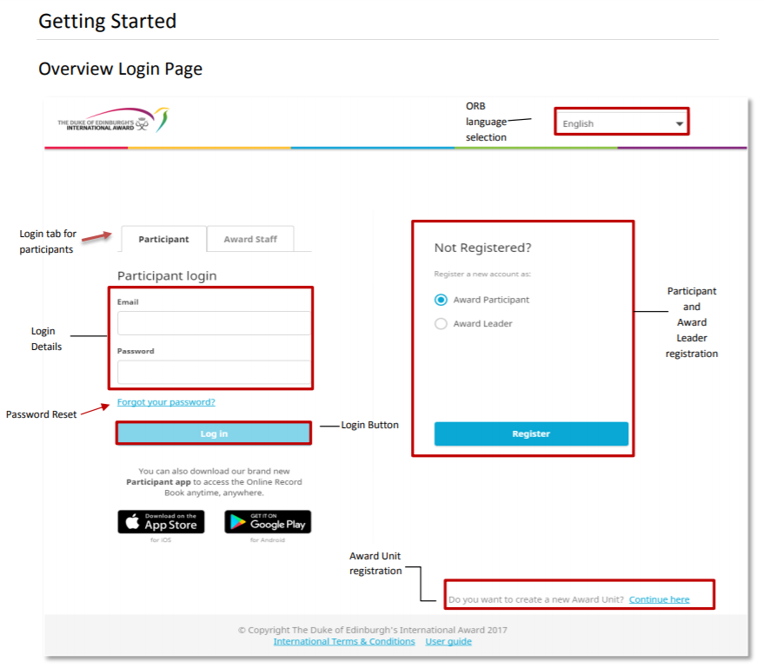
Onlinerecordbook.org

Slide 11
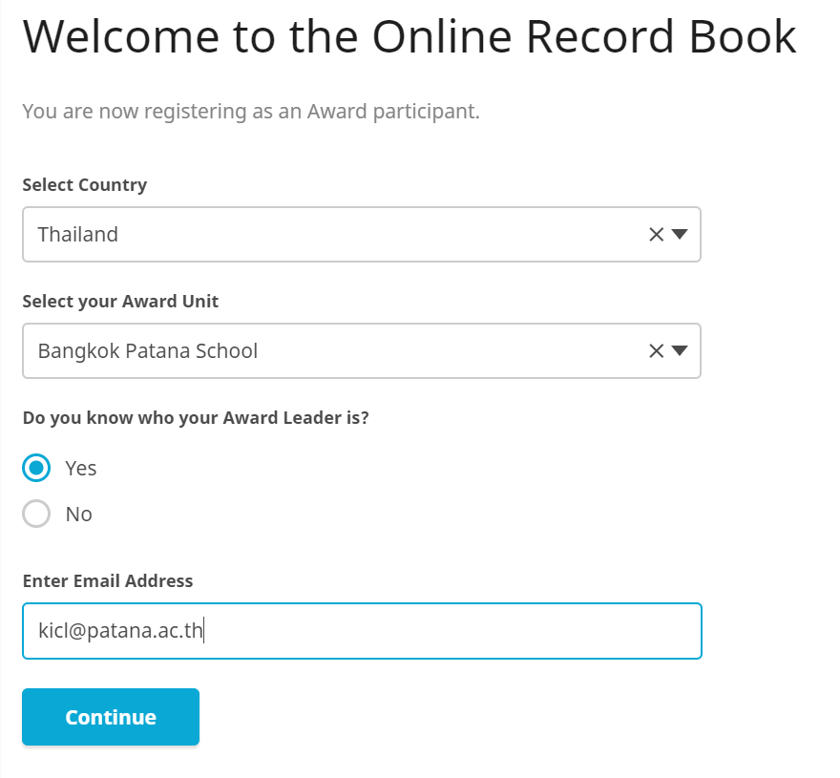

Slide 12
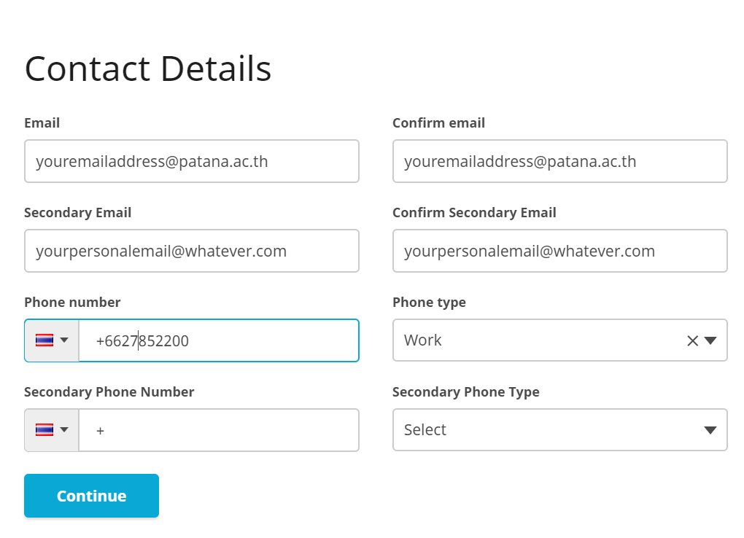

Slide 13
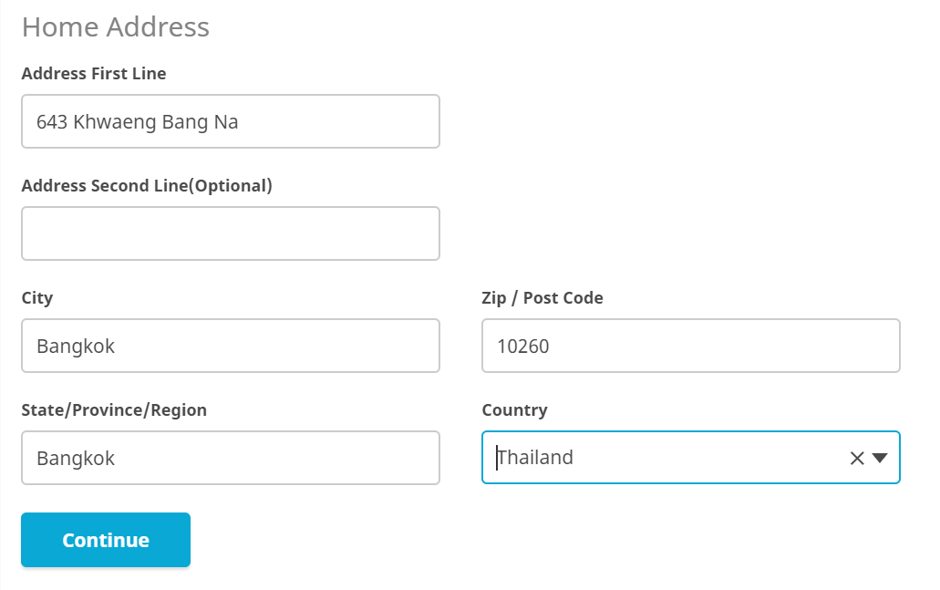

Slide 14
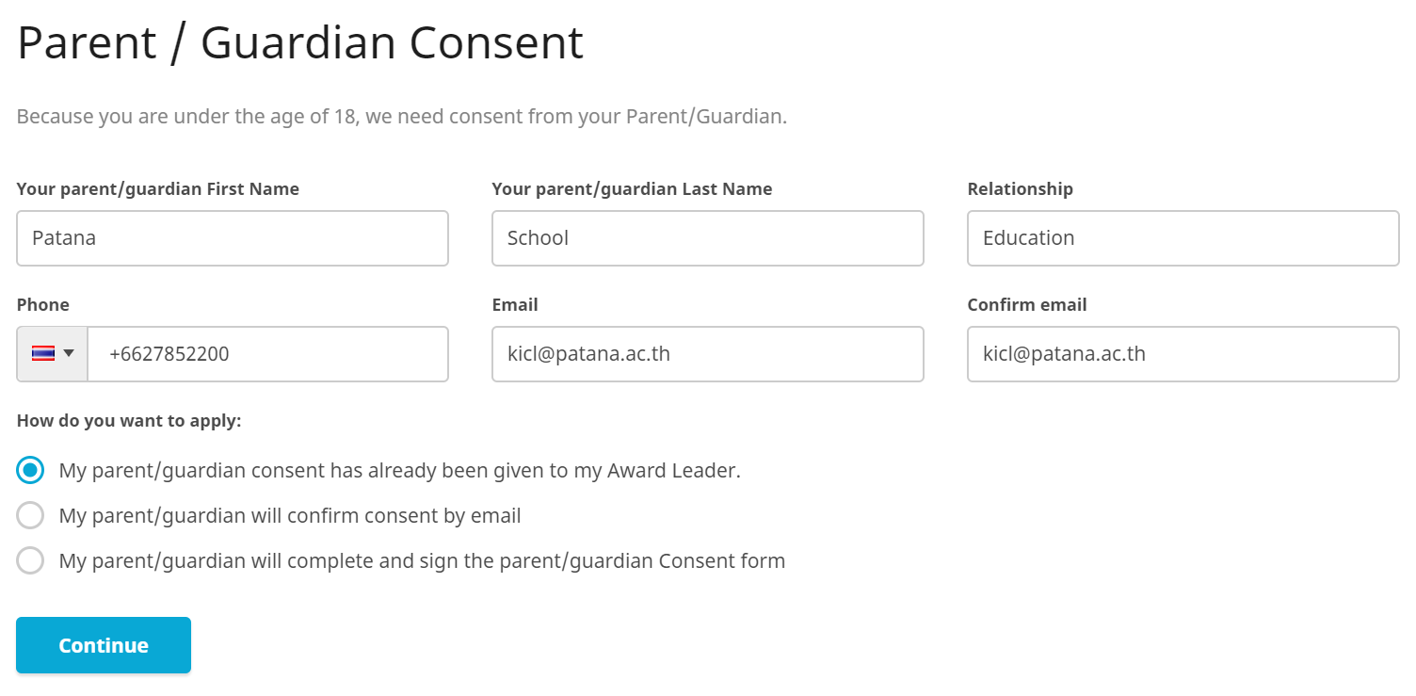

Slide 15
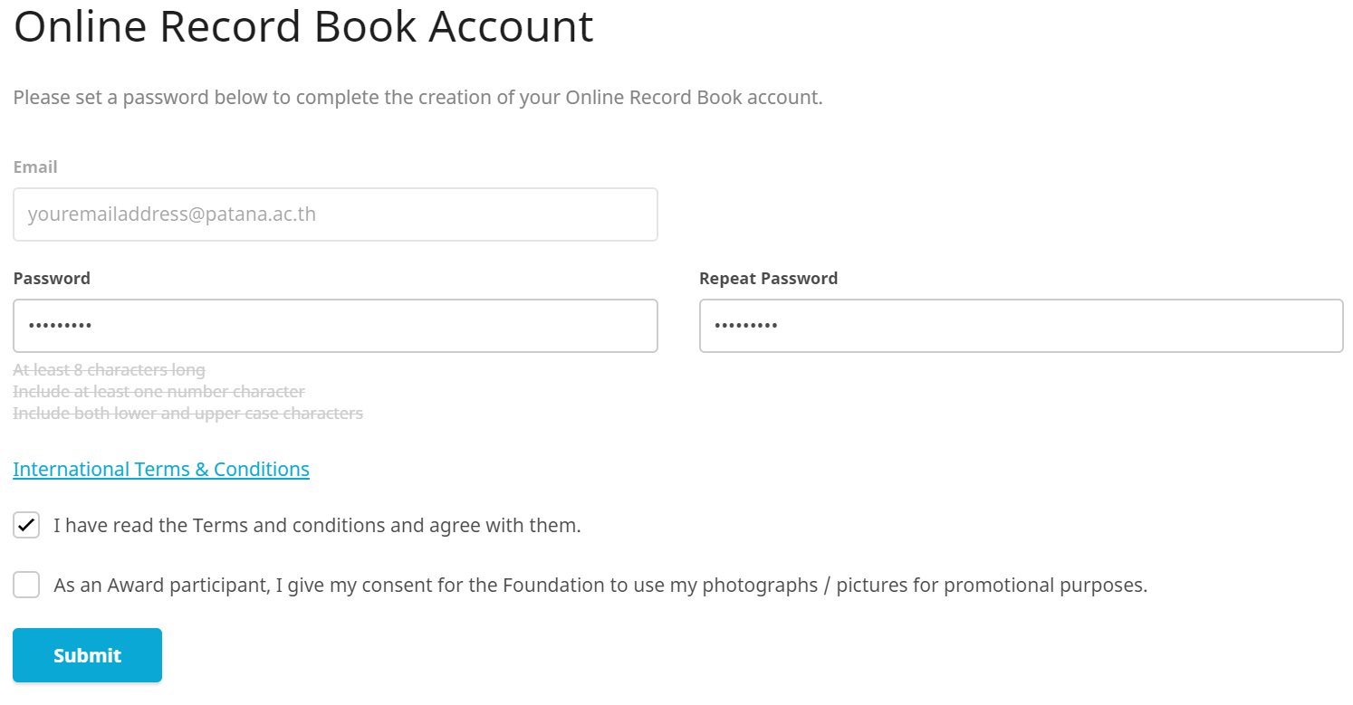

Slide 16
Congratulations

Slide 17
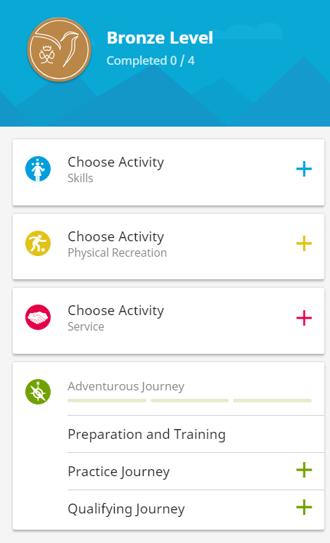
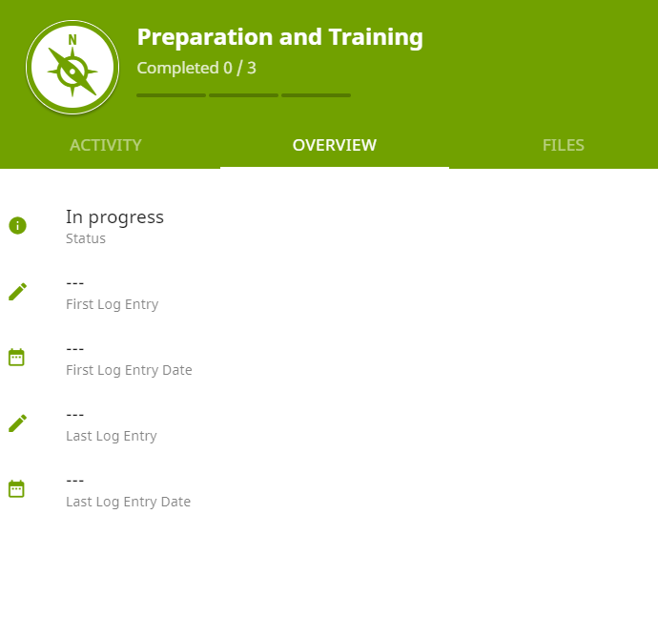

Slide 18
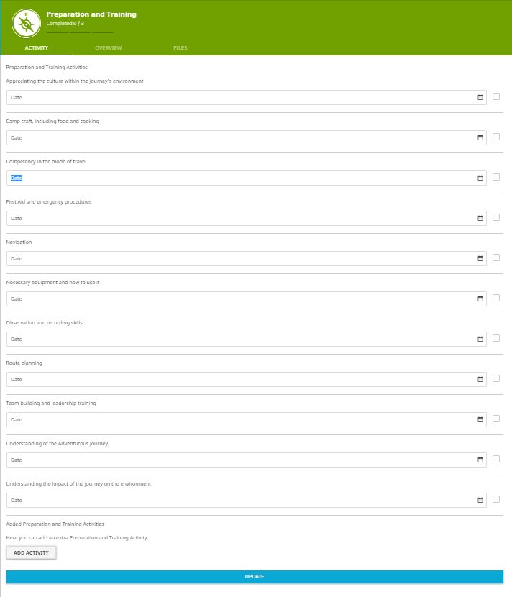

Slide 19
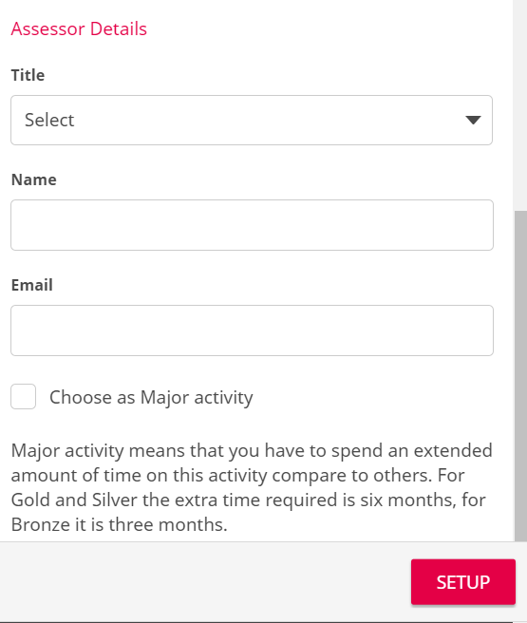
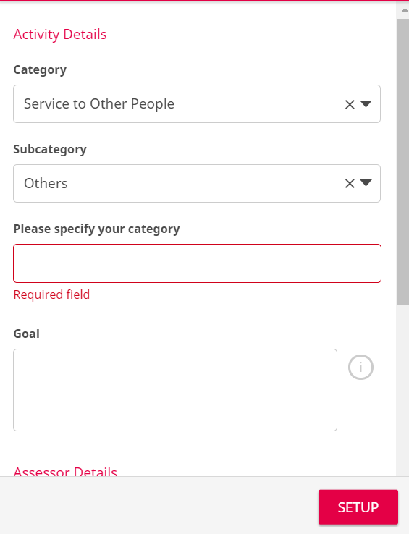

Slide 20
Now spend the remaining time during this session setting up your activities and SMART targets on the ORB.

