Slide 1
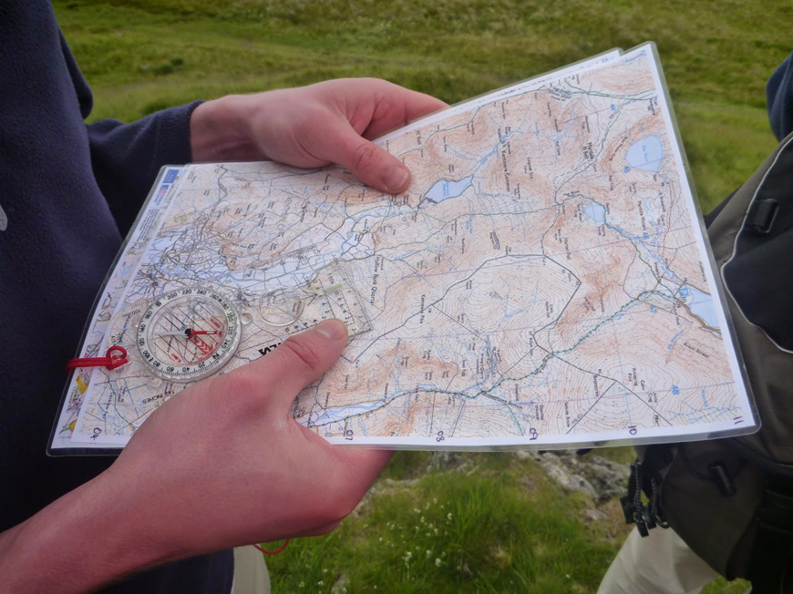
Welcome to your first expedition training Session: Navigation 101
Success Criteria:
I can:
-Work out grid references on a map
-Take a bearing using a compass
-Identify and interpret contour lines.
-Work out distances on a map
-Use distances to calculate how long it will take me to walk a section of the map.

Slide 2
Example of route card
Below is an example of a typical DofE route card. You will use this card to plan out the route you will walk on your expedition using the maps we will give you. All members of your group must contribute to completing this route card. During the journey you will take it in turns to lead and navigate your group.
Staff on the trip will be testing your understanding of where you are and how well you can apply these skills at various points during both your practice and assessed expeditions. Don’t just rely on one person in your group to do all your navigation – everyone must contribute!

Slide 3
Day 1 residential hike map
This map shows the route you will travel on the first day of your practice expedition.
You will be required make a start on your route card in the upcoming ECA sessions prior to assessed trips.

Slide 4
1. I can: work out grid references on a map.
Optional Kahoot: Year 7 Geography recap!!!
Lets see what you an remember from your Year 7 map skills lessons by playing a Kahoot!
https://create.kahoot.it/details/e673dc8b-0b1d-40ad-bb93-8f232a9a3ecf

Slide 5
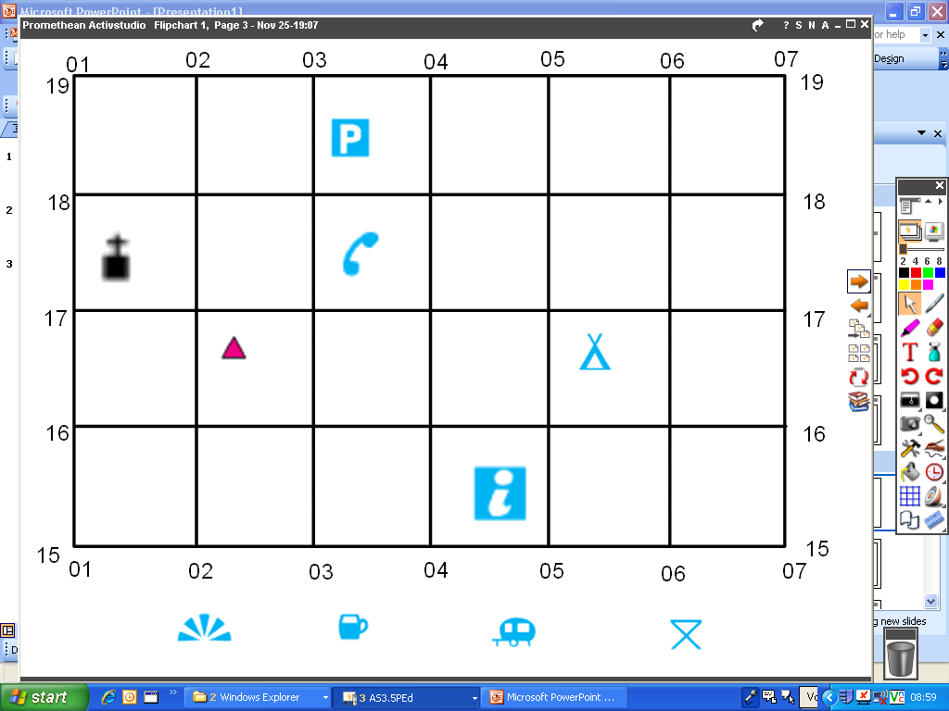
The Basics
Gridlines divide up a map, making it easier to locate places, sites and buildings. Gridlines are numbered (like coordinates on an axis in maths).
The number of the map square is called the grid reference because it refers to the square of a grid printed over the map.
Gridlines
Grid references

Slide 6
https://www.youtube.com/watch?v=OSa4npgYeJE

Slide 7
4 figure grid references
In Geography, you do not need commas or brackets like in maths.
Math coordinate: (15, 23)
Geography coordinate: 1523
You take the coordinate from the bottom left hand corner of the box.
To write out the coordinate, you go along the corridor and up the stairs.
ACTIVATE - 1: On your white-boards, four figure grid references…
Give the location of the information point:
Give the location of the camping site:
What is located at 0317?
0415
0516
Telephone box

Slide 8
6 figure grid references
What if I want to be really precise? There is a box on this map that has two things in it.
Where is it?
How can I be sure what I’m talking about?
ACTIVATE - 2: On your whiteboards six figure grid references…
Give the 6 figure GR for the telephone box:
What is located at 054167?
034175
Campsite

Slide 9
On your whiteboards … Now lets practice using the assessed Khao Yai maps. Find the grid reference for:
Start
Point 1
Point 3
Point 6
Finish

