Slide 1
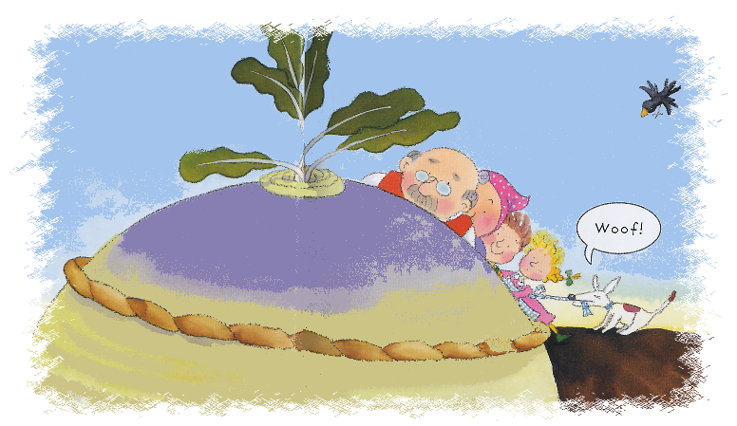
The Enormous Turnip
Story retold by Bev Evans

Slide 2
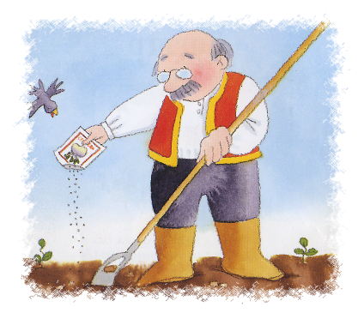
The turnip grew an grew and grew until it was ENORMOUS!
enormous!
Once upon a time there was an old man who planted some turnip seeds.

Slide 3
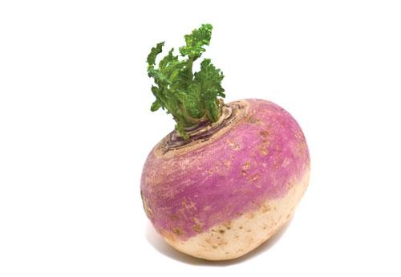
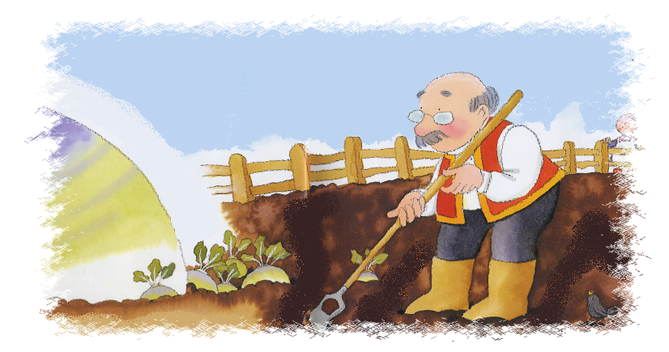
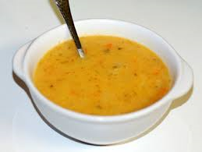
Early one morning the old man decided to pull up the turnip to make turnip soup.
Turnip
Turnip Soup

Slide 4
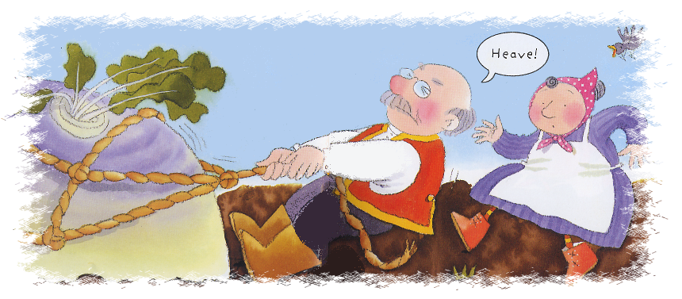
So he pulled and he pulled and he pulled but the turnip would not budge! Next he asked to his wife to help!
So the woman pulled, the man and the man pulled the turnip. But still the turnip would not budge!
Next he asked his son to help.

Slide 5
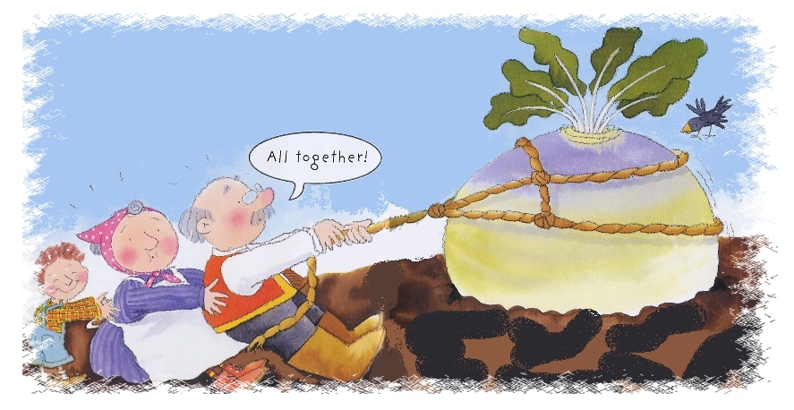
The son pulled the woman. The woman pulled the man and the man pulled the turnip. But still the turnip would not budge!
So the daughter pulled the son. The son pulled the woman. The woman pulled the man and the man pulled the turnip. But still the turnip would not budge!
Next he asked the dog to help.
Next he asked the daughter to help.

Slide 6
So the daughter pulled the son. The son pulled the woman. The woman pulled the man and the man pulled the turnip. But still the turnip would not budge!
Next he asked the dog to help.

Slide 7
So the dog pulled the daughter. The daughter pulled the son. The son pulled the woman. The woman pulled the man and the man pulled the turnip. But still the turnip would not budge!
Next he asked the cat to help.

Slide 8
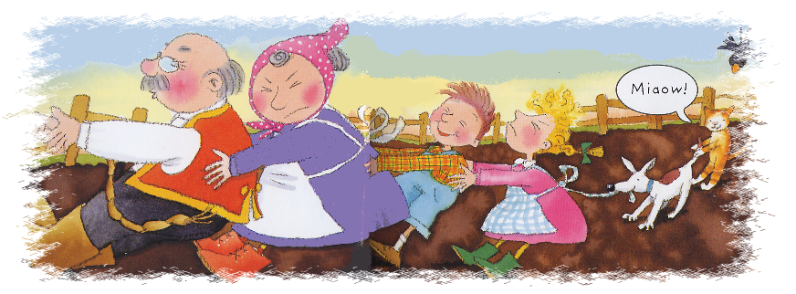
So the cat pulled the dog. The dog pulled the daughter. The daughter pulled the son. The son pulled the woman. The woman pulled the man and the man pulled the turnip. But still the turnip would not budge!
Next he asked the mouse to help.

Slide 9
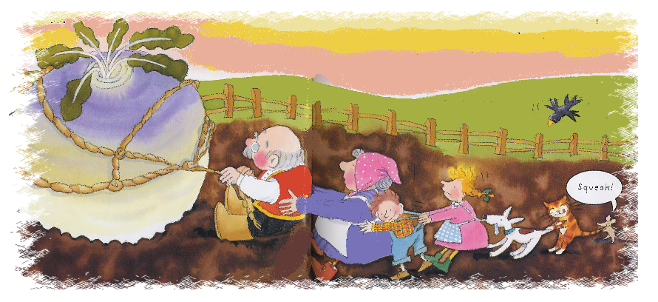
So the cat pulled the dog. The dog pulled the daughter. The daughter pulled the son. The son pulled the woman. The woman pulled the man and the man pulled the turnip. But still the turnip would not budge!
Next he asked the mouse to help.

Slide 10
So the mouse pulled the cat. The cat pulled the dog. The dog pulled the daughter. The daughter pulled the son. The son pulled the woman. The woman pulled the man and the man pulled the turnip. But still the turnip would not budge!

Slide 11
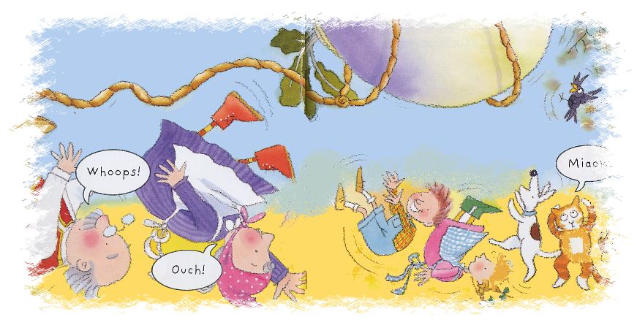
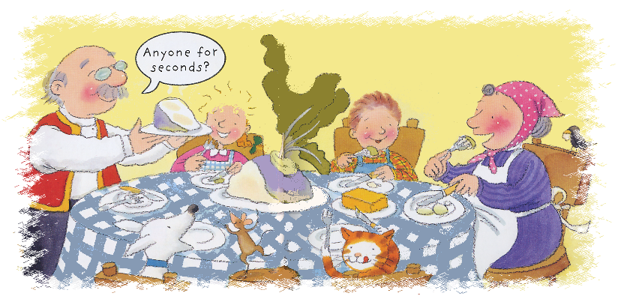
They pulled and they pulled and they pulled . Finally, the turnip came flying out of the ground and they all fell down with a Bang!
After that they all had turnip soup and lived happily ever after.

Slide 12
The End
Story retold by Bev Evans www.communication4all.co.uk
Images by Jan Lewis ©Ladybird books

