Slide 1
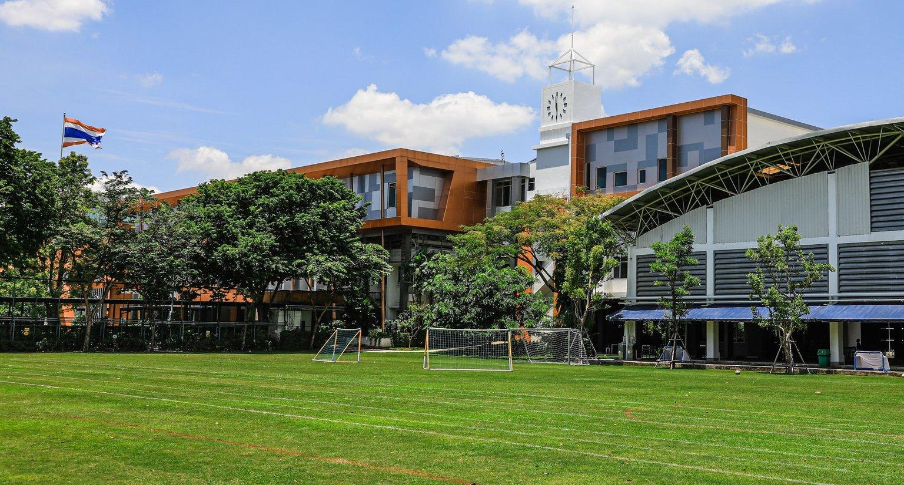
Primary End of the Day Procedures

Slide 2
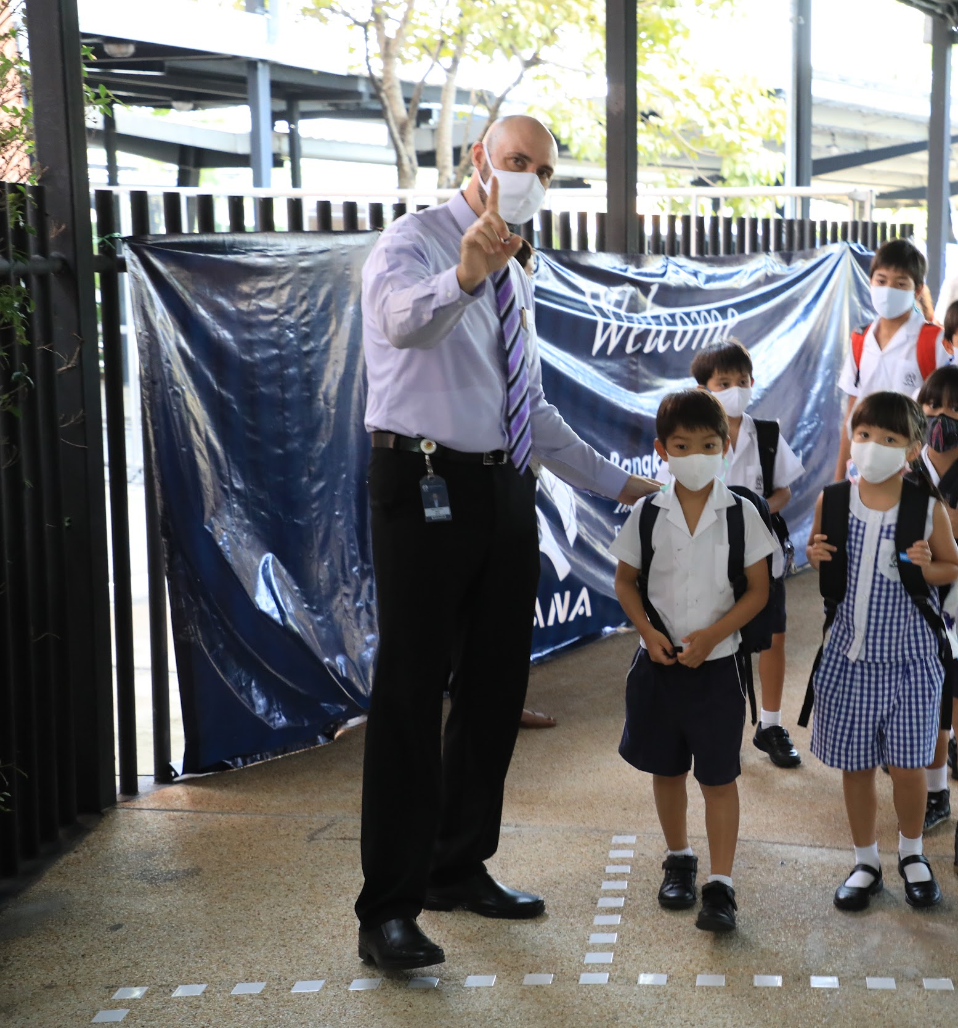
No ECA?
FS - Y2 children can be collected by a trusted adult from the classroom as usual. Students who take the bus will be walked to the Bus Park and handed over to the Bus Monitor.
Y3 Students will be walked to the Bus Park or silver gate between the Arts Centre and Foundation Stage by their Class Teacher and handed over to the Bus Monitor or their trusted adult.
Y4 - 6 Students will walk independently to the Bus Park or the silver gate to meet their trusted adult.
Parents you can help us by being on time for pick-up and not entering the campus if your child is in Y3+

Slide 3
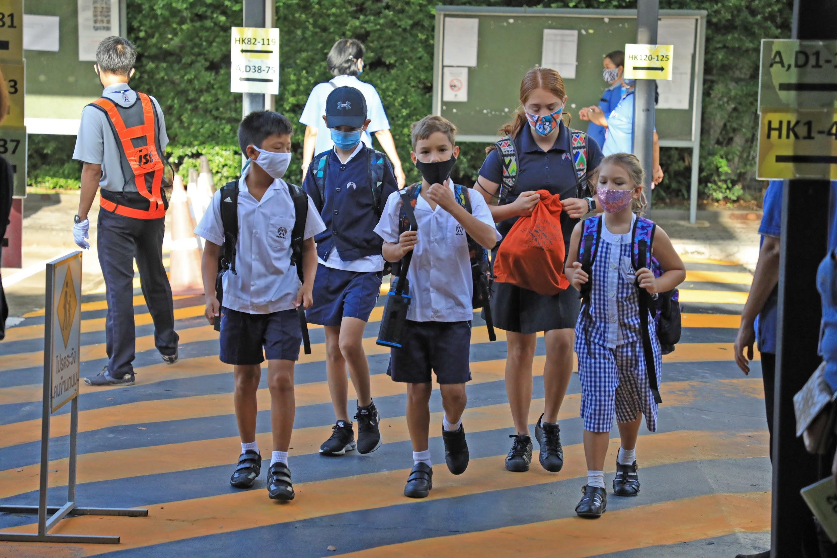
Attending an ECA that finishes at 3:30pm?
Y1 - Y2 children can be collected by a trusted adult from the ECA venue as usual. Students who take the bus will be walked to the Bus Park and handed over to the Bus Monitor.
Y3 Students will be walked to the Bus Park or silver gate between the Arts Centre and Foundation Stage by their ECA Teacher and handed over to the Bus Monitor or their trusted adult.
Y4 - 6 Students will walk independently to the Bus Park or the silver gate after their ECA to meet their trusted adult.
Parents you can help us by being on time for pick-up and not entering the campus if your child is in Y3+

Slide 4
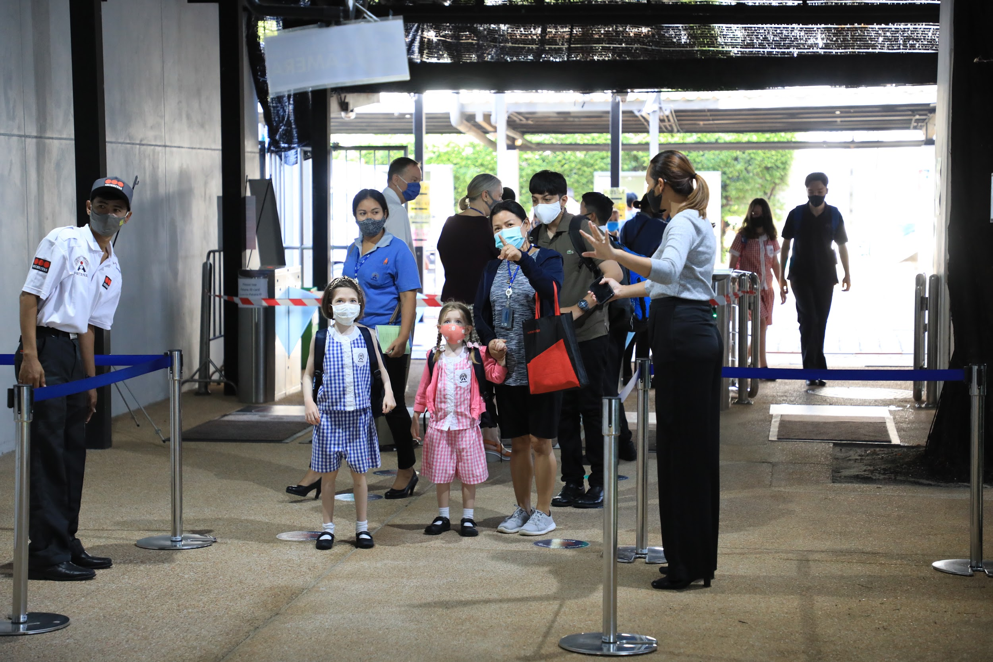
Attending an ECA that finishes at 4:30pm?
Y3 Students will be walked to the Bus Park or silver gate between the Arts Centre and Foundation Stage by their ECA Teacher and handed over to the Bus Monitor or their trusted adult.
Y4 - 6 Students will walk independently to the Bus Park or the silver gate after their ECA to meet their trusted adult.
Parents you can help us by being on time for pick-up and not entering the campus if your child is in Y3+
If your child is in Y2 and below, it helps us if you can depart promptly at 3:30pm.

Slide 5
Thank you and enjoy your ECAs!

