Slide 1
Fulfilling Potential
ASSESSMENT

Slide 2
Fulfilling Potential
ASSESSMENT
Start of Year 7
Year 6 NCT results
Year 6 Teacher Assessments
+
MidYIS data

Slide 3
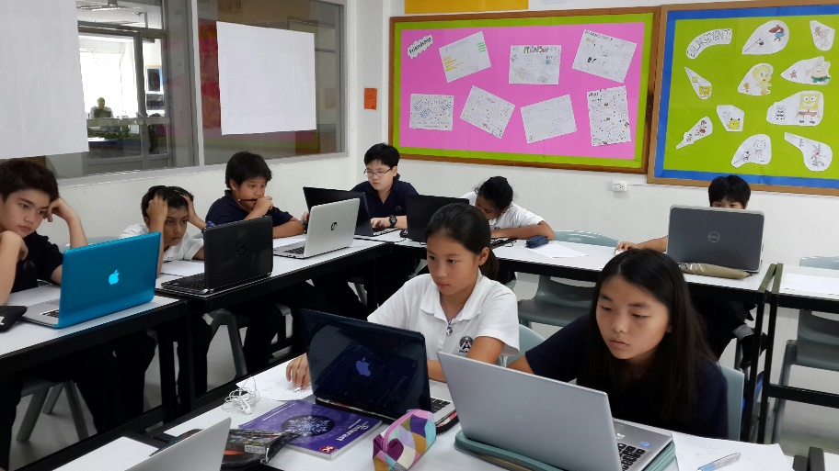
Fulfilling Potential
ASSESSMENT
Start of Year 7
MidYIS data
“MidYIS”: Middle Years Information System
50 minutes
Adaptive
Vocabulary, Maths, Non-verbal, Skills
Aptitude and ability, not achievement
Measure of “typical” performance used to give an expected level of attainment at the end of Year 9

Slide 4
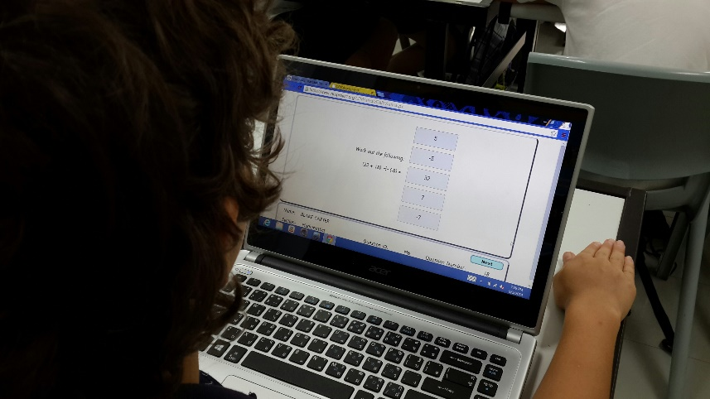
Fulfilling Potential
ASSESSMENT
Start of Year 7
MidYIS data
Next steps…
MidYIS feedback identifies potential attainment for the end of Y9 for all their subjects;
Target Grades subsequently determined;
Target Grades are then shared with parents;
Ongoing dialogue between school, student, parents:
On track?
Intervention/support?

Slide 5
Fulfilling Potential
ASSESSMENT
Levels & sub-Levels
National Curriculum Levels;
Attainment in each subject area measured in Levels from 1 – 8;
For Year 7s: Levels 1 – 6;
Levels are further sub-divided to allow for a more refined measure of attainment;
Levels are sub-divided into a, b, and c.
e.g. 5a, 5b, 5c, and so on.
Notes:
Sub-dividing Levels enables teachers to make a more precise judgments about attainment;
Sub-dividing Levels allows for a clearer picture of progress through a given Level.

Slide 6
Fulfilling Potential
ASSESSMENT
Levels & sub-Levels
5a: is strongly meeting criteria for Level 5, and is likely to be achieving or working close to Level 6 for some criteria;
5b: is working comfortably at Level 5;
5c: is meeting Level 5 criteria, but only just.

Slide 7
Fulfilling Potential
ASSESSMENT
Levels & sub-Levels
Lower end of attainment
Upper end of attainment…
1c, 1b, 1a, 2c, 2b, 2a, 3c, 3b, 3a, 4c, 4b, 4a, 5c, 5b, 5a, 6c, 6b, 6a, 7c…

Slide 8
Fulfilling Potential
ASSESSMENT
Levels & sub-Levels
Expected progress in Key Stage 3?
About 2 sub-Levels per year
Current Y7
sub-Level
5a
6c, 6b, 6a, 7c…

Slide 9
Fulfilling Potential
ASSESSMENT
Levels & sub-Levels
Expected progress in Key Stage 3?
About 2 sub-Levels per year
Current Y7
sub-Level
5a
6c, 6b, 6a, 7c…

Slide 10
Fulfilling Potential
ASSESSMENT
Levels & sub-Levels
Expected progress in Key Stage 3?
About 2 sub-Levels per year
Current Y7
sub-Level
5a
6c, 6b, 6a, 7c…

Slide 11
Fulfilling Potential
ASSESSMENT
Levels & sub-Levels
Expected progress in Key Stage 3?
About 2 sub-Levels per year
Current Y7
sub-Level
5a
6c, 6b, 6a, 7c…
Targeted
end-of- Y7
sub-Level

Slide 12
Fulfilling Potential
ASSESSMENT
Levels & sub-Levels
Current Y7
sub-Level
5a
6c, 6b, 6a, 7c, 7b, 7a…
Targeted
end-of- Y7
sub-Level

Slide 13
Fulfilling Potential
ASSESSMENT
Levels & sub-Levels
Current Y7
sub-Level
5a
6c, 6b, 6a, 7c, 7b, 7a…
Targeted
end-of- Y7
sub-Level
Targeted
end-of- Y8
sub-Level

Slide 14
Fulfilling Potential
ASSESSMENT
Levels & sub-Levels
Current Y7
sub-Level
5a
6c, 6b, 6a, 7c, 7b, 7a…
Y7
Y9
4
6
Targeted
end-of- Y7
sub-Level
Targeted
end-of- Y8
sub-Level
Targeted
end-of- Y9
sub-Level
5
7
6
8

Slide 15
Fulfilling Potential
ASSESSMENT
Levels & sub-Levels
Additional Point to Note:
KS2 and KS3;

Slide 16
Fulfilling Potential
ASSESSMENT
Levels & sub-Levels
Finally:
Goal is to establish and maintain an open dialogue regarding current attainment and targets to support each student as they strive to fulfil their potential.

