Slide 1
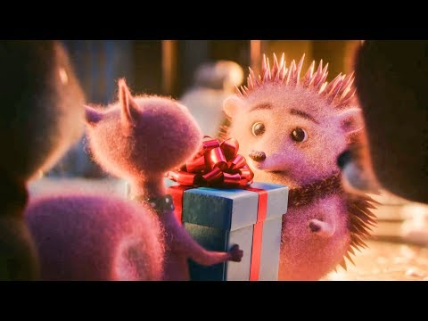
https://vimeo.com/304810288

Slide 2
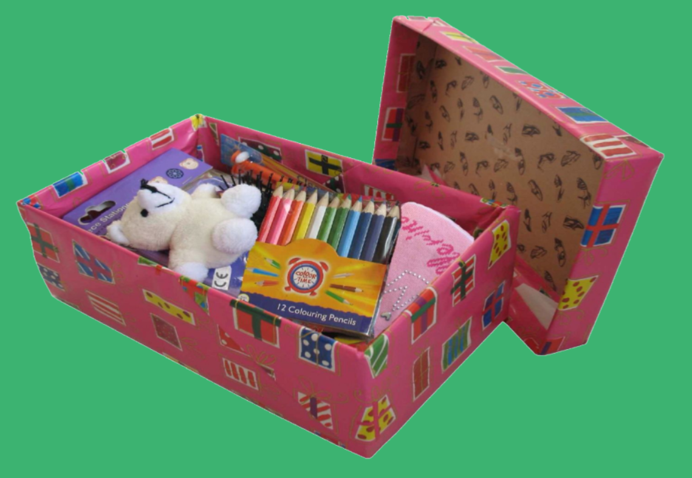
Year 5 Christmas Box Collection
Notes:
Len and Jozefien 4A

Slide 3
Notes:
https://www.youtube.com/watch?v=v7NFumFuTrA Dash and Teera 4H

Slide 4
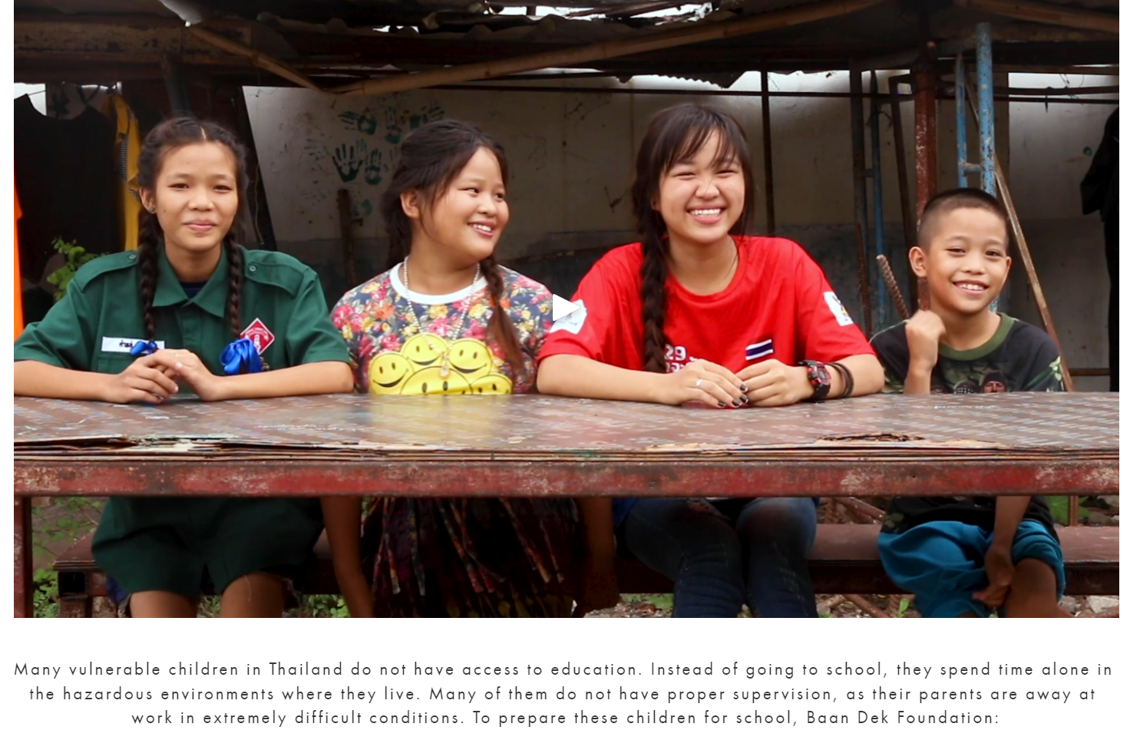
All about our Christmas charity, Baan Dek

Slide 5
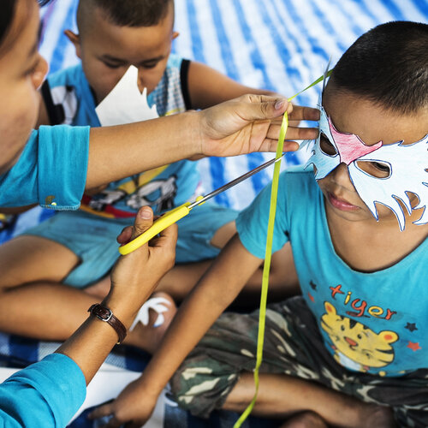
Supporting children through non-formal education sessions, after-school support, life skill education, and a range of activities to promote healthy development.

Slide 6
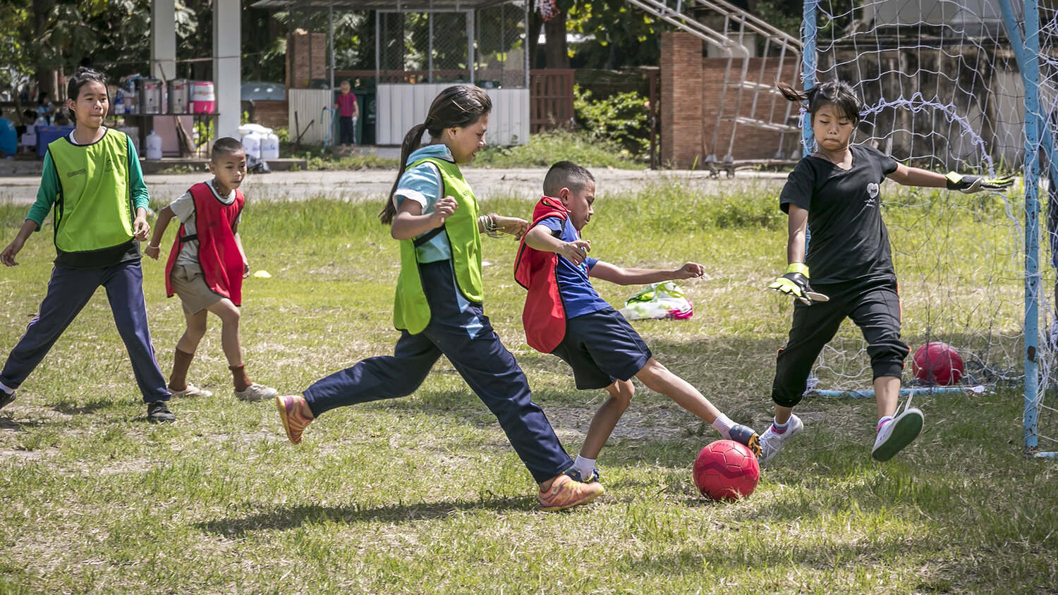
Teaching social skills through fun sports!

Slide 7
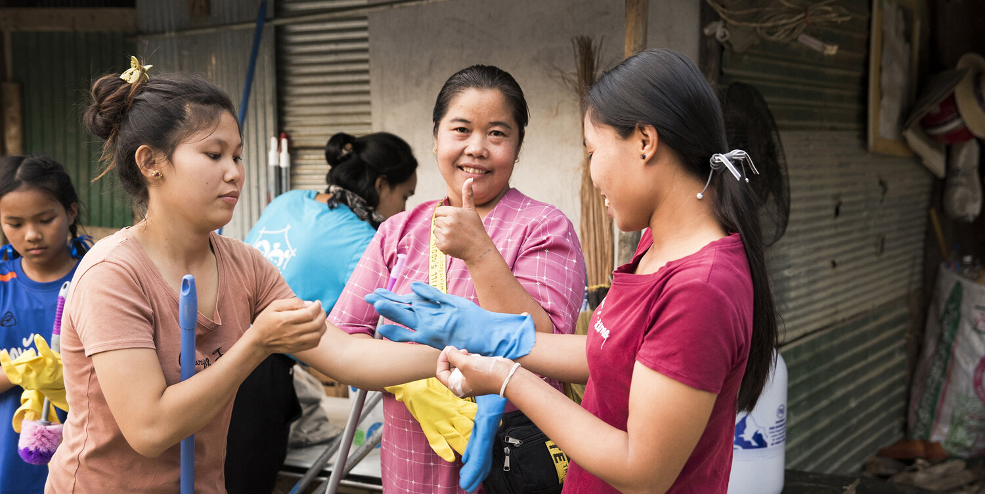
Supporting access to water, sanitation, and hygiene facilities

Slide 8
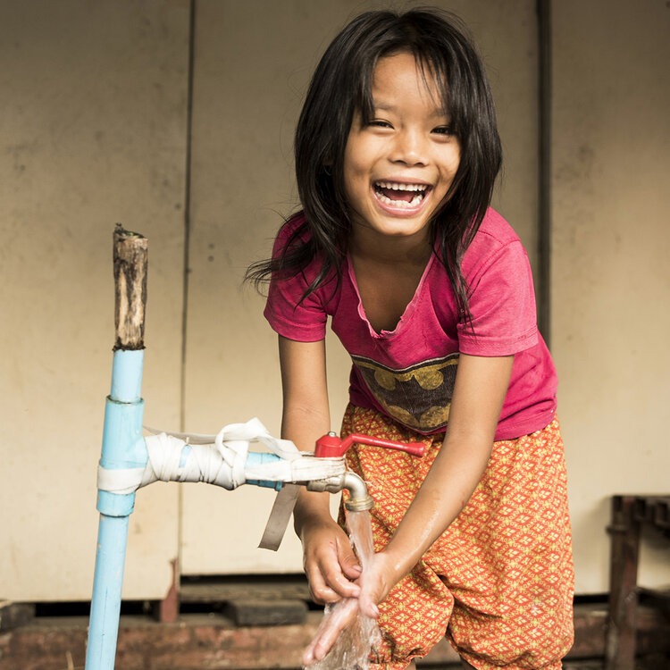
Helping provide clean water

Slide 9
Want to research further?
https://baandekfoundation.org/wash

Slide 10
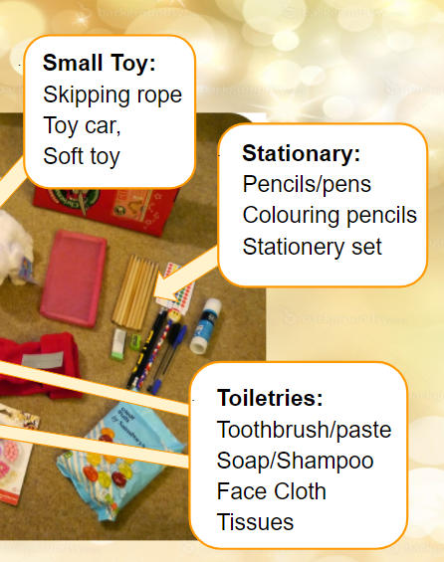
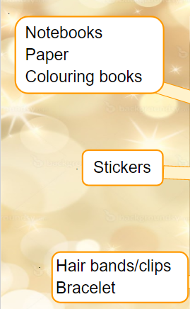
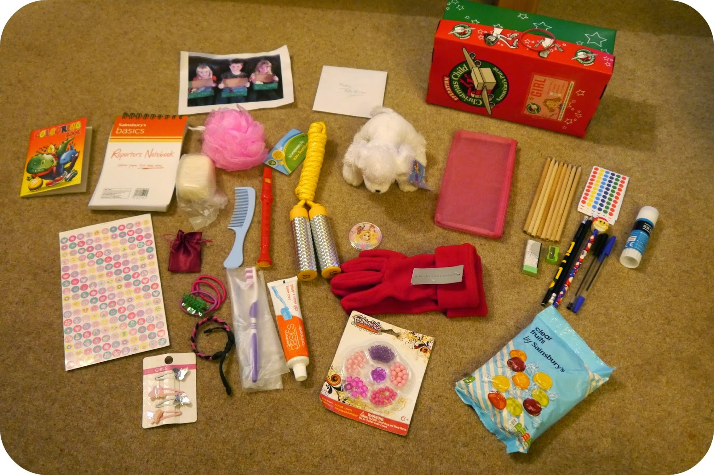
What should go in the box?
· Small Toy:
Skipping rope
Toy car,
Soft toy
·
Notebooks
Paper
Colouring books
· Stationary:
Pencils/pens
Colouring pencils
Stationery set
· Stickers
· Toiletries:
Toothbrush/paste
Soap/Shampoo
Face Cloth
Tissues
· Hair bands/clips
Bracelet
Notes:
Doyeon and Saadhvi. 4T

Slide 11
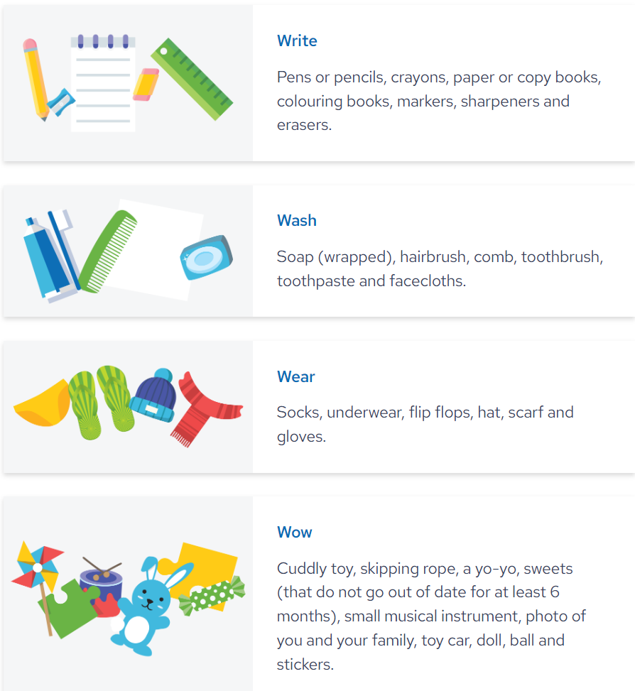

Slide 12
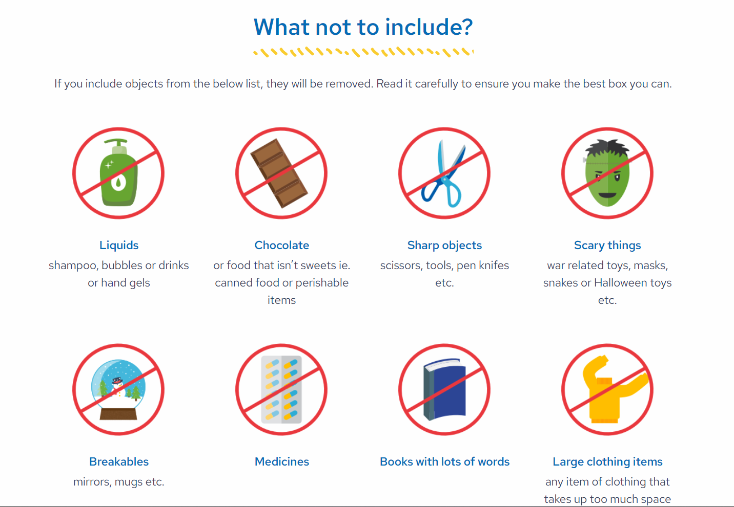
Please only include Thai language books ☺

Slide 13
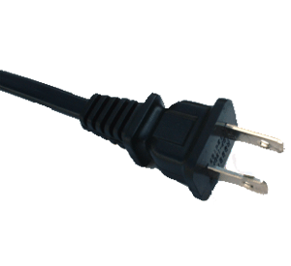
What shouldn’t you put in your box? (Class discussion)
Notes:
4R Paolo and Caleb

Slide 14
What happens next?
Please collect a shoebox from home or a shop. It doesn’t have to be a brand-new box.
Now it is time to fill it up! Wahoo!
Put them under the Year 5 Christmas Tree from the 1st of December!
Our Student Council will organise them.
If your box is not already wrapped, you can do that in school.

Slide 15
TIMELINE OF KEY DATES
List of wished for items sent out to children and parents.
Information shared in the blog on the 18th of November and in the Newsletter
Put them under the Year 5 Christmas Tree from the 1st of December!
Decorate / wrap at class discretion
Sent to Baan Dek in time for Christmas! (Dates tbc)

Slide 16
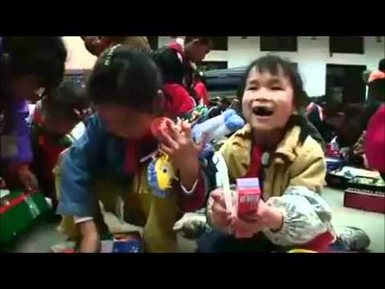
This is how happy you could make another child! Giving is the best feeling EVER!
Notes:
https://www.youtube.com/watch?v=JPvxW66prOI

Slide 17
