Slide 1
Welcome to the Year 7
Coffee Morning
Our Mission …
“ to ensure that students of all nationalities grow to their full potential as independent learners in a caring British international community”
Bangkok Patana School Master Presentation
Notes:
1

Slide 2
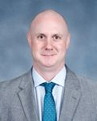
Year 7
Tim Coates
Senior Teacher - KS3 (Student Welfare)
tico@patana.ac.th
Bangkok Patana School Master Presentation
Notes:
2

Slide 3
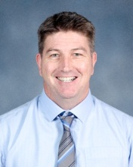
Year 7
Owen McDevitt
Head of Year 7
owmc@patana.ac.th
Bangkok Patana School Master Presentation
Notes:
3

Slide 4
Year 7
Today’s Agenda
Guests – Tony Berghuis, Brian Taylor, Scott Tooley, Laura MacRitchie, Andy Thain
Meet Head of Year 7
The Parent-Teacher partnership
Tutorial Programme
Residential Visit
Q & A/Coffee Break/Network with other parents and meet your child’s tutor
Bangkok Patana School Master Presentation
Notes:
4

Slide 5
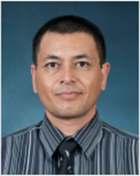
Year 7
Tony Berghuis
Senior Teacher Key Stage 3 - Curriculum and Assessment
anbe@patana.ac.th
Bangkok Patana School Master Presentation
Notes:
5

Slide 6
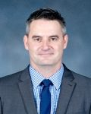
Year 7
Brian Taylor
Assistant Principal, Cross Campus Curriculum Technology Integrator
brta@patana.ac.th
Bangkok Patana School Master Presentation
Notes:
6

Slide 7
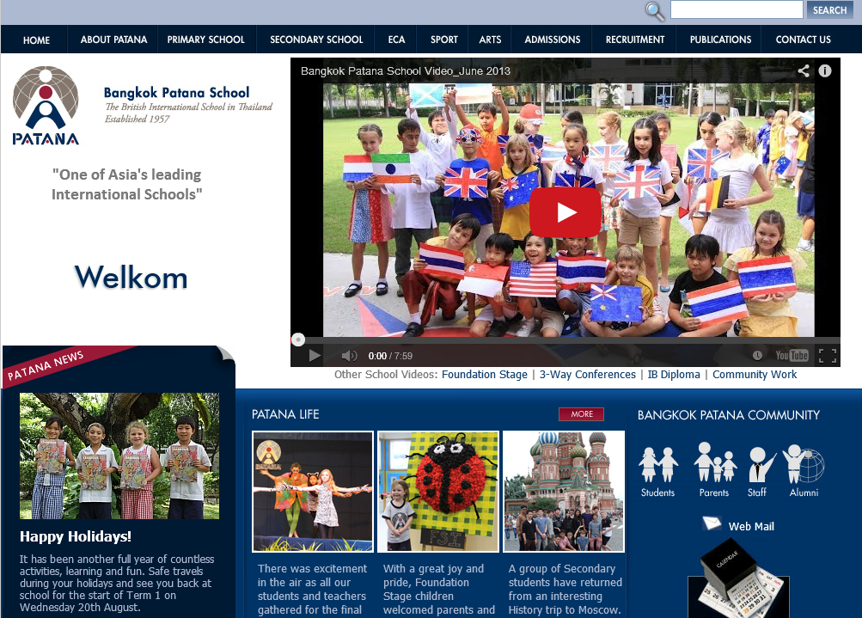

Slide 8
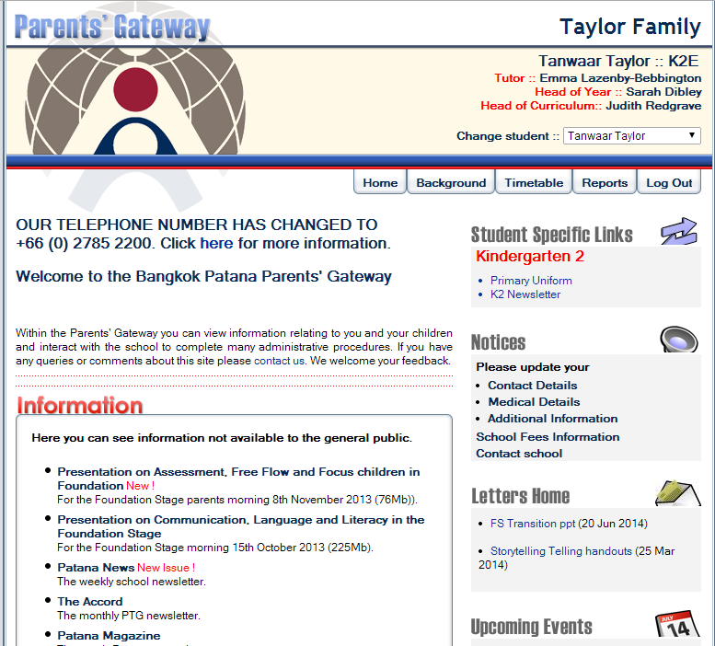
Current Parents’ Gateway

Slide 9
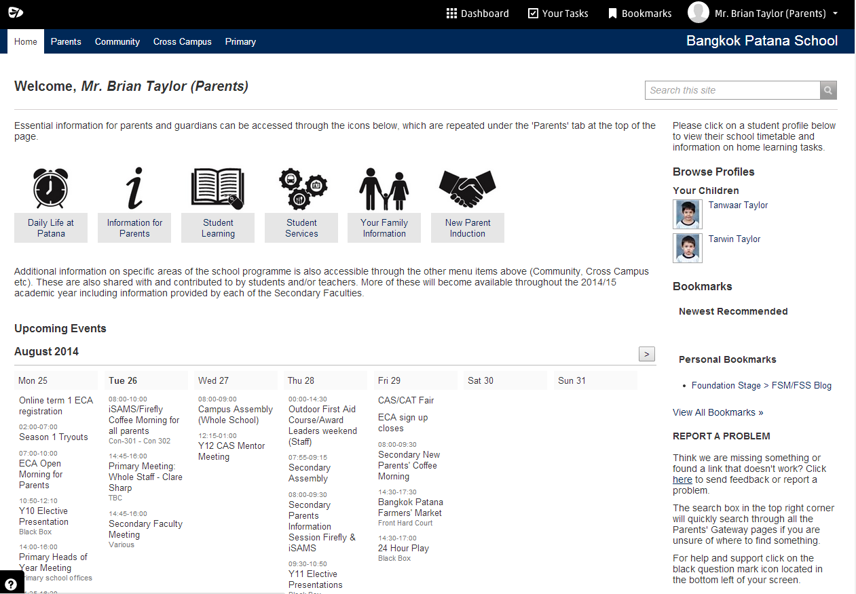
New Parents’ Gateway

Slide 10
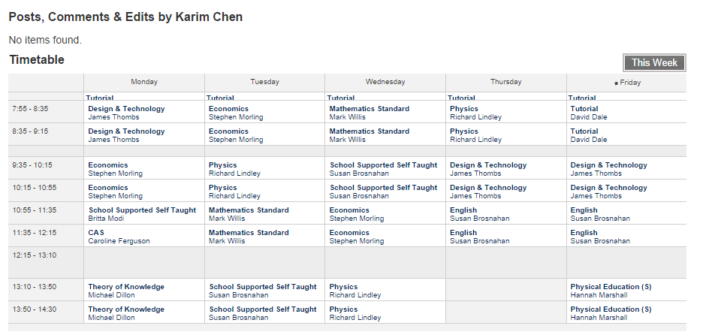
Timetable

Slide 11
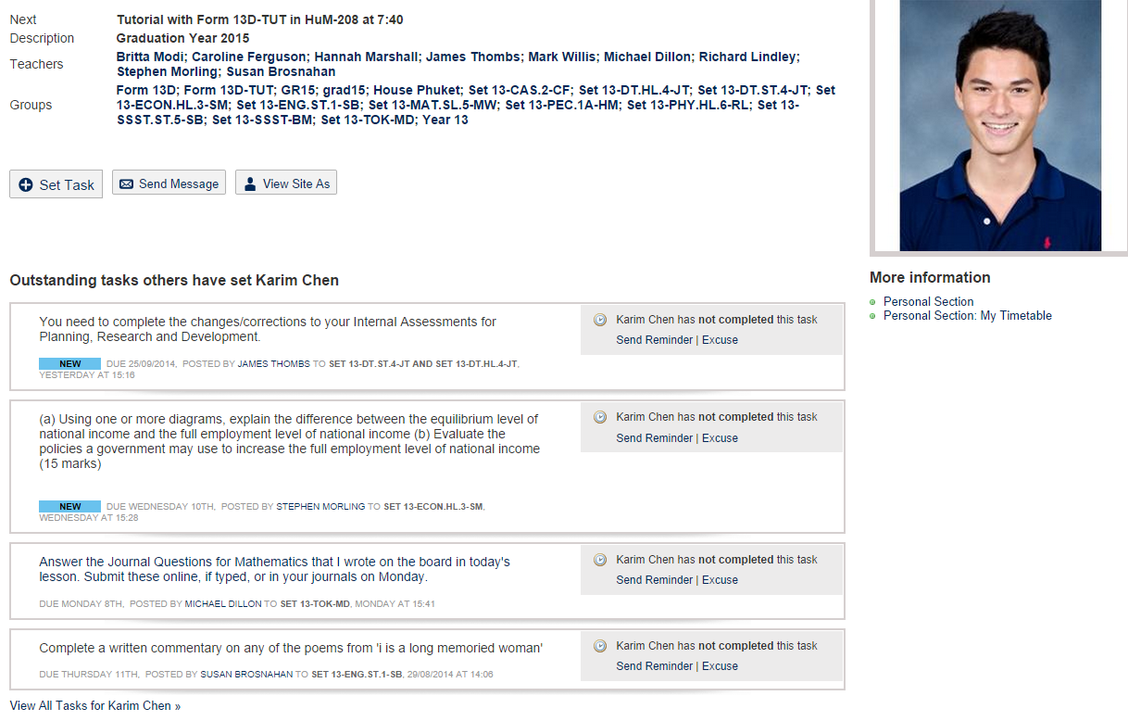
Home Learning Tasks

Slide 12
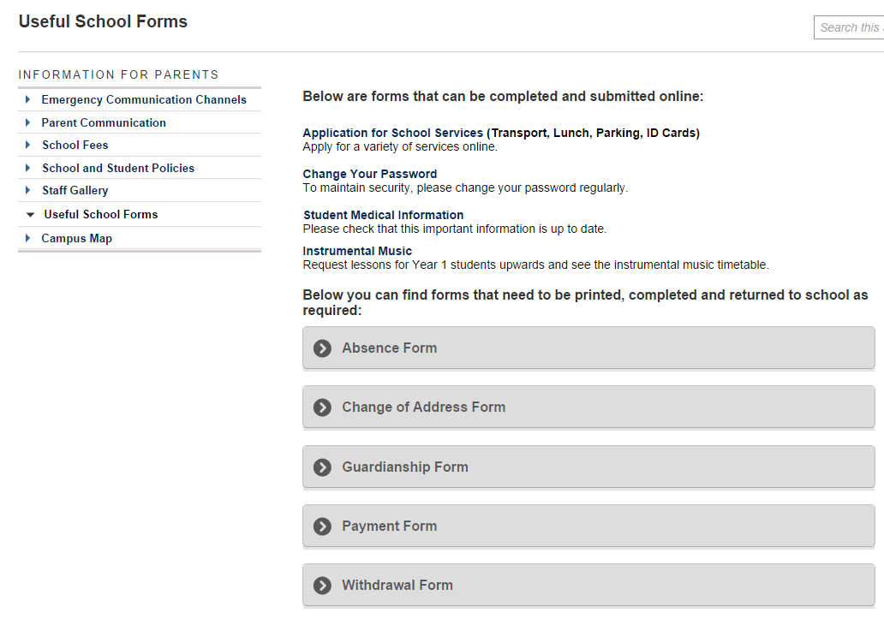
Useful School Forms

Slide 13
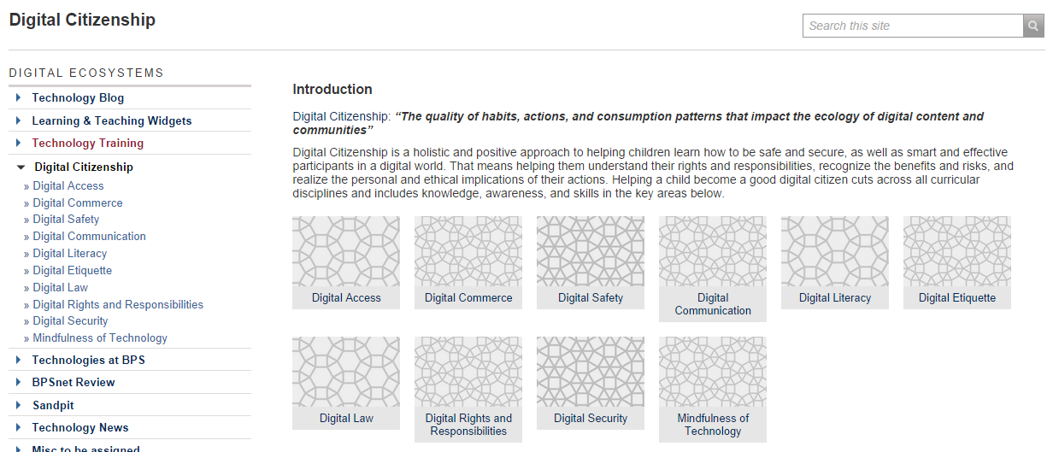
Digital Citizenship

Slide 14
commonsensemedia.org

Slide 15
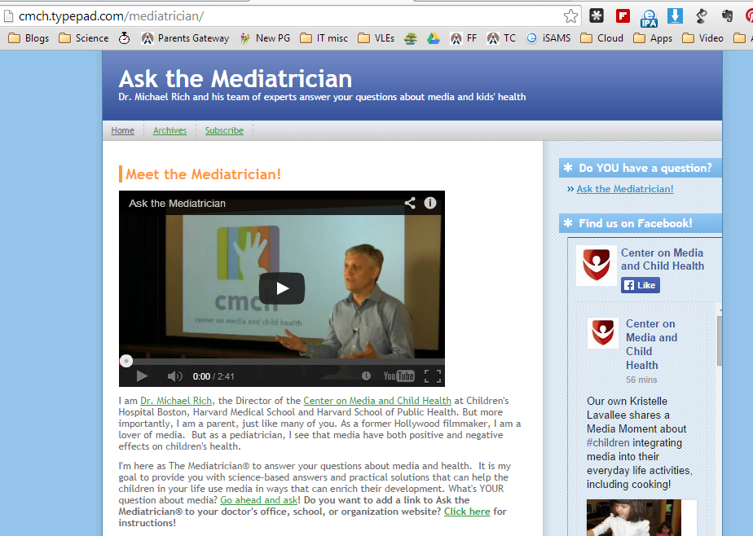
askthemediatrician.org

Slide 16
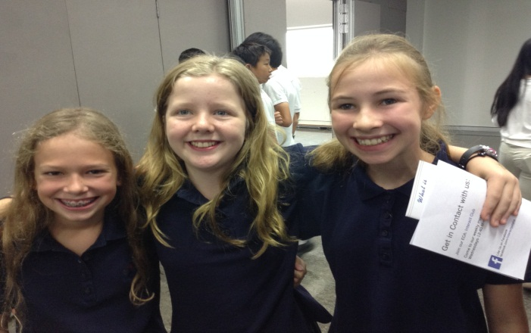
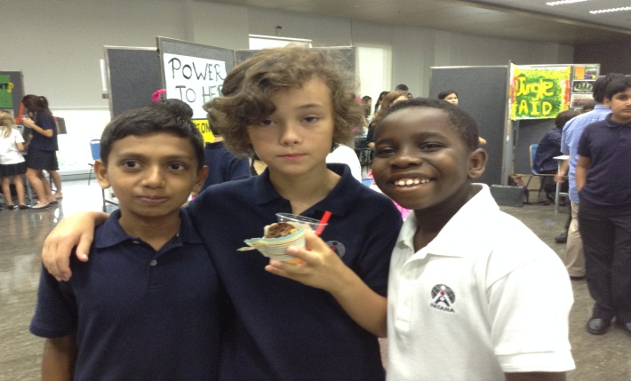
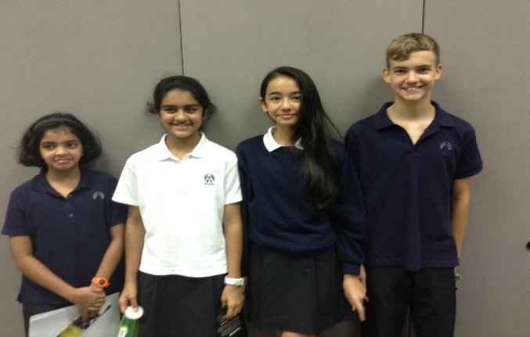
Year 7
A good start…
Bangkok Patana School Master Presentation
Notes:
16

Slide 17
The Year 7 Tutor Team
7C
7F
7H
7J
7K
7M
7S
7W
Bangkok Patana School Master Presentation
Notes:
17

Slide 18
Year 7
Parent and Teacher Partnership
Lines of Communication
Tutor or Subject teacher
Head of Year
Senior Teacher: Key Stage 3
Assistant Principal: Student Welfare
Bangkok Patana School Master Presentation
Notes:
18

Slide 19
Year 7
Parent and Teacher Partnership
Emails @patana.ac.th
Telephone contact
Patana website/Firefly
PTG
Y7 Consultations (6th Oct)
Bangkok Patana School Master Presentation
Notes:
19

Slide 20
Year 7
Parent and Teacher Partnership
Absence and Late authorisations
Absences need to be followed up quickly so we know the whereabouts of all our students. If your child is out for the day, please contact us as early as possible to tell us – Secondary Office and tutor.
Policy is to give a conduct detention for 3 unauthorised lates.
Please help us by authorising to tutors.
Bangkok Patana School Master Presentation
Notes:
20

Slide 21
Year 7
Parent and Teacher Partnership
Personal Belongings and Equipment
Welcome
Laptop (essential)
Correct school uniform
Water bottle
Correct equipment for each subject (incl. PE)
Labels on equipment
Healthy snack
Not Welcome
Dangerous items (e.g. laser pointers, knives, etc.)
Incorrect school uniform
Chewing gum, smoking, drugs, alcohol
Coloured nail varnish, braids, jewellery, excessive make-up, bandanas and obvious hair dyes
Unlabelled items
Bangkok Patana School Master Presentation
Notes:
21

Slide 22
Year 7
Parent and Teacher Partnership
Personal Belongings and Equipment
Cautions
Money (lock away)
Mobiles (locked away and turned off)
Other electronic equipment (e.g. mp3 players, cameras, etc.) (locked away and turned off)
Patana Card - please ensure your child understands this card needs to be taken very good care of!
Bangkok Patana School Master Presentation
Notes:
22

Slide 23
Year 7
Parent and Teacher Partnership
Home Learning Policy
Most children cope well with a structured programme
Get in touch with us early if problems occur
Up to five evenings a week
Around 60 minutes per evening
Bangkok Patana School Master Presentation
Notes:
23

Slide 24
Year 7
Parent and Teacher Partnership
Home Learning Policy
Students should practice playing their musical instruments for 15 minutes each evening
EAL recommends 20 minutes reading per night which will be recorded on the Home Learning database
In Term 1, MFL1 gets 30mins, MFL2 gets 20mins distributed throughout the week
In Terms 2 and 3 MFL1 gets 40mins and MFL2 gets 30mins distributed throughout the week
Bangkok Patana School Master Presentation
Notes:
24

Slide 25
Year 7
Parent and Teacher Partnership
Homework Schedule
Year 7 Homework Schedule
Bangkok Patana School Master Presentation
Notes:
25

Slide 26
Year 7
Parent and Teacher Partnership
Home Learning Schedule
Emailed to students
Emailed to parents
Tutors
Firefly
Bangkok Patana School Master Presentation
Notes:
26

Slide 27
Year 7
Parent and Teacher Partnership
Home Learning Schedule
Emailed to students
Emailed to parents
Tutors
Firefly
Get in touch early with us early if problems occur
Bangkok Patana School Master Presentation
Notes:
27

Slide 28
Year 7
The Parent Teacher Group (PTG)
Year 7 PTG Representatives:
Line Echivard
and
Anne Morganthaler Vandlik
ptg@patana.ac.th
Bangkok Patana School Master Presentation
Notes:
28

Slide 29
Year 7
Year 7 Tutor Programme
TERM 1
Overcoming Challenges
TERM 2
Who Are We?
TERM 3
Getting On
Bangkok Patana School Master Presentation
Notes:
29

Slide 30
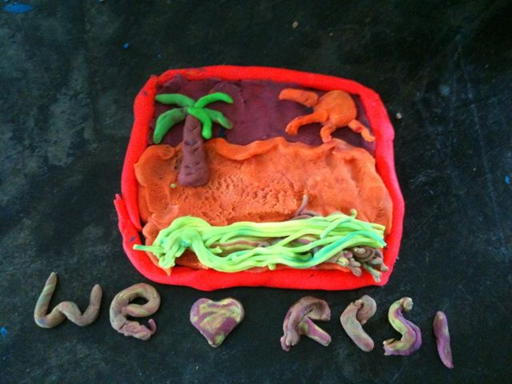
Year 7
Year 7 Residential to Rayong
Bangkok Patana School Master Presentation
Notes:
30

Slide 31
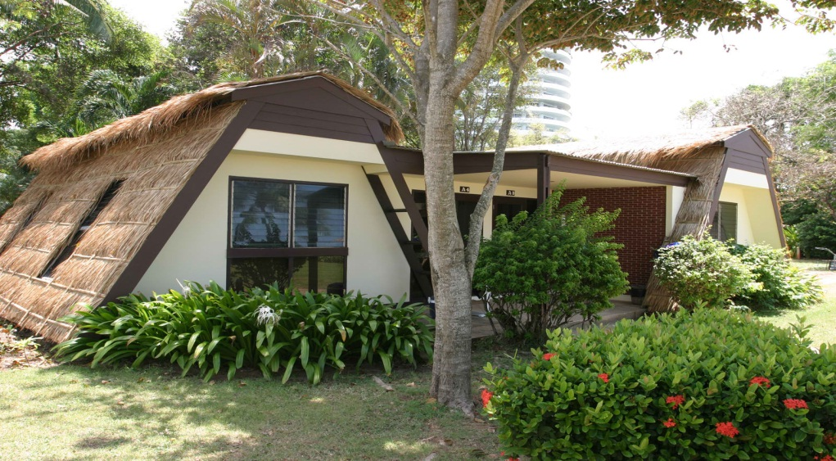
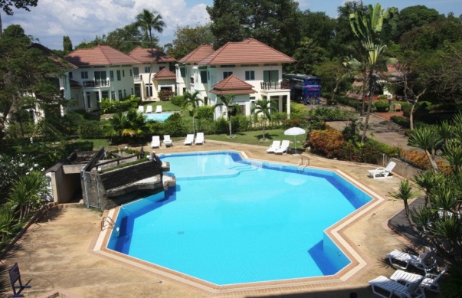
Year 7
Year 7 Residential to Rayong
WHERE:
Rayong Chalet
Bangkok Patana School Master Presentation
Notes:
31

Slide 32
Year 7
Year 7 Residential to Rayong
WHY:
To promote self-confidence
To encourage decision making skills
To give you practice at problem-solving
To encourage teamwork
To develop communication skills
To have FUN
Bangkok Patana School Master Presentation
Notes:
32

Slide 33
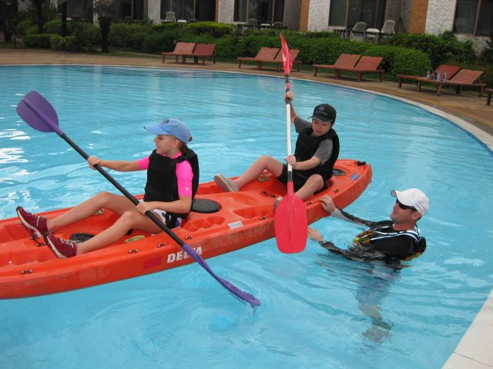
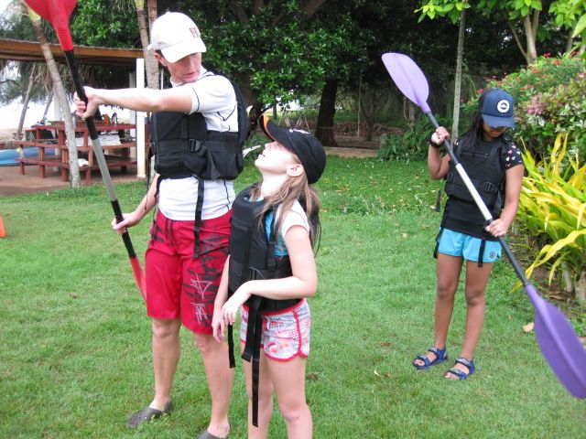
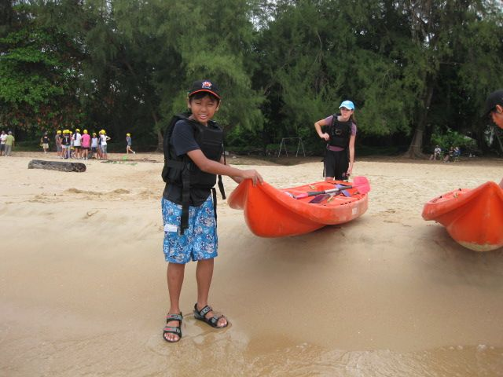

Slide 34
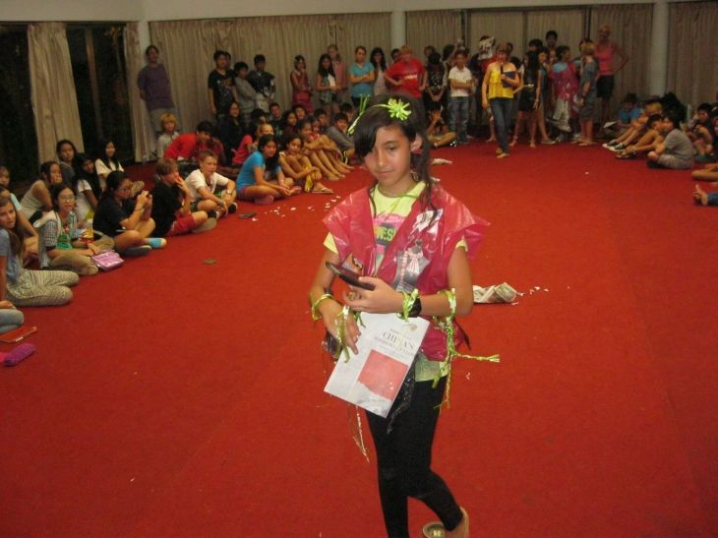
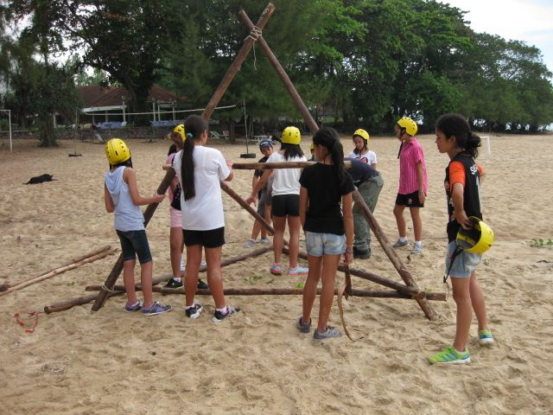
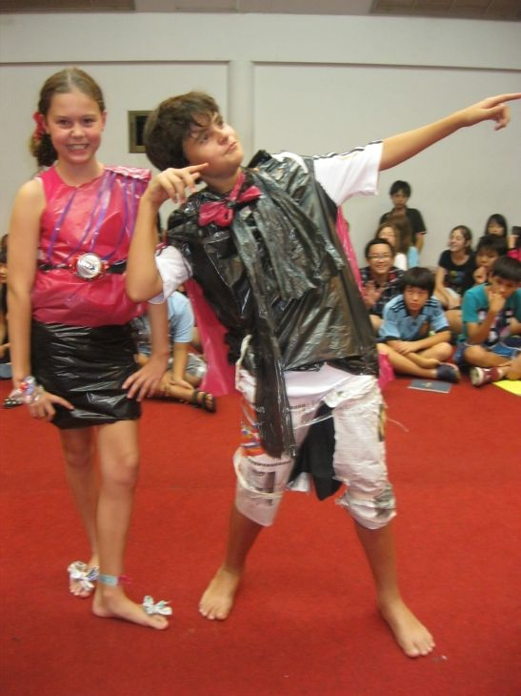

Slide 35
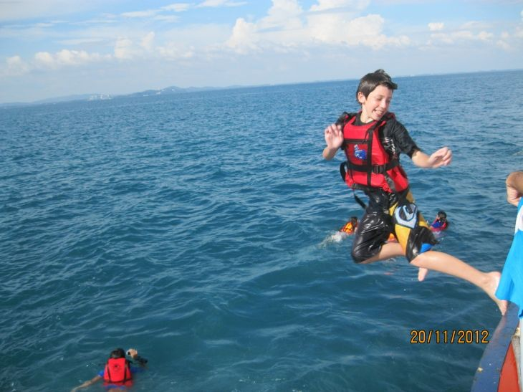
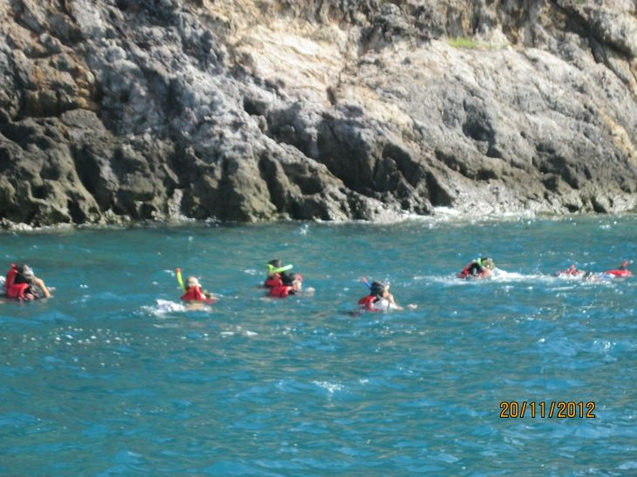
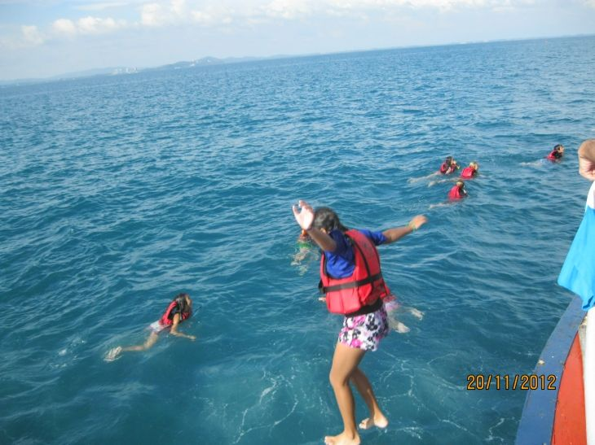

Slide 36
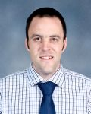
Year 7
Scott Tooley
Head of Faculty, Mathematics
scto@patana.ac.th
Bangkok Patana School Master Presentation
Notes:
36

Slide 37
Year 7
Set Structure
SET 1A | SET 1A
SET 1B | SET 1B
SET 2A | SET 2A
SET 2B | SET 2B
SET 3 | SET 3
What set will my child be in?
Bangkok Patana School Master Presentation
Notes:
37

Slide 38
Year 7
What do students study?
Number
Algebra
Geometry
Data Handling
Support/Review
Core
Extension
Mathematical Enrichment
Bangkok Patana School Master Presentation
Notes:
38

Slide 39
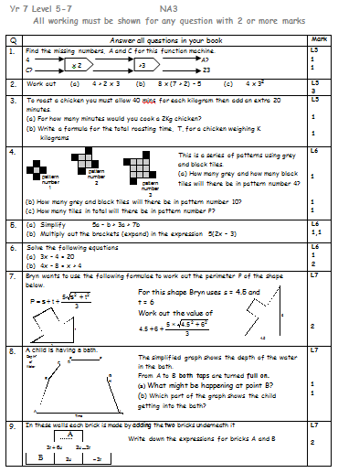
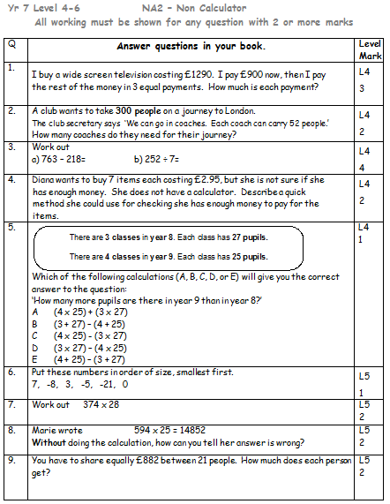
Year 7
Assessment
Students will be assessed in the following ways:
Half-termly levelled assessments.
General class learning and homework.
Bangkok Patana School Master Presentation
Notes:
39

Slide 40
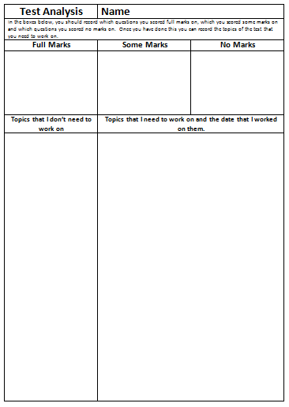
Year 7
Assessment
Student analysis of assessments will provide detailed feedback about ‘strong’ and ‘weak’ topic areas.
Students will be provided with time to work on the weaker topic areas at a time where it will be most useful.
Bangkok Patana School Master Presentation
Notes:
40

Slide 41
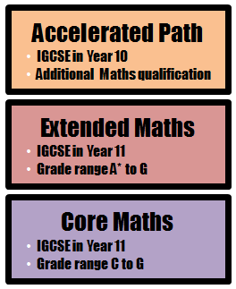
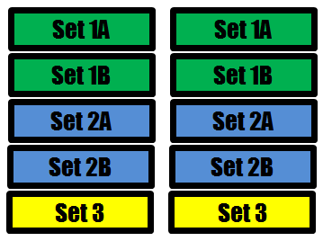
Year 7
What comes after KS3?
Bangkok Patana School Master Presentation
Notes:
41

Slide 42
Year 7
Questions?
See me afterwards or
email me on scto@patana.ac.th
Bangkok Patana School Master Presentation
Notes:
42

Slide 43
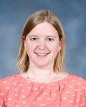
Year 7
Laura MacRitchie
Head of Music
lama@patana.ac.th
Bangkok Patana School Master Presentation
Notes:
43

Slide 44
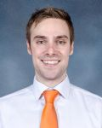
Year 7
Andy Thain
KS3 Review and Learning to Learn Co-ordinator
anth@patana.ac.th
Bangkok Patana School Master Presentation
Notes:
44

Slide 45
The Year 7 Tutor Team
7C
7F
7H
7J
7K
7M
7S
7W
Bangkok Patana School Master Presentation
Notes:
45

