Slide 1
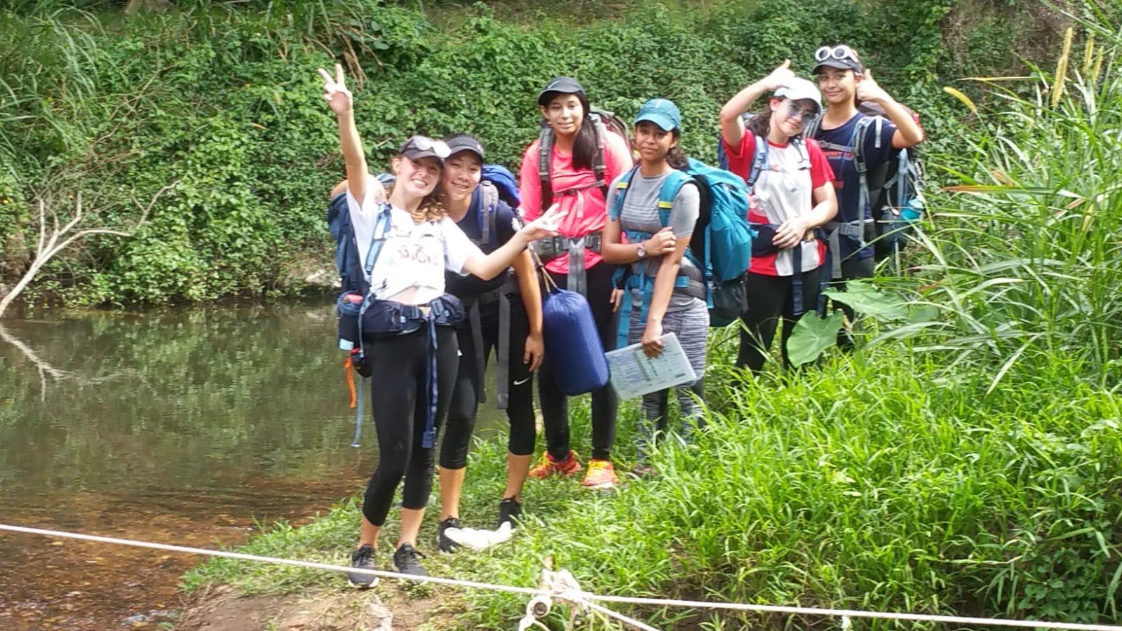
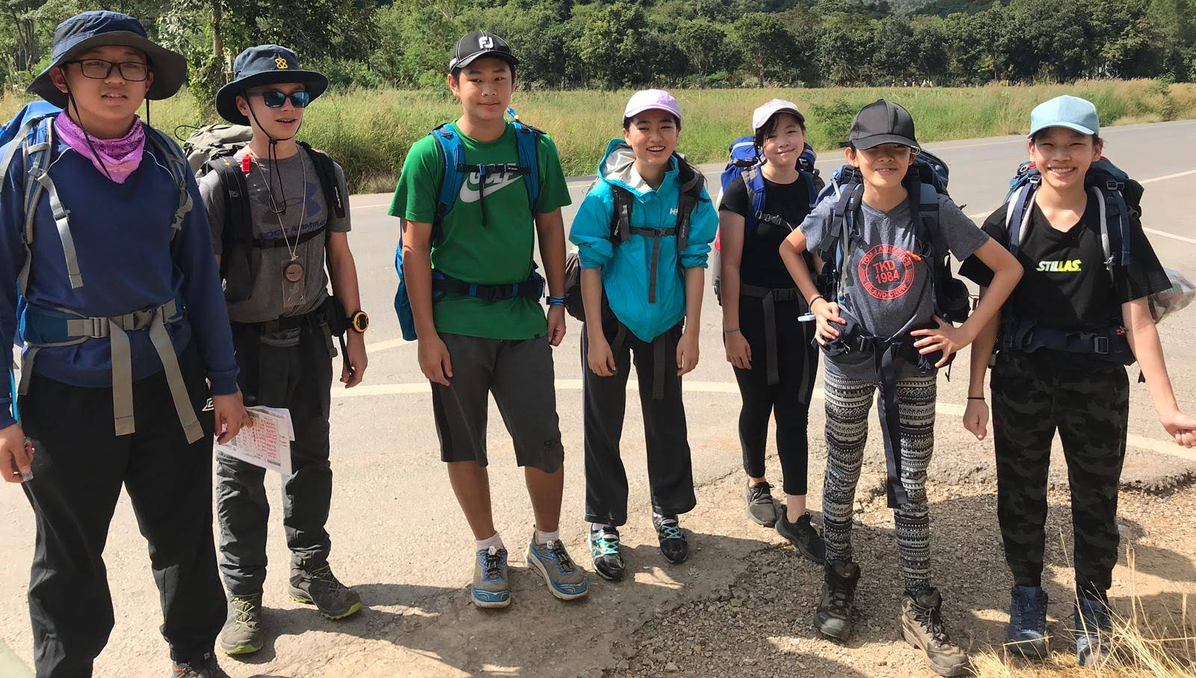
Success criteria for today’s ECA:
- Understanding of the Adventurous Journey
Understanding the impact of the
journey on the environment
- Thinking about observation and recording skills for your purpose

Slide 2
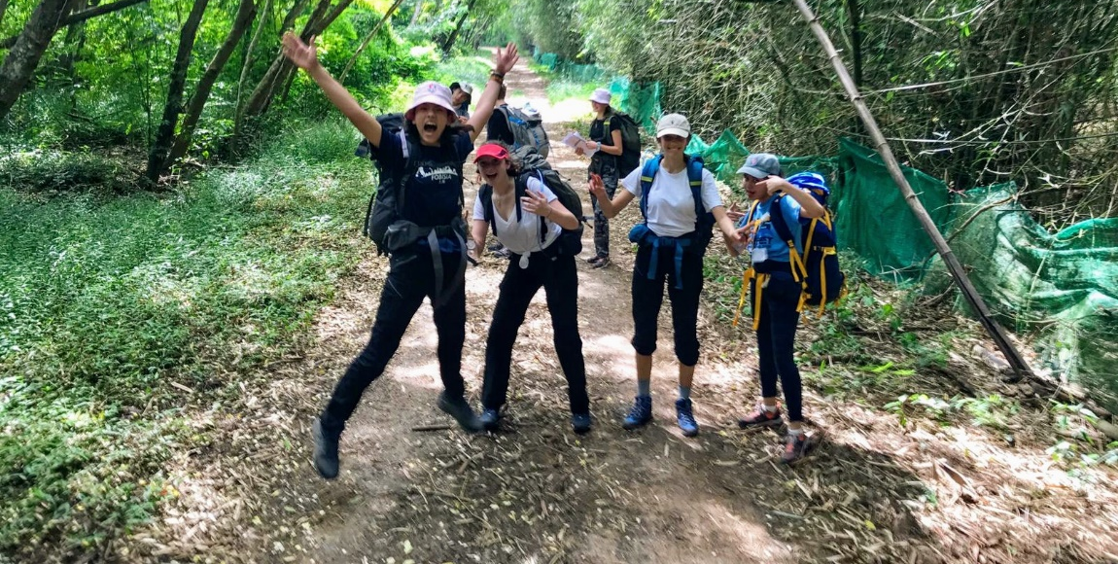
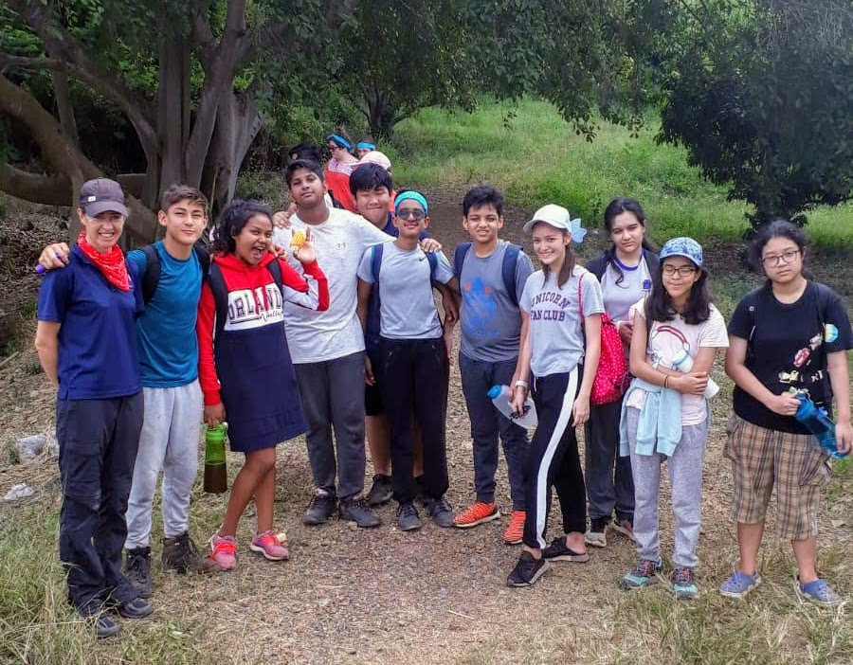
Understanding of the Adventurous Journey
Looking at the success criteria which has been emailed out to you this week, discuss in groups of four, 5 characteristics of a successful AJ and 5 characteristics of an unsuccessful AJ. Discuss as a whole group after.

Slide 3
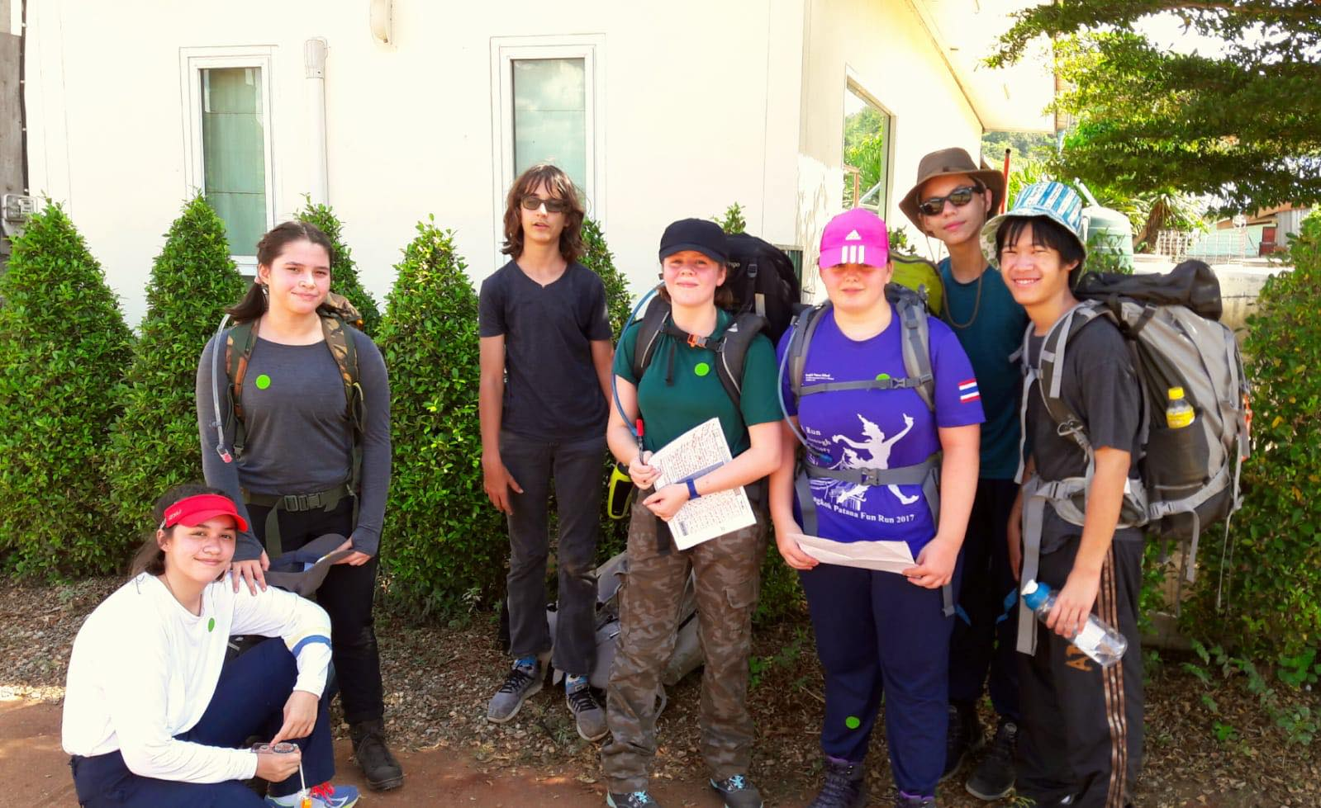
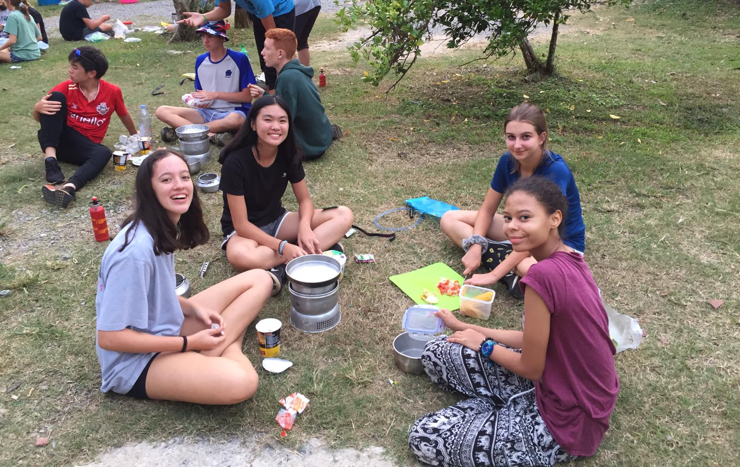
Understanding the impact of the journey on the environment
In pairs come up with 6 possible impacts that you may have on the environment in Sam Roi Yot and solutions to minimise them.

Slide 4
How can we ensure that we are good global citizens during the expedition?
Patana values
Global Citizenship:
We Are inspired to improve global sustainability

Slide 5
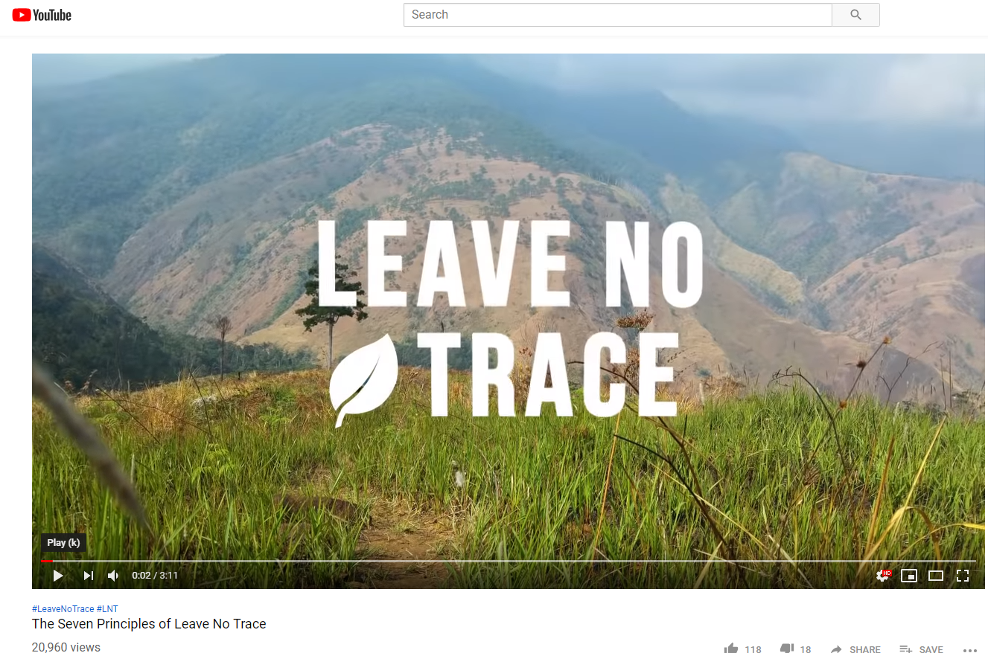
Watch the following video clip to give you some more ideas on how you can minimise your impact on the environment during your expedition:
https://www.youtube.com/watch?v=eWfh5LMTBig

Slide 6
Good global citizenship on expedition looks like this ….
- Where possible repackage food to minimise waste. Try not to bring any single use plastic.
- Pack it in, pack it out. Inspect your campsite and rest areas for trash or spilled foods. Pack out all trash, leftover food and litter.
- Leave rocks, plants and other natural objects as you find them.
- Observe wildlife from a distance. Do not follow or approach them.
- Respect other visitors and protect the quality of their experience.
- Be courteous. Yield to other users on the trail.
- Let nature's sounds prevail. Avoid loud voices and noises.

Slide 7
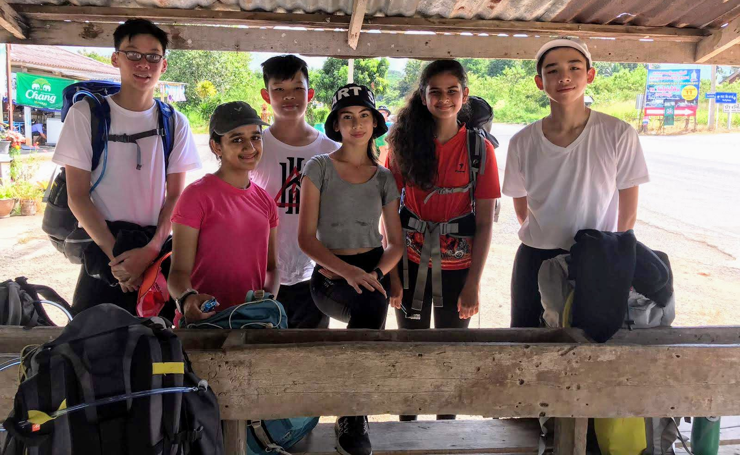
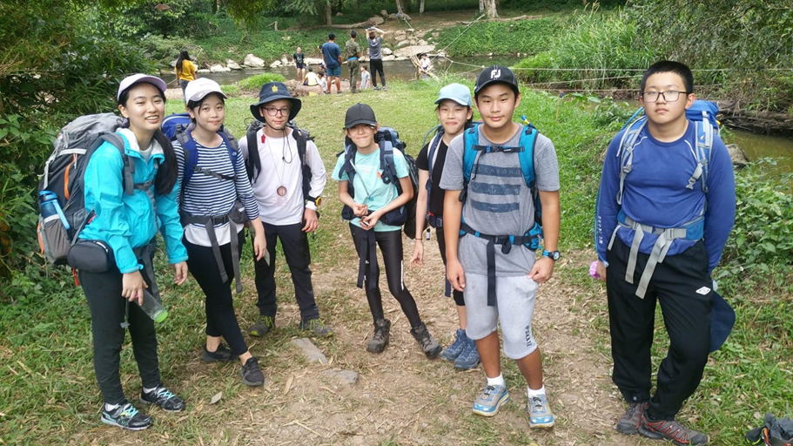
Observation and recording skills
By now you should have all started to think about your purpose.
Individually come up with 3 ideas on how you will observe and record your purpose so when you meet with your walking groups, you all have an idea to share and discuss.

