Slide 1
Purpose:
Success Criteria:
I can:
-Understand the key criteria for the assessed expedition.
-Write a purpose proposal.
-Reflect on the practice hike to identify areas of required improvement for the assessed expedition

Slide 2
Review
In pairs, discuss 3 WWWs and 2 EBIs about your own performance during the Rama 9 Outdoor Navigation ECA and how your group performed as a whole.
Three groups will be selected at random to share their reflections.

Slide 3
Purpose
Before you start your Adventurous Journey you need to have a think about how you are going to record it. For your Assessment you need to work in your groups to produce a report. All team members should have an input into the report, which can be in any format. It should tell the story of your preparation for and execution of the qualifying journey (the Assessment). This can provide a permanent record for your own personal reflection. Only after the report has been presented to your Assessor - simply travelling through the countryside is not enough!
Be as imaginative as you like!!

Slide 4
Requirements
You will be required to write a proposal in your groups before your expedition and submit it to one of the teachers supervising your expedition at least a week before you go. You will be contacted by your trip leader a few weeks in advance of your expedition to remind you of this.
You will need to arrange to meet up with your group to organise your report. Your ORB or Record book cannot be signed off until you have completed the initial proposal pre-expedition and then the final report post-expedition.
After your expedition you will need to get in touch with the staff that led your trip plus any other staff that you feel could be relevant given your report’s topic (e.g. geography teachers, biology teachers) and organise a convenient time to deliver your report to them – this could be during a lunch or break time.
You may produce your report in any one of the following ways or come up with another way:
A slide show on Powerpoint
A video diary
A written report
A photographic display
A Newspaper/Newsletter/magazine format
A promotional video encouraging others to take part
A play, song or poem
Notes:
There is a handout of the above text for the students to follow along

Slide 5
It should tell the story of your preparation for and execution of the qualifying journey (the Assessment) so think about the following:
How did you prepare? How did the group work together and prepare?
Was it what you expected? How did you find the expedition?
What did you learn?
How did you get on with the navigation, route planning, campcraft and cooking?
How did you work together as a team on the expedition?
Did you have to use any of your First Aid training?
What did you notice about the environment?
Did you learn any new skills?
Did you learn anything about yourself or other members in your team?
What would you do differently next time?
How do you think the International Award has improved you?
Can you relate any of the skills you have learnt to a school situation?
Are you ready to do the Silver?
Notes:
There is a handout of the above text for the students to follow along

Slide 6
Have a look at the presentations linked below and brainstorm your own ideas for your purpose.
To inspire you watch the following video of past purpose reports at Patana:
https://drive.google.com/file/d/1avtVSuSOCqQYxdSoXA8ACT_tgJJ5O-T7/view?usp=sharing
Past PPT purpose presentations:
https://drive.google.com/file/d/1pGeH-dWSyKiX8z6v7cwVMbIUxeBpbuBf/view?usp=sharing

Slide 7
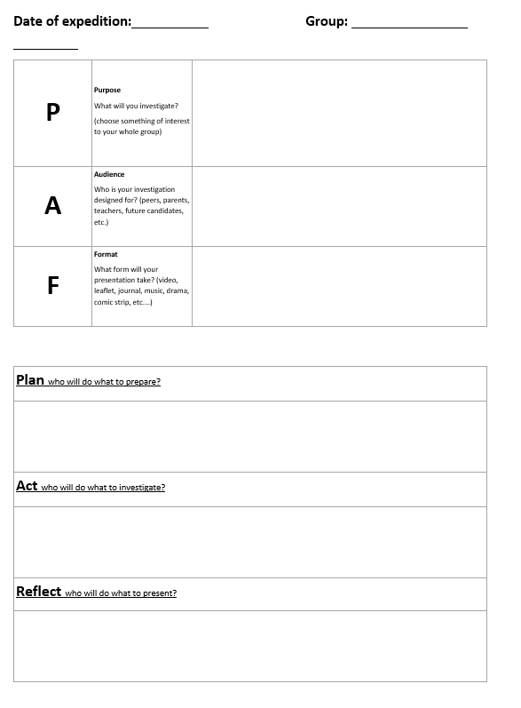
For the assessed expedition your group will need to complete the purpose planning sheet and send it to your trip leader no later than a week before your expedition.
Notes:
Each group will get a copy of this

Slide 8
Activity:
In groups of three, complete a purpose proposal form, then go on a 5 minute expedition around the school and record footage that you will use in your purpose presentation.
Return to the ECA classroom at 15:10 and you will have 10 minutes to prepare a purpose presentation.
The ECA teacher will pick three groups to present their school expedition purpose to the rest of the class.

