Slide 1
Five areas we will cover this session:
What the Award is all about
How to complete the Bronze Award with some Covid safe activity suggestions
How to get the most out of your DofE Bronze experience
The Adventurous Journey
How to get support if you run into challenges whilst completing your Award

Slide 2
On your seat is a paper and pencil
Divide the paper into three separate pieces
In the first message write about a skill that you would like to be able to show your friends
In the second message write about a sport that you would like to continue into your adult life
Imagine you are the CEO of a charity. In the third message explain what this charity does

Slide 3
The Duke of Edinburgh’s International Award is all about you
It was designed and promoted by the late Prince Philip (The Duke of Edinburgh) to allow young people the opportunity to explore their own interests and hobbies.
Activity
Have a think and then message your partner how many hours/minutes in the day do you get to do things that you want to do (not things that your family or friends want you to do).
The DofE is a way to get your out of school activities recognised, celebrated and gives you a step up when applying for university and jobs. The honest truth is many people exaggerate on their CV or portfolios (that’s kind of the point right?) but with a DofE Award, Bronze Silver or Gold due to the verification process university admissions and employers know your extra curricular activities are credible
Activity
Have a think and then tell your partner how many hours/minutes in the day do you get to do things that you want to do (not things that your family or friends want you to do).

Slide 4
Activity Time:
A game about you. Spend 30 seconds thinking about what job you would like to do when your 40 years old, if you cannot think of a job title then just give a brief description. Write it on a piece of paper but do not show it to your friend yet. Your friend should do the same. Now play 20 questions trying to find out what the other person has put down as their ideal job.

Slide 5
We have finished What the Award is.
Now let’s move on to how to complete it
GETE
 | Phys Rec | Skill | Service | Major | AJ
Bronze | 13 | 13 | 13 | 13 hours | 2 Days 1 Night
Silver | 26 | 26 | 26 | Direct Yes/No | 3 Days 2 Nights
Gold | 52 | 52 | 52 | Direct Yes/No | 4 Days 3 Nights | Residential Project
You can do one hour per week or two hours per two weeks or four hours per four weeks for each section. If you miss a week you will add it on at the end

Slide 6
GETE

Slide 7
Physical Recreation
The Physical Recreation section of the Award encourages young people to participate in sport and other physical recreation for the improvement of health, fitness and wellbeing. Encouraging healthy behaviors has benefits, not only for participants but also for their communities, whether through improved health, or active participation in team activities. This section specifically aims to improve the team skills, self-esteem and confidence of participants, which in turn can help improve both their physical and mental health.
Examples of Physical Recreation:
Ball sports — football, rugby, volleyball, basketball, cricket, golf, tennis
Athletics — running, jumping, throwing, biathlon, triathlon, decathlon
Water sports — canoeing, kayaking, swimming, water polo, diving, kite boarding Winter sports — skiing, snowboarding, curling, bobsleigh, ice hockey Martial arts karate, judo, kickboxing, boxing, taekwondo, kendo

Slide 8
Skills
The Skills section of the Award encourages the development of personal interests, creativity or practical skills. This section provides the opportunity for a participant to either improve on an existing skill, or to try something entirely new. As with the other sections, a level of commitment is required over time to progress a skill. It leads to a sense of achievement and well-being, and possibly improved employability through the development of life and vocational skills.
Examples of Skills:
Music — singing, learning to play an instrument, music event management
Sports related sports officiating, umpiring/refereeing, sports ground maintenance
Arts and crafts — ceramics, embroidery, jewellery making, drawing, painting, sculpture, photography
Nature and the environment — agriculture, astronomy, bee keeping, conservation, fishing, forestry, gardening
Communication film and video, languages, reading, writing, public speaking, journalism, website development
Games — billiards, snooker or pool, chess, darts, backgammon

Slide 9
Voluntary Service
For this section participants are required to give service (volunteer) over a set period of time. This enables them to experience the benefits that their Voluntary Service provides to others in their community.
Examples of Voluntary Service:
First aid
Visiting and supporting people in need, such as the elderly, or those with disabilities
Volunteering at a hospital or local care home
Sports coaching
Charity work

Slide 10
Adventurous Journey
The Adventurous Journey section encourages a sense of adventure and discovery while undertaking a team journey. As part of a small team, participants plan, train for and undertake a journey with a purpose in an unfamiliar environment. The journey can be an exploration or an expedition but must be a challenge. The aim of this section is to provide participants with the opportunity to learn more about the wider environment, as well as to develop their self-confidence, teamwork and health. Participants are taken out of their comfort zone but kept within a safe and secure setting, achieved through suitable training and supervision.

Slide 11
How to continue your DofE Award during CSL
Service
You can help a family member to complete your Service however it cannot be your regular household chores and this needs to be approved with me before you begin. You will still need to follow the SMART goal format. For a refresher on SMART goals use this link.
Physical Recreation
If your Phys Rec hours were logged using a school ECA, or a facility that has been closed due to Covid, you can change your activity. Home workouts are allowed under the temporary changes. As a last resort, I can be your assessor however you will need to add more detail to your logs supplemented with pictures and videos uploaded to the ORB.
Skill
If your Skill hours were logged using a school ECA, or a facility that has been closed due to Covid, you can change your activity. Practising your Skill at home through technology is now allowed under the temporary changes. As a last resort, I can be your assessor however you will need to add more detail to your logs supplemented with pictures and videos uploaded to the ORB.

Slide 12
Activity:
Discuss with your partner what you would like to do for your three sections. Be prepared to share your ideas!

Slide 13
GETE
Other important bits about completing your three sections
Each section needs an assessor who:
Monitors your progress (they do not have to be present for every session)
Is not related to you
Is older than you and has an expertise greater than yours
Can be the same person for more than one activity
You can do only do one hour per week, two hours per two weeks or four hours per four weeks, per section.
Each section needs a SMART target. Targets which are not SMART will be rejected
Your three activities are not meant to be similar. I.E Learning a new (skill) for swimming whilst improving your swim fitness (Phys Rec) and coaching swimming (Service) however…….

Slide 14
Frequently Asked Questions:
Q. Can I do more than one hour per week for my…..
A. No. The activities are designed to demonstrate you can commitment to self-improvement over an extended period.
Q. Does my assessor need to speak English
A. No
Q. How often does my assessor need to see me do an activity
A. At least three times, once at the start of you completing your activity so they can see what level you are, once the middle and then once at the end. This way they can see your progression and commitment to your activity.
Q. How are my activities checked
A. When you complete your activity hours the website (ORB) that you use to log your activities will send your assessor an email which they write a short reflection on your commitment and progression. I will then randomly select Award participants and verify their activities.
Q. Can I change my major, activity or assessor
A. Yes, however you need to talk to me about it first

Slide 15
That’s two out of the five things you need to know about the DofE done, now moving on to how to get the most out of your DofE Award.
Thinking back to the activity about what job you would like to do. Try and pick activities that are based on your interests and not what your friends or family think you should do
You will need to strike a balance between making your three activity sections easy enough to complete but challenging and engaging enough to enjoy
Discuss with your online partner some of the logistical issues that could be associated with competing your three activity sections
Break down your overall SMART target to really small chunks and try to celebrate finishing each chunk.

Slide 16
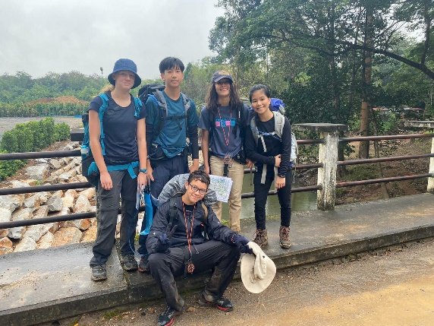
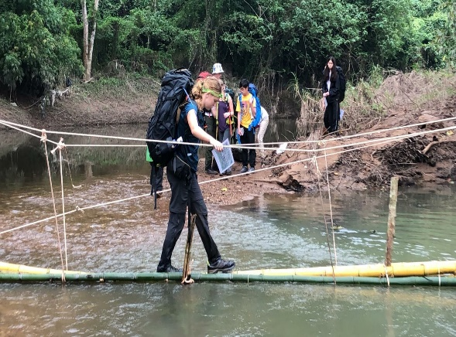
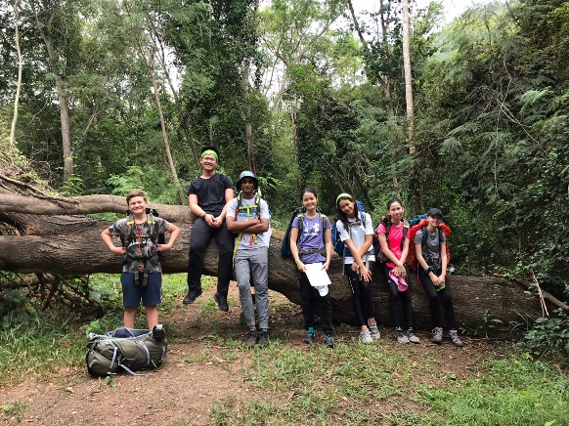
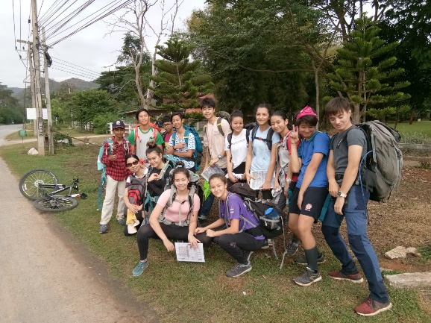
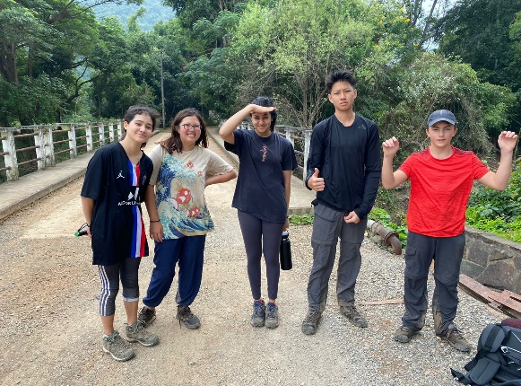
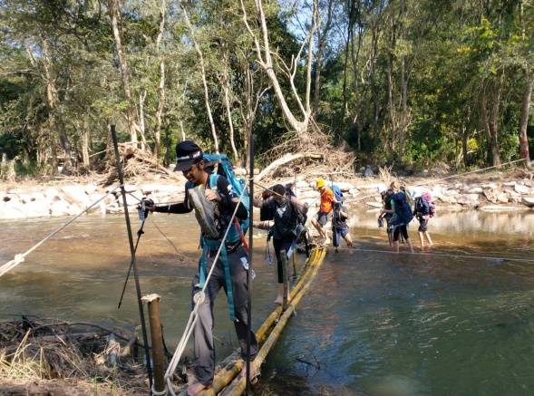
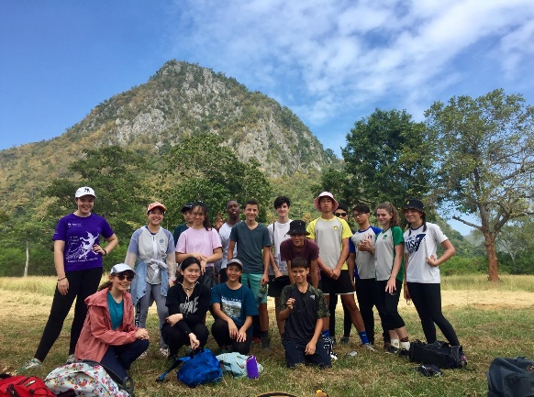
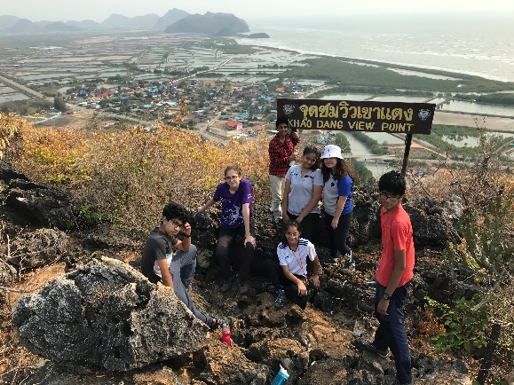
The Adventurous Journey
Practice (during Y10 resi week)
Assessed (Beginning of Term 2)

Slide 17
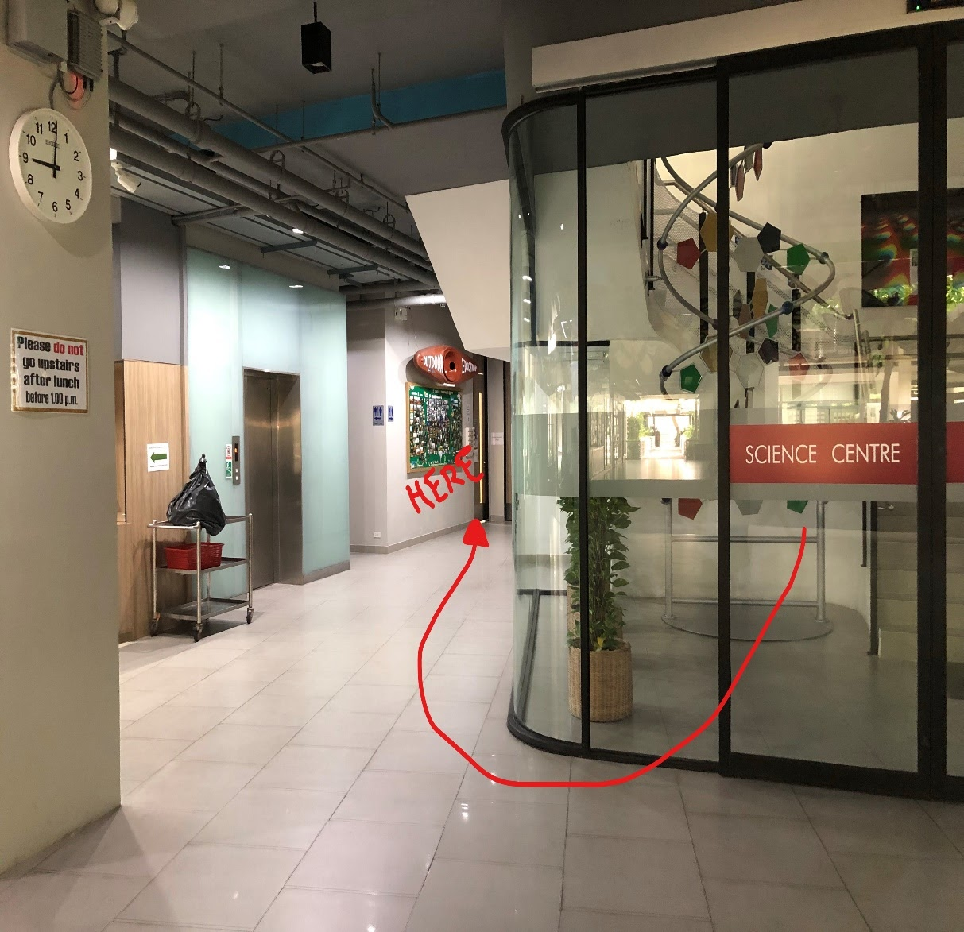
Finally: How to get support
I am in the Outdoor Ed office before school, at break time and every lunch time except Thursday lunch
Teachers are Patana are exceptionally busy so it is best to direct your questions to me
Check the DofE MS Teams page and emails
for important information
Email address KICL@patana.ac.th
Next week will learn how to use the ORB

