Slide 1
Team building
Learning intentions:
To think about possible challenges to good team work
To have fun in a team
To work together to achieve a common purpose
To clean up after yourselves

Slide 2
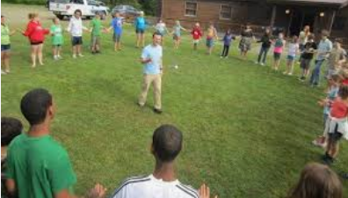
Team building
Discuss as a group what likely challenges you will encounter whilst on expedition that could hinder the walking teams ability to work together effectively

Slide 3
Get into teams of 5 or 6
https://www.youtube.com/watch?v=5M1lmH4_E4k
4 minutes to complete this task from the second the clip ends

Slide 4
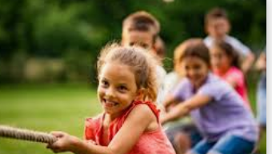
Change teams,
Still have teams of 5 or 6
How well can you complete this activity?
https://www.youtube.com/watch?v=bBVMYC-Wxkg

Slide 5
Change teams again
Still have teams of 5 or 6
Same again with this clip https://www.youtube.com/watch?v=0mTtn0D6_Po

Slide 6
Please restore the classroom and tidy any mess away.
If there is any time left work discuss as a group what likely challenges you will encounter whilst on expedition that could hinder the walking teams ability to work together effectively

