Slide 1
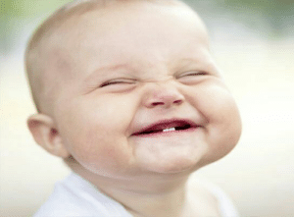
WELCOME TO OUR SMILE DAY ASSEMBLY

Slide 2
SMILE DAY IS ON FRIDAY MARCH 11TH 2022

Slide 3
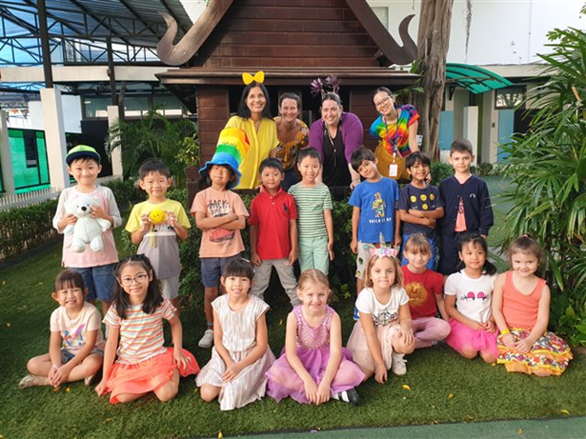
SMILE DAY HAPPENS EVERY 2 YEARS. WE RAISE MONEY TO SUPPORT OPERATION SMILE.

Slide 4
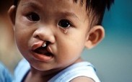
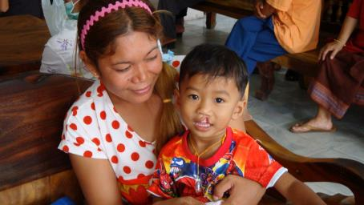
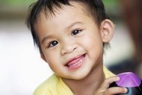
Changing lives one smile at a time.

Slide 5
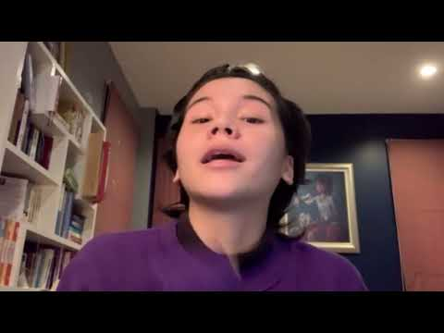
How does Bangkok Patana School help Operation Smile?

Slide 6
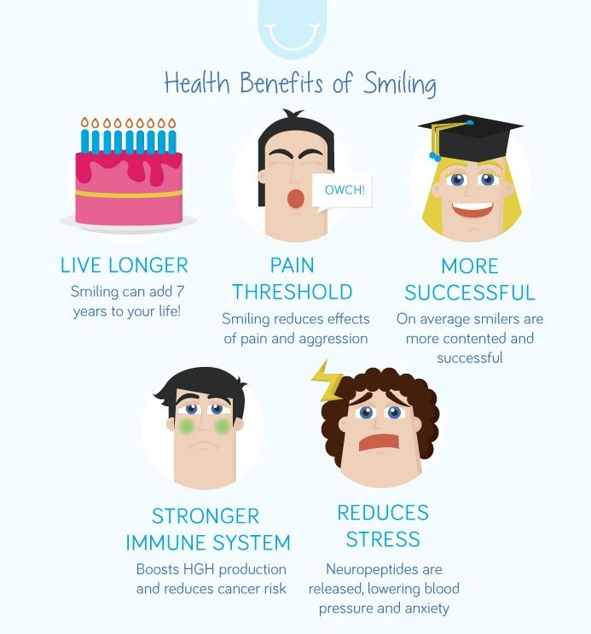
Do you know how
important it is to smile?

Slide 7
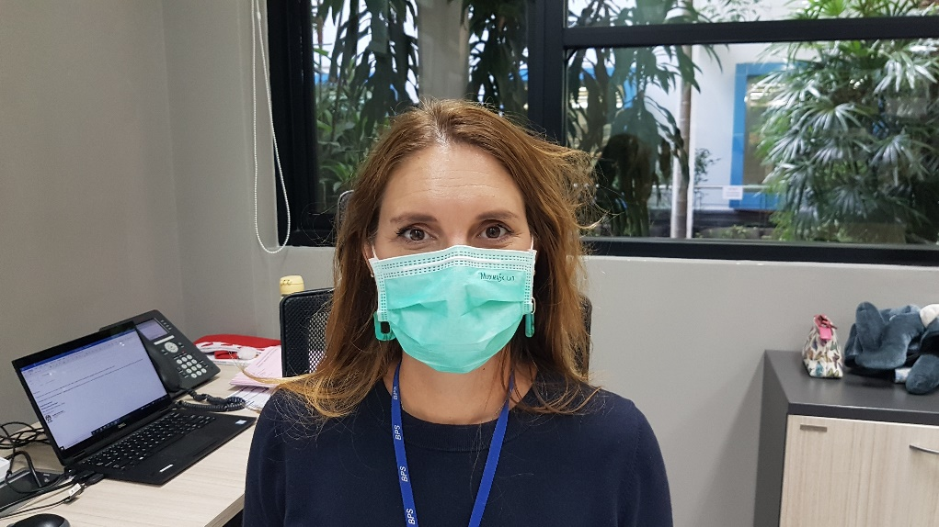
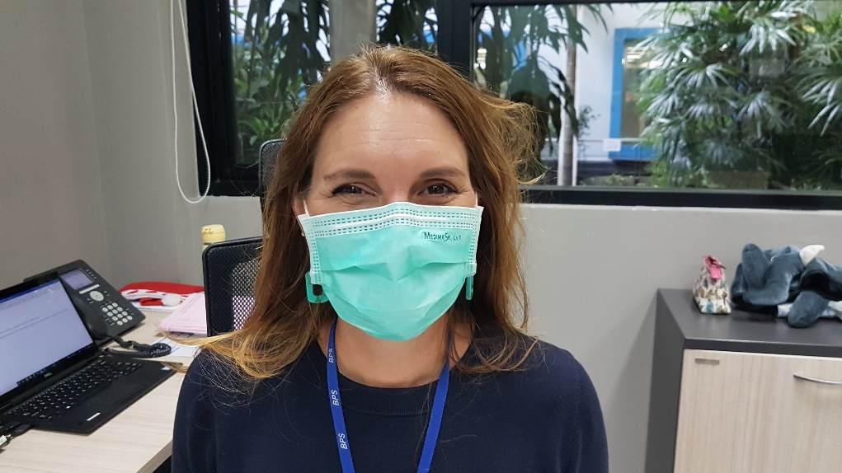
But with masks on, we can’t show our smiling mouths. Can you spot when someone has smiling eyes?
Mrs McCormack
A
B

Slide 8
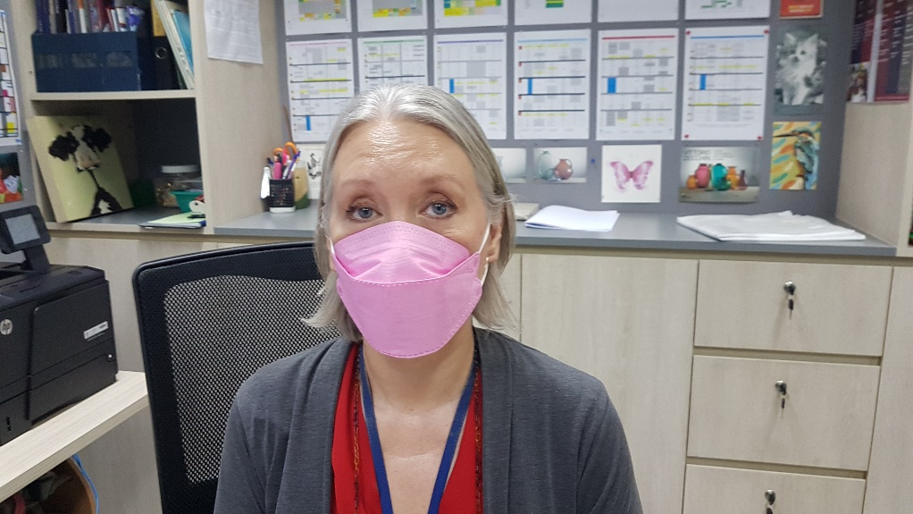
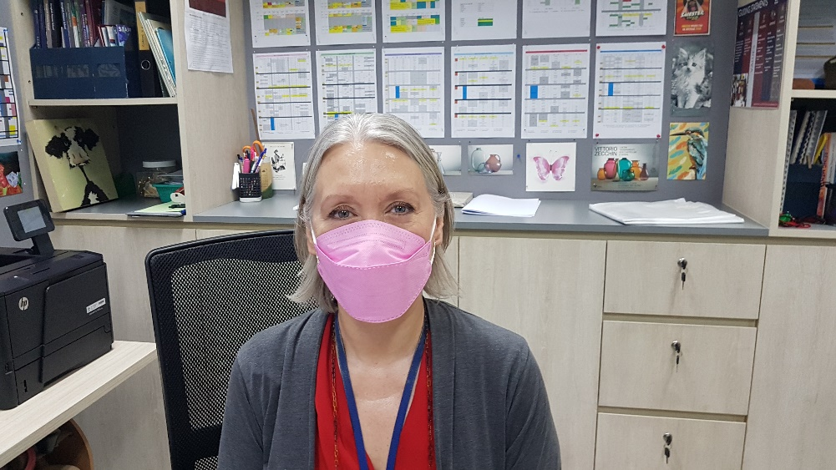
Ms Battram
A
B

Slide 9
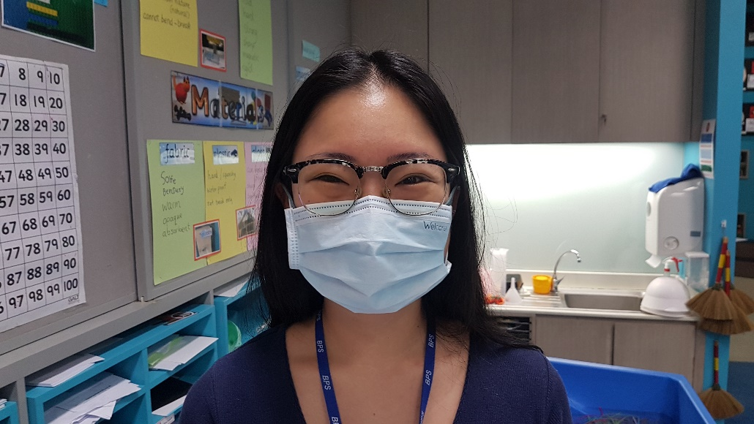
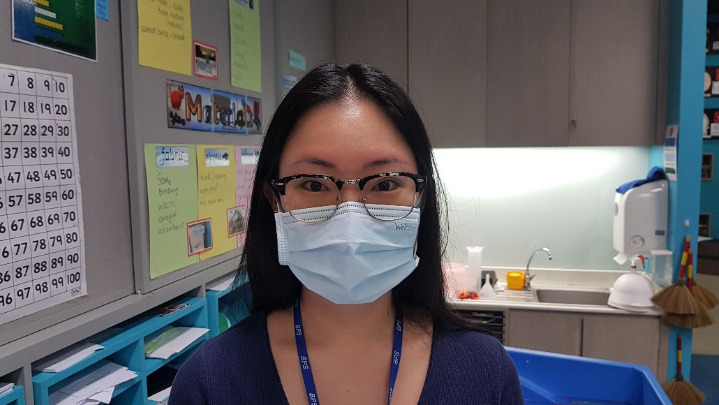
Ms Diana
A
B

Slide 10
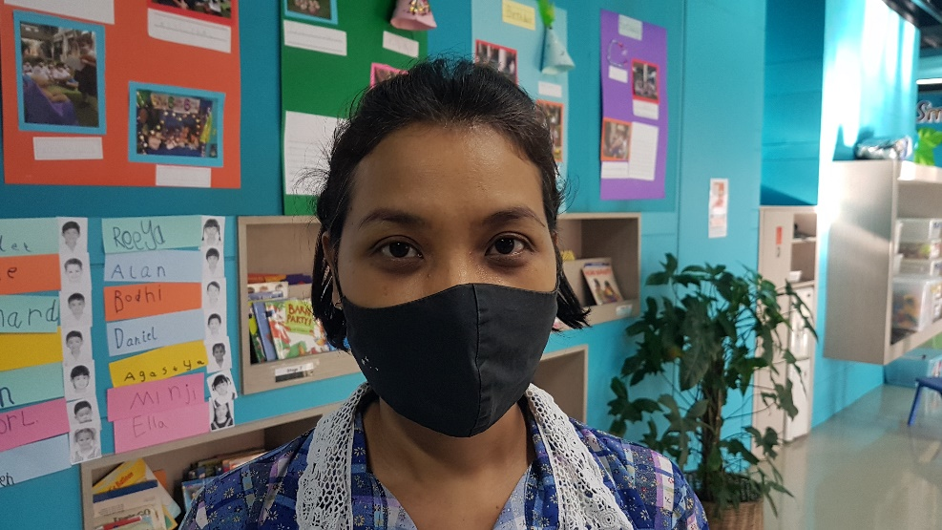
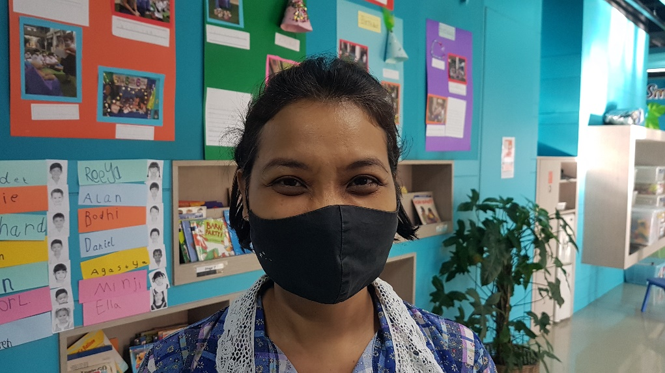
Ms Ning
A
B

Slide 11
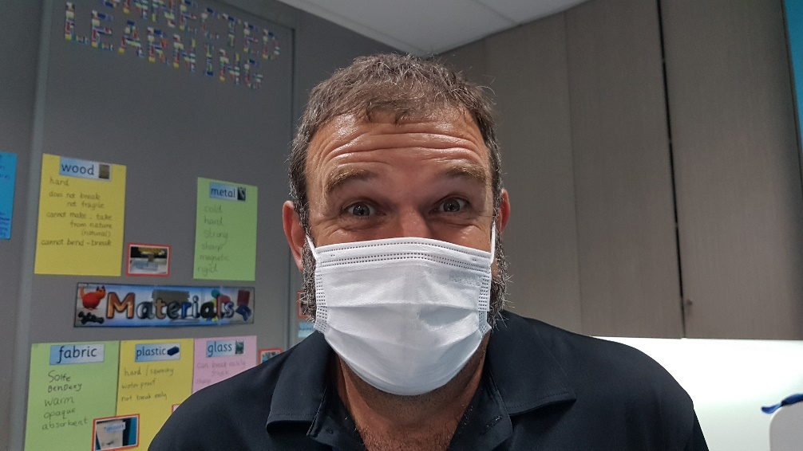
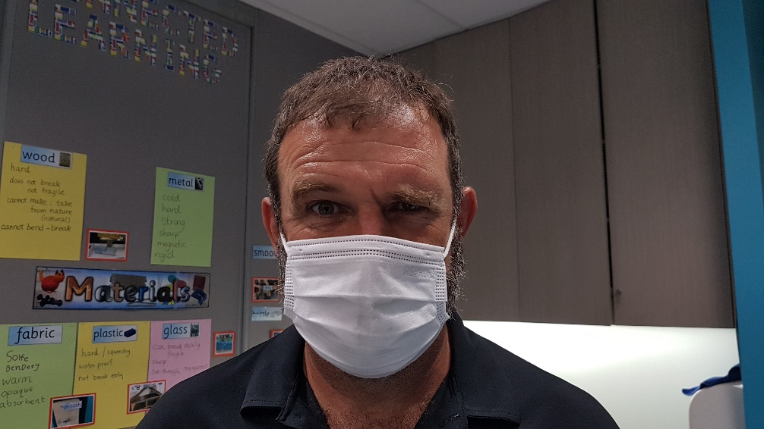
Mr Tatam
A
B

Slide 12
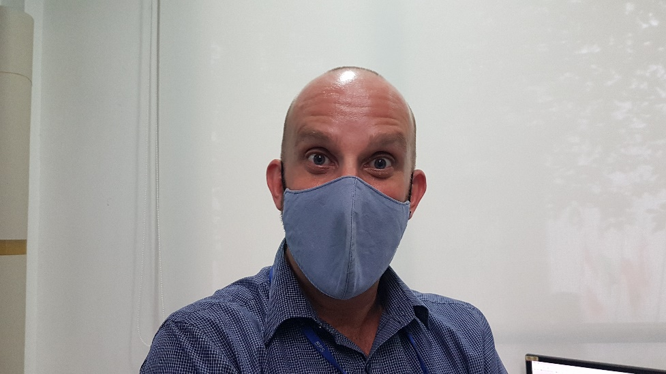
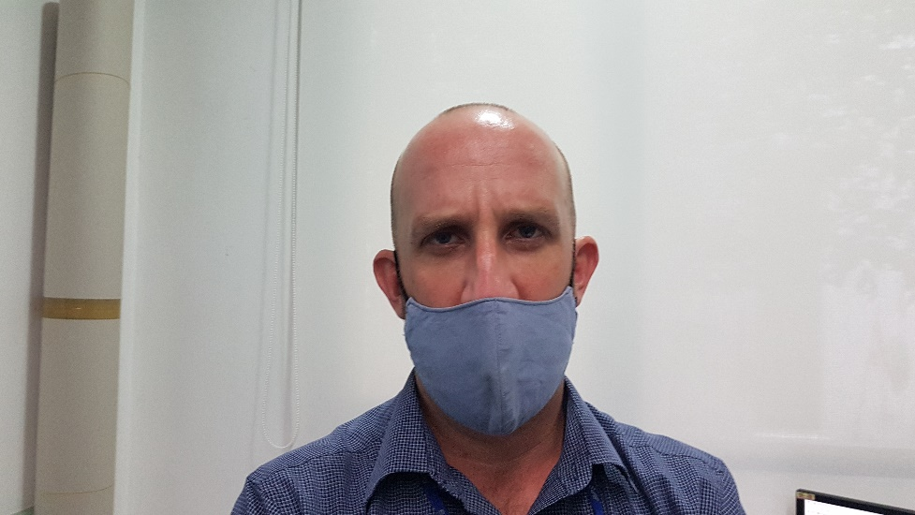
Mr Max
A
B

Slide 13
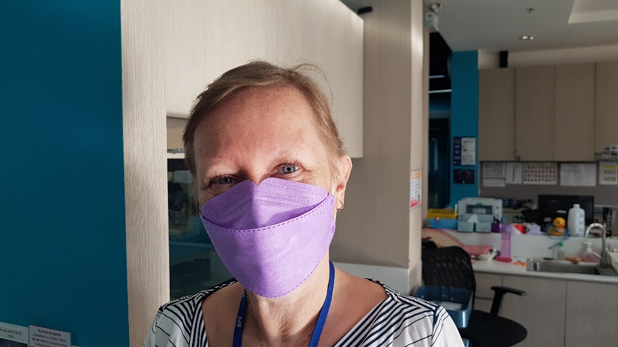
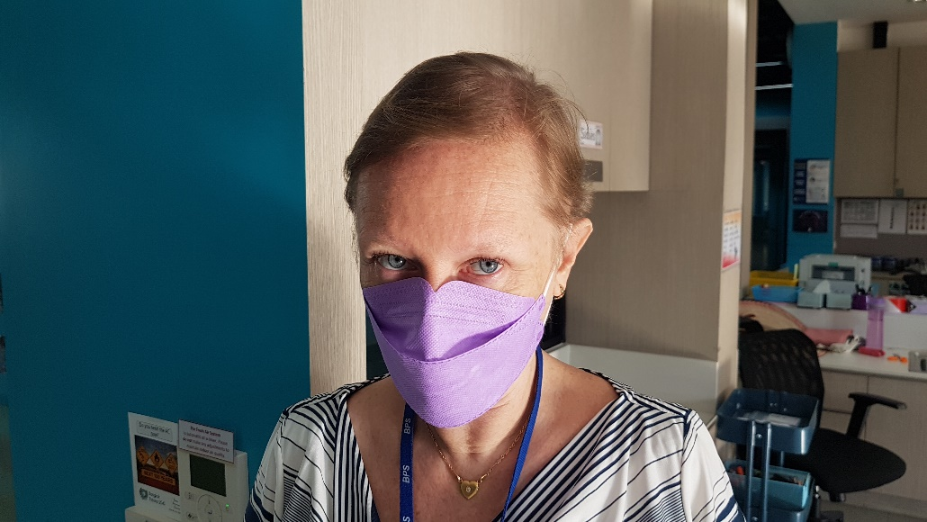
Ms Tracey
A
B

Slide 14
WHAT MAKES YOU SMILE?

Slide 15
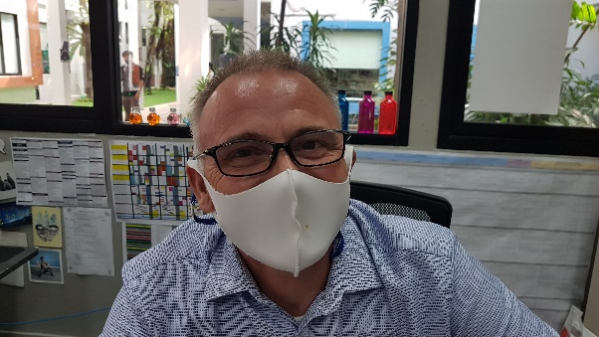
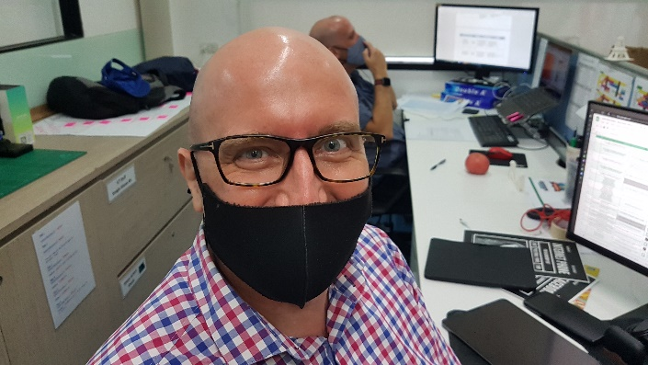
W
Go
When the children are smiling.
Going out to play time with the children.
When my 3 cats are happy playing together.
Playing Minecraft with Mackenzie.
Trees
Trees!

Slide 16
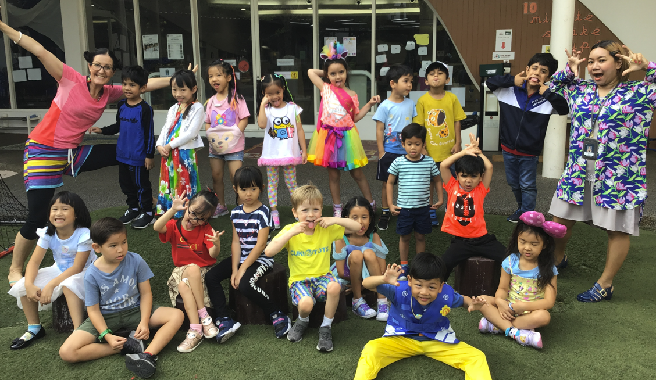
What do you need to do?
Bring in 100b donation.
Wear bright clothes.
Join in the fun!

Slide 17
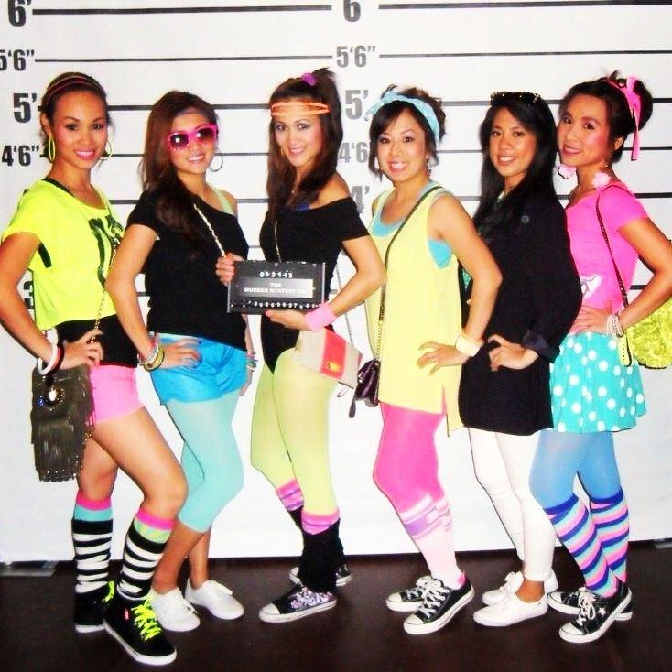
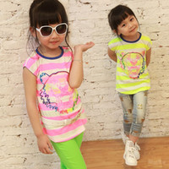
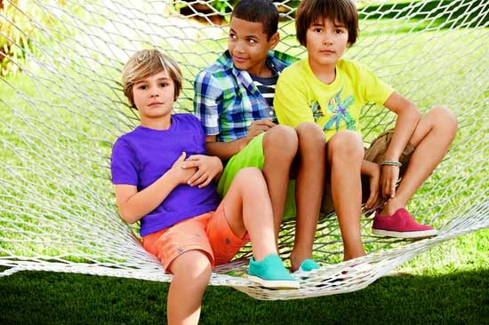
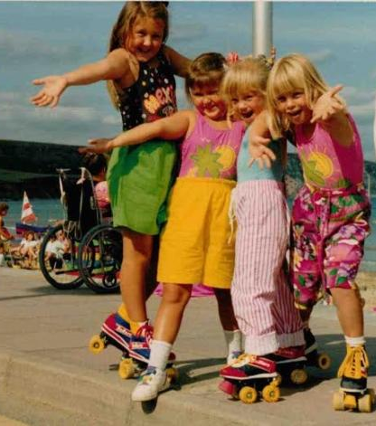
Brightest is best!!

Slide 18
‘How can I earn my
100 baht for Smile Day?

Slide 19
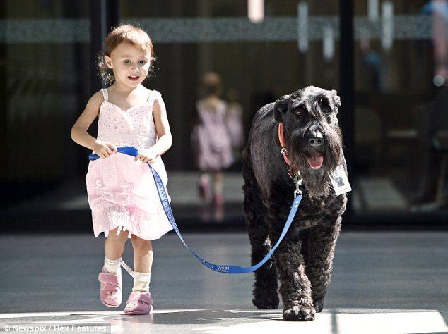
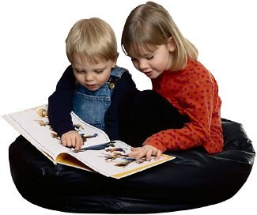
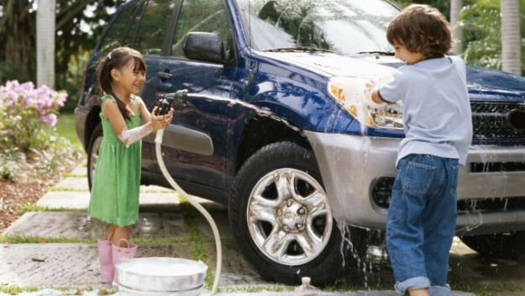
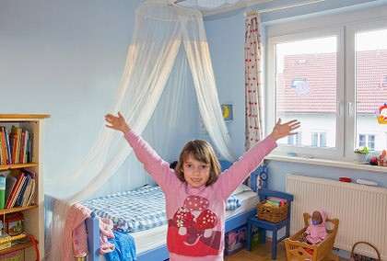
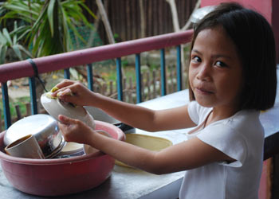
Help with the cooking
Take the dog for a walk
Read to a younger sibling
Help with the
washing up
Help wash the car
Tidy your room

Slide 20
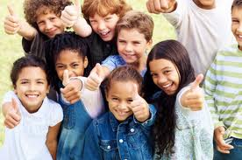
Or, just be generous and donate your pocket money!

Slide 21
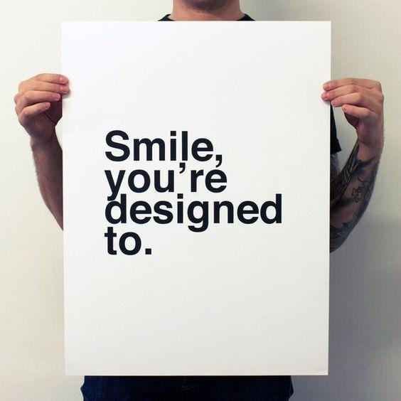
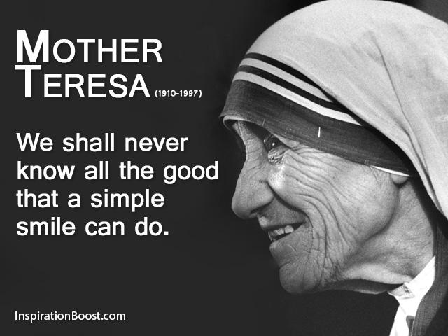
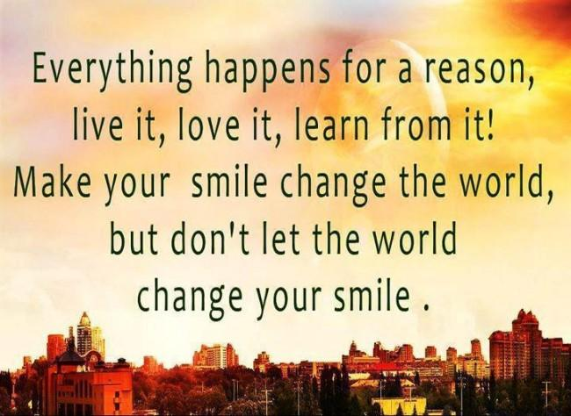
Happy Smile Day!

