Slide 1
Changing me

Slide 2
Our Bodies
Our Learning Intentions
Star Words
Can I name body parts?
male
female
body
private parts
genitals

Slide 3
Which cat is male?
Which cat is female?
How do you know?

Slide 4
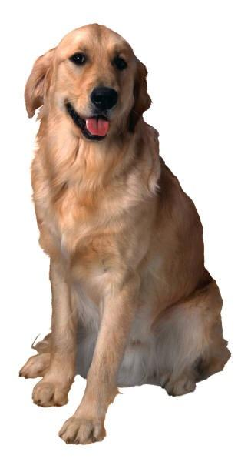
Which dog is male?
Which dog is female?
How do you know?

Slide 5
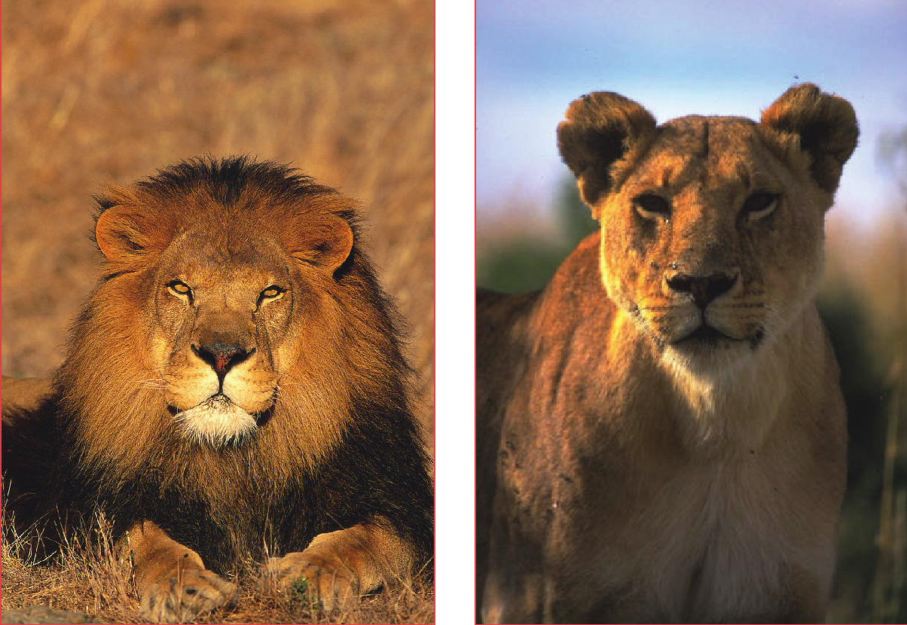

Slide 6
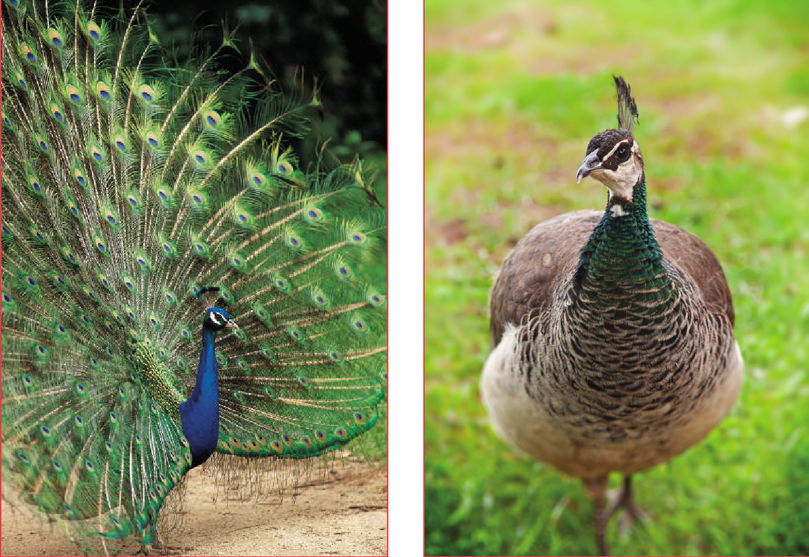

Slide 7
How can we tell the difference between a male and a female?
How can we tell who’s a boy and who’s a girl?

Slide 8
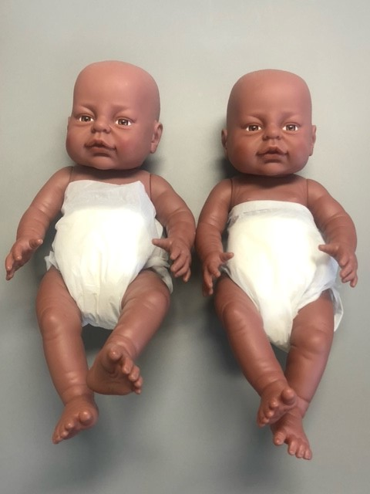
Which of the baby’s body parts can you name?
Which baby do you think is male?
Which baby do you think is female?
How will you know?
If the babies were older, would it be easier?

Slide 9
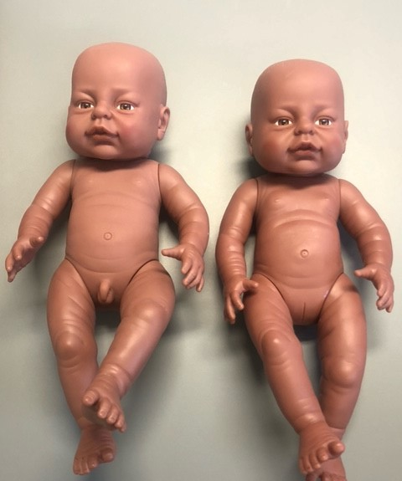
Spot the difference
Their genitals are different.
Do you know any scientific names for male and female genitals?

Slide 10
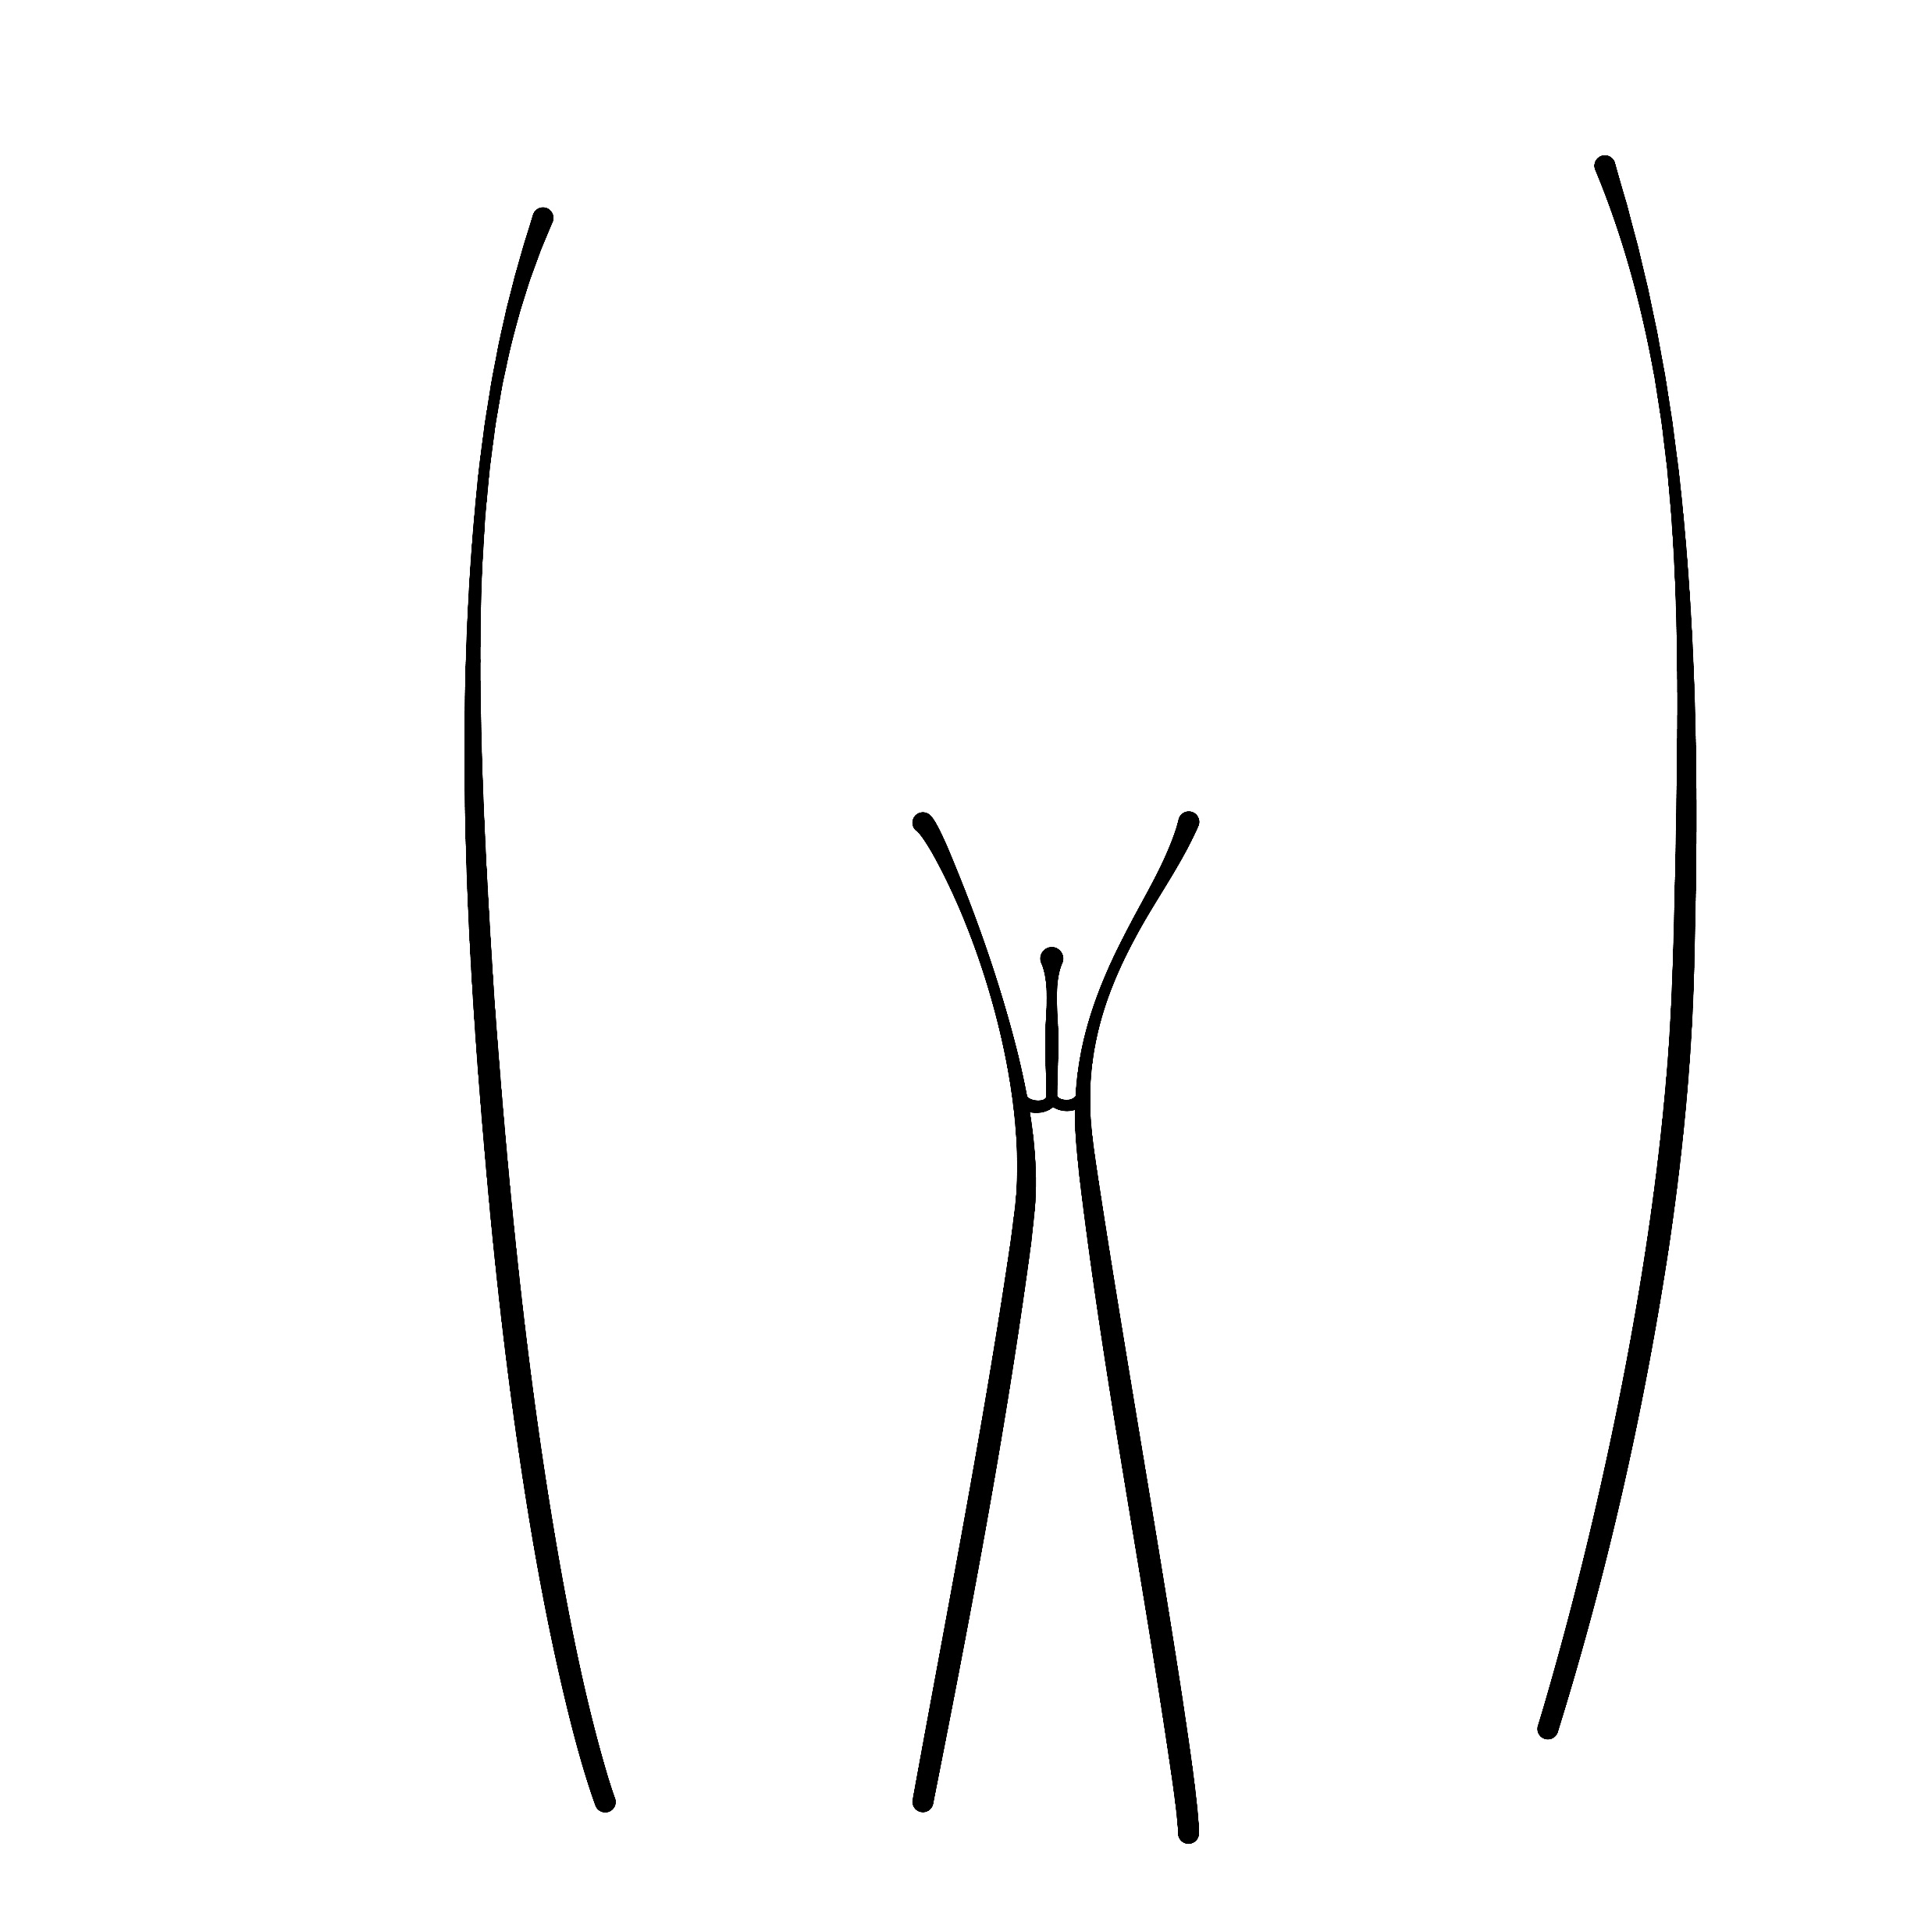
male genitals
female genitals
vagina
(inside the body)
penis
testicles
vulva

Slide 11
What are the correct names for the body parts that make boys and girls different?
Do you use different names for private parts at home?
These are your private parts and they are personal to you.

Slide 12
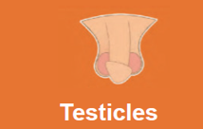
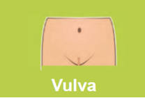
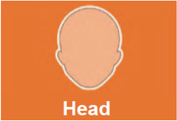
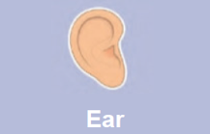
Can I sort female and male body parts?
Boys
Girls

Slide 13
When is it ok to talk about these private parts?
When is it not ok to talk about these body parts?

Slide 14
Pantasaurus Song

Slide 15
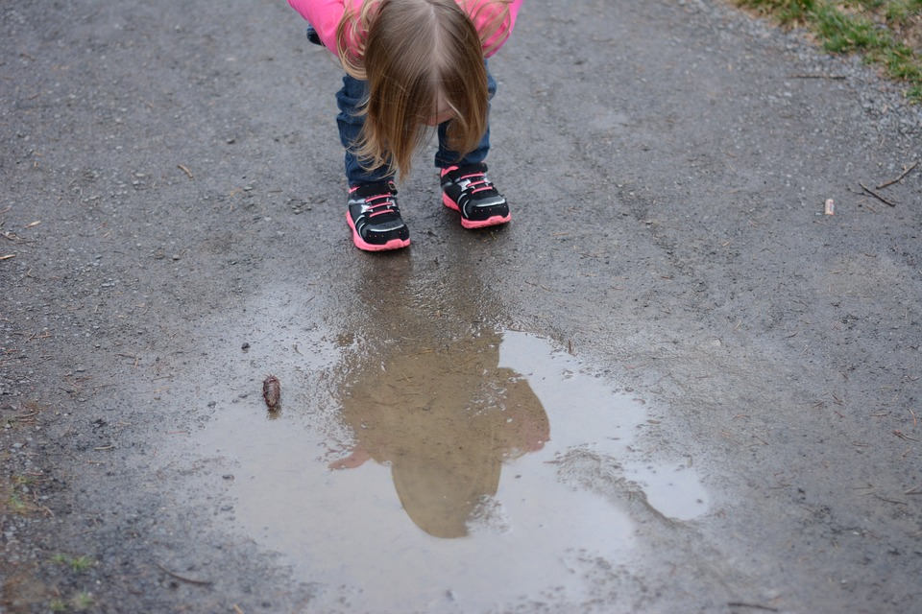
Reflection
What is the message in this song?

Slide 16
