Slide 1
TECHNOLOGY &
Saving on the App
DIGITAL CREATIVITY
YEAR 6

Slide 2
YEAR 6
Digital Creativity & Computing Units
FILM & FILMMAKING
GAME DESIGN
IMAGE EDITING & PHOTOGRAPHY MINECRAFT* (class teacher/ Mr. Glenn projects)

Slide 3
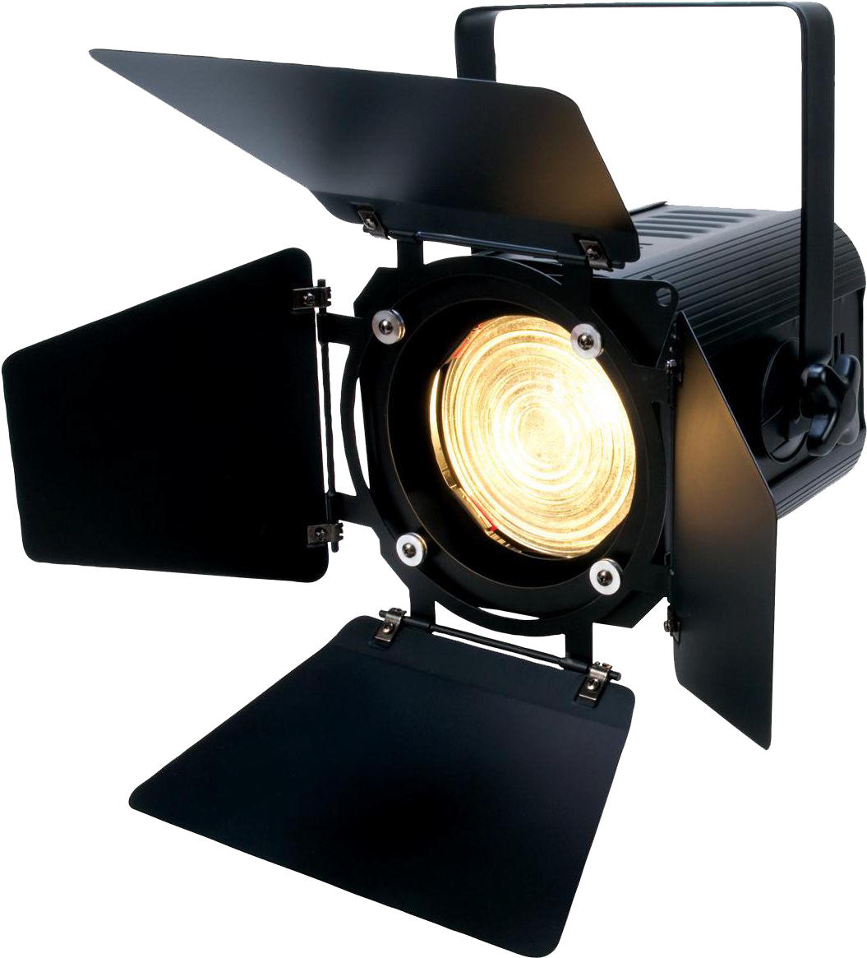
THIS TERM:
FILMMAKING
Celebration, Creativity, Culture, Fun and Positivity

Slide 4
THIS UNIT
We will be learning about:
How to read a film
The grammar of film, shot types and how to use them to tell a story
Film Production: how to shoot a film
Post-Production: the magic of editing
Why? To make a 30-50 second Film
Celebration, Creativity, Culture, Fun and Positivity

Slide 5
I am a ﬁlmmaker
I am a director
I am a camera operator I am an editor
I am an sound recordist
Celebration, Creativity, Culture, Fun and Positivity

Slide 6
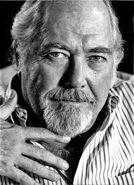
“Filmmaking is the chance to live many lives”
- Robert Altman
Celebration, Creativity, Culture, Fun and Positivity

Slide 7
“Cinema is not only about making people dream. It’s about changing things and making people think.”
– Nadine Labaki
Celebration, Creativity, Culture, Fun and Positivity

Slide 8
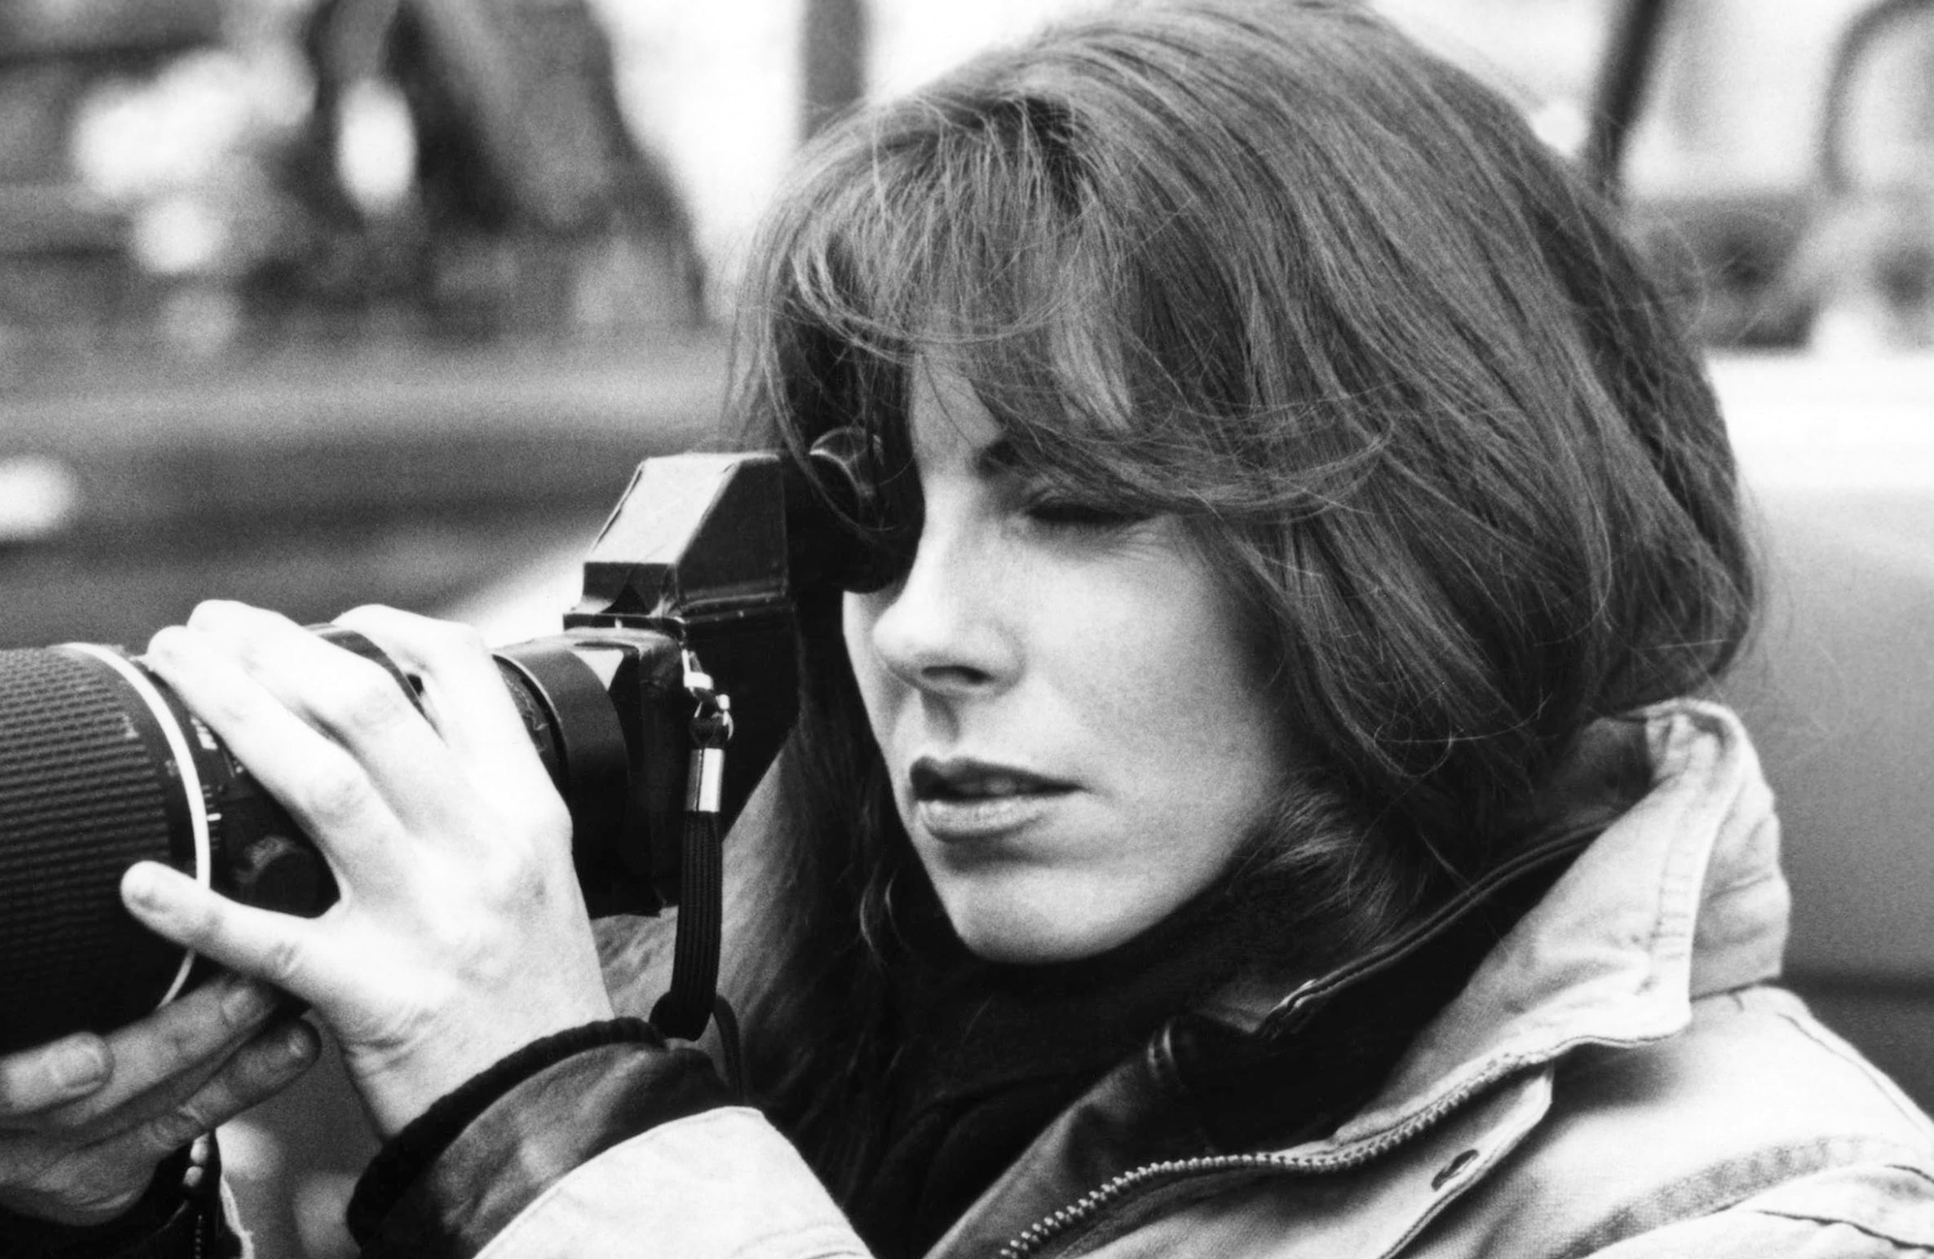
Painting has a limited audience, I recognized film as this extraordinary tool that could awe tremendous numbers of people
- Kathryn Bigelow
Celebration, Creativity, Culture, Fun and Positivity

Slide 9
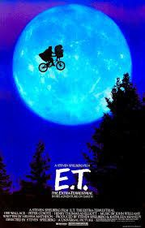
“I love editing. It’s one of my favorite parts about ﬁlmmaking.”
- Steven Spielberg.

Slide 10
_{week}01 THE FRAME
To tell stories through ﬁlm you need to know your shot types and what they’re used for!

Slide 11
SHOT TYPES
What’s the story?
What type of shot is used?
Use a suitable tempalte in Whiteboard [Link]

Slide 12
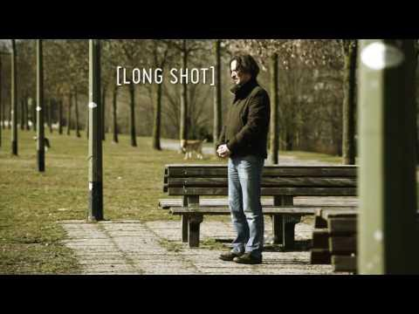
BASIC SHOT TYPES

Slide 13
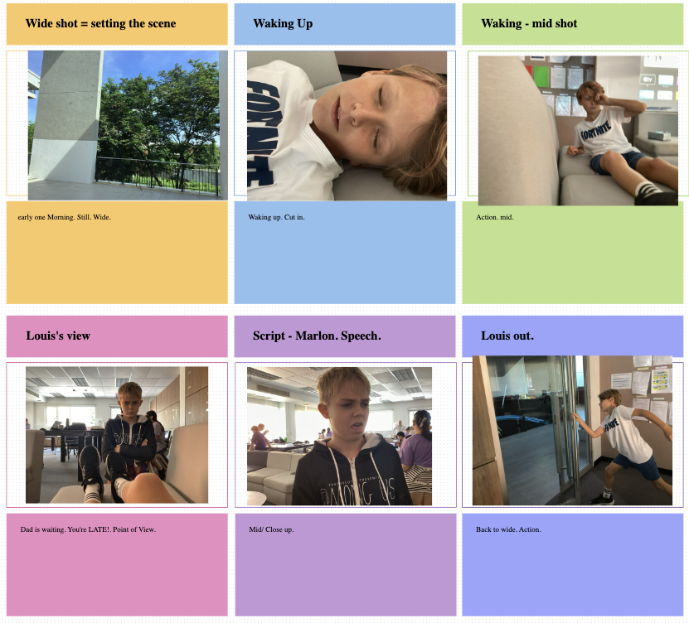
SHOT TYPES
Create a shot list poster in Whiteboard: what story is being told in each frame?
Close up

Slide 14
ACTIVITY:
Use this resource to help you compose and label your shots:
LI: To learn the shot types and how they are used
In pairs create an information poster
about the different shot types.
Take it in turns to compose 5 shots and take pictures of each other showing each different shot type.
Import your pictures to a Whiteboard and label each one.
THINK: STORY - what could be happening in each shot?
LINK

Slide 15
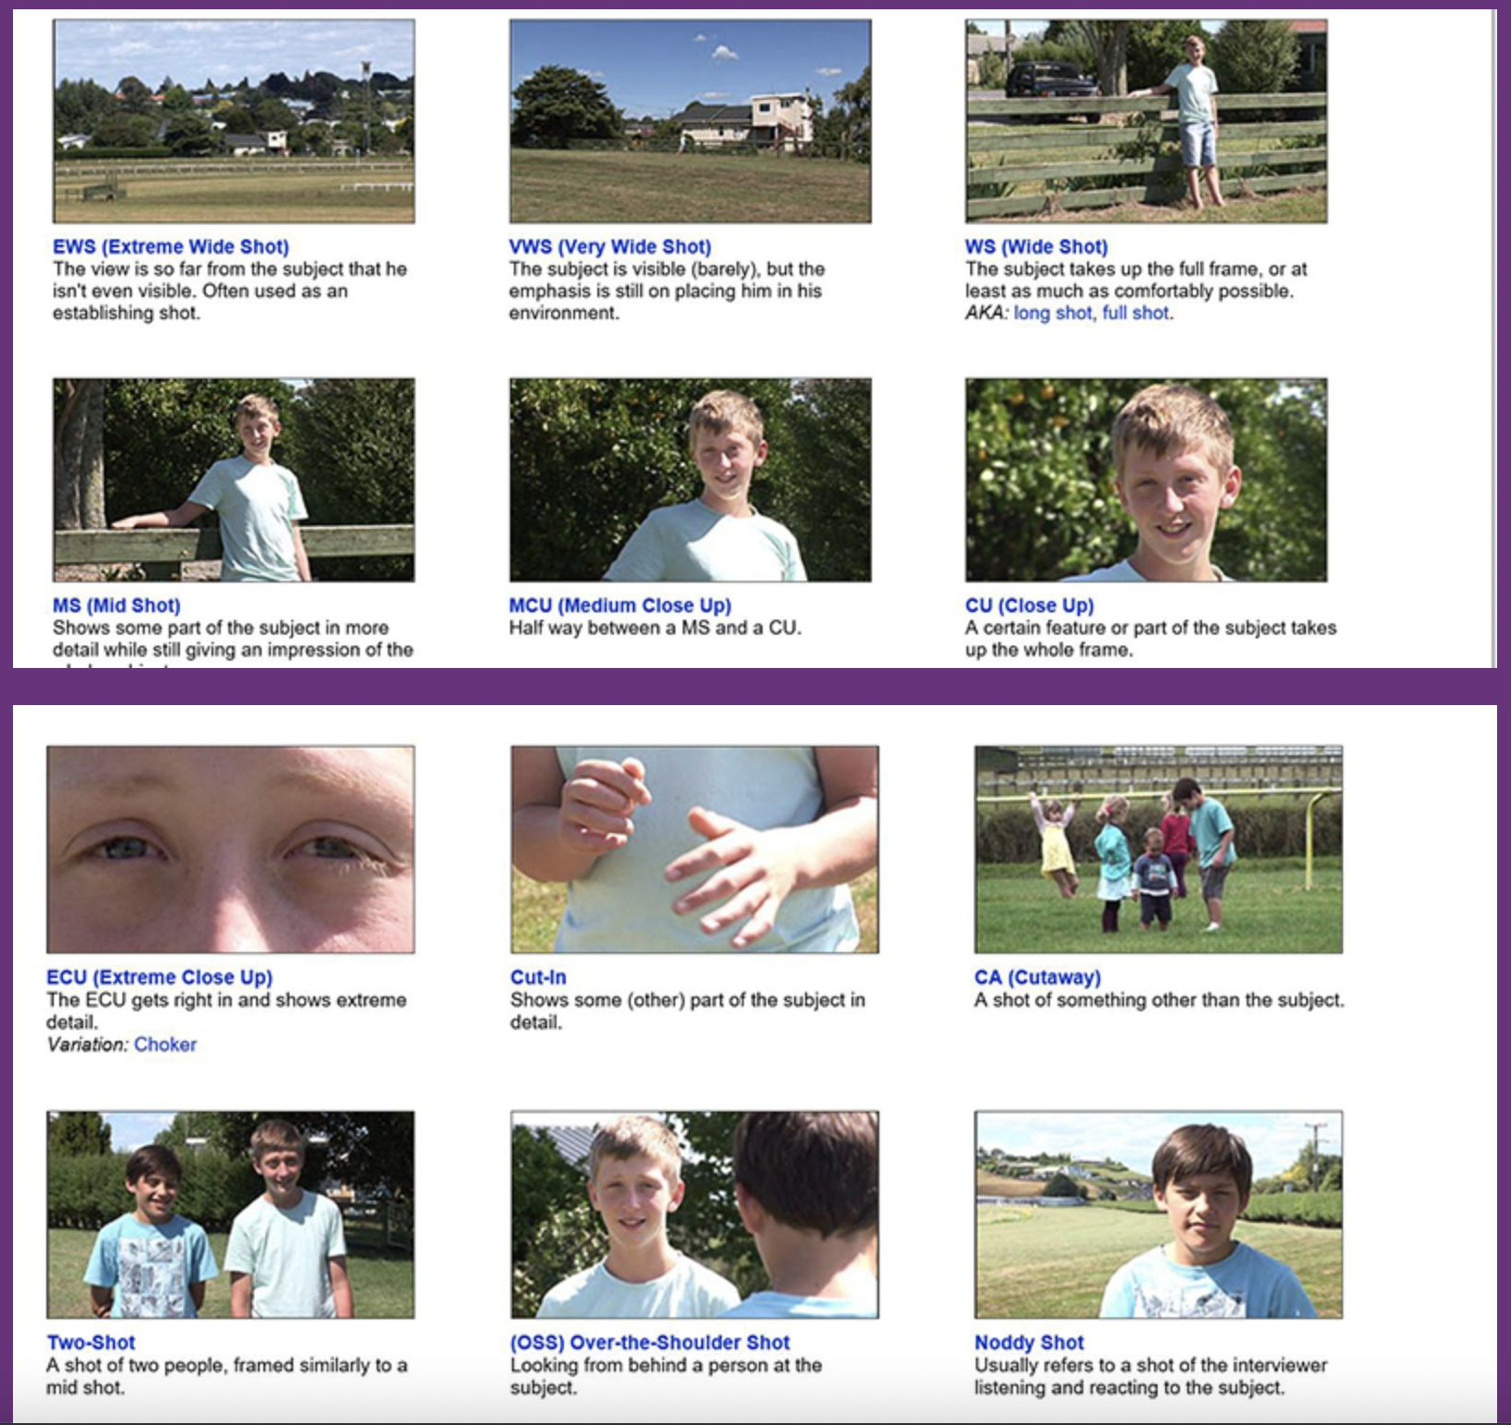
ACTIVITY
Create a shot type poster in Whiteboard

