Slide 1
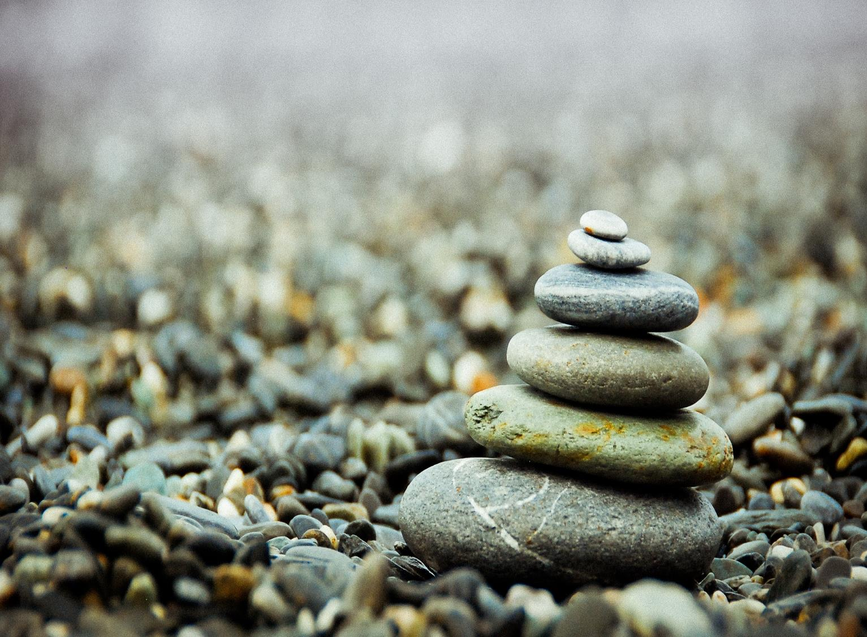
All photos published on Unsplash are licensed under Creative Commons Zero which means you can copy, modify, distribute and use the photos for free, including commercial purposes, without asking permission from or providing attribution to the photographer or Unsplash.

Slide 2
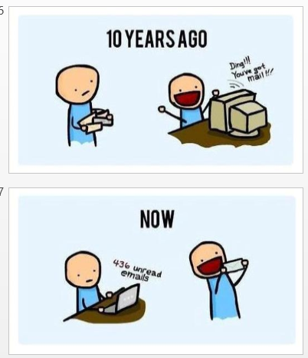

Slide 3
How many emails do you have in your inbox right now?
Do you use folders in your inbox?
Do you use the Outlook calendar?
Do you use tasks?
Do you categorize or tag emails?

Slide 4
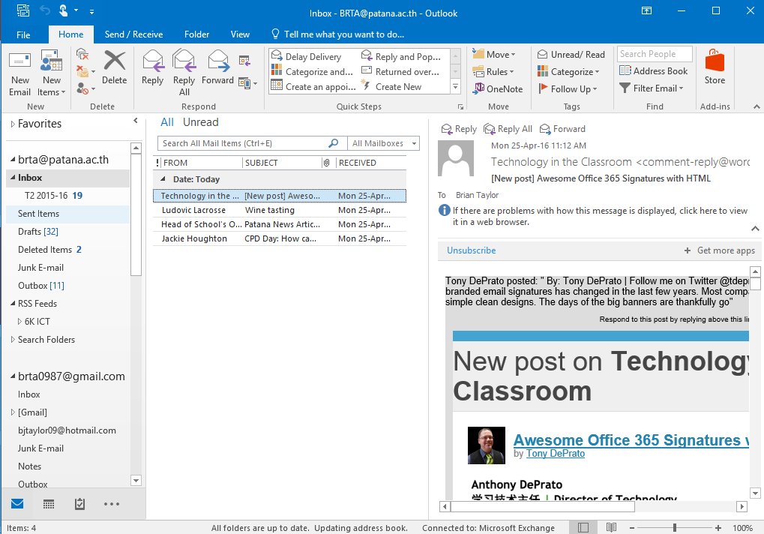

Slide 5
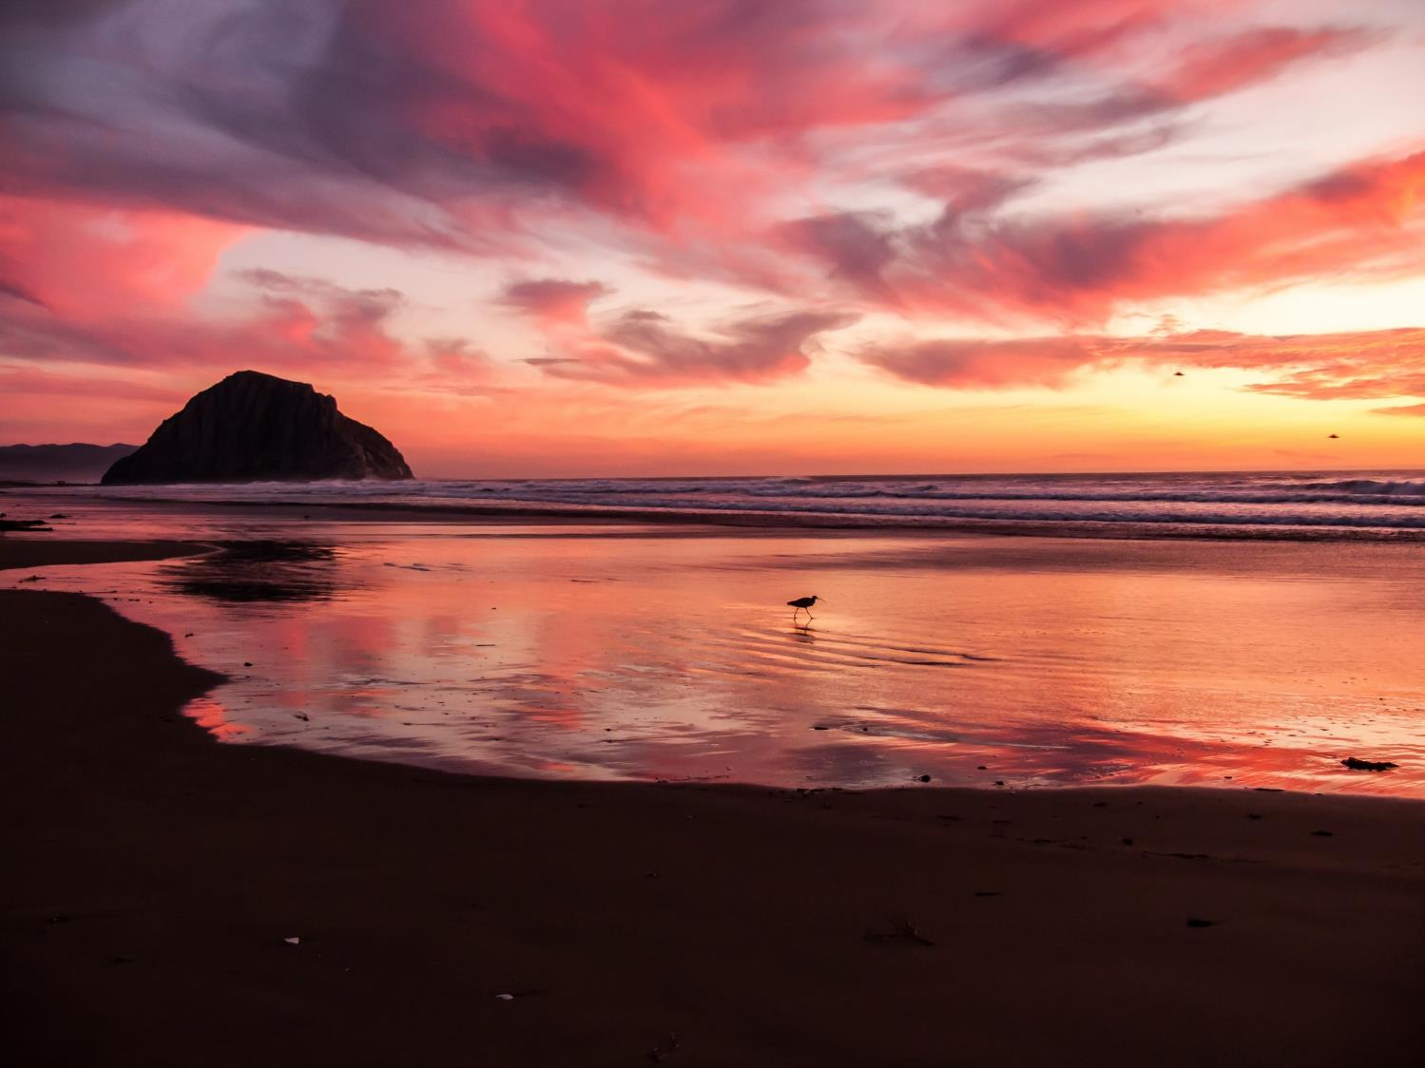

Slide 6
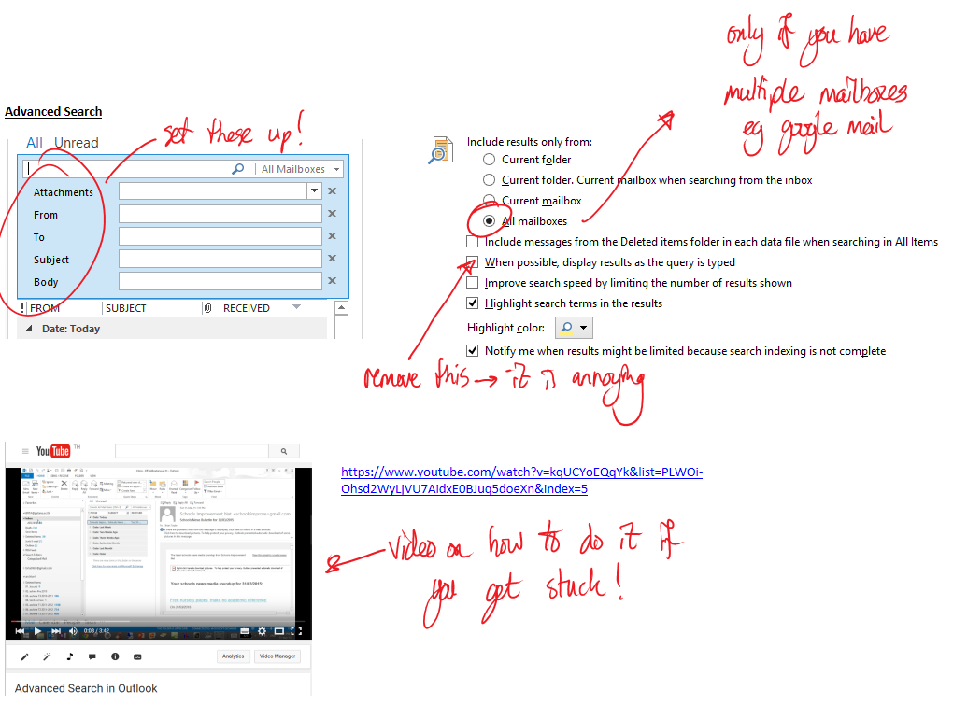
https://www.youtube.com/watch?v=kqUCYoEQqYk&list=PLWOi-Ohsd2WyLjVU7AidxE0BJuq5doeXn&index=5

Slide 7
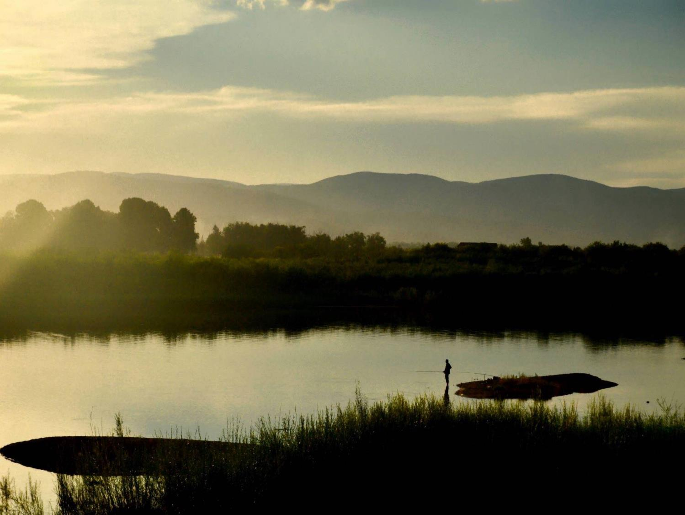

Slide 8
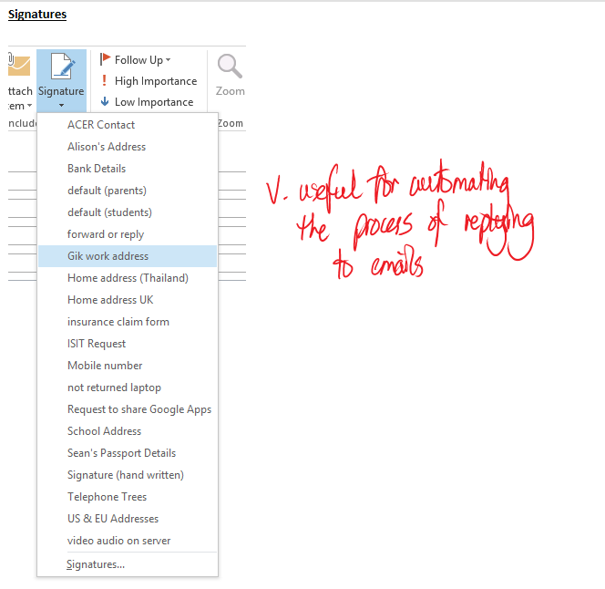

Slide 9
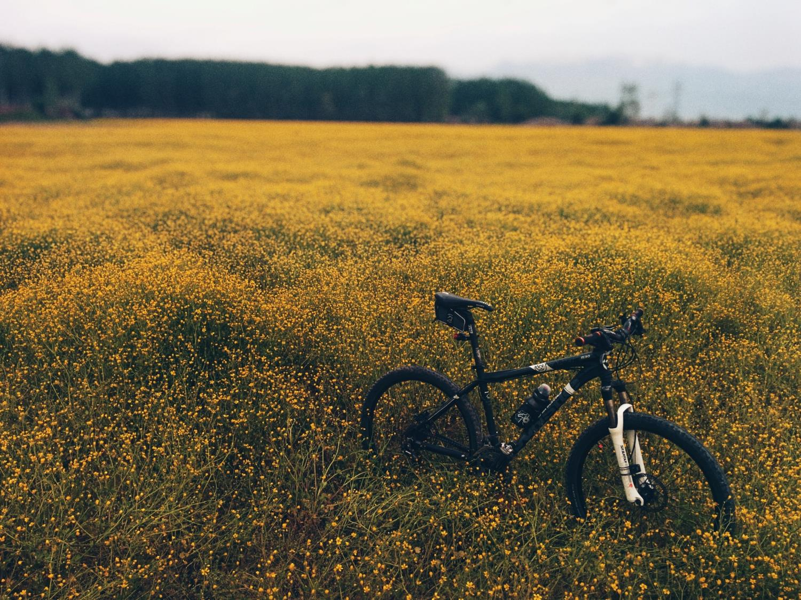

Slide 10
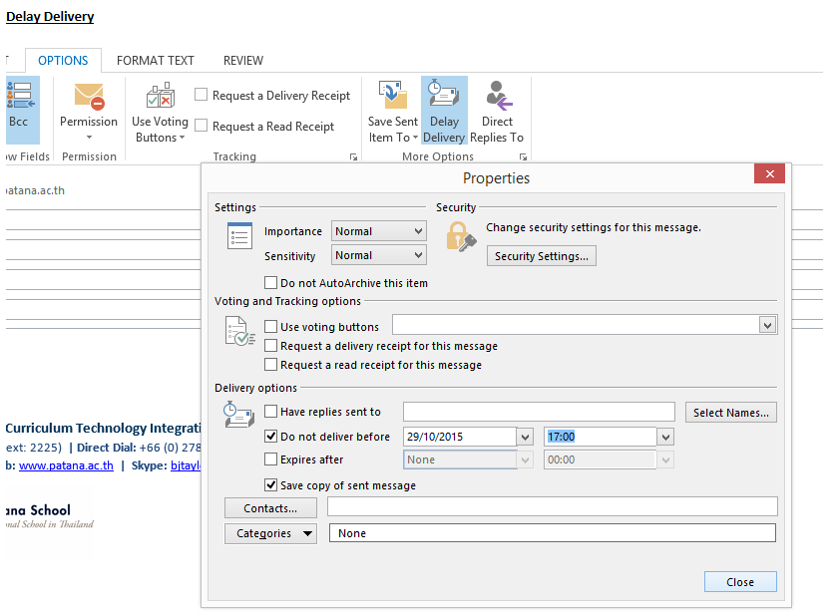

Slide 12
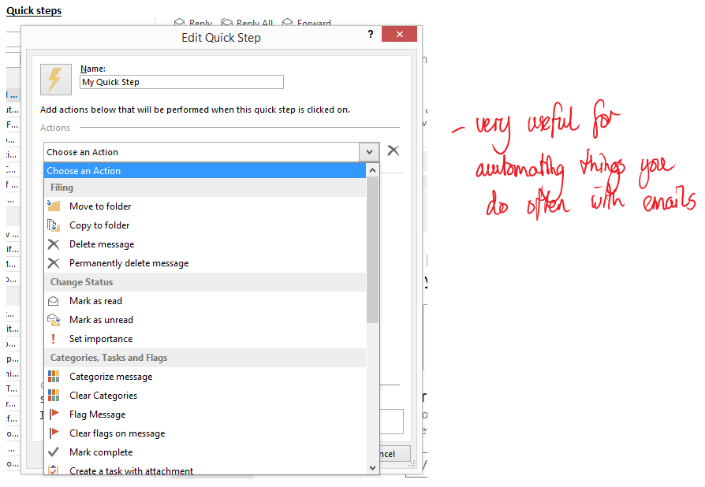

Slide 13
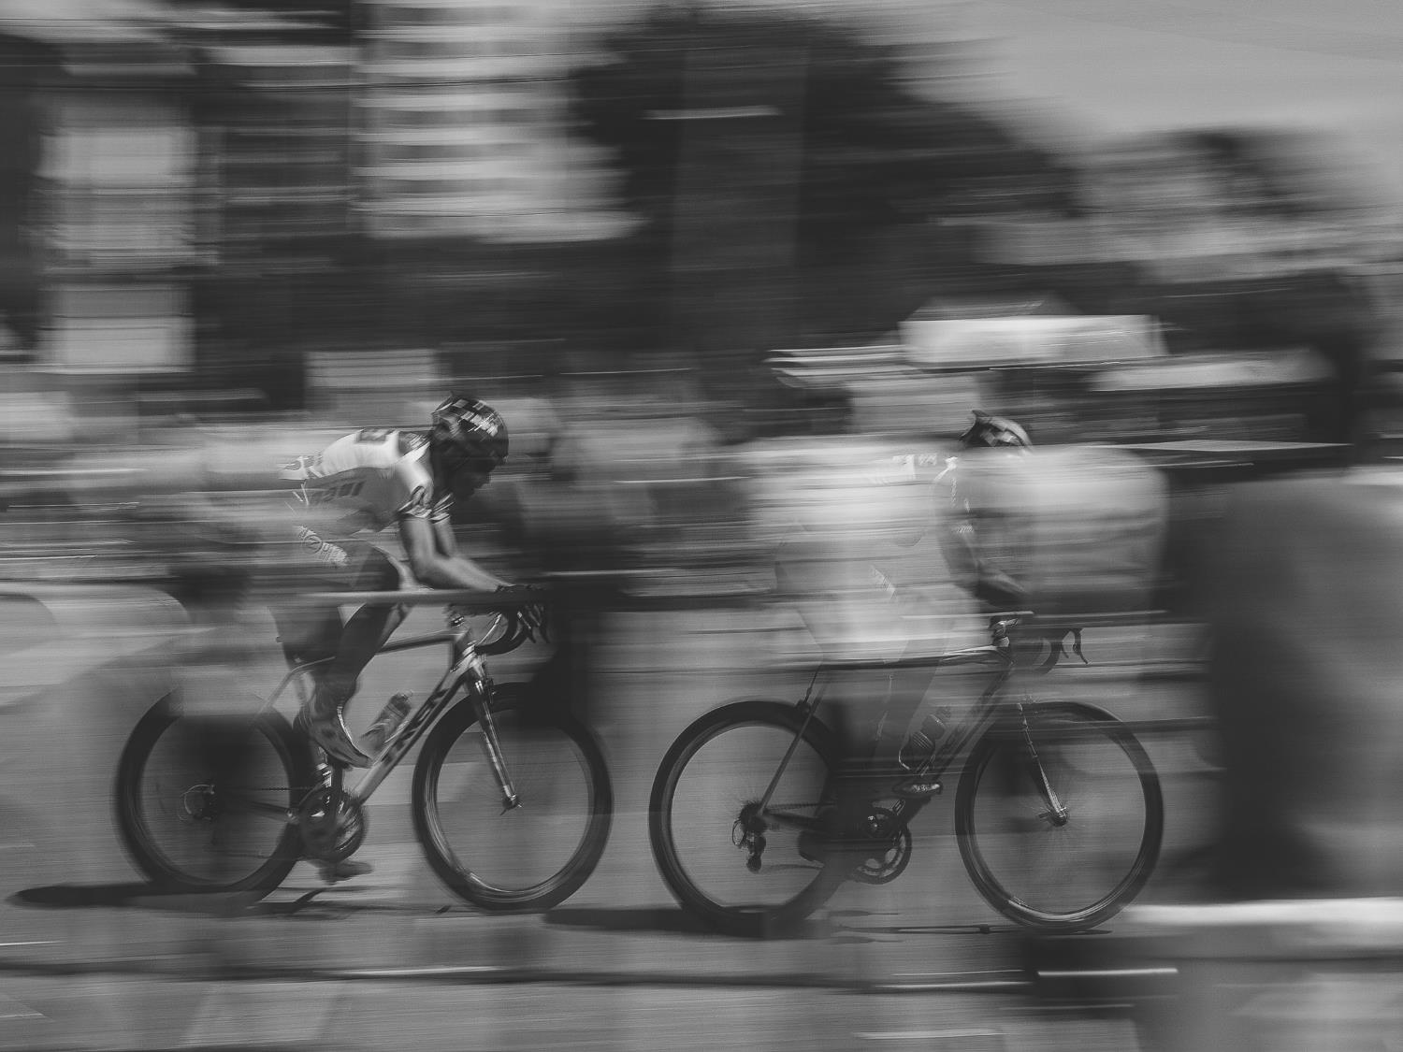

Slide 14
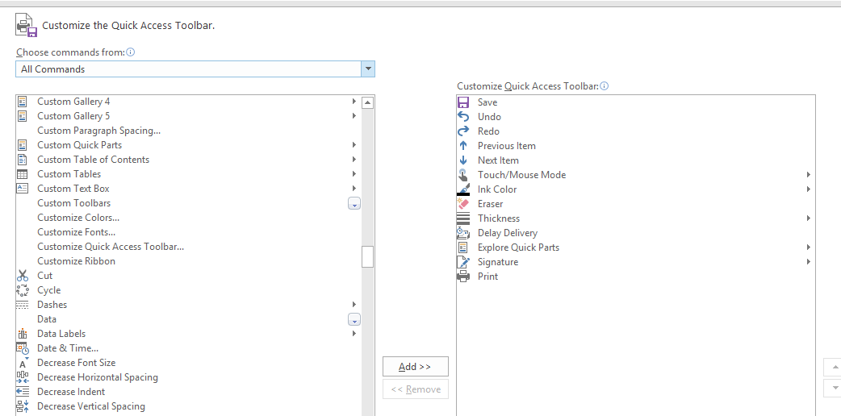

Slide 15
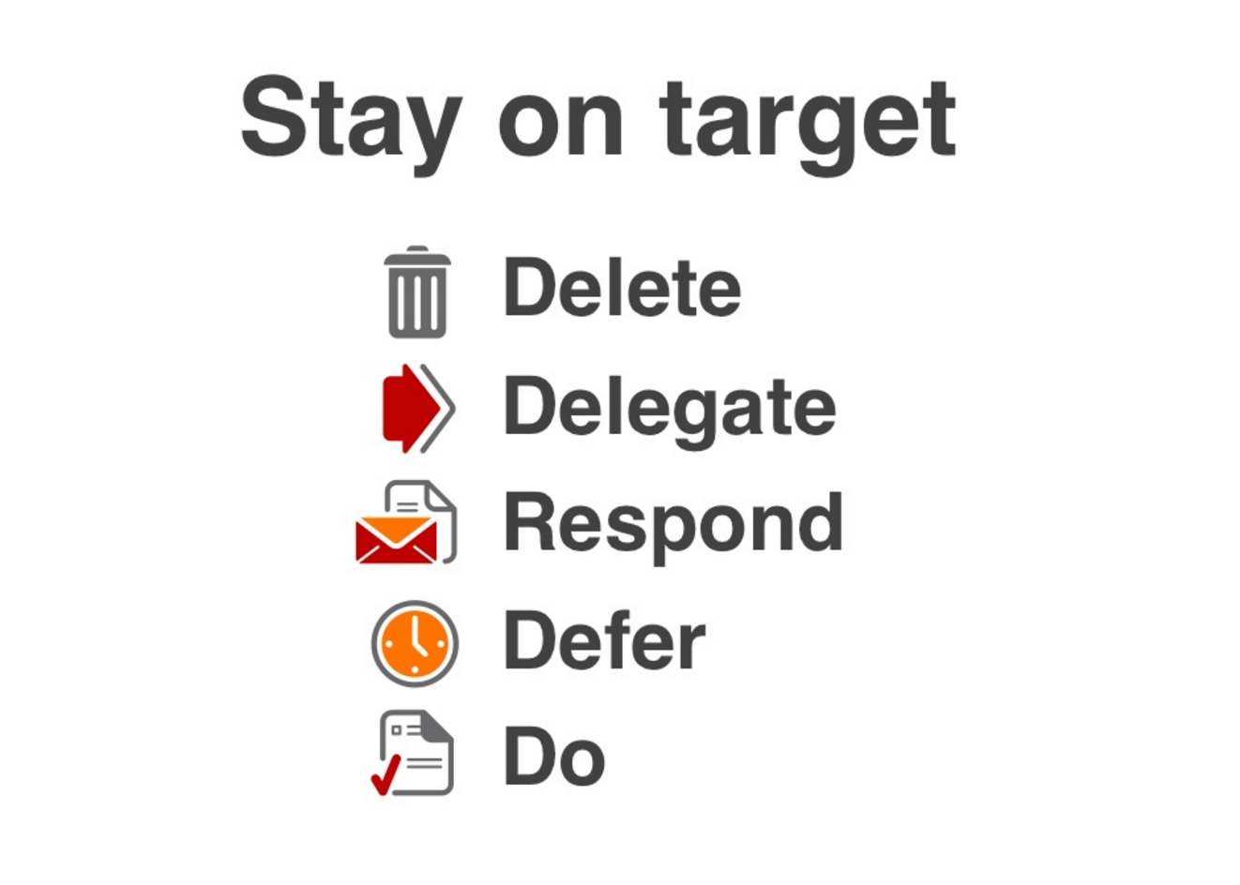
http://www.slideshare.net/merlinmann/inbox-zero-actionbased-email

Slide 16
Feedback for us?
Your next steps?

Slide 17
My Next Steps

Slide 18
My Next Steps
90:10
http://www.slideshare.net/AsmaAnsari2/stephen-coveys-90-10-principle

Slide 19
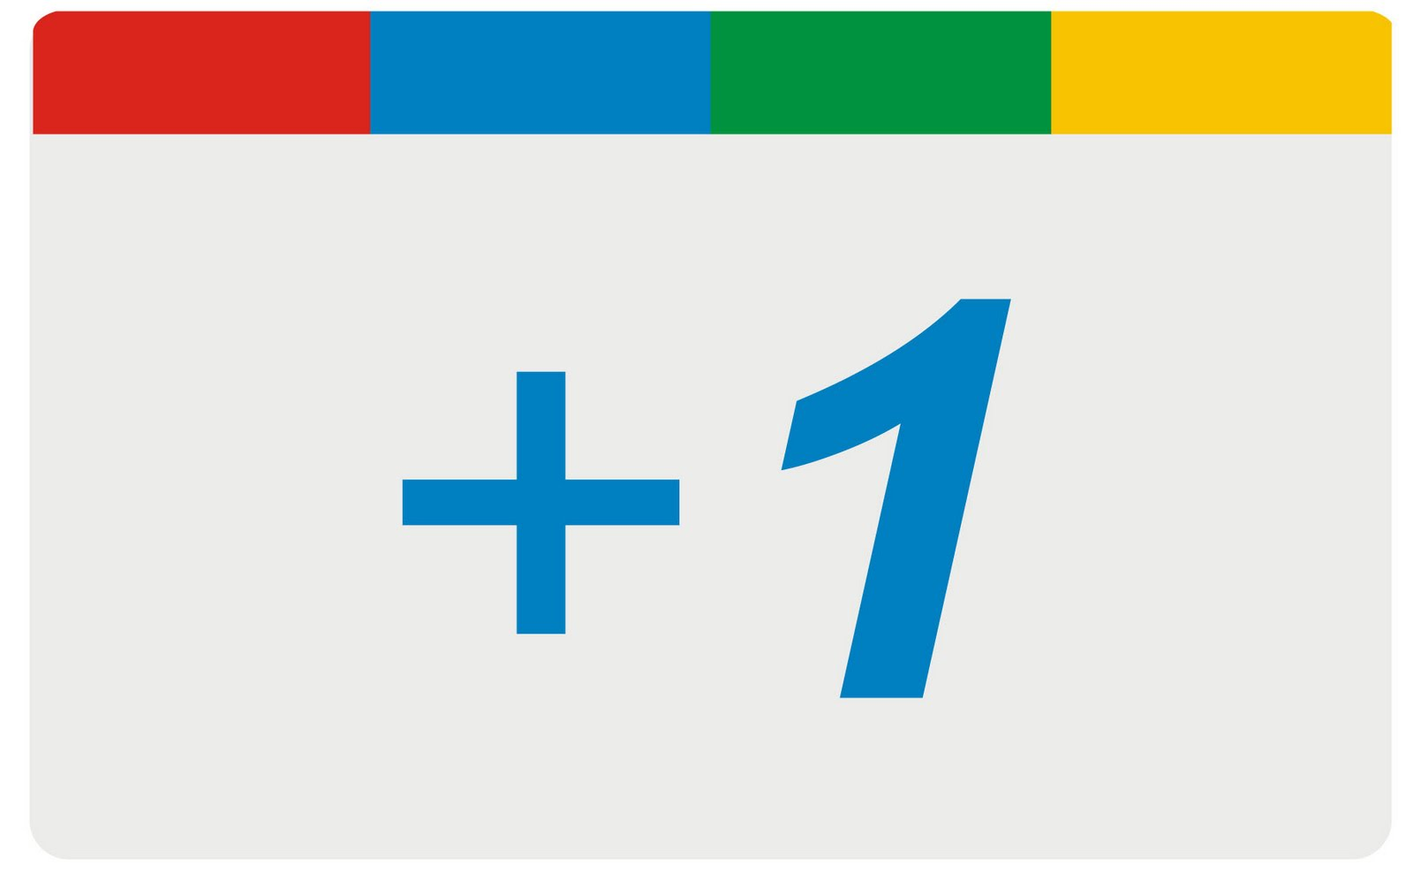
My Next Steps
http://www.ethoseo.com/wp-content/uploads/2013/10/Plus-1-Badge.jpg

Slide 20
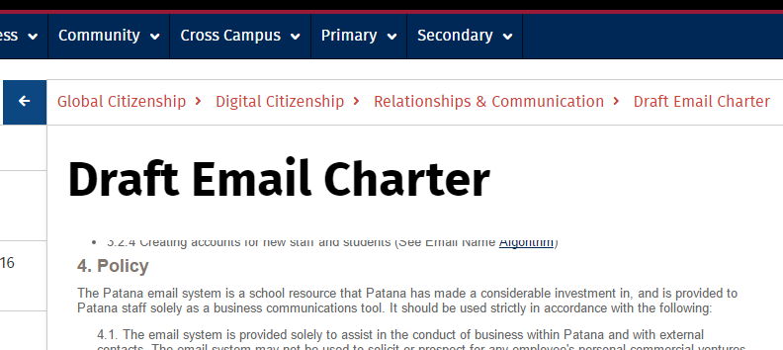
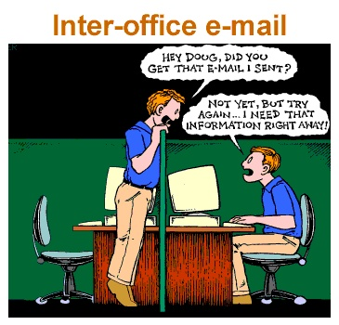
My Next Steps
http://community.patana.ac.th/gc/digital-citizenship/relationships-and-communication/draft-email-charter

Slide 21
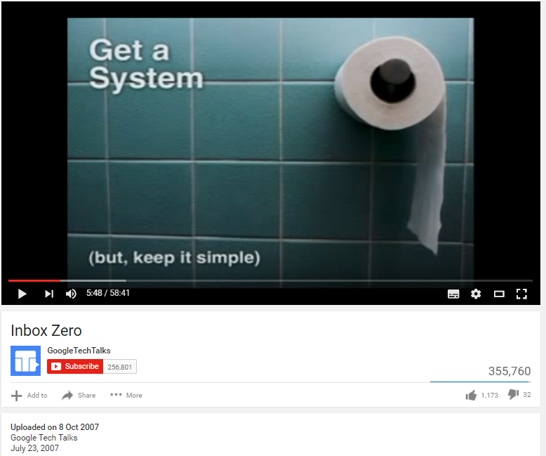
Influences
Merlin Mann Google Tech Talk
https://www.youtube.com/watch?v=z9UjeTMb3Yk
http://www.slideshare.net/merlinmann/inbox-zero-actionbased-email/26
https://youtu.be/z9UjeTMb3Yk?t=341 (to 7min 42sec)

