Slide 1
THIS TERM:
FILM & FILMMAKING
CONFLICT

Slide 2
₀₃ FIVE SHOT
Week 5
STORY
To use knowledge of shot types to plan and shoot a simple 5 shot story sequence

Slide 3
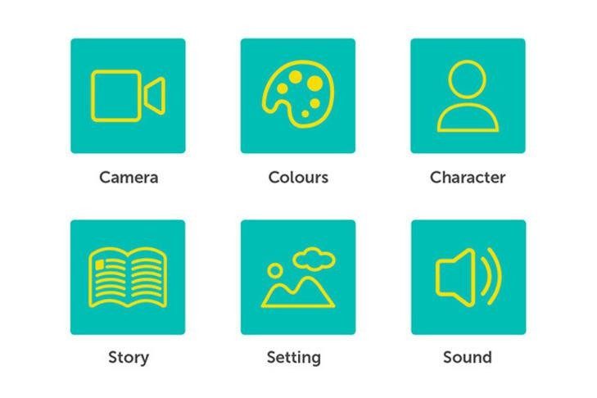
Recap: The 3Cs and the 3Ss of ﬁlm

Slide 4
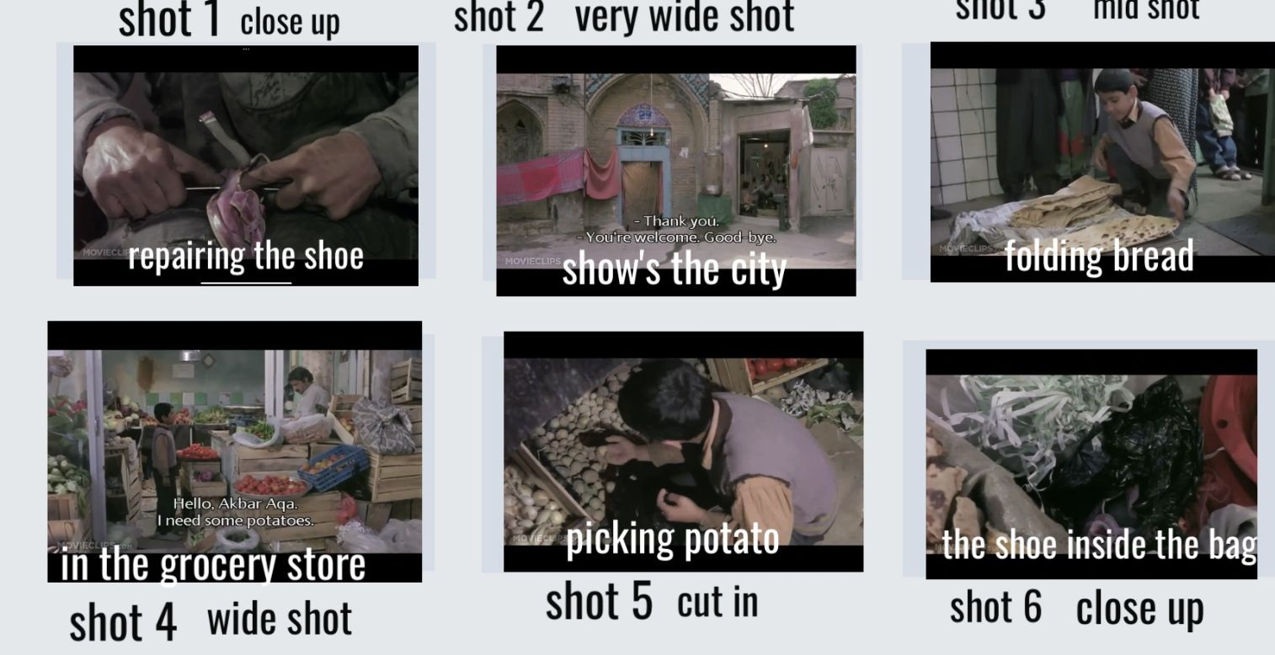

Slide 5
Sign up for the Children of Heaven Screening
Part 1: Wednesday and Friday Lunchtime
A post will go out on Teams later today

Slide 6
The ﬁve shot storyboard
A visual storytelling exercise
To introduce us to a new character, ﬁrst showing us something they are doing (driving, writing, playing an instrument) and then showing us more about the scene in front of us.
To show things in more detail. As it includes close-up shots it can show incredible detail we might have missed in other types of shots.

Slide 7
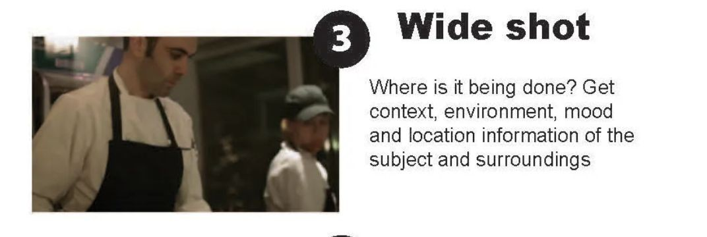
Production
Brief: Create a ﬁve shot ﬁlm

Slide 9
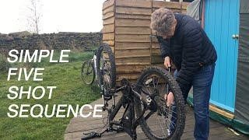

Slide 10
The 'Five Shots, Ten Seconds' formula is simple. Get the following ﬁve video shots in sequence, with each shot lasting at least 10 seconds:
A closeup on the hands of a subject showing
WHAT is happening
A closeup on the face showing WHO is doing it
A wide shot showing WHERE it's happening
An over the shoulder shot (OTS) linking together the three previous concepts
An unusual or side/low shot to provide story-speciﬁc context

Slide 11
BRIEF: CREATE A FIVE SHOT SEQUENCE TO TELL A SIMPLE STORY
Work in Pairs Create a ﬁve shot sequence
Think of a very simple idea for your story
Shoot the scene - add all footage to a
folder 5 shot story
Edit in iMovie and upload to PowerPoint in Teams/ OneDrive. Put Link into

Slide 12
Ideas for Five Shot stories
A child sits down and on checking their email on their iPad discovers they’ve won major award.
Writing a secret note
Drawing a picture
Accidentally bumping into an old friend on the street. Conversation and leave.

Slide 13
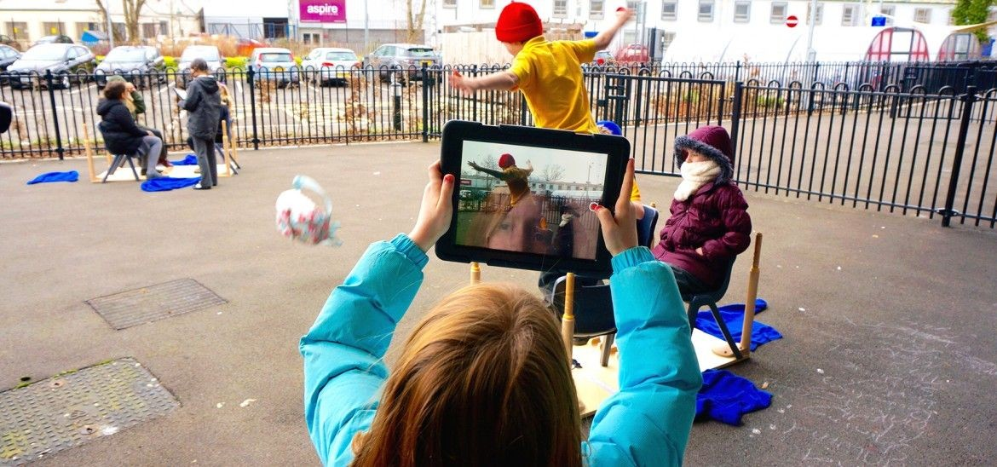
Composing the shots
Compose carefully!
Make sure your medium shots look like medium shots, close ups look like close ups!
Hold the camera as steady as possible (lean on something if necessary)
Shoot 10 seconds of each each shot
Airdrop to your partner and save the shots in a folder
Put together in iMovie

Slide 14
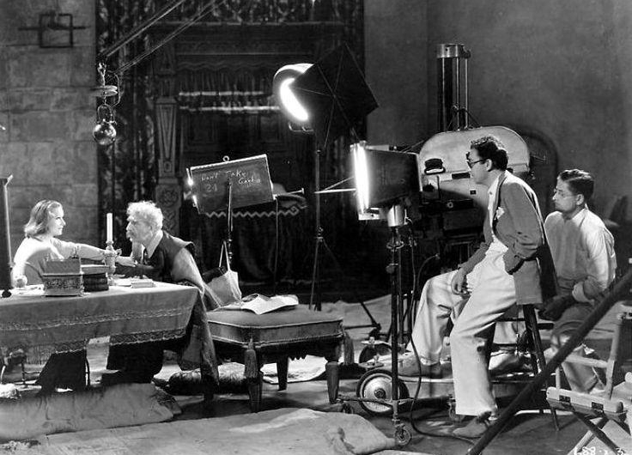
Production
The Shoot

Slide 15
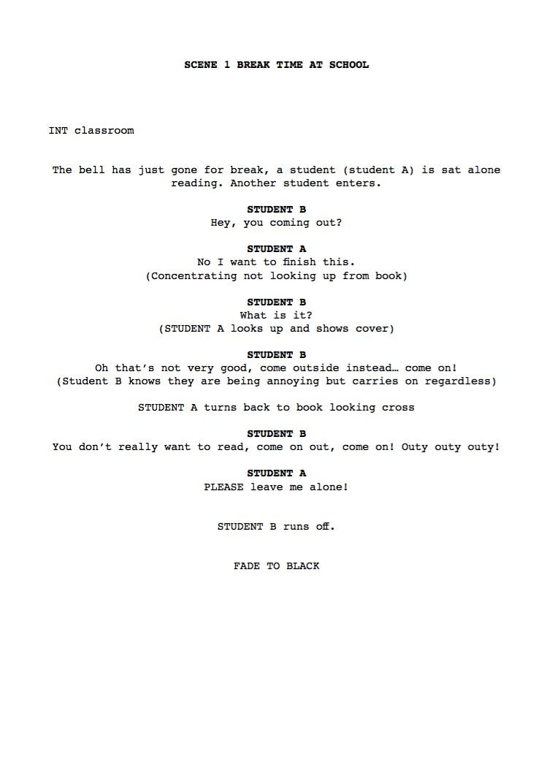
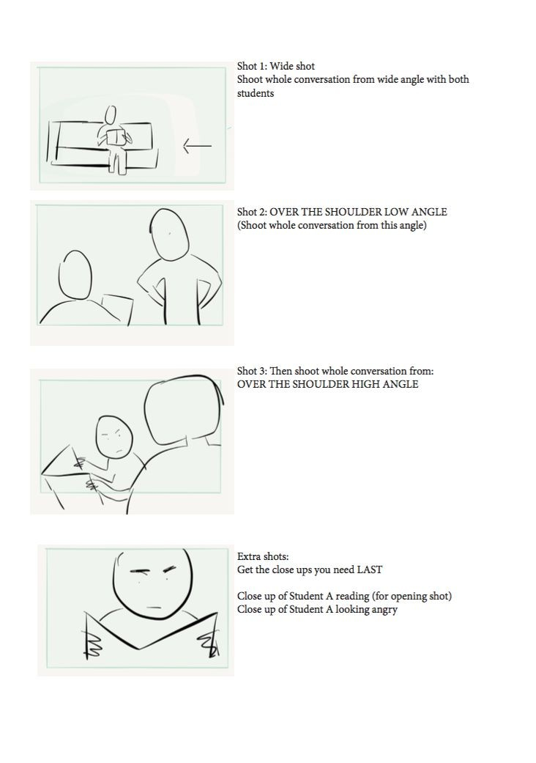
PRODUCTION!
NEXT WEEK…

