Slide 1
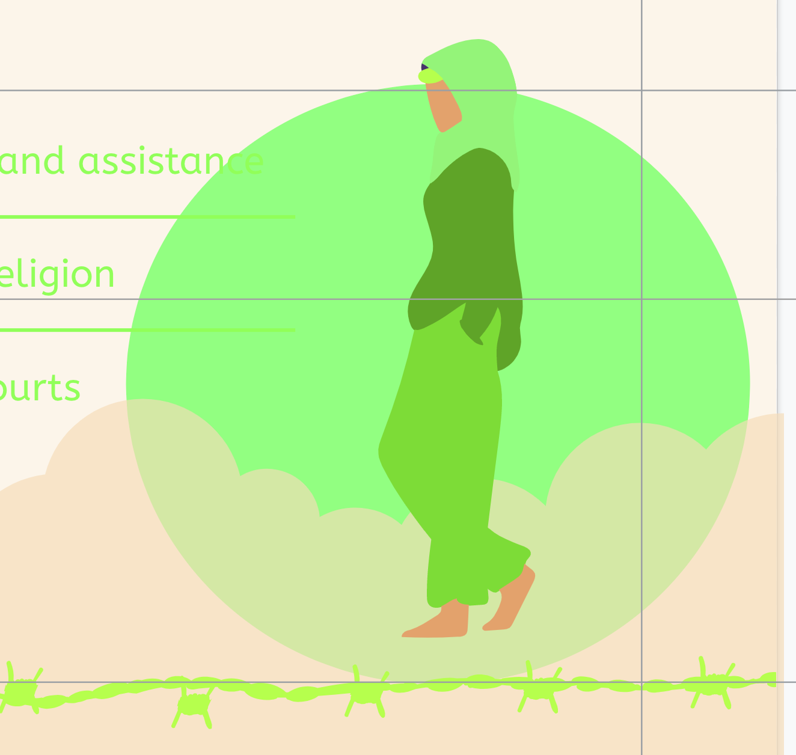
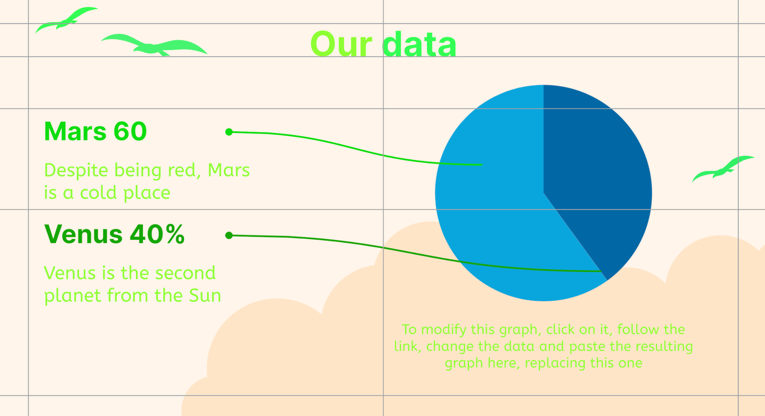
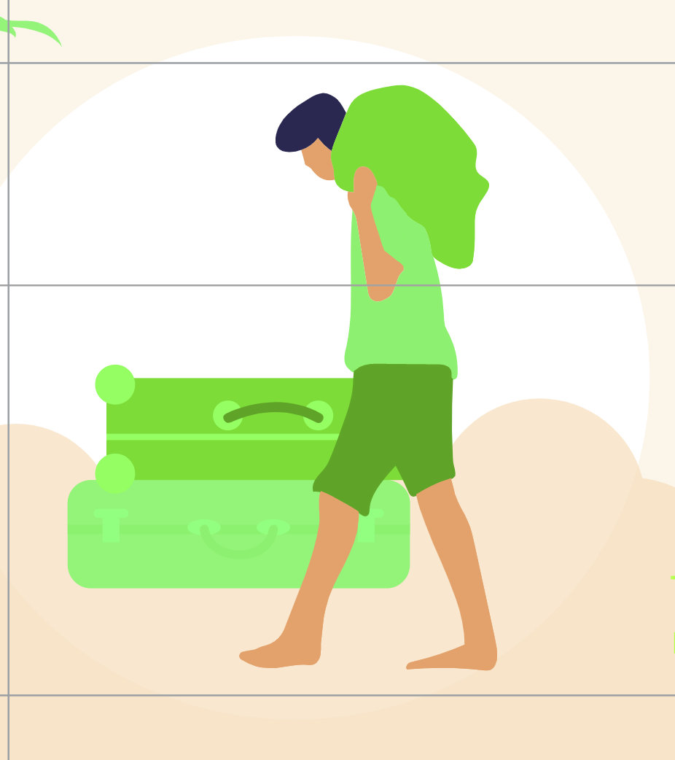
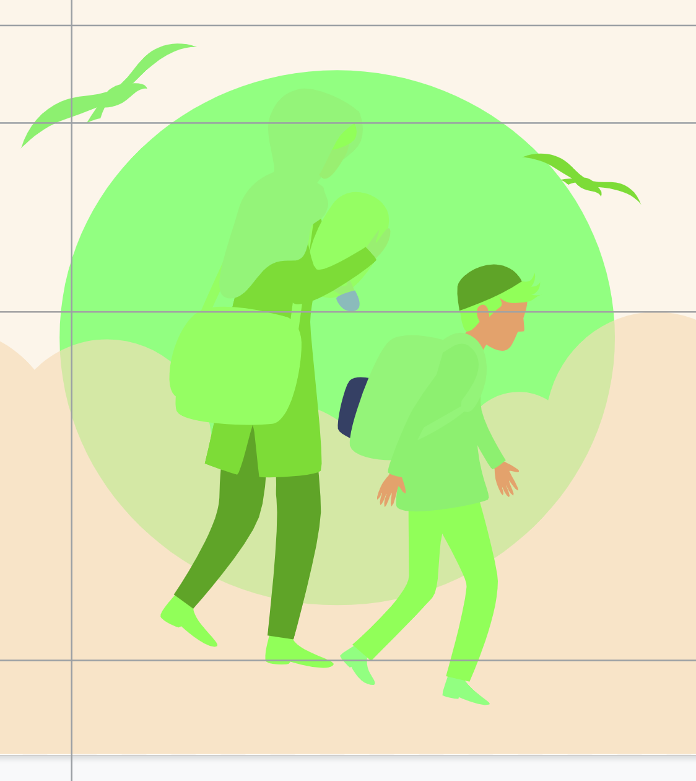
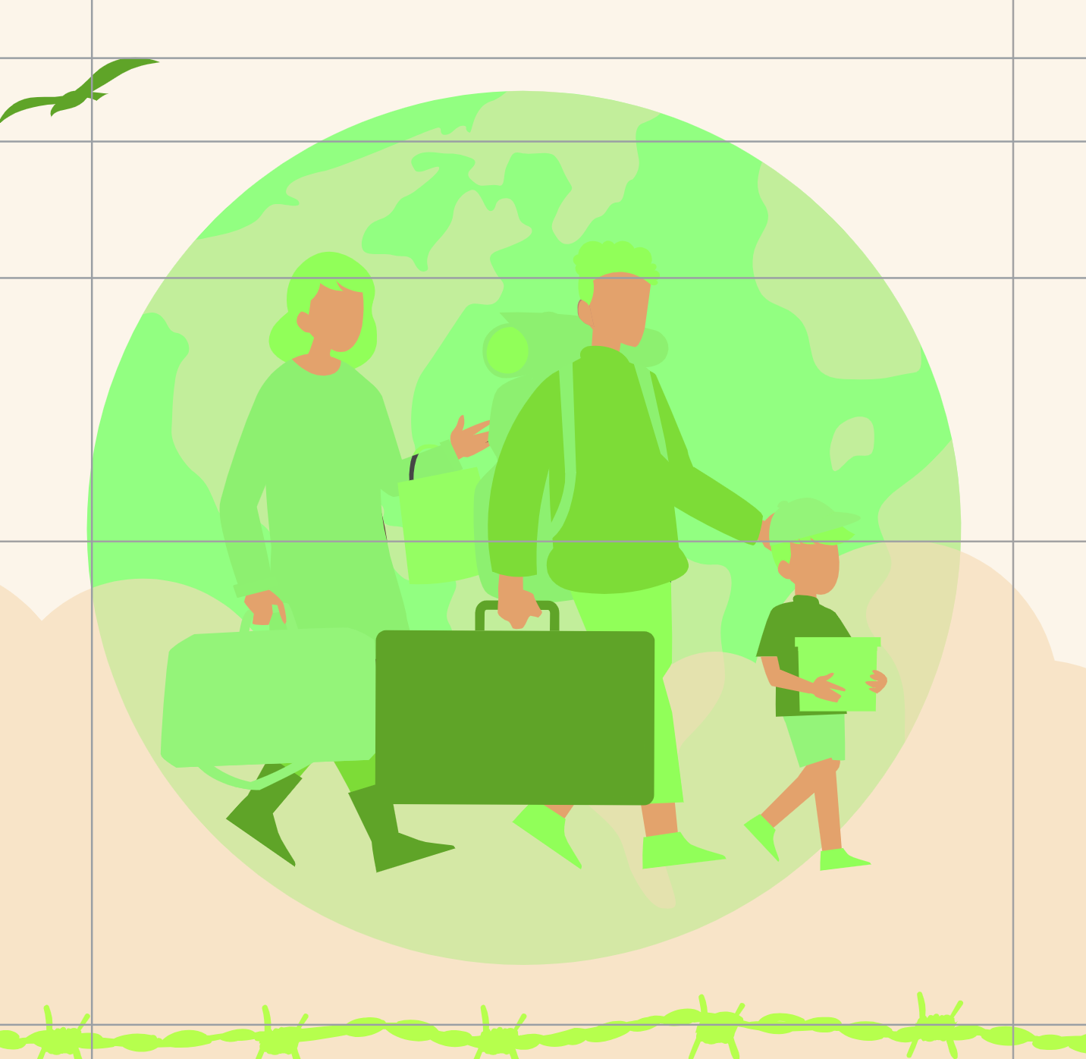
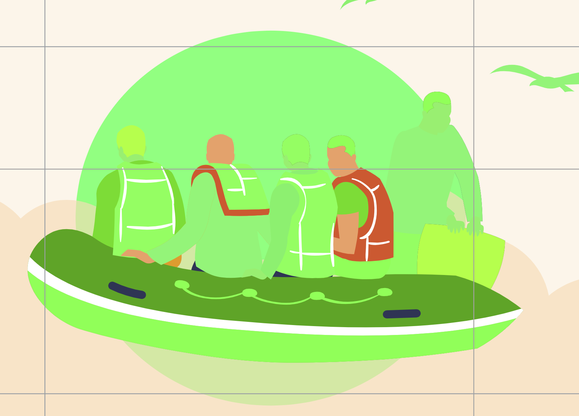
Great Migrations
Year 6: Term 2

Slide 2
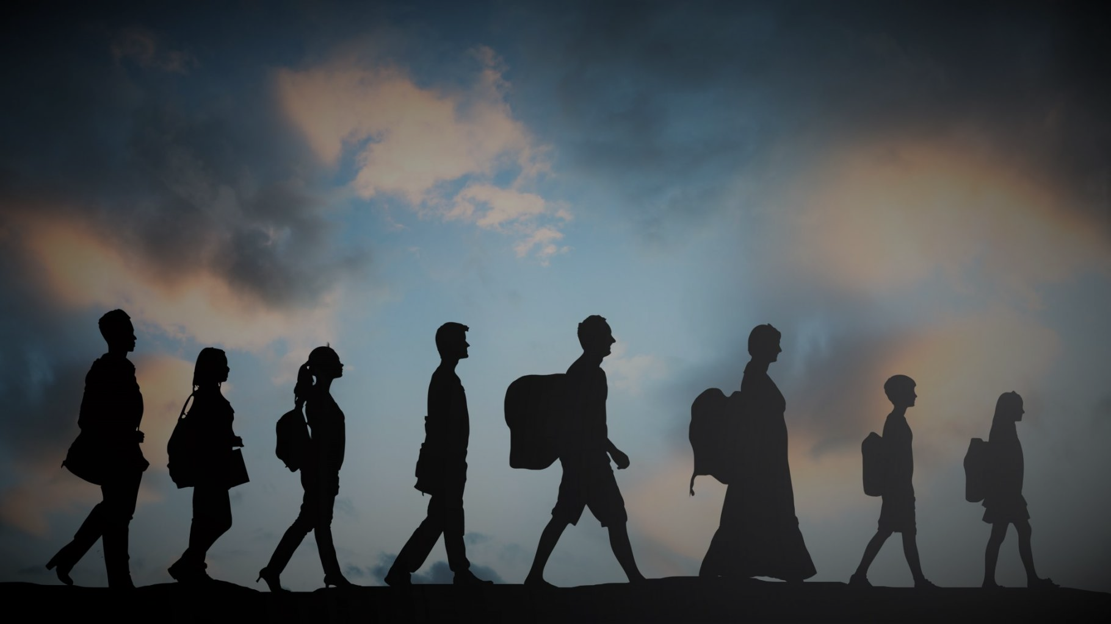
What does the word ‘migration’ mean to you?
Share your ideas in the chat or raise your hand.
‘

Slide 3
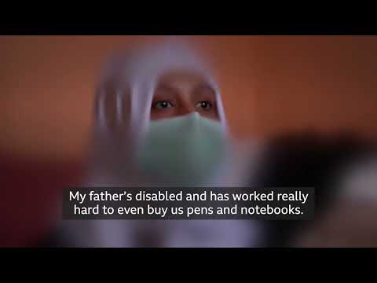
EQ: What is great about migrations?
Explain thinking……
I think….
I know….
I wonder….
Alternative: Video link

Slide 4
Human Migration
Why do people migrate?
Noun
the movement of people from one place to another
Share your ideas in the chat or raise your hand.

Slide 5
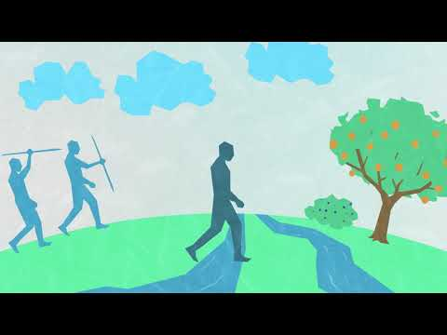
What forces do you think drive human migration?

Slide 6
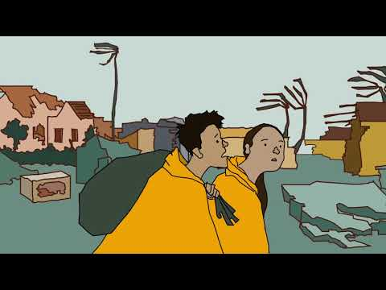
Migrant or refugee? Is there a difference?

Slide 7
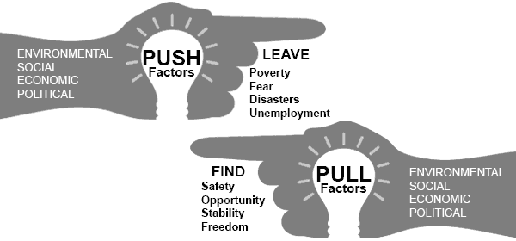
People move for many reasons, these reasons are called push and pull factors.
‘

Slide 8
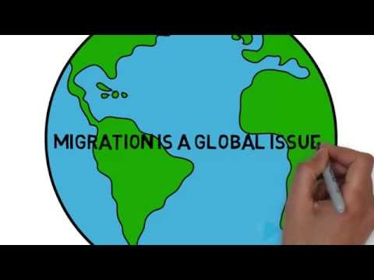
Why do people migrate?

Slide 9
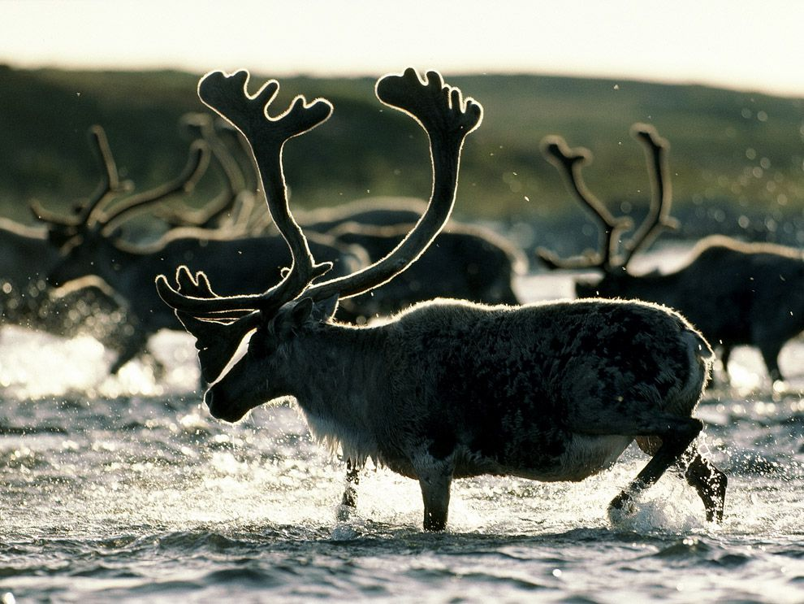
Do all animals migrate the same way?
Are humans the only species that migrate?

Slide 10
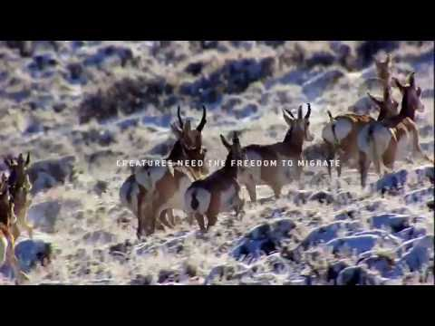
What are the similarities / differences between animal and human migration?

Slide 11
What do you want to find out during this unit of learning?
Share your ideas in the chat or raise your hand.

