Slide 1
Welcome to the Year 7
Coffee Morning
Our Mission …
“ to ensure that students of all nationalities grow to their full potential as independent learners in a caring British international community”
Bangkok Patana School Master Presentation
Notes:
1

Slide 2
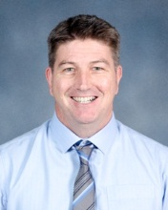
Year 7
Owen McDevitt
Head of Year 7
owmc@patana.ac.th
Bangkok Patana School Master Presentation
Notes:
2

Slide 3
Year 7
Today’s Agenda
Guests – Tony Berghuis (Assessment), Brian Taylor (ICT), Laura MacRitchie (Music), Andy Thain (L2L)
Meet the Head of Year 7
The Parent-Teacher partnership
Tutorial Programme/Residential Visit
Q & A/Coffee Break/Network with other parents and meet your child’s tutor
Bangkok Patana School Master Presentation
Notes:
3

Slide 4
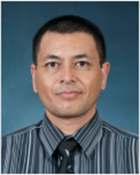
Year 7
Tony Berghuis
Senior Teacher Key Stage 3 –
Curriculum and Assessment
anbe@patana.ac.th
Bangkok Patana School Master Presentation
Notes:
4

Slide 5
Fulfilling Potential
ASSESSMENT
Start of Year 7
Year 6 NCT results
Year 6 Teacher Assessments
+
MidYISdata

Slide 6
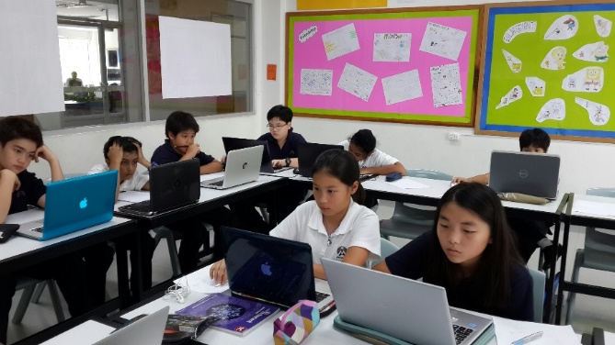
Fulfilling Potential
ASSESSMENT
Start of Year 7
MidYIS data
“MidYIS”: Middle Years Information System
CEM Centre: Centre for Evaluation and Monitoring (Durham University)
50 minutes
Adaptive
Vocabulary, Maths, Non-verbal, Skills
Aptitude and ability, not achievement
Measure of “typical” performance used to give an expected Level of attainment at the end of Year 9

Slide 7
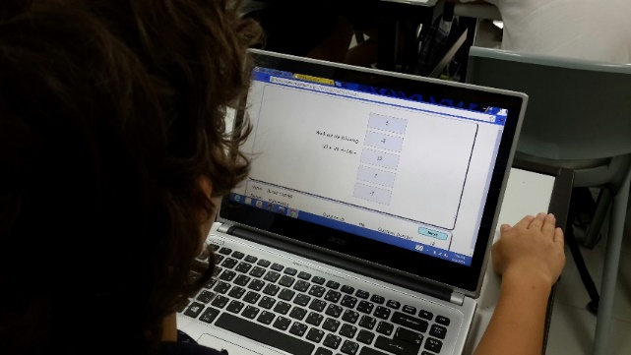
Fulfilling Potential
ASSESSMENT
Start of Year 7
MidYIS data
Next steps…
MidYIS feedback identifies potential attainment for the end of Y9 for all subjects;
Target Grades subsequently determined;
Target Grades are then shared with parents and students;
Ongoing dialogue between school, student, parents:
On track?
Intervention/
support?

Slide 8
Fulfilling Potential
ASSESSMENT
Levels & sub-Levels
National Curriculum Levels;
Attainment in each subject area measured in Levels from 1 – 8 + EP;
For Year 7s: Levels 1 – 6;
Levels are further sub-divided to allow for a more refined measure of attainment;
Levels are sub-divided into a, b, and c.
e.g. 5a, 5b, 5c, and so on.
Notes:
Sub-dividing Levels enables teachers to make a more precise judgments about attainment;
Sub-dividing Levels allows for a clearer picture of progress through a given Level.

Slide 9
Fulfilling Potential
ASSESSMENT
Levels & sub-Levels
5a: is strongly meeting criteria for Level 5, and is likely to be achieving or working close to Level 6 for some criteria;
5b: is working comfortably at Level 5;
5c: is meeting Level 5 criteria, but only just.

Slide 10
Fulfilling Potential
ASSESSMENT
Levels & sub-Levels
Lower end of attainment
Upper end of attainment…
1c, 1b, 1a, 2c, 2b, 2a, 3c, 3b, 3a, 4c, 4b, 4a, 5c, 5b, 5a, 6c, 6b, 6a, 7c…

Slide 11
Fulfilling Potential
ASSESSMENT
Levels & sub-Levels
Expected progress in Key Stage 3?.................................................
About 2 sub-Levels per year
Current Y7
sub-Level
5a
6c, 6b, 6a, 7c…

Slide 12
Fulfilling Potential
ASSESSMENT
Levels & sub-Levels
Expected progress in Key Stage 3? About 2 sub-Levels per year
Current Y7
sub-Level
5a
6c, 6b, 6a, 7c…

Slide 13
Fulfilling Potential
ASSESSMENT
Levels & sub-Levels
Expected progress in Key Stage 3? About 2 sub-Levels per year
Current Y7
sub-Level
5a
6c, 6b, 6a, 7c…

Slide 14
Fulfilling Potential
ASSESSMENT
Levels & sub-Levels
Expected progress in Key Stage 3? About 2 sub-Levels per year
Current Y7
sub-Level
5a
6c, 6b, 6a, 7c…
Targeted end-of- Y7
sub-Level

Slide 15
Fulfilling Potential
ASSESSMENT
Levels & sub-Levels
Expected progress in Key Stage 3? About 2 sub-Levels per year
Current Y7
sub-Level
5a
6c, 6b, 6a, 7c…
Targeted end-of- Y7
sub-Level
Targeted end-of- Y8
sub-Level

Slide 16
Fulfilling Potential
ASSESSMENT
Levels & sub-Levels
Expected progress in Key Stage 3? About 2 sub-Levels per year
Current Y7
sub-Level
5a
6c, 6b, 6a, 7c 7b 7a …
Targeted end-of- Y7
sub-Level
Targeted end-of- Y8
sub-Level
Targeted end-of- Y9
sub-Level

Slide 17
Fulfilling Potential
ASSESSMENT
Levels & sub-Levels
Y7
Y9
4
6
5
7
6
8

Slide 18
Fulfilling Potential
ASSESSMENT
Levels & sub-Levels
Additional Points to Note:
Progress across KS3 is, indeed, 2 whole Levels;
This equates to 2 sub-Levels
2 sub-Levels equates to “good progress”
Progress across KS3 is, largely, consistent, with slightly more progress being made in Year 7;
Notes:
Sub-dividing Levels enables teachers to make a more precise judgments about attainment;
Sub-dividing Levels allows for a clearer picture of progress through a given Level.

Slide 19
Fulfilling Potential
ASSESSMENT
Levels & sub-Levels
FINALLY:
Goal is to establish and maintain an open dialogue regarding current attainment and targets to support each student as they strive to fulfil their potential.
Notes:
Sub-dividing Levels enables teachers to make a more precise judgments about attainment;
Sub-dividing Levels allows for a clearer picture of progress through a given Level.

Slide 20
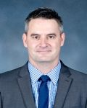
Year 7
Brian Taylor
Assistant Principal, Cross Campus Technology Curriculum Integrator
brta@patana.ac.th
Bangkok Patana School Master Presentation
Notes:
20

Slide 22
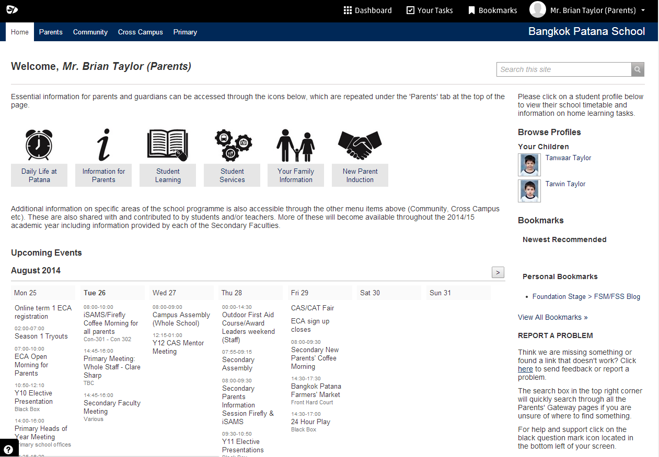
New Parents’ Gateway

Slide 23
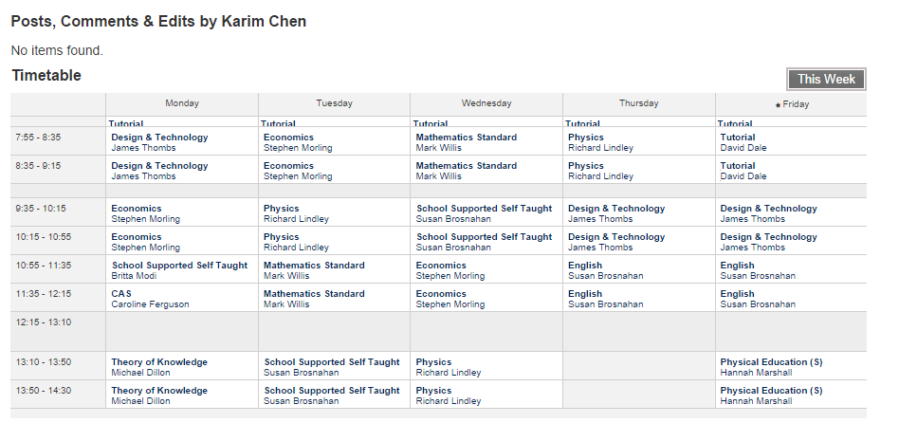
Timetable

Slide 24
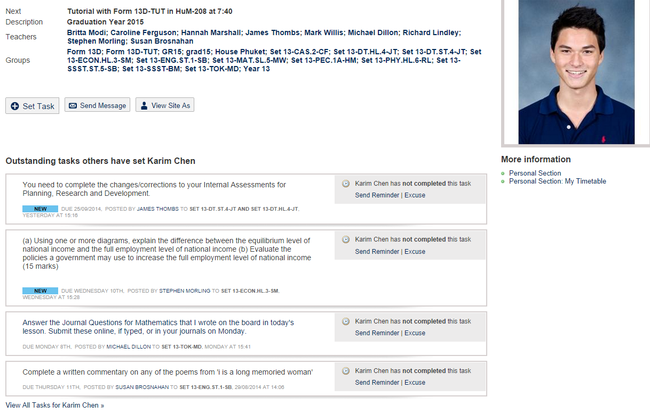
Home Learning Tasks

Slide 25
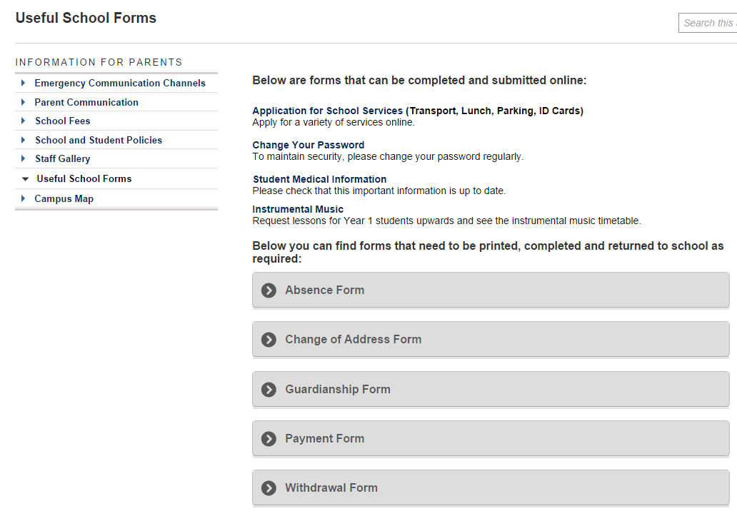
Useful School Forms

Slide 26
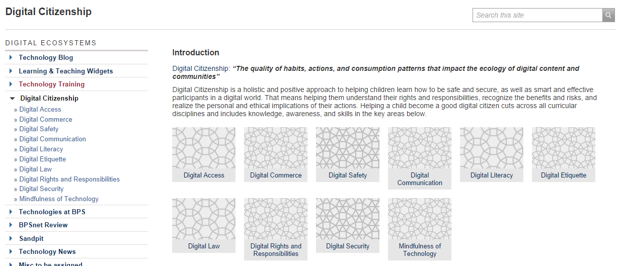
Digital Citizenship

Slide 27
commonsensemedia.org

Slide 28
Year 7
Parent and Teacher Partnership
Lines of Communication
Tutor or Subject teacher
Head of Year
Senior Teacher: Key Stage 3
Assistant Principal: Student Welfare
Bangkok Patana School Master Presentation
Notes:
28

Slide 29
Year 7
Parent and Teacher Partnership
Emails @patana.ac.th
Telephone contact
Patana website/Firefly
Key Stage 3 Student Handbook
PTG
Y7 Student and Parents’ Conference (Monday 5th Oct 16:00 – 19:00)
Bangkok Patana School Master Presentation
Notes:
29

Slide 30
Year 7
Parent and Teacher Partnership
Absence and Late authorisations
Absences need to be followed up quickly so we know the whereabouts of all our students. If your child is out for the day, please contact us as early as possible to tell us – Secondary Office and tutor.
Policy is to give a conduct detention for 3 unauthorised lates.
Please help us by informing the tutors as soon as possible.
Bangkok Patana School Master Presentation
Notes:
30

Slide 31
Year 7
Parent and Teacher Partnership
Personal Belongings and Equipment
Welcome
Laptop (essential)
Correct school uniform
Water bottle
Correct equipment for each subject (incl. PE)
Labels on equipment
Healthy snack
Not Welcome
Dangerous items (e.g. laser pointers, knives, etc.)
Incorrect school uniform
Chewing gum, smoking, drugs, alcohol
Coloured nail varnish, braids, jewellery, excessive make-up, bandanas and obvious hair dyes
Unlabelled items
Bangkok Patana School Master Presentation
Notes:
31

Slide 32
Year 7
Parent and Teacher Partnership
Personal Belongings and Equipment
Cautions
Money (lock away)
Mobiles (locked away and turned off)
Other electronic equipment (e.g. mp3 players, cameras, etc.) (locked away and turned off)
Patana Card - please ensure your child understands this card is valuable and an important part of their daily school life.
Bangkok Patana School Master Presentation
Notes:
32

Slide 33
Year 7
Parent and Teacher Partnership
Home Learning Policy
Most children cope well with a structured programme
Get in touch with us early if problems occur
Up to five evenings a week
Bangkok Patana School Master Presentation
Notes:
33

Slide 34
Year 7
Parent and Teacher Partnership
Home Learning Policy
Students should practice playing their musical instruments for 15 minutes each evening
EAL recommends 20 minutes reading per night which will be recorded on Firefly
In Term 1, MFL1 gets 30mins, MFL2 gets 20mins distributed throughout the week
In Terms 2 and 3 MFL1 gets 40mins and MFL2 gets 30mins distributed throughout the week
There may, on occasion, be Home Learning from Learning to Learn and Tutorial.
Bangkok Patana School Master Presentation
Notes:
34

Slide 35
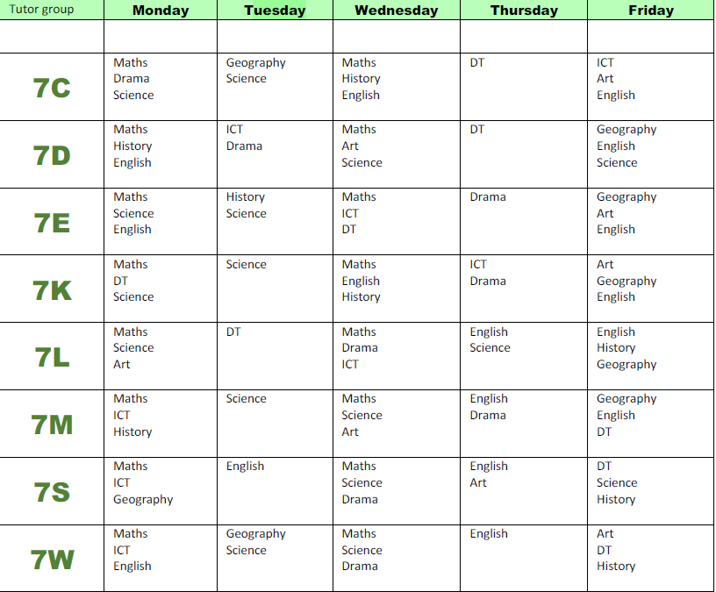
Year 7
Parent and Teacher Partnership
Bangkok Patana School Master Presentation
Notes:
35

Slide 36
Year 7
Parent and Teacher Partnership
Home Learning Schedule
Tutors
Firefly
Please do get in touch with us if problems occur
Bangkok Patana School Master Presentation
Notes:
36

Slide 37
Year 7
The Parent Teacher Group (PTG)
Year 7 PTG Representatives:
Tess Liptavat
Saipin (Nog) Tangtrongchitr
Secondary PTG Rep:
Malene Lungaard
ptg@patana.ac.th
Bangkok Patana School Master Presentation
Notes:
37

Slide 38
Year 7
Year 7 Tutor Programme
TERM 1
Overcoming Challenges
TERM 2
Who Are We?
TERM 3
Getting On
Bangkok Patana School Master Presentation
Notes:
38

Slide 39
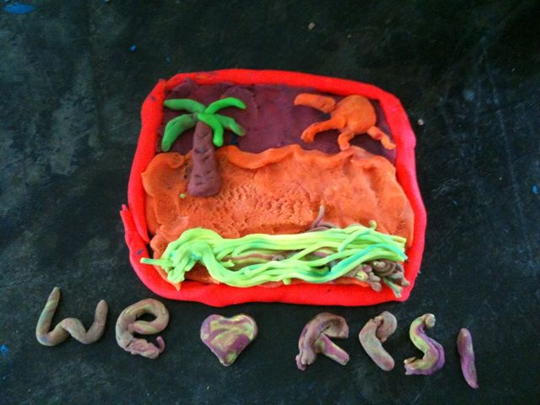
Year 7
Year 7 Residential to Rayong
Bangkok Patana School Master Presentation
Notes:
39

Slide 40
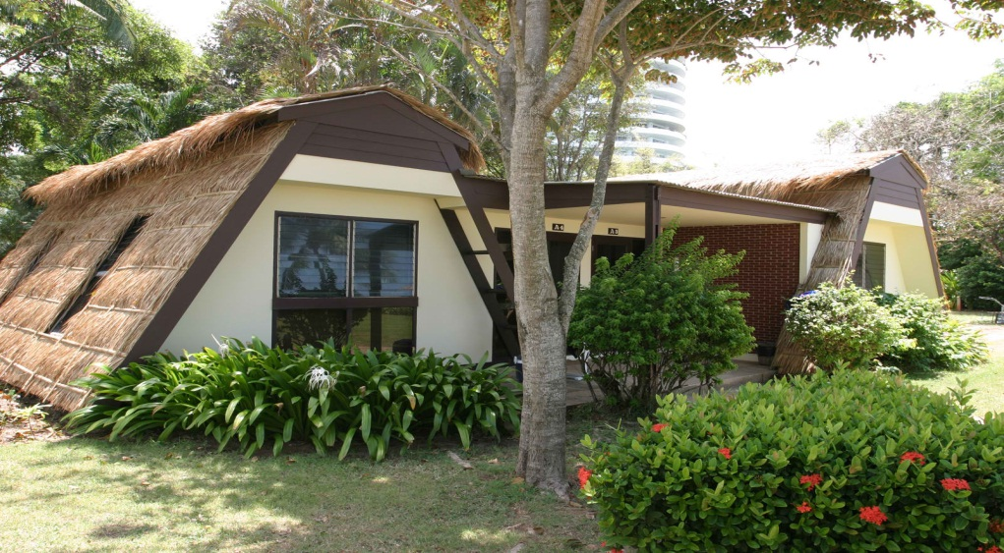
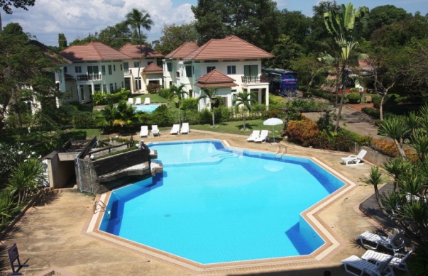
Year 7
Year 7 Residential to Rayong
WHERE:
Rayong Chalet
Bangkok Patana School Master Presentation
Notes:
40

Slide 41
Year 7
Year 7 Residential to Rayong
WHY:
To promote self-confidence
To encourage decision making skills
To provide problem-solving opportunities
To encourage teamwork
To develop communication skills
To have FUN
Bangkok Patana School Master Presentation
Notes:
41

Slide 42
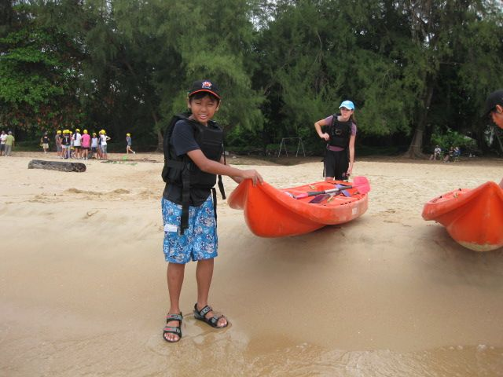

Slide 43
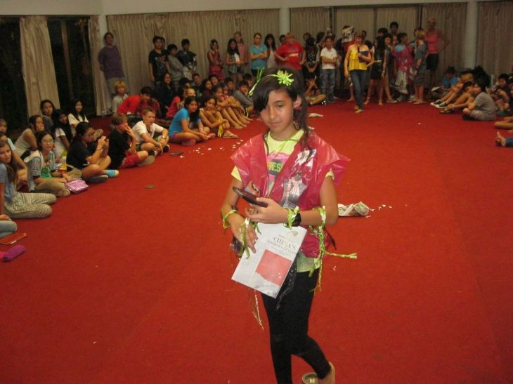
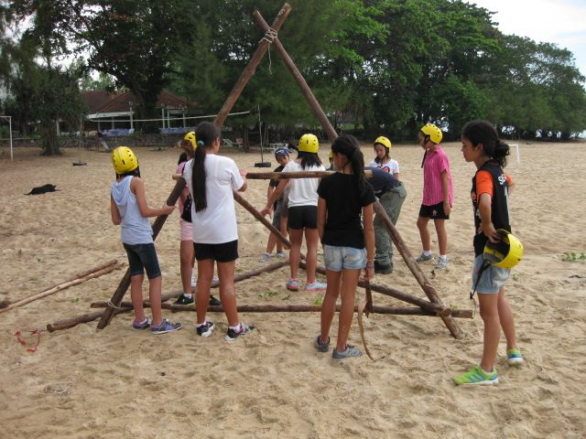
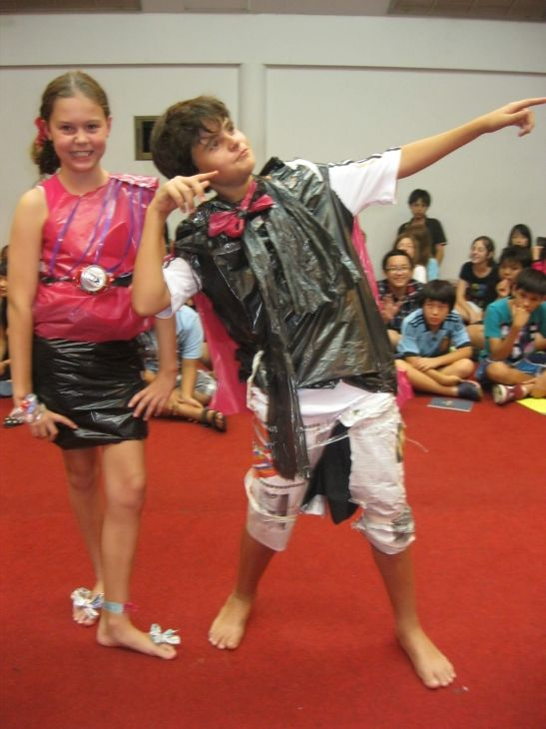

Slide 45
Year 7
Reducing our waste:
Water Bottles for Year 7 by October 1
Bangkok Patana School Master Presentation
Notes:
45

Slide 46
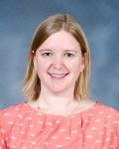
Year 7
Laura MacRitchie
Head of Music
lama@patana.ac.th
Bangkok Patana School Master Presentation
Notes:
46

Slide 47
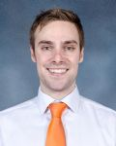
Year 7
Andy Thain
Learning to Learn Co-ordinator
anth@patana.ac.th
Bangkok Patana School Master Presentation
Notes:
47

Slide 48
Year 7
Learning to Learn
@ BPS
10th September 2015
Bangkok Patana School Master Presentation
Notes:
48

Slide 49
Year 7
Toolkit and Mindset
Bangkok Patana School Master Presentation
Notes:
49

Slide 50
Year 7
Mindset - Ensuring that our learners are aware of the behaviours, attributes and attitudes that enable success.
Toolkit - The transferable part of the course. A range of transferable strategies and skills that are universally required across the curriculum as well as beyond the confines of school.
Bangkok Patana School Master Presentation
Notes:
50

Slide 51
Year 7
Developing Individual Potential
Self directed resourceful =
most successful students at IGCSE/IB
Bangkok Patana School Master Presentation
Notes:
51

Slide 52
Year 7
Specific Examples:
Collating evidence and organising data - (Science, Maths, Geography).
Thinking Hats - Alternative Perspectives (History, Tutorial, Geography).
Communication and Textual interpretation - Analysis of Texts (English, Art, Drama).
Bangkok Patana School Master Presentation
Notes:
52

Slide 53
Year 7
But what do the activities look like?
Your turn.
Please form a line in order of the day you were born in.
January 1st by that door
December 31st by that door
Only catch is that you must do it in silence.
Bangkok Patana School Master Presentation
Notes:
53

Slide 54
Year 7
In teams…
Number yourselves 1-6.
When I call your number you will come to the front and look at the secret picture for 30 seconds.
You then go back to your team and describe it to them.
They must try and replicate the image based on your descriptions.
You may not draw if you have just returned from looking at the picture.
Bangkok Patana School Master Presentation
Notes:
54

Slide 55
Year 7
Learning to Learn @ BPS
Assessment
Holistic overview based on the IB Learner Profile.
Based on students’ Firefly blog.
Will be focused on Socratic discussions with students as they move through the course.
Bangkok Patana School Master Presentation
Notes:
55

Slide 56
Year 7
Y7 Connections Programme
Monday 21st March: Y7 Launch Day (Periods 5-6)
Tuesday 29th March – Wednesday 30th March
(all day, each day): Main Project Days
Thursday 31st March (Periods 3-4):
Y7 Connections
Celebration (w/parents)
Bangkok Patana School Master Presentation
Notes:
56

Slide 57
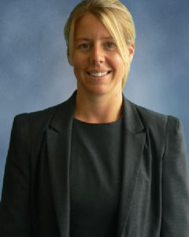
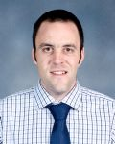
Year 7
Lena Perriam
Scott Tooley
Senior Teacher - KS3
(Student Welfare)
Head of Faculty,
Mathematics
lepe@patana.ac.th
scto@patana.ac.th
Bangkok Patana School Master Presentation
Notes:
57

Slide 58
The Year 7 Tutor Team
7C
7D
7E
7K
Mun Yee Chong
Tania Leyland
Alan Derby
Louise MacGregor
Miles Ellerby
Simon Worrall
Karen McGuire
Mark Willis
7L
7M
7S
7W
Bangkok Patana School Master Presentation
Notes:
58

