Slide 1
Year 6 Digital Safeguarding
What is Digital Citizenship (DC)?
How to search for yourself online
How to post positively
When to tweet and when to text

Slide 2
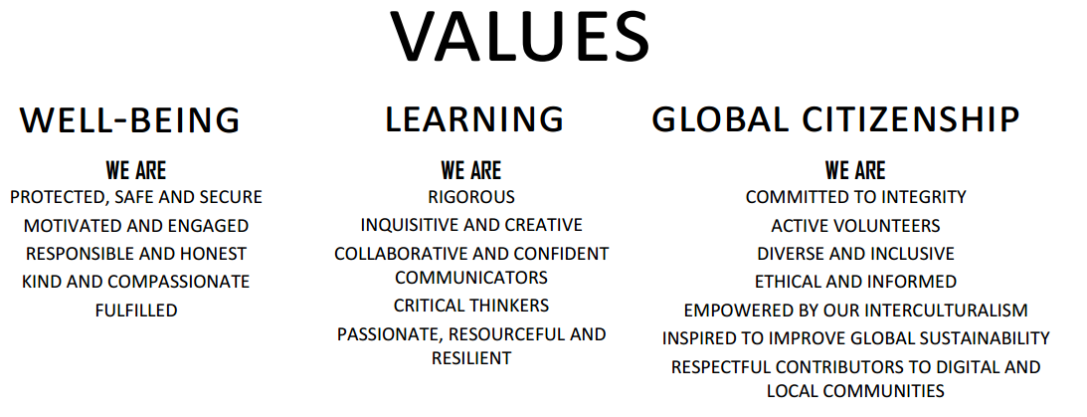

Slide 3
1. What is Digital Citizenship?

Slide 4
1. What is Digital Citizenship?
Having a positive impact
on our online communities

Slide 5
2. How to search for yourself online
Start with Google
First Name + Last Name
Brian Taylor
“First Name + Last Name” (in quotes)
“Brian Taylor”
“First Name + Last Name” + City
“Brian Taylor” Bangkok
“First Name + Last Name” + School
“Brian Taylor” Bangkok Patana School
“First Name + Middle Name + Last Name” (public records)
“Brian Jon Taylor”
“First Name + Middle Name + Last Name” + email address
“Brian Jon Taylor” brta@patana.ac.th

Slide 6
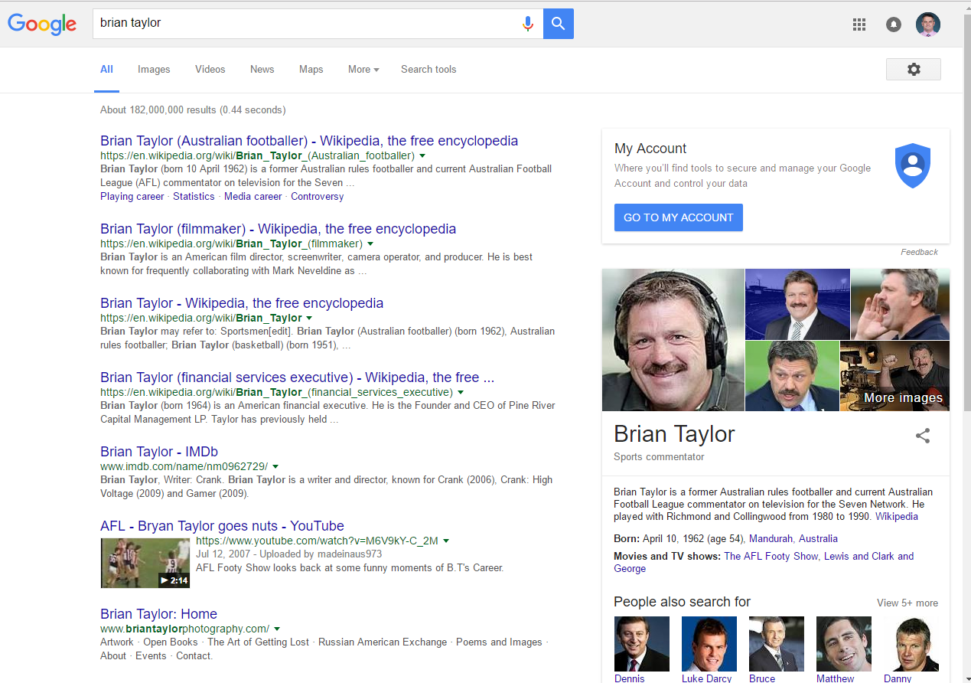

Slide 7
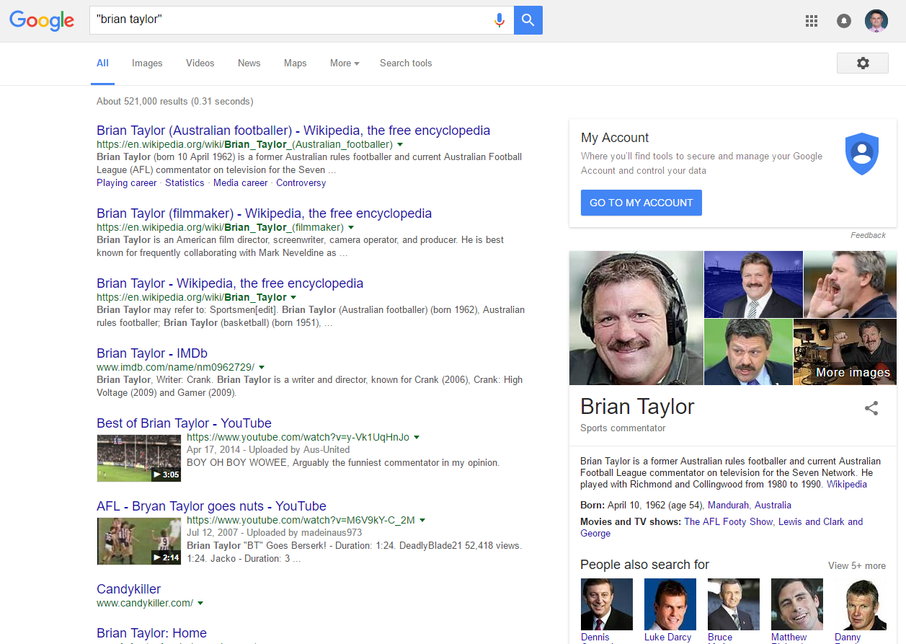

Slide 8
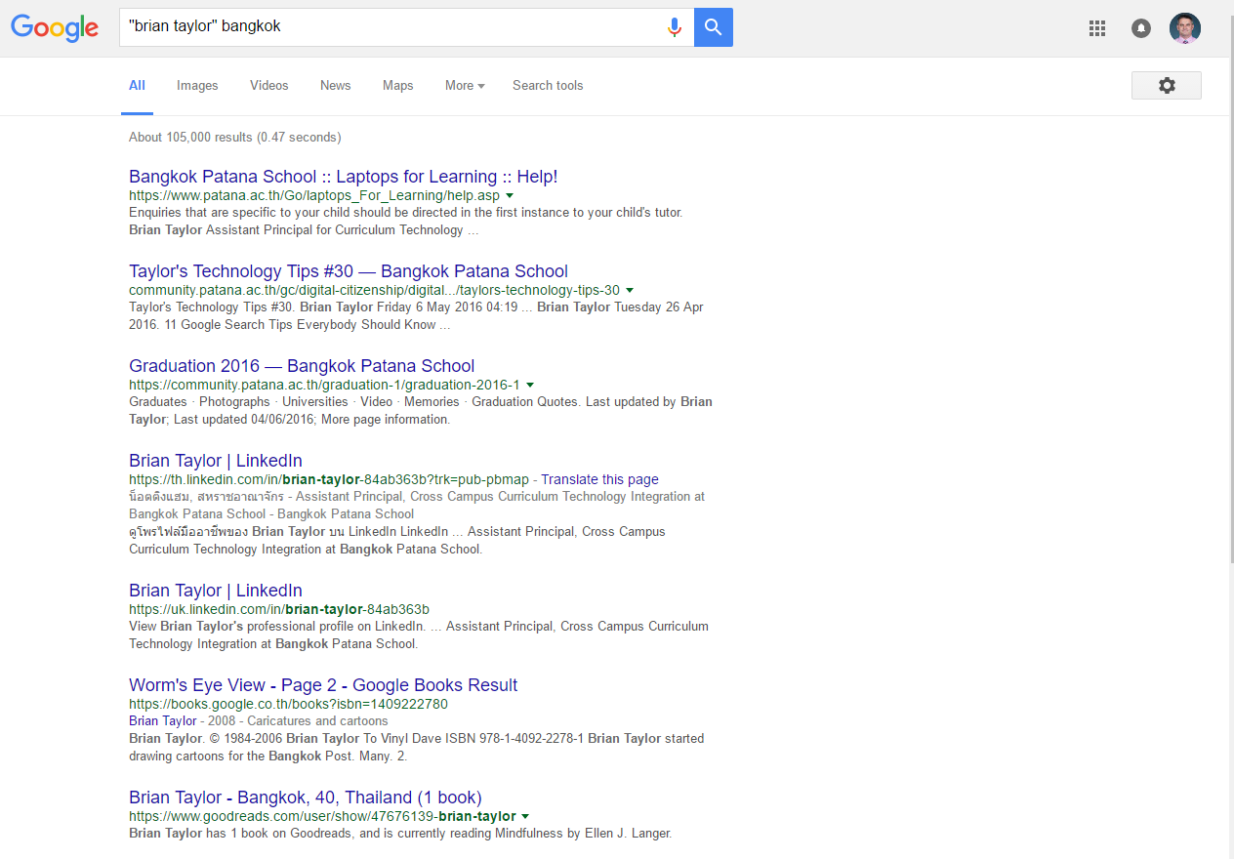

Slide 9
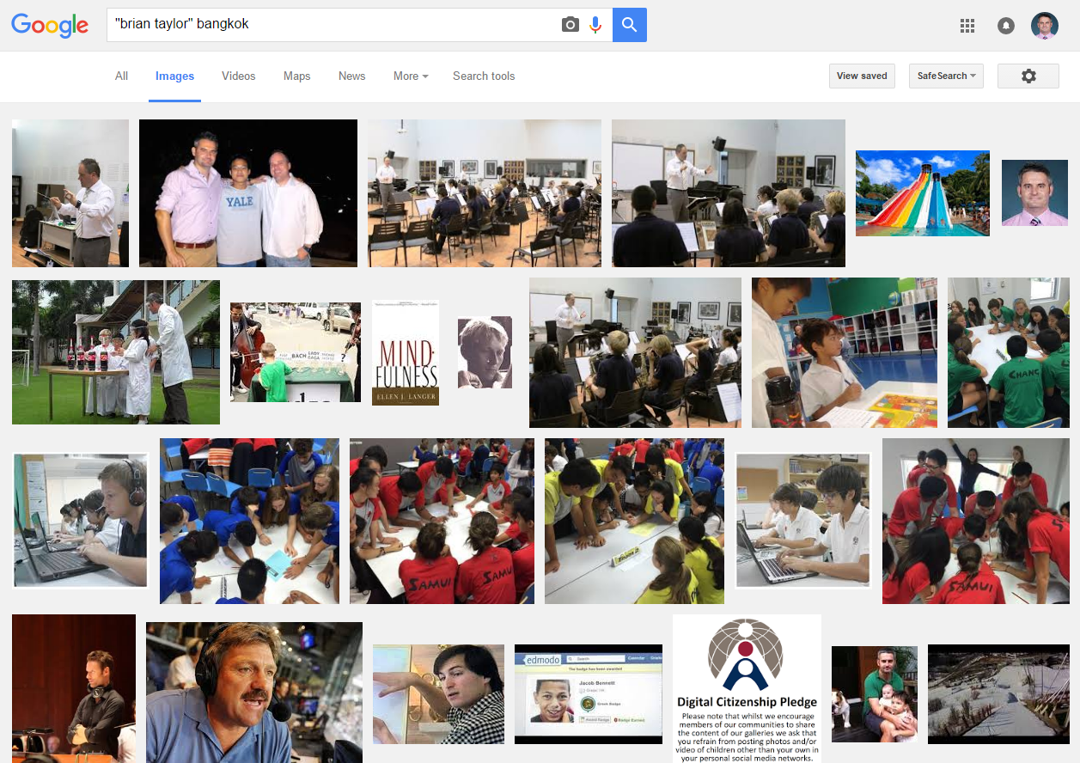

Slide 10
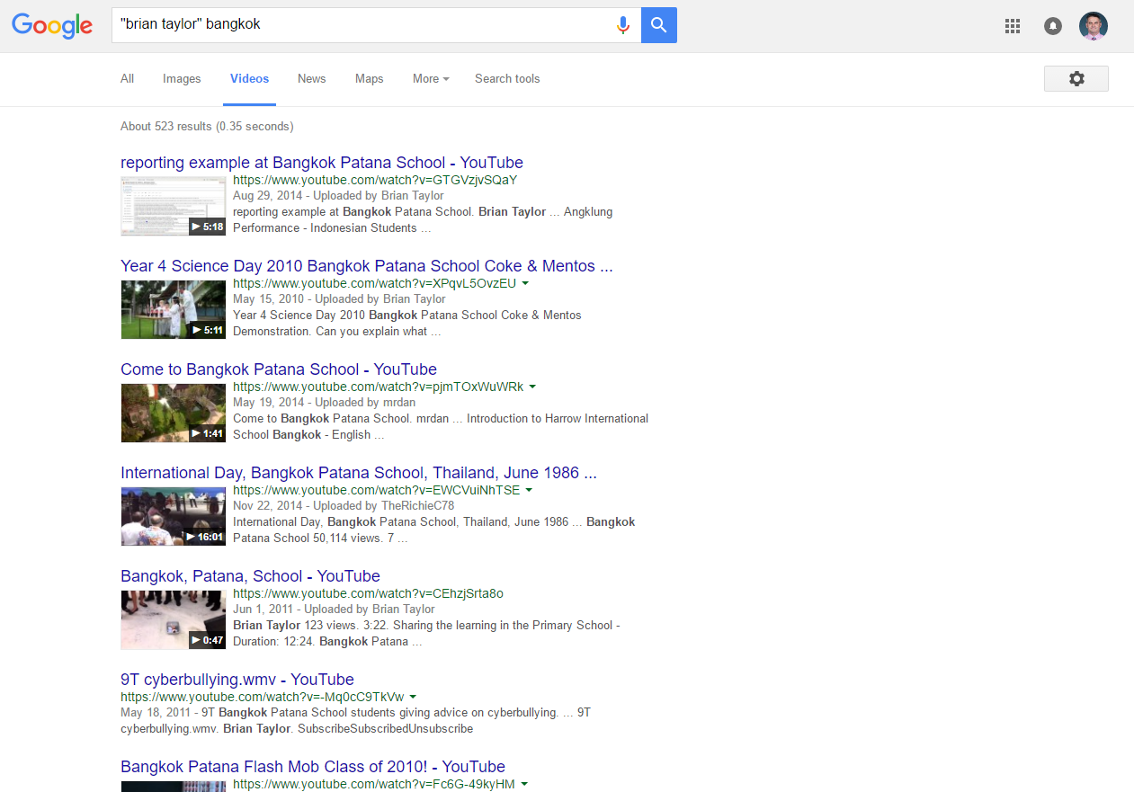

Slide 11
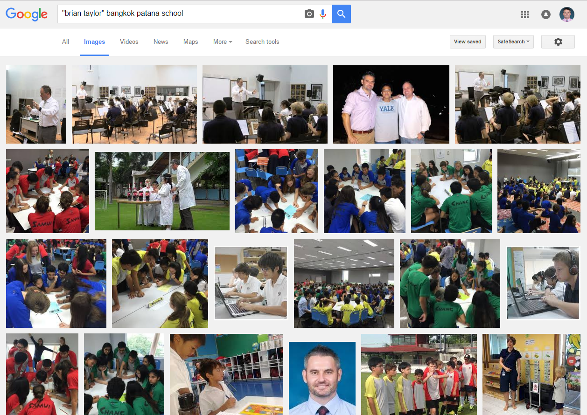

Slide 12
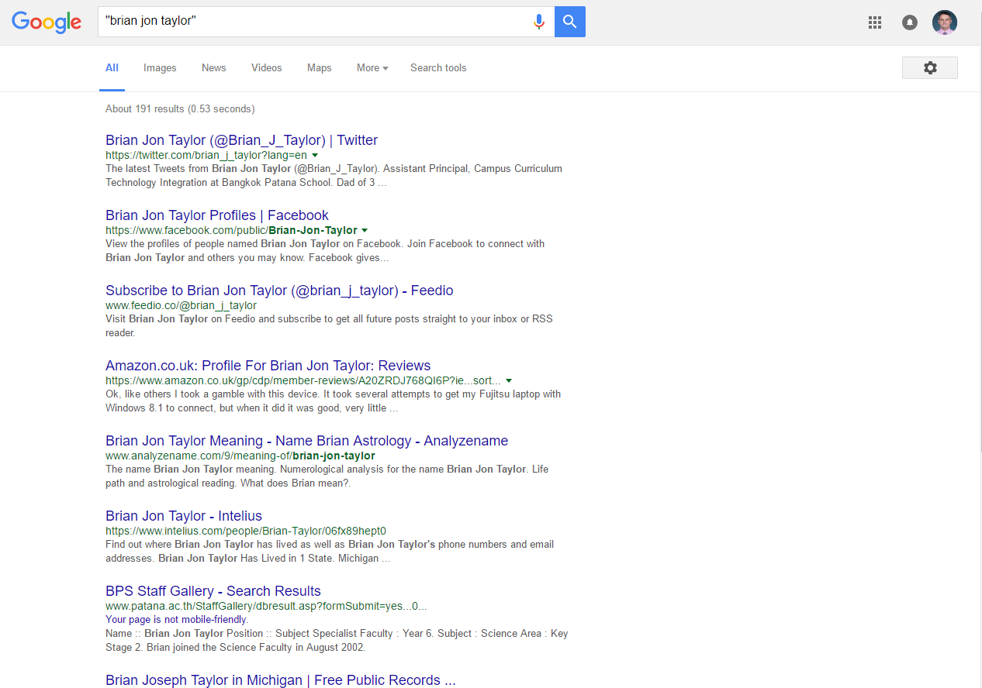

Slide 13
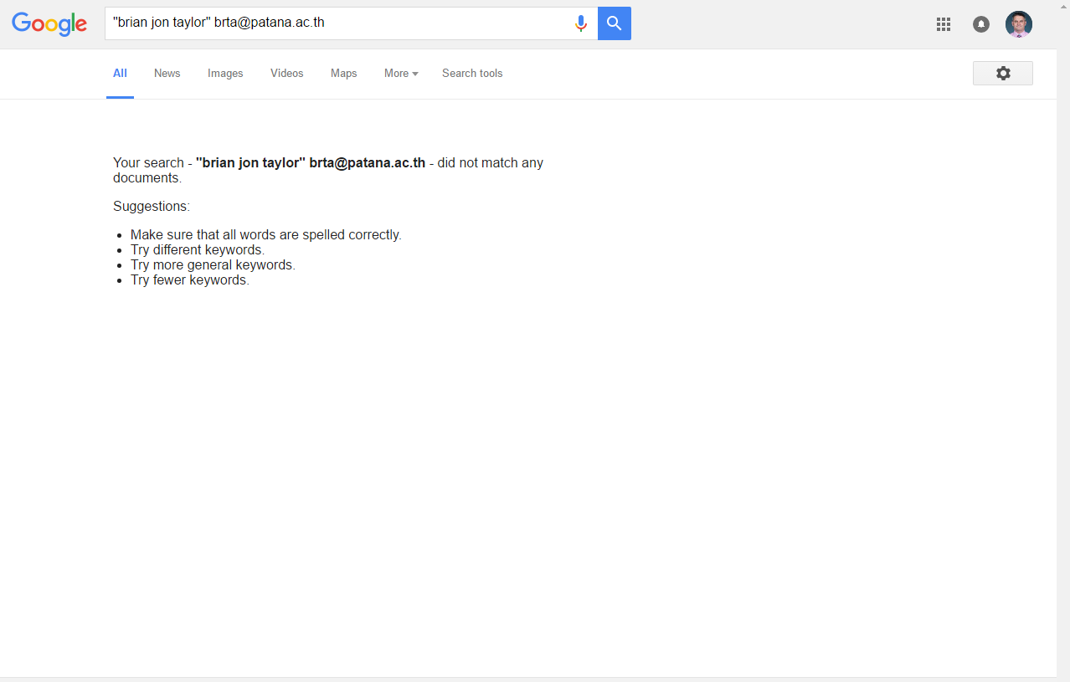

Slide 14
Year 6 Digital Safeguarding
What is Digital Citizenship (DC)?
How to search for yourself online
How to post positively
When to tweet and when to text

Slide 15
3. How to post positively
Social media message formula:
Group photos are better than selfies
Gratitude = say thank you
Mention the organization
Mention the activity
Mention the outcome
= less about you & material things, more about the experience

Slide 16
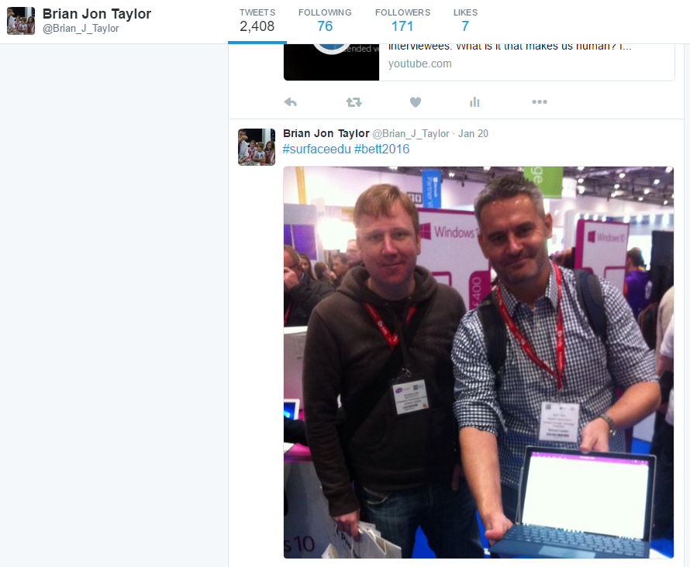
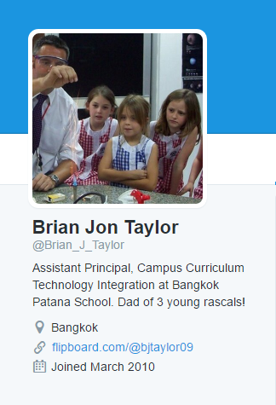

Slide 17
Year 6 Digital Safeguarding
What is Digital Citizenship (DC)?
How to search for yourself online
How to post positively
When to tweet and when to text

Slide 18
4. When to tweet and when to text
I hate this class, it is so boring
I cannot wait for the weekend

Slide 19
4. When to tweet and when to text
The other team sucks, I hope they lose
We’re up by 24 points. Go Patana!

Slide 20
4. When to tweet and when to text
Simon, you’re an idiot – I’m glad we broke up
Thanks to my friends for all their support

Slide 21
Year 6 Digital Safeguarding
What is Digital Citizenship (DC)?
How to search for yourself online
How to post positively
When to tweet and when to text

Slide 22
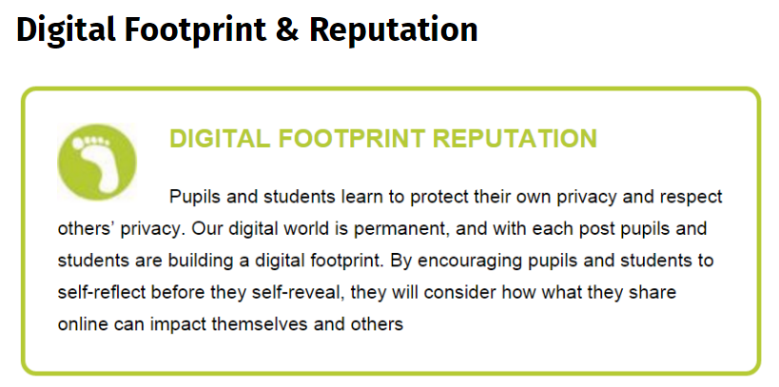
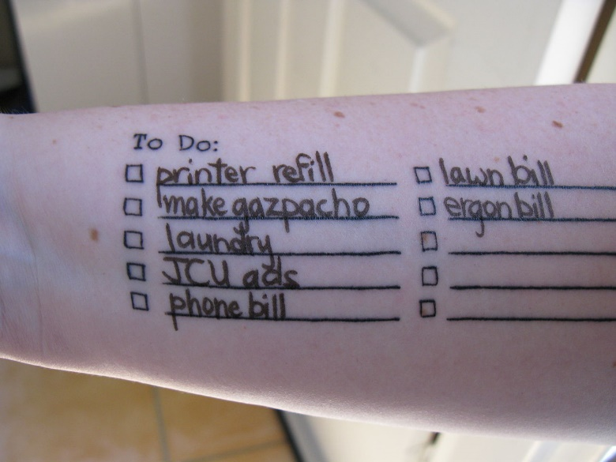
Source: https://en.wikipedia.org/wiki/Time_management#/media/File:My_to_do_list_is_healed_and_in_use!_(4668030838).jpg

Slide 23
Dear ………………..…….
My next steps as a good digital citizen are:
DC

